Slide 1
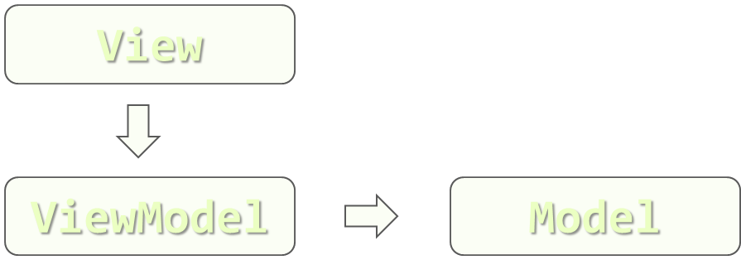
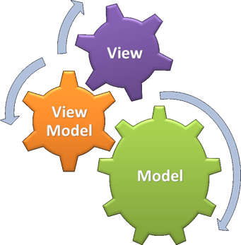
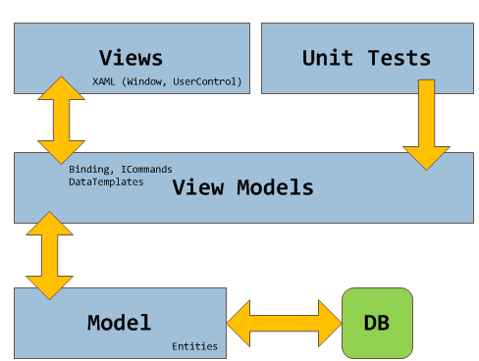
Model-View-ViewModel
Core Idea of Silverlight and WPF
Doncho Minkov
Senior Technical Trainer
http://minkov.it
Telerik Software Academy
academy.telerik.com

Slide 2
Table of Contents
Introduction in MVVM
MVVM Architecture
The View
The Model
The ViewModel
Simple Implementation
Benefits

Slide 3
Introduction in MVVM
What is Really MVVM?

Slide 4
Introduction in MVVM
MVVM is a multi-layer architectural pattern
Mostly used in WPF, Silverlight and Win8 Apps
Lately used with HTML and JavaScript
Model-View-ViewModel separates presentation logic from business logic
MVVM makes it easier
For developers and the front-end developers
Change the presentation layer at any point
Extend the project with less difficulties
Testing components

Slide 5
MVVM Architecture
The View, the Model, the ViewModel

Slide 6
MVVM Architecture
MVVM consists of three layers
View is the Presentation Layer
Contains only GUI elements, but no functionality
Model is an object model that represents the real state content
A data access layer that represents that content
Holds just pure C# objects and data
Should not be coupled with a concrete technology and its DLLs (WPF or Silverlight)

Slide 7
MVVM Architecture (2)
ViewModel is a "Model of the View"
Abstraction of the View
Serves in data binding between Views and Models
Acts as a binder/converter of data
Passes commands from the View into the Model
Exposes public properties, commands, and abstractions
Should be as less coupled with technology as possible

Slide 8
MVVM Layers Connections
View
ViewModel
Model
The idea of MVVM is to make the layers loosely coupled
The View knows only about the ViewModel
The View has no idea of the Model
The ViewModel only knows about the Model
The ViewModel has no idea of the View
The Model knows nothing about the other layers

Slide 9
MVVM Execution
What happens when an user clicks a Button?
The View fires event that a button was clicked
The View calls a Method in the ViewModel
The ViewModel gets/sets some data from/in the Model
User Fires an Event
The ViewModel requests data
View
ViewModel
Model
The View Shows the new data
The ViewModel Updates

Slide 10
Simple MVVM Implementation

Slide 11
Simple MVVM Implementation
An application that keeps a set of people
The user can add or delete a person at any time
The user can see all the people
Application architecture
Model
Keeps the people
ViewModel
Gets/deletes/adds the names
View
Gives a UI for these operations

Slide 12
Simple MVVM Implementation
Live Demo

Slide 13
Implementing the ViewModel
INotifyProperyChanged

Slide 14
ViewModel Implementation
A question pops out
How does the View know about changes in the ViewModel?
How the ViewModel knows about changes in the Model?
There is no backward direction, right?
The answer is simple
The INotifyPropertyChanged interface
Gives an event to notify about changes

Slide 15
INotifyProperyChanged
The INotifyPropertyChanged interface contains only one event
PropertyChanged(object sender, PropertyChangedEventArgs e)
The point of this event is to be called when the data is changed
Both Model and ViewModel should implement this interface
In small project only the ViewModel can implement it

Slide 16
Implementing INotifyPropertyChanged
The View automatically subscribes for the PropertyChanged event
public class ViewModel:INotifyPropertyChanged
{
PropertyChanged(object sender,PropertyChangedEventArgs e)
OnPropertyChanged(string propertyName) {
if(this.PropertyChanged!=null) {
var args=new PropertyChangedEventArgs(propertyName);
PropertyChanged(this,args);
} }
}

Slide 17
MVVM Real Life Implementation
Lets Get Practical

Slide 18
Implementing ImageViewer
We will implement an Image Viewer application using WPF and MVVM
The user should be able to see all the images in a given folder
The user should be able to add/delete images
The user should be able to select an image to enlarge it
Next and Previous buttons should be available

Slide 19
MVVM Real Life Implementation
Live Demo

Slide 20
Model View ViewModel
http://academy.telerik.com

Slide 21
Exercises
Implement a WPF/Silverlight application Calculator. The Calculator should support the operation supported by the Windows Standard Calculator:
Addition, Subtraction, Division, Multiplication
Saving a value to be used later
Square root, Power, Logarithm
Implement a Clock application. The Clock should show the current date and time. The user is able to set a list of alarms. When the time for the alarm comes, a message box should be shown to the user. The clock should have both analog and digital UI, configurable by a property.

