Slide 1
XAML Basics
Elements, Properties and Stuff
Doncho Minkov
Technical Trainer
http://minkov.it
Telerik Software Academy
http://academy.telerik.com

Slide 2
Table of Contents
XAML Syntax
XML
Elements
Properties
XAML Controls
Control resources
Variables in XAML
Collections

Slide 3
XAML Syntax

Slide 4
XAML Syntax
XAML stands for eXtensible Application Markup Language
i.e. uses syntax that is actually pure XML
Very similar to HTML
Meant to build applications' UI
Briefly XAML consists of
Elements
Properties
Elements may have properties

Slide 5
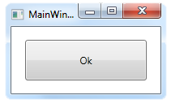
XAML Application
A XAML application consists of many elements
The first (the root) is either Window or UserControl
Depends if you are using WPF or Silverlight
<Window x:Class="Syntax.MainWindow" xmlns="http://schemas.microsoft.com/winfx/2006/xaml/pr esentation"
xmlns:x="http://schemas.microsoft.com/winfx/2006/xaml"
Title="MainWindow" Height="350" Width="525">
<Grid> <Button Width="150" Height="50"
Click="OnOkButtonClick">Ok</Button>
</Grid>
</Window>
The Content of the Application

Slide 6
XAML Syntax
Live Demo

Slide 7
Elements and Attributes
UI elements have a set of common properties and functions
Such as Width, Height, Cursor, and Tag properties
Declaring an XML element in XAML
Equivalent to instantiating the object via a parameterless constructor
Setting an attribute on the object element
Equivalent to setting a property with the same name

Slide 8
Elements and Attributes (2)
Elements and attributes are case sensitive
The attributes can be enclosed in single quotes (') or double quotes (")

Slide 9
Elements and Attributes
Live Demo

Slide 10
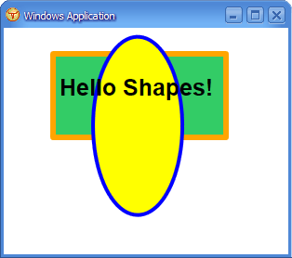
Property Elements

Slide 11
Property Elements
Not all properties have just a string value
Some must be set to an instance of an object
XAML provide syntax for setting complex property values, called property elements
Take the form TypeName.PropertyName contained inside an TypeName element
A property element
<Ellipse>
<Ellipse.RenderTransform>
<RotateTransform Angle="45" CenterY="60" />
</Ellipse.RenderTransform>
</Ellipse>

Slide 12


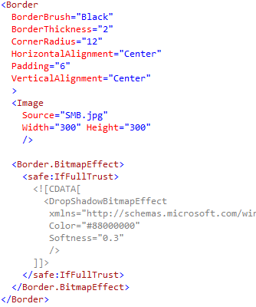
Property Elements
Live Demo

Slide 13
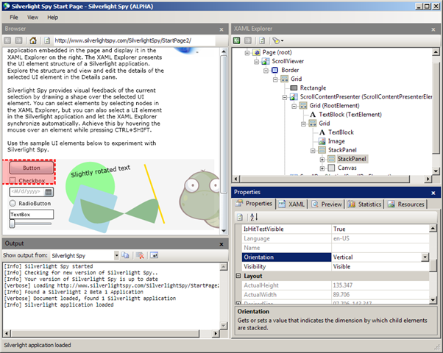
Content Properties

Slide 14
Content Properties
One of the element's properties is default
Known as content property
Typically contains the child elements
Content properties are used without prefix:
A content property
<Border>
<TextBox Width="300"/>
</Border>
<!-- Explicit equivalent -->
<Border>
<Border.Child>
<TextBox Width="300"/>
</Border.Child>
</Border>
A property element

Slide 15


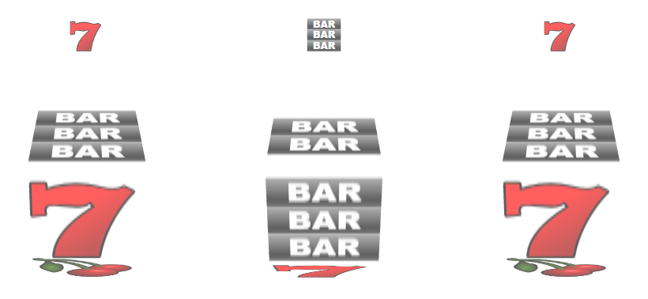
Attached Properties

Slide 16
Attached Properties
Attached properties are special kind of properties
Can be attached to any object
Not just the one defining the property
The syntax is the same as setting a normal property
The property must be prefixed with the name of the element defining the property and a dot

Slide 17
Attached Properties (2)
Attached properties allow common behavior to be applied to arbitrary elements
Allow a child item to access a property of its parent item
The base of Attached Behavior
Commonly used attached properties:
Canvas.Left and Canvas.Right
Grid.Row, Grid.Column and Grid.Rowspan

Slide 18
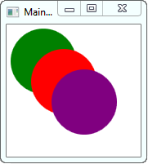
Attached Properties – Example
Using the Canvas.Left and Canvas.Top attached properties to position Ellipses
The default value is 0
<Canvas>
<Ellipse Fill="Green" Width="80" Height="80"/>
<Ellipse Canvas.Left="25" Canvas.Top="25"
Fill="Red" Width="80" Height="80"/>
<Ellipse Canvas.Left="50" Canvas.Top="50"
Fill="Purple" Width="80" Height="80"/>
</Canvas>
<!-- The result is : -->

Slide 19
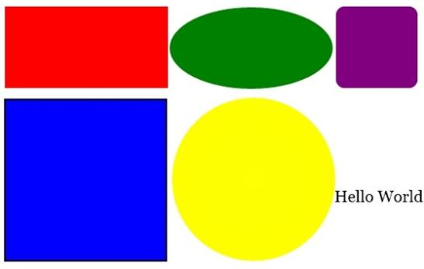
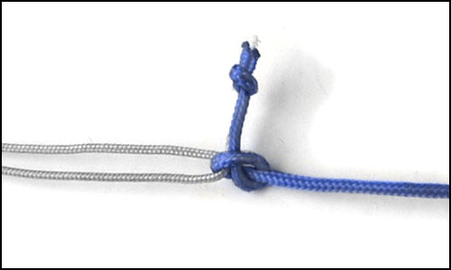
Attached Properties
Live Demo

Slide 20
Dependency Properties

Slide 21
Dependency Properties
A Dependency Properties are properties that extend the functionality of a common language runtime (CLR) property
Interact with properties directly and never know that they are implemented as a dependency property
The purpose of dependency properties is to provide a way to compute the value of a property based on the value of other inputs

Slide 22
Dependency Properties (2)
A Dependency Property can be implemented to provide
Self-contained validation
Default values
Callbacks that monitor changes to other properties
Example of Dependency Properties
Text property of TextBlock
Gets the Text from the TextBox
<TextBox Name="TextBoxFrom"/>
<TextBlock Text="{
Binding ElementName=TextBoxFrom, Path=Text}"/>

Slide 23
Dependency Properties
Live Demo

Slide 24
XAML Controls

Slide 25
XAML Controls
The controls are the smallest components of a XAML Application
Every control consists of
Appearance
Code-behind

Slide 26
XAML Controls
Live Demo

Slide 28
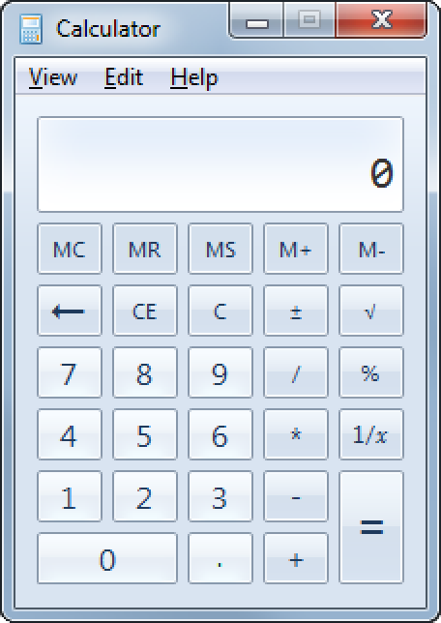
Exercises
Create a calculator application that looks like the Windows Calculator
Implement the functionality

