Slide 1
XAML Concepts
Dependency and Attached Properties, Templates
Doncho Minkov
Senior Technical Trainer
http://minkov.it
Telerik Software Academy
http://academy.telerik.com

Slide 2
Table of Contents
Templates in XAML and WPF
Control Templates
Data Templates
The Dependency Objects
Dependency Properties
Attached Properties
Attached Behavior
Data Templates
CellTemplate, ItemTemplate, ContentTemplate

Slide 3

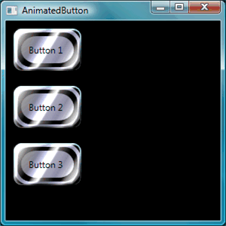
Templating in WPF

Slide 4
Templating in WPF
Two kinds of templates in WPF
ControlTemplate and DataTemplate
ControlTemplate is used for the visualization of the control itself
DataTemplate is used to present the content of the control

Slide 5
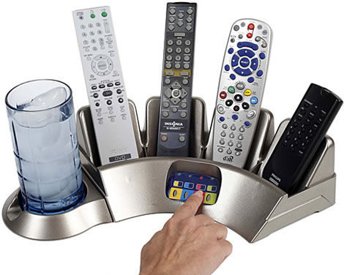
Control Template
How to Control the Appearance?

Slide 6
Control Templating
Controls in WPF are separated into:
Logic
Defines the states, events and properties
Template
Defines the visual appearance of the control
The wireup between the logic and the template is done by DataBinding

Slide 7
Control Templating (2)
Each control has a default template
This gives the control a basic appearance
The default template is typically shipped together with the control and available for all common windows themes
It is by convention wrapped into a style
Identified by value of the DefaultStyleKey property that every control has

Slide 8
Control Templating (3)
The template is defined by a dependency property called Template
The appearance of a control can be completely replaced by setting this to another instance
The ControlTemplate is often included in a style that contains other property settings

Slide 9
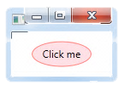
Control Template Example
ContentPresenter presents the Content of the Control
<ControlTemplate TargetType="Button"
x:Key="EllipseButton">
<Grid>
<Ellipse Fill="Pink" Stroke="Red" Opacity="0.5"/>
<ContentPresenter HorizontalAlignment="Center"
VerticalAlignment="Center"/>
</Grid>
</ControlTemplate>
…
<Button Content="Click"
Template="{StaticResource EllipseButton}" />

Slide 10


Control Template
Live Demo

Slide 11


Data Templating

Slide 12
Data Template
DataTemplates are a similar concept as ControlTemplate
Give you a very flexible and powerful way to replace the visual appearance of a data item
Controls like ListBox, ComboBox or ListView
If you don't specify a data template
WPF takes the default template that is just a TextBlock

Slide 13
Data Template (2)
If you bind complex objects to the control, it just calls ToString() on it
Within a DataTemplate, the DataContext is set to the data object
So you can easily bind to the data context to display various members of your data object

Slide 14
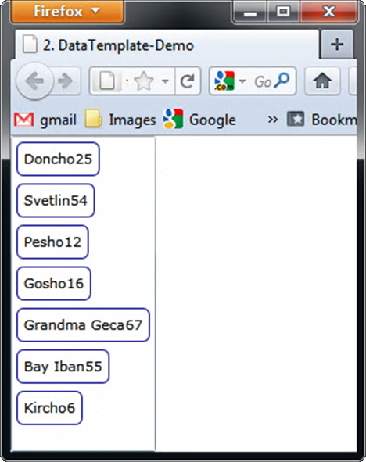
Data TemplateExample
Without a DataTemplate you just see the result of calling ToString() on the object.
With the data template we see the name of the property and a TextBox that even allows us to edit the value
<DataTemplate>
<Border BorderBrush="DarkBlue" CornerRadius="5">
<StackPanel Orientation="Horizontal">
<TextBlock Text="{Binding Name}"/>
<TextBlock Text="{Binding Age}"/>
</StackPanel>
</Border>
</DataTemplate>

Slide 15


Data Templating
Live Demo

Slide 16
Dependency Object

Slide 17
Dependency Object
The DependencyObject
Represents an object that participates in the dependency property system
Enables WPF / SL property system services
The property system's functions:
Compute the values of properties
Provide system notification about values that have changed
DependencyObject as a base class enables objects to use Dependency Properties

Slide 18
Dependency Object (2)
DependencyObject has the following members:
Get, Set, and Clear methods for values of any dependency properties
Metadata, coerce value support, property changed notification
Override callbacks for dependency properties or attached properties
DependencyObject class facilitates the per-owner property metadata for a dependency property

Slide 19
Dependency Properties
Dependencies

Slide 20
Dependency Properties
Silverlight, WPF and WinRT provide a set of services that can be used to extend the functionality of a CLR property
These services are typically referred to as the Silverlight / WPF/WinRT property system
Dependency Property is a property that is backed by the SL/WPF property system

Slide 21
Dependency Properties (2)
Dependency properties are typically exposed as CLR properties
At a basic level, you could interact with these properties directly
May never find out they are dependency properties
Better to know if a property is Dependency or CLR
Can use the advantages of the dependency properties

Slide 22
Dependency Properties (3)
The purpose of dependency properties is to provide a way to compute the value of a property based on the value of other inputs
Can be implemented to provide callbacks to propagate changes to other properties
Provide two-way data binding with UI controls

Slide 23
Dependency Properties
Live Demo

Slide 24
Attached Properties
How to set properties from another place

Slide 25
Attached Properties
An attached property is intended to be used as a type of global property that is settable on any object
In WPF and Silverlight attached properties are defined as dependency properties
They don't have the wrapper property
Examples of Attached Properties
Grid.Row, Grid.Column, Grid.RowSpan
Canvas.Top, Canvas.Left, Canvas.Bottom

Slide 26
Attached Properties
Live Demo

Slide 27
Creating and Registering Dependency Properties

Slide 28
Custom Dependency Properties
DependencyProperties must be registered in the Property System
Done by the static method DependencyProperty.Register()
The Register() takes few parameters
Name of the property - string
The object type of the property - Type
The type that the property belongs to - mostly UserControl

Slide 29
Custom Dependency Properties
Dependency property can be registered using the following template
or using code snippet propdp
Dependency Property's instance is always readonly
public static readonly
DependencyProperty ScrollValueProperty =
DependencyProperty.Register(
"ScrollValue",
typeof(double),
typeof(UserControl),
null);
The name of the Dependency Property
Registration to the Property System

Slide 30
Dependency Property Registration
Two Register Methods:
Register(String, Type, Type)
Registers a dependency property with the specified property name, property type, and owner type
Register(String, Type, Type, PropertyMetadata)
Add Property metadata
Default value or Callback for Property changes

Slide 31
Dependency Property Wrapper
After the registration of the Dependency Property it needs wrapper
Used to make it look like plain old CLR Property
DependencyObject has two methods used for the wrapping of dependency properties
SetValue(DependenyProperty, value)
GetValue(DependenyProperty)
public double ScrollValue
{
get { return (double)GetValue(ScrollValueProperty); }
set { SetValue(ScrollValueProperty , value); }
}

Slide 32
Creating and Registering Dependency Properties
Live Demo

Slide 33
Creating and Registering Attached Properties
How to make attached properties?

Slide 34
Custom Attached Properties
The registration of attached properties is a little different than DependencyProperties
Has a code snippet propa
public static Thickness GetMargin(DependencyObject obj)
{
return (Thickness)obj.GetValue(MarginProperty);
}
public static void SetMargin(DependencyObject obj, Thickness val)
{
obj.SetValue(MarginProperty, val);
}
public static readonly DependencyProperty MarginProperty =
DependencyProperty.RegisterAttached("Margin",
typeof(Thickness), typeof(ContentMargin),
new FrameworkPropertyMetadata(default(Thickness),
new PropertyChangedCallback(OnPropertyChanged)));

Slide 35
Custom Dependency and Attached Properties
Live Demo

Slide 36
Attached Behavior
The real usage of Attached Properties

Slide 37
Attached Behavior
Attached behavior is behavior that does not exist on the control by default
i.e. binding a command to a TextBlock
TextBlock does not have a property Command
Attached Behavior is done using Attached Properties
Create an Attach Property that accepts Command

Slide 38
Attached Behavir: Sample
Creating a way to bind a command to the MouseLeftButtonDown event
public static ICommand GetClick(DependencyObject obj) {…}
public static void SetClick(DependencyObject obj,
Icommand value) {…}
public static readonly DependencyProperty ClickProperty =
DependencyProperty.RegisterAttached("Click",
typeof(ICommand),
typeof(CommandsBehavior),
new PropertyMetadata(ExecuteClickCommand));
<TextBlock commandBehavior:CommandsBehavior.Click="{Binding Click}"
Text="Click" />

Slide 39
Attached Behavior
Live Demo

Slide 40
INotifyPropertyChanged vs DependencyProperties

Slide 41
INotifyPropertyChanged vs. DependencyProperties
Both INotifyPropertyChange and DependencyProperties do the same
Notify the binding target about changes
Yet both have pros and cons
INotifyPropertyChanged is slower than DP, but is more flexible and loosly coupled with the XAML platform
DependencyProperties are much faster, yet they are harder to implement and are tightly coupled with the XAML platform

Slide 42
XAML Concepts

Slide 43
Exercises
Extend the VideoPlayer Control from the example:
Add a slider that slides with the video length
Add a slider that changes the volume
Add buttons for Play, Pause, Stop
Add key events for volume UP/DOWN
Add key events to jump 5 seconds forward/backward in the video

