Slide 1
XAML Layout Containers
Panels, Tab Containers
Doncho Minkov
Technical Trainer
http://minkov.it
Telerik Software Academy
academy.telerik.com

Slide 2
Table of Contents
Containers Overview
Containers in XAML
Three Kinds of Containers (Panels)
Absolute coordinates, Stacking, Proportional
GridSplitters and Sizing
XAML Tab Containers

Slide 3
Containers Overview
What is a Container? Containers in XAML

Slide 4
What is a Container?
Containers are things that contain other things
Like divs and sections in HTML
They hold other controls / elements
Used to build the layout of the application
Every container is given a space to consume
All his children are in this space

Slide 5
Containers in XAML
In XAML containers are called Panels
Three common types of panels
Panels with absolute coordinates
Panels with stacking order
Panels with proportional or with rows/columns
Absolute coordinates Panels
Canvas
Controls inside the canvas are arranged based on the Canvas position and size

Slide 6
Containers in XAML (2)
Stacking Panels
StackPanel, DockPanel, WrapPanel
Elements are arranged in a stacking order
i.e. first come goes in the beginning
Proportional Panels
Grid and UniformGrid
Arrange the elements in a table-like layout

Slide 7
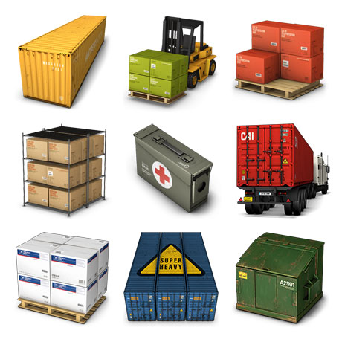
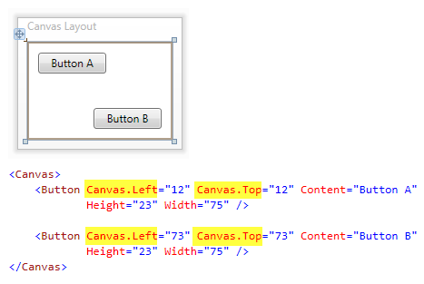
The Canvas Container

Slide 8
The Canvas Container
The Canvas is a layout container
An element that holds other elements
Elements inside are positioned using fixed coordinates
Places elements behind or in front of others (depending on the z-order)
Supports size and clipping

Slide 9
The Canvas Container (2)
To position elements inside a Canvas use attached properties
Example:
Places a Rectangle at specific location in a Canvas
<Canvas>
<Rectangle Canvas.Left="30" Canvas.Top="30"
Fill="Red" Width="100" Height="100"/>
…
</Canvas>

Slide 10
The Canvas Container (3)
Placing elements behind or in front of others depends on the z-order
The default z-order
Defines which elements are "on top of" the other elements
Determined by the order in which the children are added to the Canvas
Customize the z-order of any child element using Canvas.ZIndex attached property

Slide 11
The Canvas Container – Example
<Canvas Background="White" Height="680">
<Rectangle Canvas.Left="0" Canvas.Top="0" Fill="Red"
Width="100" Height="100" Canvas.ZIndex="3" />
<Rectangle Canvas.Left="20" Canvas.Top="20"
Fill="Orange" Width="100" Height="100"
Canvas.ZIndex="2" />
<Canvas Canvas.Left="300" Canvas.Top="300"
Canvas.ZIndex="1">
<Rectangle Width="120" Height="330" RadiusX="20"
RadiusY="20" Fill="Black"/>
<Ellipse Canvas.Left="10" Canvas.Top="10"
Width="100" Height="100" Fill="Red"/>
</Canvas>
</Canvas>

Slide 12

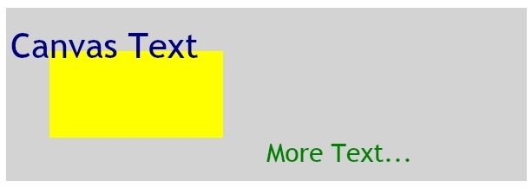
Customize the Z-order and Multiple Canvas Elements
Live Demo

Slide 13
Stacking Panels
StackPanel, DockPanel, Wrap Panel

Slide 14
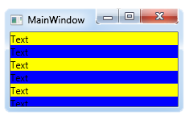
StackPanel
The StackPanel arranges the elements in one row/column
Depends on the orientation property
If the size of each element is not explicitly set all elements have the same width/height
Can set flow orientation
Vertical or Horizontal
<StackPanel>
<TextBlock Text="Text" Background="Yellow"/>
<TextBlock Text="Text" Background="Blue"/>
</StackPanel>

Slide 15
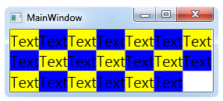
WrapPanel
The WrapPanel is much like StackPanel but if there is no space left, arranges the elements in the next row/columns
Depends on the orientation property
Example:
<WrapPanel>
<TextBlock Text="Text" Background="Yellow"/>
<TextBlock Text="Text" Background="Blue"/>
<TextBlock Text="Text" Background="Yellow"/>
<TextBlock Text="Text" Background="Blue"/>
</WrapPanel>

Slide 16
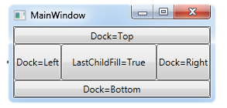
DockPanel
The DockPanel provides docking of elements to the left, right, top or bottom of the panel
Defined by the attached property Dock
To dock an element to the center of the panel, it must be the last child of the panel
LastChildFill property must be set to true.
<DockPanel LastChildFill="True">
<Button Content="Top" DockPanel.Dock="Top"/>
<Button Content="Bottom" DockPanel.Dock="Bottom"/>
<Button Content="Left"/>
<Button Content="Right" DockPanel.Dock="Right"/>
<Button Content="LastChildFill=True"/>
</DockPanel>

Slide 17
Stacking Panels
Live Demo

Slide 18
Proportional Panels
Grid and UniformGrid

Slide 19
Grid Panel
The most powerful layout container in XAML
Everything can be done with Grid
Sometimes a way harder than using StackPanel
Arranges the elements in a table-like layout
Predefined number of rows and columns
Each element has explicitly set grid row/column
Using the attached properties Grid.Row and Grid.Column
If no columns/rows are defined, works the like canvas

Slide 20
Grid Panel (2)
Number of Rows is defined by a content property called "RowDefinitions"
Each row can be set a height
The same with "ColumnDefinitions"
<Grid.RowDefinitions>
<RowDefinition Height="50"/>
<RowDefinition/>
<RowDefinition/>
</Grid.RowDefinitions>
<Grid.ColumnDefinitions>
<ColumnDefinition/>
<ColumnDefinition Width="50"/>
</Grid.ColumnDefinitions>

Slide 21
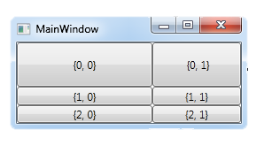
Grid Panel (3)
Each of the elements in a Grid should have a Grid.Row and/or Grid.Column property set
<Grid>
…
<Button Grid.Row="0" Grid.Column="0" Content="{0, 0}"/>
<Button Grid.Row="0" Grid.Column="1" Content="{0, 1}"/>
<Button Grid.Row="1" Grid.Column="0" Content="{1, 0}"/>
<Button Grid.Row="1" Grid.Column="1" Content="{1, 1}"/>
<Button Grid.Row="2" Grid.Column="0" Content="{2, 0}"/>
<Button Grid.Row="2" Grid.Column="1" Content="{2, 1}"/>
</Grid>

Slide 22
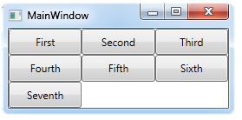
UniformGrid Panel
Much like the common Grid panel
Cannot set position explicitly
Each elements is with the same size
Fills the elements depending of the number of rows/columns
FlowDirection property sets the arrange style of the elements
<UniformGrid Rows="3">
<Button Content="First"/>
…
<Button Content="Seventh"/>
</UniformGrid>

Slide 23
Proportional Panels
Live Demo

Slide 24
Additional Notes on Panels

Slide 25
XAML Panels
Note that most of the panels are not available in Silverlight
All of them are available in WPF
Silverlight supports only Canvas, StackPanel and Grid
If you need one of the others
Use Grid or write your own
There is a class Panel which can be inherited
Or…
Install SL SDK and enjoy more controls

Slide 26
Additional Notes on Panels
Live Demo

Slide 27
GridSplitters

Slide 28
GridSplitter
Offer the user a way to adjust the layout of your application
Changing the size of a column or row in a grid
Use GridSplitter only to rearrange a Grid panel
<Grid Height="100" Width="400">
<Grid.ColumnDefinitions>…</Grid.ColumnDefinitions>
<Ellipse Grid.Column="0" Fill="Red" />
<GridSplitter Grid.Column="1"
HorizontalAlignment="Stretch" />
<Ellipse Grid.Column="2" Fill="Blue" />
</Grid>

Slide 29
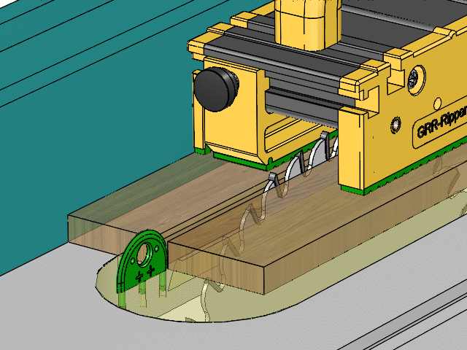
GridSplitter
Live Demo

Slide 30
Sizing

Slide 31
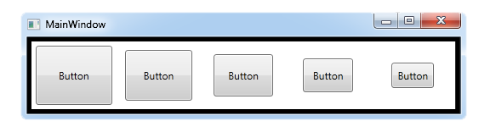
Sizing
There are a number of properties to set the size of a panel or the elements in it
Width, Height, MaxWidth, MaxHeight, MinWidth, MinHeight
Padding and Margin
<StackPanel>
<Button Content="First" Margin="1" Padding="5"
Height="50" Width="Auto"/>
…
<Button Content="Fifth" Margin="5" Padding="1"
Height="50" Width="Auto"/>
</StackPanel>

Slide 32
Sizing
Live Demo

Slide 33
Border Container

Slide 34
Border Container
The Border is a special kind of container
It can hold only one child element
The child element becomes surrounded by a border
The Border properties for border style
BorderBrush
BorderThickness
CornerRadius

Slide 35
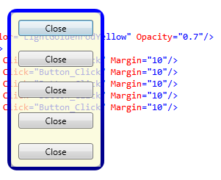
Border Example
Lets make a window with no Windows border, rounded corners and transparent background
No Windows Border
<Window … WindowStyle="None"/>
<Border BorderThickness="5" Background="Transparent"
CornerRadius="10">
<Border.BorderBrush>
<LinearGradientBrush StartPoint="0,0" EndPoint="0,1">
<GradientStop Color="Blue" Offset="0.2"/>
<GradientStop Color="DarkBlue" Offset="0.8"/>
</LinearGradientBrush>
</Border.BorderBrush>
…
</Border>

Slide 36
Border Container
Live Demo

Slide 37
TabControl

Slide 38

TabContol
TabControl is useful for switching between multiple pages of content
Tabs in a TabControl are typically placed on the top
TabStripPlacement property can set their placement to Left, Right, or Bottom
Available only in WPF
<TabControl>
<TabItem Header="Tab 1">Content for Tab1.</TabItem>
<TabItem Header="Tab 2">Content for Tab2.</TabItem>
<TabItem Header="Tab 3">Content for Tab3.</TabItem>
</TabControl>

Slide 39
TabControl
Live Demo

Slide 40
XAML Layout Containers
http://academy.telerik.com

Slide 41
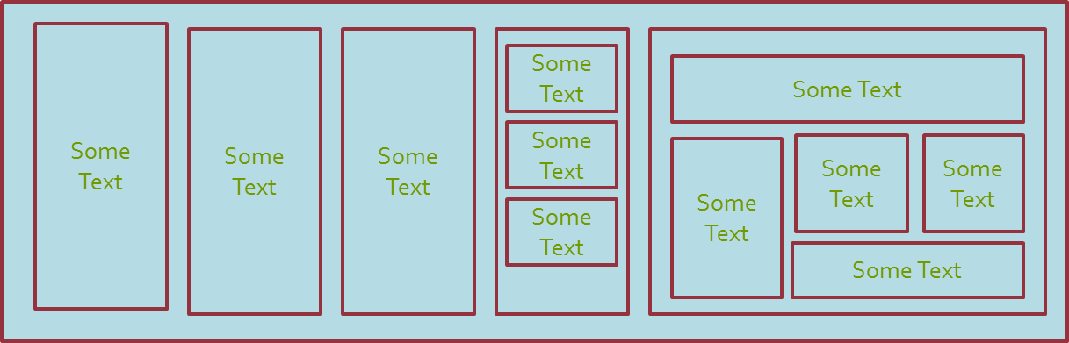
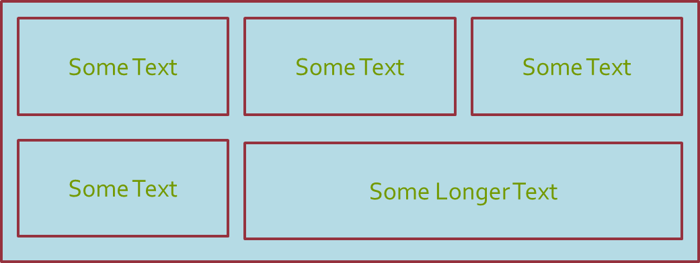
Exercises
Create the following:
*Note: Don't use Grid for everything

Slide 42
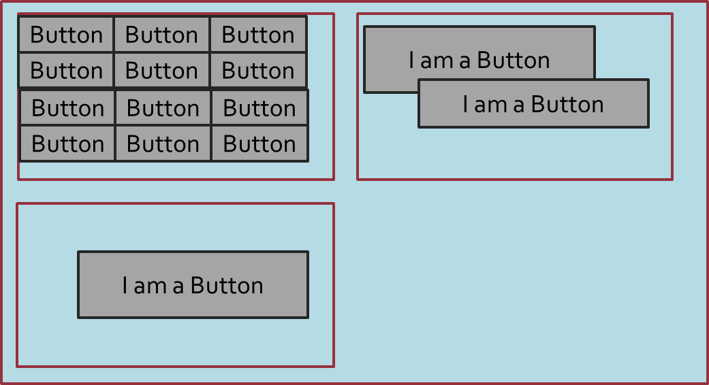
Exercises (2)
Create the following:
*Note: Don't use Grid for everything

Slide 43
Exercises (3)
Using Tabs create the previous XAMLs in tab controls
Add GridSplitter whenever you used Grid as a panel
Create all the exercises in both WPF and Silverlight

