Slide 1
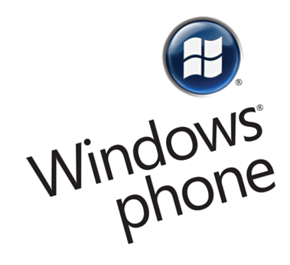
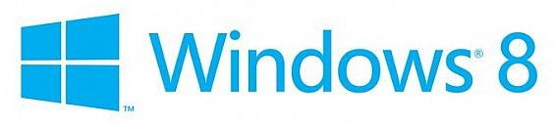



XAML Overview
Markup for WPF and Silverlight
Doncho Minkov
Technical Trainer
http://minkov.it
Telerik Software Academy
http://academy.telerik.com

Slide 2
Table of Contents
What is XAML?
What is XAML Used for?
XAML Basics
XAML in WPF, Silverlight and Windows 8
The Future of XAML

Slide 3

What is XAML?

Slide 4
What is XAML?
Stands for eXtensible Application Markup Language
Declarative markup language for building UI
Based on XML
Used to simplify creation of UI for a .NET apps
Separates presentation (UI) from business logic
XAML enables a workflow where different parties can work simultaneously
The UI and the logic of an application can be developed using different tools (VS and Blend)

Slide 5
What is XAML? (2)
XAML is used for creating and initializing .NET objects
Used as a human-authorable way of describing the UI
Used to separate the UI from the business logic
XAML contains a hierarchy of elements representing visual objects
These objects are known as user interface elements or UI elements

Slide 6
Declarative UI with XAML
XAML is a completely declarative language
A declarative language says "what"
An imperative language says "how"
XAML describes the behavior and integration of components (in most cases UI components)
Cannot describe business logic

Slide 7
History of XAML
Introduced in 2006 with .NET 3.0
With Windows Presentation Foundation (WPF)
WPF is "the new way" to create desktop apps
Successor of Windows Forms
Silverlight is introduced in 2007
Under the name WPF/E - WPF Everywhere
Used JavaScript for back-end
Windows Runtime (WinRT) introduced in 2011
Used for Windows Store apps
Closer to Silverlight than WPF

Slide 8
XAML-related Technologies
Windows Presentation Foundation - WPF
The successor of Windows Forms
Uses XAML to describe the presentation (UI)
C# / VB.NET for the back-end logic
Silverlight
Develop RIA in collaboration with ASP.NET
Browsers need a Silverlight plugin
Windows Runtime - WinRT
Build Windows Store apps in Windows 8

Slide 9
XAML Features

Slide 10
Vector Graphics
All XAML graphics are Direct3D applications
Direct3D (part of DirectX) is used in graphical applications where performance is important
Uses the video card hardware for rendering
The result: high-quality rich-media UI
Vector-based graphics allow lossless scaling
XAML implements a floating-point logical pixel system and supports 32-bit ARGB color

Slide 11
Animation
XAML supports time-based animations
Presentation timers are initialized and managed by XAML
Scene changes are coordinated using a storyboard
Animations can be triggered by external events
Including user action or events
Animation can be defined on a per-object basis directly from the XAML markup

Slide 12
Audio and Video Support
XAML can incorporate audio and video into a user interface
Audio support in XAML is a thin layer over the existing functionality in Win32 and WMP
XAML supports the videos formats that the OS supports
i.e. if WMP can play a file – XAML can too
Relationship between video and animation is also supported
They are both ways of showing moving images
Animation can be synchronized with media

Slide 13
Styles
In XAML a style is a set of properties applied to the content used for visual rendering
Similar to the concept of CSS
Use them to standardize non-formatting characteristics
XAML styles have specific features
Ability to apply different visual effects based on user events
Styles are created using MS Expression Blend

Slide 14
Templates
Templates in XAML allow you to fully change the UI of anything in XAML
Different templates available within XAML
ControlTemplate
Manages the visualization of a control
ItemsPanelTemplate
Handles the visualization panel of list control
DataTemplate and HierarchicalDataTemplate
Responsible for the visualization of items in list controls

Slide 15
Commands
Commands are more abstract and loosely-coupled version of events
Examples: copy, cut, paste, save, etc.
XAML support for commands reduces the amount of code we need to write
It gives us more flexibility to change the UI without breaking the back-end logic
Commands have action, source, target and binding

Slide 16
Commands (2)
The power of commands:
XAML defines a number of built-in commands
Commands have automatic support for input actions
Some XAML controls have built-in behavior tied to various commands
Commands are intended to do two things:
Check whether an action is available
Execute an action

Slide 17
Object-Based Drawing
At the lower-level XAML works in terms of shapes, not in terms of painting pixels
Shapes are vector-based and are easily scaled
Developers create shape objects and let XAML maintain the view in the most optimized way
XAML provides a number of ready-to-use shape objects like line, rectangle, ellipse, path, etc.
Shape objects can be used inside panels and inside most XAML controls

Slide 18
Declarative vs. Programmatically?
Why we need XAML?

Slide 19
Declarative vs. Programmatically
With XAML each element can be done either declaratively or programmatically
No difference in the execution or performance
Instantiating element from the code behind ruins the idea of XAML
The same as Windows Forms
The following two examples are identical
With XAML
With Code Behind
<Button Content="Click me!"/>
Button button=new Button();
button.Content="Click me!";

Slide 20
Declarative UI
When not using XAML with WPF/Silverlight
Miss the idea of separation of concerns
Two parties cannot work simultaneously on the same file
What happens when making object declaratively?
It is the same as instantiating the element with parameterless constructor
All the magic happens in InitializeComponents()

Slide 21
Declarative or Programmatically?
Live Demo

Slide 22
XAML Overview
http://academy.telerik.com

