Slide 1
XAML Styling
Lets Make it Shiny!
Doncho Minkov
Senior Technical Trainer
http://minkov.it
Telerik Software Academy
academy.telerik.com

Slide 2
Table of Contents
Styles in XAML
What is a style?
Properties and values
Resources
Static resource and Dynamic resource
Ways to use Styles
Inline, External and Embed
Resource dictionaries
Using Styles

Slide 3
Styles in XAML

Slide 4
What is a Style?
Style is a collection of property values that you can apply to an element in one step
Very similar to CSS standard in HTML
XAML styles allow you to define a common set of formatting characteristics
XAML styles has some limitations, though
You can't share styles between different elements
Each element can inherit just one Style
At least you can't do it the standard way

Slide 5
Properties and Values
A style consists of many Property-Value pairs, called Setters
Each Setter sets a value to some of the properties of the corresponding control
Example:
<Style x:Key="ShinyButton">
<Setter Property="FontSize" Value="14"/>
<Setter Property="Width" Value="150"/>
<Setter Property="Height" Value="100"/>
</Style>

Slide 6
Setters
Live Demo

Slide 7
Inline and External Styles
Where to put these styles?

Slide 8
Places of Styles
Like CSS, XAML styles can be placed
Inlined in the control
Embedded in a control resources
In External file, i.e. a resource dictionary
Inline styles by setting the property element Style directly in the control
<Button …>
<Button.Style>
<Style … > … </Style>
</Button.Style>
</Button>

Slide 9
Embedded Styles
Embedded styles are placed in the resources of a control
Can be used in all its child controls
<UserControl.Resources>
<Style>…</Style>
</UserControl.Resources>
<Grid.Resources>
<Style>…</Style>
</Grid.Resources>

Slide 10
External Styles
With resources dictionaries styles can be placed in an external file
Usable with many windows/pages
How to import the resource dictionary in our window/usercontrol?
<UserControl.Resources>
…
</UserControl.Resources>
<Grid.Resources>
<Style>…</Style>
</Grid.Resources>

Slide 11
Control Resources
Static and Dynamic

Slide 12
Resources
What are resources?
Stuff needed for the application
Brushes, styles, templates, variables...
Resources are used to store commonly used data in one place
And not define it everywhere
Each FrameworkElement and FrameworkContentElement has its resources
Both dynamic and static
Defined in the property element Resources

Slide 13
Static And Dynamic Resources
Two types of Resources
Static and dynamic
What's the difference?
Static resources are evaluated when the application starts
If the resource is changed runtime, the thing using it will not see the change
Dynamic resources are evaluated runtime, when the resource is needed
Only available in WPF

Slide 14
Static and Dynamic Resources
Live Demo

Slide 15
Using Styles

Slide 16
Defining a Style
Defining a Style for a Button Control
Inline in the <Control.Style>
<Window.Resources>
External Style file
<Button Content="This is Also BIG">
<Button.Style>
<Style>
<Setter Property="FontFamily" Value="Georgia"/>
<Setter Property="FontSize" Value="40"/>
</Style>
</Button.Style>
</Button>

Slide 17
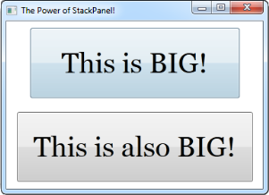
Applying Style
Make a Button Control and set the Style Property
Style can be defined in Window.Resources:
<Button Style="{StaticResource BigButtonStyle}"
x:Name="BigButtonExample" Content = "This is BIG!" />
Key property
The target control
<Window.Resources>
<Style x:Key="BigButtonStyle" TargetType="Button">
<Setter Property="FontFamily" Value="Georgia"/>
<Setter Property="FontSize" Value="40"/>
<Setter Property="Padding" Value="20"/>
</Style>
</Window.Resources>
The property we are overriding
The new value

Slide 18
Styling Control
There are 2 ways to customize a control
For example: CircledButton
Using Styles
Using Templates
In both you have to override the ControlTemplate
May lose some of the functionality of the control

Slide 19
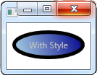
Styled Control Using Style
<Style x:Key="ButtonStyleColorful" TargetType="Button">
…
<Setter Property="Template">
<Setter.Value>
<ControlTemplate TargetType="Button">
<Ellipse Stroke="Black"
StrokeThickness="5" Fill="Blue"/>
<TextBlock Foreground="Silver"
Background="Transparent" Text="With Style"/>
</ControlTemplate>
</Setter.Value>
</Setter>
</Style>

Slide 20
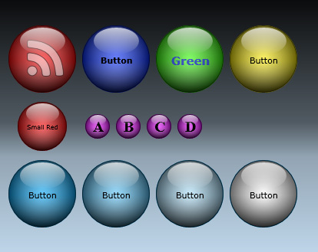

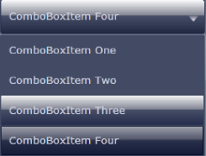

XAML Styling
Live Demo

Slide 21

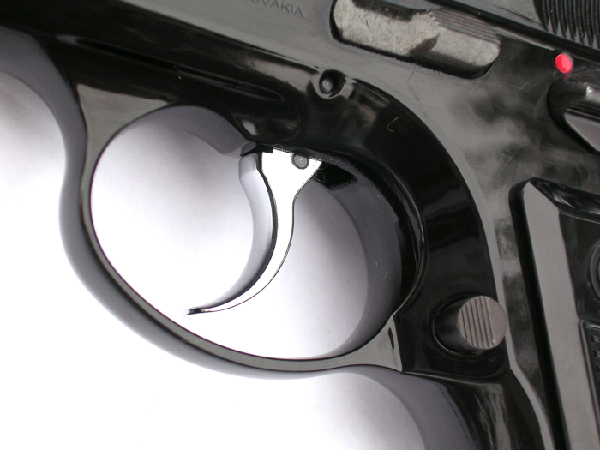
Triggers
Dynamic Styles

Slide 22
Triggers
Triggers define a list of setters that are executed if the specified condition is fulfilled
Property Triggers
When a property gets a specified value
Event Triggers
When a specified event is fired
Data Triggers
When a binding expression reaches a specified value

Slide 23
Triggers Example
<ControlTemplate>
<Ellipse x:Name="Circle"
Width="20" Height="20"
Fill="Blue"/>
<ControlTemplate.Triggers>
<Trigger Property="IsMouseOver"
Value="True">
<Setter TargetName="Circle"
Property="Fill" Value="Red"/>
</Trigger>
</ControlTemplate.Triggers>
</Controltemplate>
When to execute the trigger
Which element the trigger will affect
The Property of the affected element

Slide 24
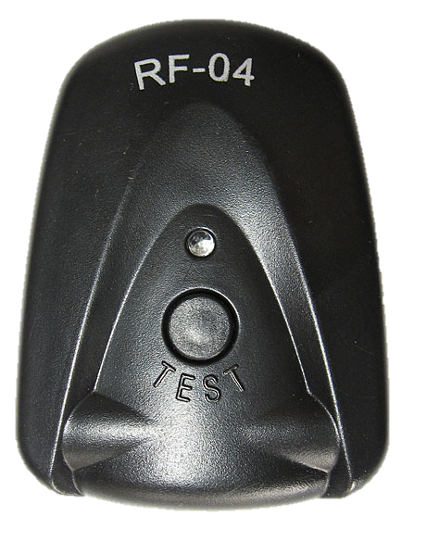
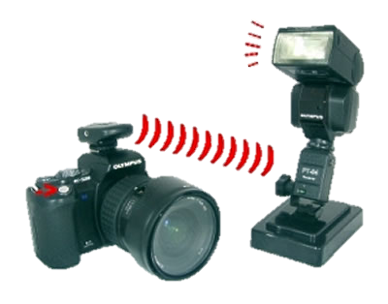
Triggers
Live Demo

Slide 25
XAML Styling

