Slide 1
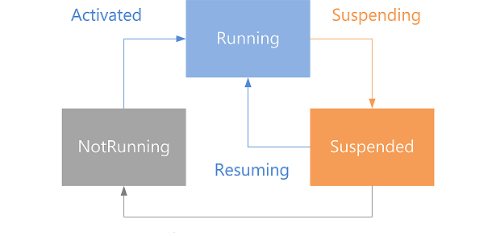
App Lifecycle & Saving States
Activation, Suspension, Resuming, Termination App data, Session state
George Georgiev
itgeorge.net
Telerik Software Academy
academy.telerik.com

Slide 2
Table of Contents
Adapting to Lifecycle
Activation
Resuming
Suspension
Saving App State
User data
Session data
Restoring App State

Slide 3
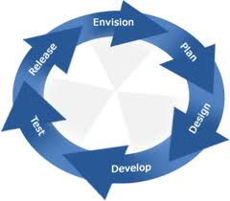
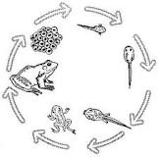
Adapting to Lifecycle
Responding to lifecycle events

Slide 4
Adapting to Lifecycle
Apps are notified of most lifecycle events
Can register handlers
optional ‘args’ parameter
exception: termination
Activation
Windows has activated the app
App can learn about its previous execution state
from args parameter
WinJS.Application.onactivated event

Slide 5

Activation
Live Demo

Slide 6
Adapting to Lifecycle
Resuming
User returned to app while it was suspended
The app still resided in memory
App information could be outdated
Could have been suspended for a long time
Decide whether to refresh data or keep old data
Windows.UI.WebUI.WebUIApplication.onresuming event
Note: could be replaced

Slide 7

Resuming
Live Demo

Slide 8
Adapting to Lifecycle
Suspension
App was off screen and computation will stop
Last chance to save session state
Several seconds available (approx. 5)
Windows could terminate the app without notice
WinJS.Application.oncheckpoint event

Slide 9
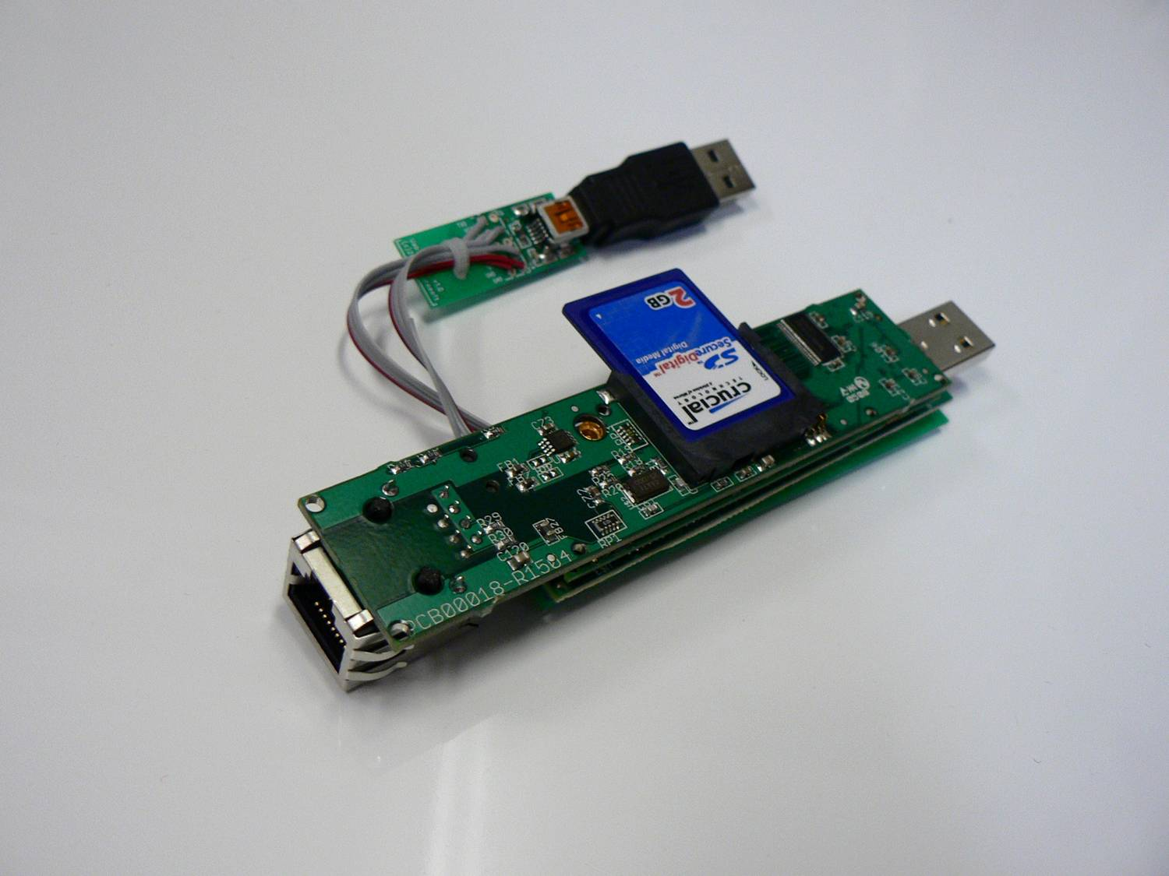
Saving App State
User data storage, Session data storage, when to save data

Slide 10
Saving App State
User data
All information generated by the user
Names, settings, passwords, work etc.
Never lose user data!
Save often
Use ApplicationData storage
current
localSettings

Slide 11
Saving App State
Session state
Session data – current user’s session
Generally, what the user sees
Ends when user closes the app
Shouldn’t end if app is suspended and terminated
Not fatal to lose
Save when app is about to be suspended
Use WinJS.Application.session objects
You can directly add properties

Slide 12
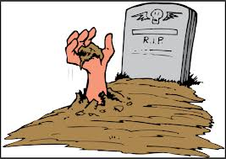
Saving & Restoring App States
Live Demo

Slide 13
App Lifecycle & Saving States
http://academy.telerik.com

Slide 14
Exercises
Implement a simple poem editor. It should take user input line by line and produce HTML code with the poem's text.
The editor should check for rhymes and report non-rhyming lines to the user
The poem editor should have a setting to check for rhymes on pairs of directly sequential lines, or by skipping a line. E.g. if we have 4 lines:
first option means check line 1 with line 2 and line 3 with line 4
the second option means check line 1 with line 3 and line 2 with line 4)
The poem editor should have a setting which determines how many lines form a verse (typically 4) and separate verses in the produced HTML

Slide 15
Exercises
The poem editor should be able to save the file through a file picker, as well as open previously saved files. The user should also be able to start working on a new poem, discarding changes to the current (but there should be a message in the UI warning him)
The poem editor should keep a local backup of the current poem, until the user changes the current poem by opening another one.
The poem editor should be work appropriately with the application lifecycle of Windows Store applications
Saving user data, session state, etc.

