Slide 1
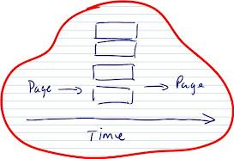

WinJS Asynchronous Programming
Using and creating Promises and Web Workers
George Georgiev
Technical Trainer
itgeorge.net
Telerik Software Academy
academy.telerik.com

Slide 2
Table of Contents
Asynchronous programming in JavaScript
WinJS Promise
Promises explained
Using Promises
Creating Promise objects
Chaining promises
Promise error handling
Web Workers in Store Apps
Overview, Using web workers in Store Apps

Slide 3

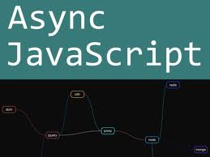
Asynchronous Programming in JavaScript
How to do it

Slide 4
Asynchronous Programming in JavaScript
JavaScript is single-threaded
Long-running operations block other operations
Asynchronous operations in Javascript
Delayed execution
Event handlers
Callbacks
Problems
Heavily-nested callbacks are hard to read
Exceptions may not propagate up

Slide 5

Promises
The evolution of Callback-oriented programming

Slide 6
Promises
A promise is an object which represents an eventual (future) value
Methods "promise" they will return a value
Correct or representing an error
A Promises can be in one of three states:
Fulfilled (resolved, succeded)
Rejected (an error happened)
Pending (unfulfilled yet, still being computed)

Slide 7
Promises
Promise objects can be used in code as if their value is known
Actually we attach code which executes
When the promise is fulfilled
When the promise is rejected
When the promise reports progress (optionally)
Promises are a pattern
No defined implementation, but strict requirements
Initially described in CommonJS Promises/A

Slide 8
Promises
More specifically:
Each promise has a .then() method accepting 3 parameters:
Success, Error and Progress function
All parameters are optional
So we can write:
* Provided promiseMeSomething returns a promise
promiseMeSomething()
.then(function (value) {
//handle success here
}, function (reason) {
//handle error here
});

Slide 9
Promises
Each .then() method returns a promise in turn
Meaning promises can be chained:
Promises enable us to:
Remove the callback functions from the parameters and attach them to the "result"
Make a sequence of operations happen
Catch errors when we can process them
asyncComputeTheAnswerToEverything()
.then(addTwo)
.then(printResult, onError);

Slide 10
WinJS Promises
WinJS has an implementation of Promises/A
WinJS.Promise object
Computes a value at some time in the future
Can attach procedures to call in future with Promise.then() and Promise.done()
When computation was successful
When there was an error
When a progress update is available
All exposed WinRT asynchronous operations are wrapped in Promises

Slide 11
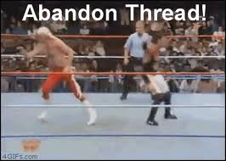
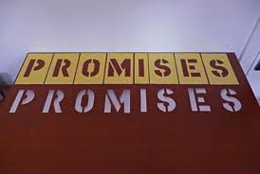
Using Promises
Live Demo

Slide 12
WinJS Promises
Creating a Promise
“constructor” function
Receives 3 parameters – oncomplete, onerror, onprogress
Contains the code that computes the promise value
Should call oncomplete, onerror, onprogress in the respective situations
“oncancel” function
Code to execute if the promise was cancelled

Slide 13

Creating a Promise
Live Demo

Slide 14
WinJS Promises from Callbacks
In web, we often have callback-based async operations
Executed by the browser
When done, browser calls the function we gave it
WinRT APIs are generally promise-based
Some important functionality in HTML5 is still callback-based
Such callback-oriented APIs are easy to wrap in promises

Slide 15

Promises from Callbacks
Live Demo

Slide 16
WinJS Promises from Values
Sometimes we need a promise from a normal value
So the code is consistent
Because we are not sure if the value is a promise or value
WinJS supports a WinJS.Promise.as function
If an object is a promise, just returns it
Else, wraps it in a promise
In the success state, i.e. calls the success handler with the object as a parameter

Slide 17
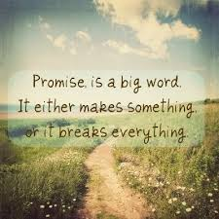
Promises from Values
Live Demo

Slide 18
WinJS Promises
Chaining promises
Promise.then() returns a Promise
Uses the return value of the previous promise
Can attach another .then() or .done() to it
Promise.done() returns undefined
Throws exception if the Promise is in the error state and there is no error handler
Good practice – use as end of Promise chain
Easier to read than nested callbacks

Slide 19

Chaining Promises
Live Demo

Slide 20
WinJS Promises
Error handling
Errors are sent to the chain of .then()s or .done()s
When the chain has a .then()
If there is an onerror, it is called
Else, a promise in the error state is returned
When the chain has a .done()
If there is an onerror, it is called
Else, an exception is thrown

Slide 21

Promise Error Handling
Live Demo

Slide 22
Web Workers
Achieving actual asynchrony

Slide 23
Web Workers
A Web Worker is just JS code
Run in a separate thread by the browser/system
Does not share resources with the main thread
Communication done through messages
postMessage function, onMessage event
Two types
Dedicated –used only by main thread
Shared – can "talk" with other workers
WinRT supports dedicated workers
Good for long-running operations

Slide 24
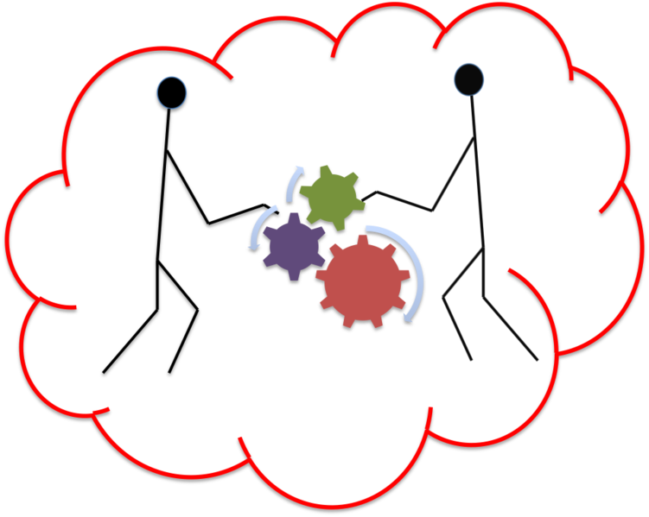
Using Web Workers
Live Demo

Slide 25
Asynchronous Programming with WinJS & Web Workers
Do you haz them?
http://academy.telerik.com

Slide 26
Exercises
Implement a PrimeNumbersCalculator class
Which has methods to:
Calculate the prime numbers up to a given number N
Calculate the first N prime numbers by given N
Calculate the prime numbers in the range [A,B], where A and B are given
All the methods should be truly asynchronous
The calculations should be executed in web workers
The methods should return promises
The PrimeNumbersCalculator should keep exactly 3 web workers
Should be able to handle up to 3 requests at the same time
If there is a request and no worker can handle it, the promise returned from the corresponding method should be in the error state

Slide 27
Excercises
Implement a UI for the PrimeNumbersCalculator
It should provide fields for number input
It should provide buttons to trigger calculations
It should display results of calculations
It should display errors information to the user
E.g. "You can only have up to 3 running calculations at a time"
The UI should always be responsive, by using the promises from the calculator

