Slide 1
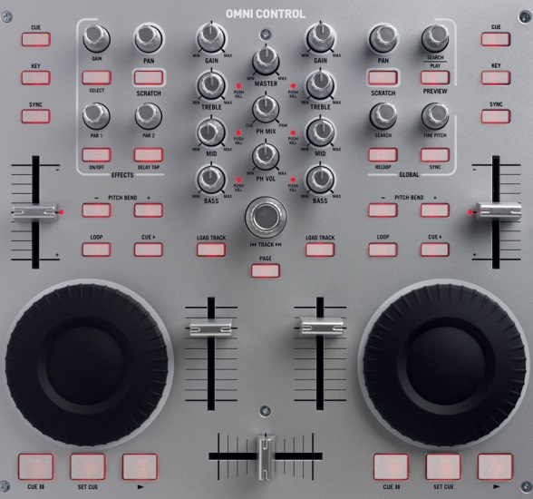
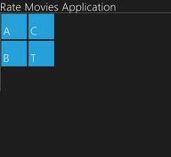
WinJS Controls
Creating and accessing controls, Types, Event-handling
George Georgiev
itgeorge.net
Telerik Software Academy
academy.telerik.com

Slide 2
Table of Contents
What are WinJS Controls?
Creating controls
In markup
In code
Common WinJS Controls
DatePicker
Rating
Flyout
Menu & MenuCommand
AppBar & AppBarCommand

Slide 3
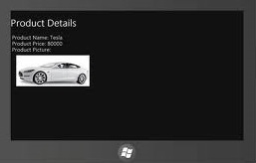
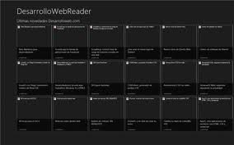
What are WinJS Controls?
Introduction to Windows Library for JavaScript Controls

Slide 4
What are WinJS Controls
Set of controls for Store Apps
Combine several HTML elements to achieve a more complex functionality
Generated by WinJS
In DOM elements with special attributes
Can be styled and have events attached just like regular HTML elements
Have implemented data-binding capabilities
<div data-win-control="…"></div>

Slide 5

Creating WinJS Controls
Creating from markup, Creating from code

Slide 6
Creating WinJS Controls
Declaring WinJS controls in markup
Create a host element (e.g. div)
Set an attribute data-win-options to some control type
You can set additional properties with the data-win-options attribute
You have to call WinJS.UI.processAll()
To generate controls defined in markup
The Blank Template does this
<div data-win-control="WinJS.UI.TimePicker"></div>

Slide 7
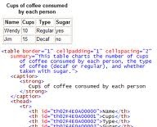
Creating WinJS Controls in markup
Live Demo

Slide 8
Creating WinJS Controls
Creating WinJS controls in JavaScript code
Controls can be generated in code
Create a host element (div) for the control
WinJS.UI holds 'constructors'' for the WinJS controls
Call a constructor and pass it the container (div)
var hostElement = document.getElementById(‘host-id’);
var ratingControl = new WinJS.UI.Rating(hostElement);

Slide 9

Creating WinJS Controls in JavaScript Code
Live Demo

Slide 10
Creating WinJS Controls
Accessing WinJS controls
WinJS controls are "inside" their host element
First access the host element
Then use the element property winControl
var hostElement = document.getElementById(…)
var winJsControl = hostElement.winControl;

Slide 11
Common WinJS Controls
DatePicker, Rating, Flyout, Menu, AppBar

Slide 12
Common WinJS Controls
DatePicker
Enables picking dates
Notable properties
minDate
maxDate
current – the selected date

Slide 13
DatePicker
Live Demo

Slide 14
Common WinJS Controls
Rating
Implements rating mechanism
Notable properties
minRating
maxRating
userRating – the selected rating

Slide 15
Rating
Live Demo

Slide 16
Common WinJS Controls
Flyout
Looks like a dialog window
Attaches to a control
Can be closed by clicking outside of it
Notable properties
show(element) method shows the flyout
innerHTML defines flyout markup
You can add it at the html file too
Can have buttons, paragraphs, divs, etc.
anchor – defines the control to attach to

Slide 17
Flyout
Live Demo

Slide 18
Common WinJS Controls
Menu & MenuCommand
Looks like a context menu
Can have multiple MenuCommands
MenuCommands are buttons, checkboxes, etc.
MenuCommands defined in innerHTML of Menu
Menu attaches to a control
anchor – defines the control to attach to

Slide 19
Menu & MenuCommand
Live Demo

Slide 20
Common WinJS Controls
AppBar & AppBarCommand
The App’s AppBar
Has two sections – global and selection
Can have multiple AppBarCommands in the sections
AppBarCommands attach to one of the sections

Slide 21
AppBar & AppBarCommand
Live Demo

Slide 22
WinJS Controls
schoolacademy.telerik.com

Slide 23
Exercises
Implement a Time Calculator control
A time calculator calculates the time between two moments in time
The time calculator should have two controls for date input
Start and end date
The time calculator should have two controls for time input
Start and end time
The time input controls should be hideable
A switch should show/hide the time input controls
The calculator should have a calculate button which opens a menu
The menu should display three options
Calculate days
Calculate hours
Calculate days and hours
The calculator should print output in an html element
Style the calculator so that it looks like a single control (not just several controls lying around). Use touch-friendly design and layout. Read through this article and try to follow anything you find useful

