Slide 1


WinJS Pages and Navigation
Page controls, Page lifecycle, Navigation patterns & controls
George Georgiev
Technical Trainer
itgeorge.net
Telerik Software Academy
academy.telerik.com

Slide 2
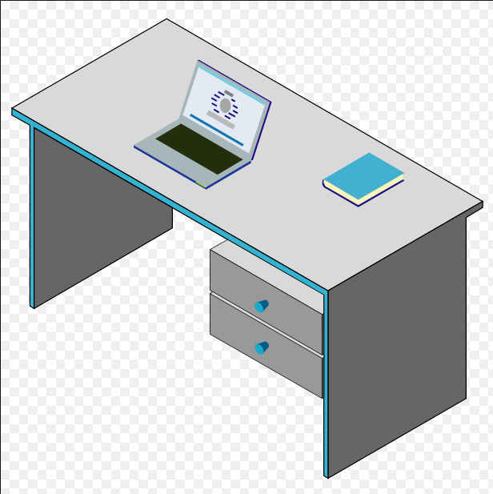
Table of Contents
Pages in Store Apps
WinJS Page Controls
Introduction & Lifecycle
Rendering pages
Handling lifecycle events
Navigation in Store Apps
Multi vs. Single-page navigation
WinJS Navigation app
Using PageControlNavigator

Slide 3
Pages in Store Apps
Separating and structuring content

Slide 4
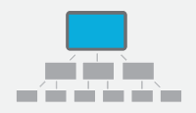
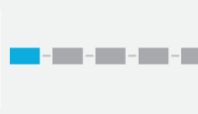
Pages in Store Apps
Windows Store Apps have a concept of pages
Different pages have different content
… or different views for the same content
Provide users with a familiar experience
Websites have pages, mobile apps often look like websites
Pages are navigated to an from in two main navigation patterns
Hierarchical system
Flat system

Slide 5
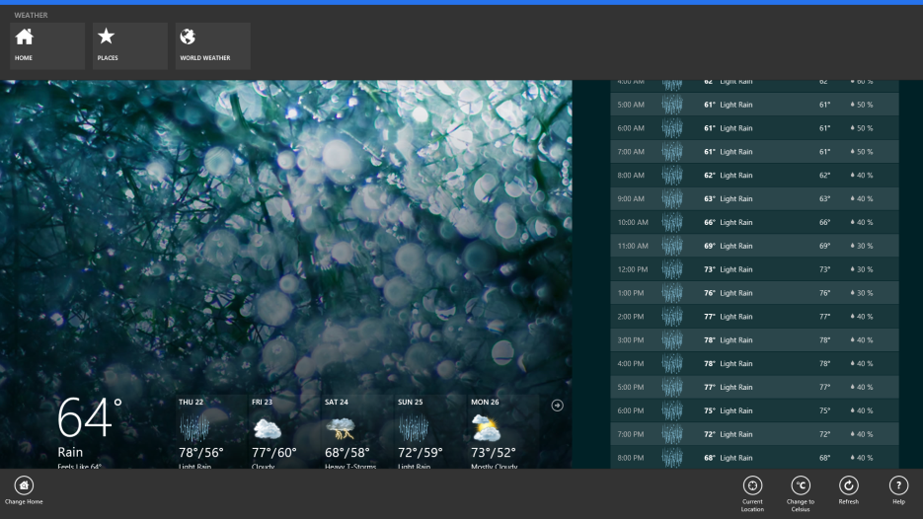
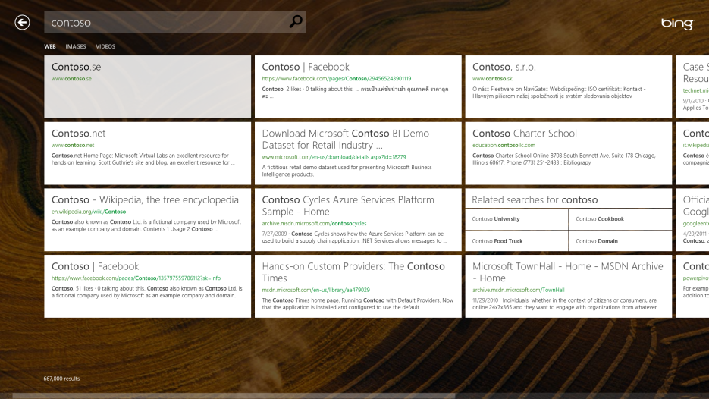
Pages in Store Apps
Apps use common page navigation tools
Text hyperlinks/"Tile" hyperlinks
Navigation back button
Nav Bar to change between main pages/sections
Or switch content view

Slide 6
WinJS Page Controls
Combining HTML, CSS and JS into objects

Slide 7
WinJS Page Controls
Several ways to render pages in Store Apps using WinJS
<iframe> for external content (as in HTML5 apps)
HtmlControl for static html content
PageControls
Modular units HTML, CSS, JS
Defined as objects with URIs
Have lifecycle events (loading, initializing, …, ready)

Slide 8
WinJS Page Controls
Defining page controls – WinJS.Pages.define()
Page URL (should point to actual html file)
Page members set (including event handlers)
Displaying pages from page controls
Direct hyperlink navigation
All lifecycle events happen
Using WinJS.Pages.render()
Loads a page, goes through lifecycle
Places the page in a provided element

Slide 9
Defining and Displaying Page Controls
Live Demo

Slide 10
Page Control Lifecycle Events
Responding to loading, initialization, processing, etc.

Slide 11
Page Control Lifecycle Events
Pages go through several stages on display
Loading – getting the targeted html
Initializing –activities without html content
Rendering – parsing & placing loaded html
Processed stage – after WinJS.processAll() has been called on the content
Ready stage – final stage before page displayed
Stages have events & default implementations
Most stages can return a promise to delay the next while doing async work (except load & render)

Slide 12
Page Control Lifecycle – ready()
Ready stage
Most commonly needed to implement
Setups the page right before the user sees it
Corresponds to the ready() event
Receives element in which page is rendered
Options (if passed to WinJ.Pages.render)
WinJS.UI.Pages.define("/pages/target/target.html", {
ready: function (element, options) {
...
},
});

Slide 13
Implementing the ready event
Live Demo

Slide 14
Page Control Lifecycle – init()
Initialization stage
Initialization before content is set (i.e. no html)
Good for starting async work like downloads
Good for initializing properties
Corresponds to the init() event
Receives element in which page is rendered
Options (if passed to WinJ.Pages.render)
WinJS.UI.Pages.define("/pages/target/target.html", {
init: function (element, options) {...},
...
});

Slide 15
Implementing the init event
Live Demo

Slide 16
Page Control Lifecycle – load()
Loading stage
Before any other event, gets html from the page URI
Expected to return DOM element(s) for render()
Corresponds to the load() event
Receives URI to page to be rendered
By default just copies elements with WinJS.UI.Fragments.renderCopy
WinJS.UI.Pages.define("/pages/target/target.html", {
load: function (uri) {...}, ...
});

Slide 17
Implementing the load event
Live Demo

Slide 18
Page Control Lifecycle – error()
Error event
Called if anything goes wrong during the lifecycle
i.e. an exception is thrown
Corresponds to the error() event
Receives the result of a Promise in the error state
Can be an object, a string, etc.
WinJS.UI.Pages.define("/pages/target/target.html", {
error: function (errorValue) {...}, ...
});

Slide 19
Implementing the error event
Live Demo

Slide 20
Navigation in Store Apps
Multi-page and Single-page, using Navigation & Navigation App Template

Slide 21
Multi-Page Navigation
Multi-page navigation is the most common in the web
Following a hyperlink
Unloads the current page
Loads the targeted page
Supported in Windows Store Apps
Simple to implement (just place a hyperlink)
Still triggers Page control lifecycle events
<a href="ms-appx:///page.html">Go to page</a>

Slide 22
Multi-Page Navigation
Disadvantages to multi-page navigation
App screen goes blank while loading next page
All scripts are destroyed and new ones loaded
Could miss system events
Scripts used by several pages need to be reloaded in each one
Overall lower performance than single-page navigation

Slide 23
Single-Page Navigation
Single-Page navigation doesn't switch pages
Keeps a default/master page
With common styles, headers, scripts, etc.
With a placeholder element for other pages
Page content is loaded and inserted in the master page's placeholder
New page scripts are loaded
Old scripts stay loaded
script context is not destroyed
Common scripts referenced in the master page

Slide 24
Single-Page Navigation
WinJS has support for the Single-Page Navigation model
WinJS.Navigation namespace
Navigation events
Navigation history
Go Back and Go Forward capabilities
Can use the namespace to create your own navigation control
Can use the Navigation App Template's Application.PageControlNavigator

Slide 25
Single-Page Navigation with Navigation App Template
Live Demo

Slide 26
WinJS Pages and Navigation
http://academy.telerik.com

Slide 27
Exercises
Find an article you like in Wikipedia and make it into a navigation app (preferably an article with a larger table of contents)
The main page of the app should contain a general description of the subject (first few paragraphs in article) and a table of contents in the form of tiles with pictures and headings
Tiles should be similar to those on the start screen or in the Grid App (same design concepts, not pixel-perfect)
Clicking on a "table of contents tile" should open a page with the corresponding section of the article
The user should be able to read the content and go back
To get the content of the page, just copy it the article
* Implement task 1 by downloading and parsing the article, instead of "hardcoding" the html

