Slide 1
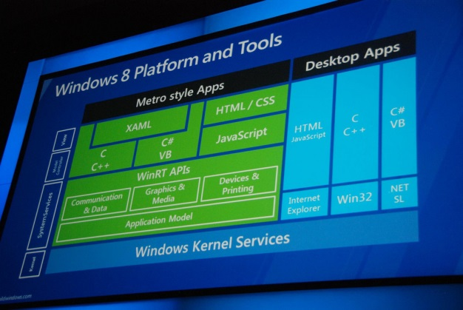


WinJS and WinRT Introduction
What are WinJS and WinRT, Using the APIs in JavaScript
George Georgiev
Technical Trainer
itgeorge.net
Telerik Software Academy
academy.telerik.com

Slide 2
Table of Contents
Building Store Apps like normal HTML5 Apps
Runtime
Capabilities
Building Apps with WinJS and WinRT
What is WinJS
What is WinRT

Slide 3

Building Store Apps like HTML5 Apps
What works, runtime, capabilities

Slide 4
Store Apps like HTML5 Apps
Windows Store Apps using JavaScript
Executed in IE10 engine (IE11 on Windows 8.1)
Can be a normal HTML5 App
HTML, CSS, JavaScript
Any JS libraries you like – jQuery, knockout, etc.
Access HTML5 APIs like Geolocation, localStorage
If you have a HTML5 App for a browser, you can "copy-paste" it into a Store App
It will most probably run

Slide 5
Building a Store App from a browser App
Live Demo

Slide 6
HTML5 App capabilities in Win8
HTML5 Apps generally can do anything they can in IE, with a few restrictions & capabilities
APIs like Geolocation need to be permitted from Control Panel
Loading dynamic page content is disabled
Need to use toStaticHTML
Same Origin Policy does NOT apply
You can AJAX or XHR anything you like
No access to the file system
Can use web workers (Dedicated worker only)

Slide 7
Building Store Apps with WinJS and WinRT
What are WinJS and WinRT, what's the benefit

Slide 8
Store Apps w/ WinJS & WinRT
WinJS – a fully-featured JavaScript library
DOM queries
Pages and Navigation
Classes and Namespaces support
+ inheritance, mixing
Promises, xhr requests
Data binding
Controls fitting in the UI model
Animations

Slide 9
Store Apps w/ WinJS & WinRT
WinRT APIs (the Windows namespace)
Application model
Activation, suspension, viewStates, etc.
File storage, Application file system access
File & Folder pickers, roaming data, settings, etc.
Contracts, Extensions
Devices
Geolocation, Sensors, Cameras, Speakers, etc.
Networking, Security, Notifications, etc.
Basically gives you access to all Windows 8 APIs

Slide 10
Store Apps w/ WinJS & WinRT
Building fully-featured Store Apps
HTML5 + WinJS + WinRT (Windows namespace)
Access to all HTML5 features
Access to all Windows APIs
Can still use any third-party library
jQuery, Knockout, KendoUI, Underscore, etc.
Note: If you can do it with WinJS, better skip third-party libraries

Slide 11
Building a Simple Store App with HTML5, WinJS & WinRT
Live Demo

Slide 12

WinJS and WinRT Introduction
http://academy.telerik.com

Slide 13




Free Trainings @ Telerik Academy
C# Programming @ Telerik Academy
csharpfundamentals.telerik.com
Telerik Software Academy
academy.telerik.com
Telerik Academy @ Facebook
facebook.com/TelerikAcademy
Telerik Software Academy Forums
forums.academy.telerik.com

