Slide 1
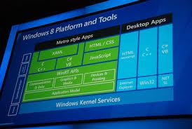



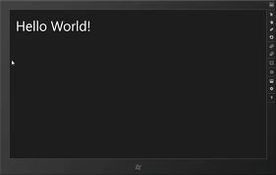




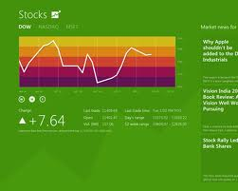


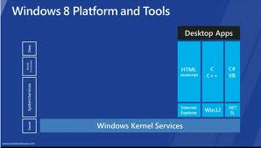
Windows 8 Development
Development technologies, WinRT, The “Ecosystem”
George Georgiev
itgeorge.net
Telerik Software Academy
academy.telerik.com

Slide 2
Table of Contents
Development platform
Desktop Apps Development
Win32, .NET 4.5, browser apps
Store Apps Development
WinRT, The “Ecosystem”
Development tools
Visual Studio 2012
Store Apps Distribution

Slide 3




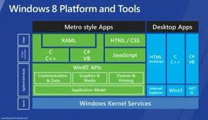
Development Platform
The Desktop and Store App Development Stacks

Slide 4

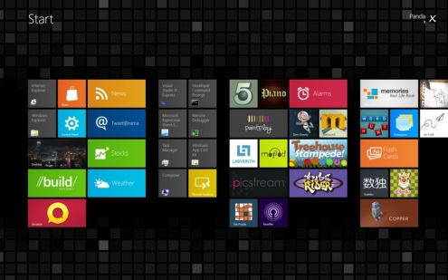
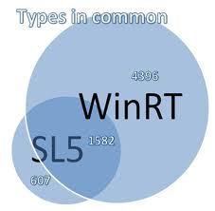
Windows 8 Development Platform
Windows 8 has two app “environments”
Desktop Apps environment
Home to traditional desktop apps
Only in Windows 8 & Windows 8 Pro
Store Apps environment (WinRT)
Home to the new Store Apps
Available in ALL Windows 8 versions
Hence, two app development platforms

Slide 5
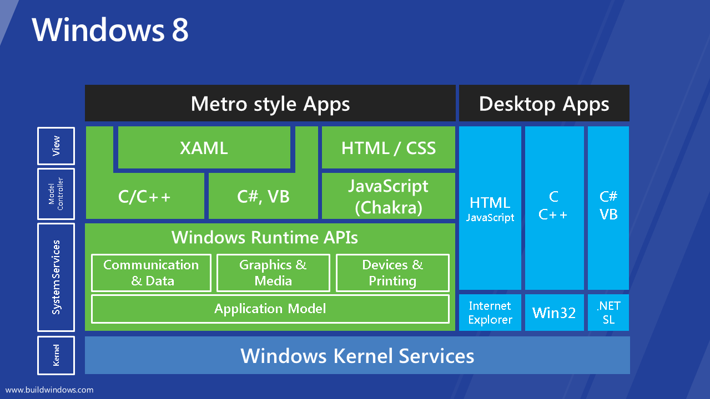
Windows 8 Development Platform – Chart

Slide 6






Desktop App Development
Desktop Development Stack and Environment

Slide 7
Windows 8 Development Platform
Desktop App Development (default)
Technologies
Win32, .NET 4.5, Silverlight, DirectX, OpenGL
Languages
C/C++, C#, VB.NET
Environment
Same as previous Windows versions
Backward compatibility
Traditional app distribution

Slide 8






Store App Development
The New Development Stack and Environment

Slide 9
Windows 8 Development Platform
Store Apps Runtime (WinRT)
Enhanced COM (unmanaged)
Heavily asynchronous
Applications sandboxed
Features such as Contracts, Extensions
API available to all supported languages
Much from .NET + new features

Slide 10
Windows 8 Development Platform
Store Apps – Development stacks
HTML and CSS
with JavaScript
XAML
with C#
with C/C++
DirectX
with C++
Store Apps distribution – only* Windows Store

Slide 11
Windows 8 Development Platform
Store Apps “Ecosystem”
the runtime, together with the apps, toolbars, tiles, etc.
“Win as One” principle
Use other Apps
Use the system
Use devices
Fit into the UI model

Slide 12
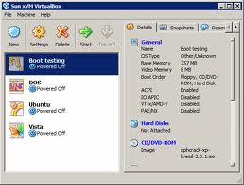

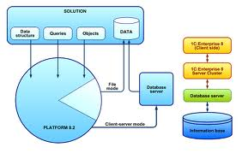
Store App Development Tools
Using Visual Studio 2012 and other tools to develop Windows 8 Apps

Slide 13
Store App Development Tools
Microsoft Visual Studio 2012 – official WinRT and .NET development tool
Many languages: JavaScript, C#, VB.NET, C++…
Supports development for many technologies
Main tool for Metro Apps developmet (WinRT)
Very powerful and feature rich
Write, compile, model, design GUI, data, build, execute, debug, simulate, test, deploy, refactor
Commercial product, has free editions

Slide 14
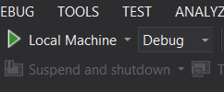
Store App Development Tools
Visual Studio – Key features for Metro Apps
Debug Simulator
Emulates the App in a tablet
Pick from Debug dropdown
Debug Location toolbar
Suspend, Suspend and shutdown, Resume
(add from View>>Toolbars>>Debug Location)
Store (right click on project)
Enables interactions with Windows Store
Enables creating App packages

Slide 15
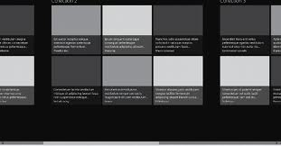
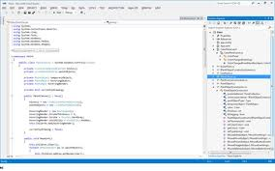
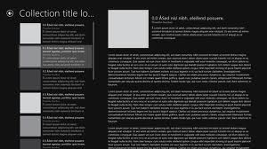
Visual Studio 2012 & Store Apps
Live Demo

Slide 16


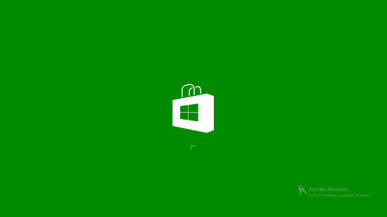

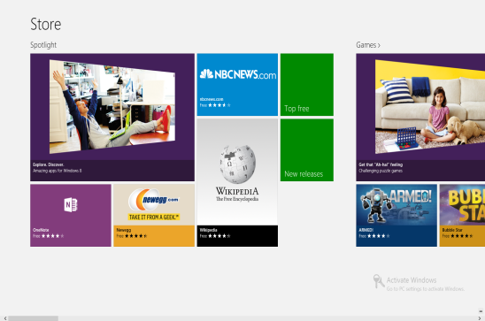
Store App Distribution
The Windows Store, Developer license and all that jazz

Slide 17
Store App Distribution
Windows Store
Distribution of Store Apps and their updates
Apps can be free or paid
Place to submit Apps
requires Developer Account
Apps must meet certification requirements
Apps that don’t meet requirements are rejected
Requirements: http://bit.ly/rVo1VY

Slide 18
Store App Distribution
Developer License
Signs apps you create with a temporary key
Enables running uncertified Apps (side-loading)
i.e. to create an application and debug it
Uncertified apps come outside of Windows Store (need to be signed with a temporary key)
Sort of a way to avoid Windows Store
Installing Visual Studio 2012 RC gets you one
Free to get and renew separately
Don’t mistake with Developer Account (Store)

Slide 19
Windows 8 Development
schoolacademy.telerik.com

