Slide 1
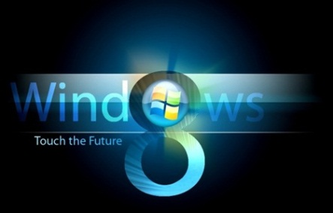

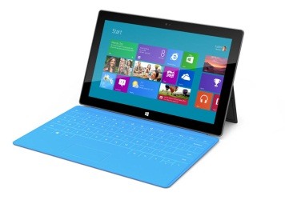
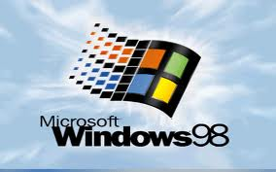
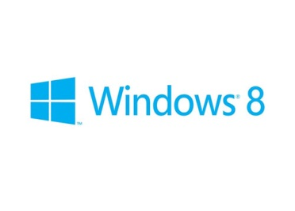





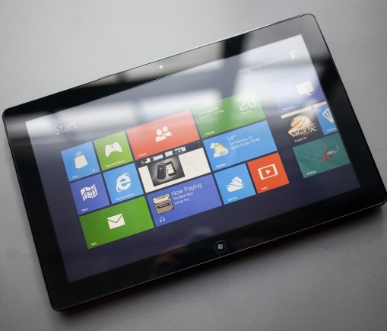
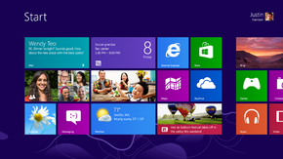
Windows 8 Intro
Features, Concepts, Windows RT, Desktop & Metro style
George Georgiev
itgeorge.net
Telerik Software Academy
academy.telerik.com

Slide 2
Table of Contents
What is Windows 8?
Overview
Device support
"Modern" design language
The Windows 8 “desktop” – user perspective
Windows RT
Windows “Start Screen” (Windows RT)
Windows Charms

Slide 3
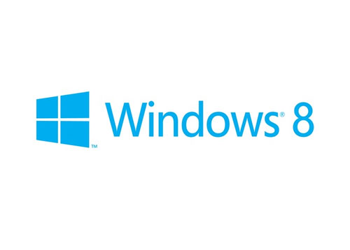
Windows 8
It’s here

Slide 4
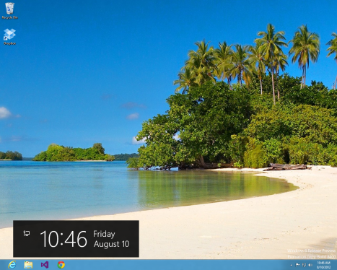
Windows 8
Microsoft’s shot at mobile & desktop
New runtime
“Fast and fluid”
Designed touch-friendly
New UI design – Modern
Low resource footprint
Windows 8, Windows 8 Pro, Windows RT
Released October 26, 2012
Upcoming update – Windows 8.1 (RTM in two weeks or so)

Slide 5
Windows 8 Device Support
Device support
Windows RT – can run on ARM
Tablets, notebooks, etc.
Windows 8 full – x86/x64/IA32 processors
PCs
Windows 8 (Release Preview) requirements
Architecture | IA-32 (32-bit) | x86-64 (64-bit)
Processor | 1 GHz (with PAE, NX and SSE2 support)
Memory (RAM) | 1 GB | 2 GB
Graphics Card | DirectX 9 graphics device with WDDM 1.0 or higher driver
Storage | 16 GB | 20 GB

Slide 6
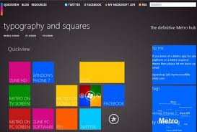
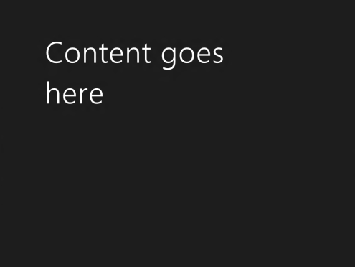
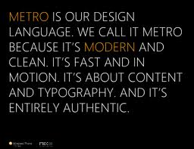


Modern Design Language
“Modern”, Clean, Typography-oriented design for Windows 8

Slide 7
MODERN DESIGN LANGUAGE
Content matters
Showcase content
Clean and open layout
Minimize distraction
Remove lines, boxes, and unnecessary effects
Limit navigational chrome on screen
Clear information hierarchy
Use typography to structure content.
Use size, weight, and color consistently

Slide 8
Modern Design Language
Metro style silhouette
Content composition forms application identity
Align with the Metro style silhouette
provide a sense of familiarity and confidence
Direct interactions
Let users directly manipulate content
Avoid controls for content manipulation
Semantic zoom
Content-first way to navigate

Slide 9
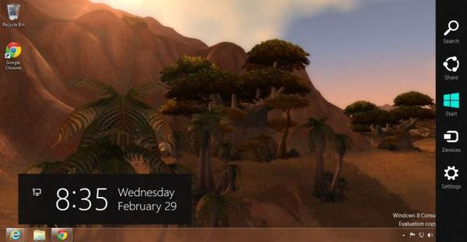
Windows 8 Desktop
What’s new, what’s old, what’s gone

Slide 10
Windows 8 Desktop
Desktop similar to previous Windows versions
Icons, task bar
Entry point to traditional Desktop Apps
.NET, Win32, etc.
New features
File Manager (Windows Explorer)
Ribbon with more controls
Enhanced Task Manager
Access to Charms

Slide 11
Windows 8 Desktop (2)
Removed/changed features
No Start button on taskbar
No Start Menu (replaced with Start Screen)
!!! No file/folder deletion confirmation dialog
Deletion can still be undone and deleted files can be restored from Recycle bin
No Desktop Gadgets
… and
A brand new BSOD screen !

Slide 12

Windows RT
Windows for mobile devices (Windows on ARM)

Slide 13
Windows RT
Windows RT
Windows 8 for mobile devices using ARM
Can run only Store Apps
from App Store
Distributed only to device manufacturers
Main interface – Windows Start Screen
Has some additional hardware requirements
Windows Key, volume keys, etc.
http://en.wikipedia.org/wiki/Windows_RT

Slide 14
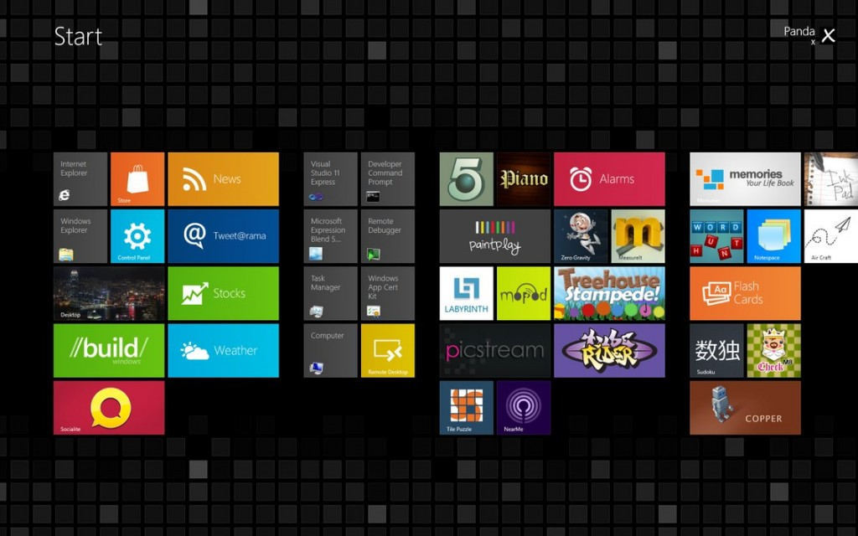
Windows Start Screen
a.k.a. Windows Metro and so on…

Slide 15
Windows Start Screen
Door to the new Windows UI and Runtime
Replaces the Start Menu
Based on the Modern design language
Main interface in Windows RT
Provides access to Store Apps and the Desktop
Apps represented through tiles
Several views for apps (landscape, portrait, snapped)

Slide 16
Windows Start Screen – Tiles
Store App Tiles
Represent apps
Can be square or wide
Can be live
Live tiles can display app information
Users can turn off/on a live tile
Important to attract users
It’s your app’s front door!

Slide 17




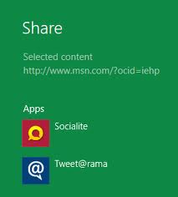
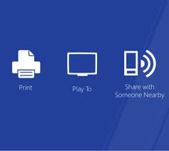
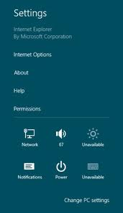
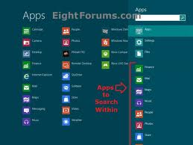
Windows Charms
The Charms Bar, Charms Concept, Charm Types

Slide 18
Windows Charms
Charms Bar – universal toolbar of Windows 8
Can be shown from anywhere (apps, desktop, start screen, etc.)
Contains 5 “charms” (commands)
Charms can work depending on context
Apps can implement their response to a charm
Good Store Apps respond to most charms
Store Apps shouldn’t create their own controls for commands in the Charms Bar
Except for Search

Slide 19
Windows Charms Explained
Search
Search Windows or Apps that implement search
Share
Send content from one app to another
Devices
Control devices with Windows or Apps
Settings
Change Windows or App settings
Start – change between App and Start Screen

Slide 20
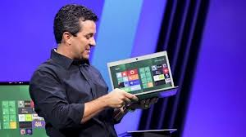
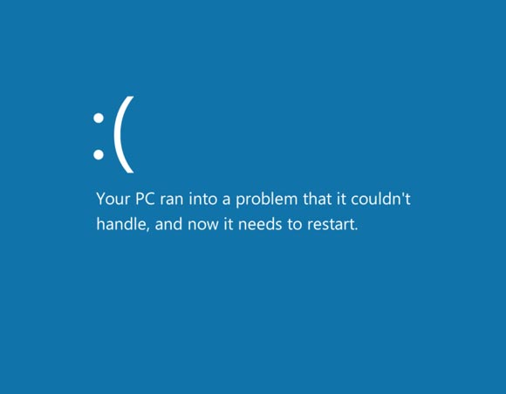
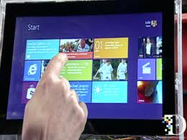
Windows 8
Live Demo

Slide 21
Windows 8 Intro
http://schoolacademy.telerik.com

Slide 22
Windows 8 Hotkey List
A list of most of the commands available in Windows 8

Slide 23
Windows 8 Hotkey list (1)
Win + Print Screen – Take Screenshot (Saves as PNG in Pictures Library)
Win + C – Open Charms Bar
Win + Tab – Open Switch List
Win + Q – Open Global Search
Win + W – Search Within System Settings
Win + F – Search Within Files (Allows you to search directly within Files)
Win + Z – Access Options of Metro Apps (Can also be accessed by right-clicking on an empty space)
Win + I – Open Settings Menu
Win + P – Open Second Screen/ Projector Settings (For dual monitor setup)
Win + H – Go to Share Settings Pane (Lists sharing options relative to currently running app)
Win + K – Open Devices Settings Pane (Lists currently connected devices)
Win + X – Open System Utility Settings Menu in bottom-left corner.

Slide 24
Windows 8 Hotkey list (2)
Win + T – Preview Opened Windows in Taskbar (Brings up the window thumbnail from taskbar one by one)
Win + U – Open Ease of Access Center
Win + E – Open Windows Explorer
Win + R – Open Run Dialogue Box
Win + Pause – Open System Properties Window
Win + Enter – Open Windows Narrator
Win + Shift + . – Snap Application to Right Side (Toggles between Right side, Left side and Full Screen)
Win + . – Snap Application to Left Side
Win + , – Peek at Desktop (Aero Peek)
Win + D – Go to Desktop
Win + M – Minimize All Applications
Win + B – Go Back to Desktop

Slide 25
Windows 8 Hotkey list (3)
Win + J – Switches focus between snapped Metro applications
Win + L – Lock Screen
Win + Page Up/ Page Down – Switch Primary & Secondary Monitors (Dual Display)
Ctrl + Mouse Scroll (In Start Screen) – Tile Zoom Toggle
Ctrl + Mouse Scroll (In Desktop) – Change Desktop Icon Size
Ctrl + Shift+ N – Create New Folder in Current Directory

