Slide 1


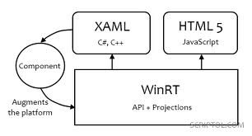

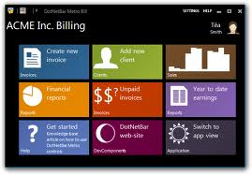
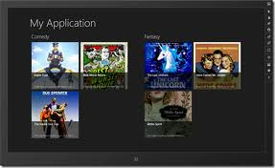
Windows Store Apps
UI, Runtime, Views, Roaming to the Cloud
George Georgiev
itgeorge.net
Telerik Software Academy
academy.telerik.com

Slide 2
Table of Contents
User Interface
Modern design language
Interactions
Runtime
Lifecycle & Suspension
Background tasks
Views
Store Apps & Cloud

Slide 3
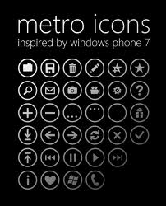
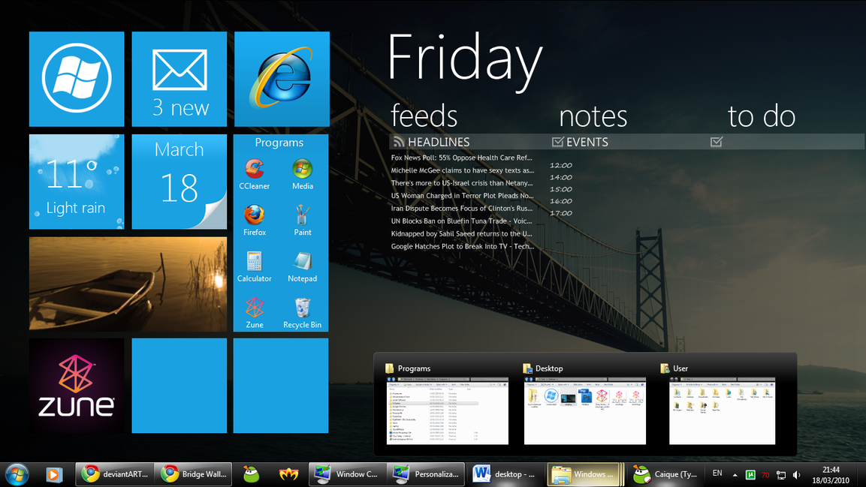
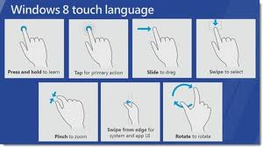
"Modern" User Interface
Using "Modern" Design, Contracts, App bar

Slide 4
Modern User Interface
Ensure content first
Get content that actually “matters”
Free content from UI accessories
Use Modern design
Make your app feel familiar
Create an immersive experience
Leverage the Charms and App bar

Slide 5
Modern User Interface
Leveraging the edge
The Charms bar
Place for inter-App operations (Search, Share…)
Make users confident to find common controls
Implement contracts you need
The App bar
Navigation, App-specific tools and commands
Avoid center
Use left or right side

Slide 6
Modern User Interface
Interactions
Prefer direct interactions
Focus on touch ergonomics
Use fingers’ capabilities
Fast and fluid
Purposeful animations
Animations “connect”
Use physics
i.e. if user slides fast – move fast

Slide 7
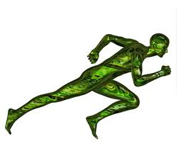
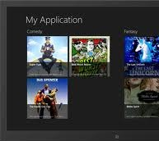
Store App Runtime
Suspension, Background tasks, Resources

Slide 8
Store App Runtime
Store apps run ONLY on screen
Store apps in background are suspended
Store apps are notified of suspension
Suspension
App stops running (no processing)
App resides in memory
Suspended apps can be terminated
To free resources (app unloaded from memory)
Without notification

Slide 9
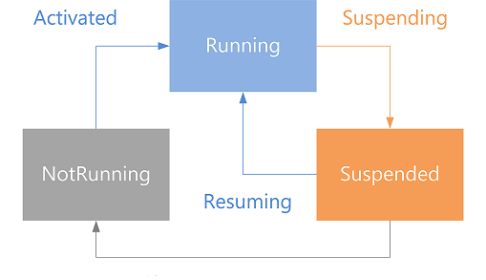
Store App Lifecycle

Slide 10
Store App Runtime
Background Tasks (extension)
Enable processing for apps in background
For tasks not requiring user interaction
Downloading mail, chat notifications, etc.
CPU and Network available
Very strong contraints
Application data (storage)
Virtual per-app storage
Apps do not have typical file system access
Except through Pickers

Slide 11
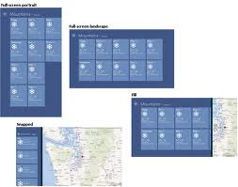
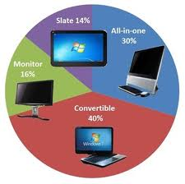
Store App Views
View states, Form factors, Scaling

Slide 12
Store App Views
View States
Full-screen
Landscape, Portrait
Snapped left, snapped right
Consider other snapped apps
Your app could be on-screen with a snapped app
With Windows 8.1, apps can be smoothly resized down to 320px width
Can have lots of apps on-screen

Slide 13
Store App Views
Form factors
Apps can run on a wide range of devices
Large screen monitors
Tablet screens
Low-resolution and high-resolution
Consider different screen forms
UI layout
Touch ergonomics
Built-in controls adapt to different form factors

Slide 14
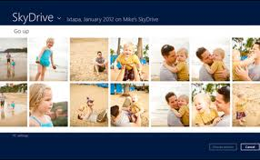
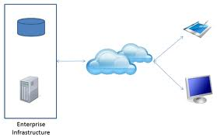

Store Apps & Cloud
Utilizing Cloud services

Slide 15
Store Apps & Cloud
Store Apps should feel alive and connected
Cloud is a viable technology
High availability, high replicability
Lowers costs
Roam to the Cloud
Store Apps usually have network access
Syncing files is very popular
Some devices have limited resources
Software and computations can be out-sourced
Data sources can be shifted to the cloud

Slide 16
Windows Store Apps
http://academy.telerik.com

