Slide 1

Southwest Regional
Climate Hub
Developed by the
Asombro Institute for Science Education (www.asombro.org)

Slide 2
Effects of Climate Change
Global warming: warmer air and water
What effects would you expect?
Think about water cycle, evaporation experiment
Notes:
Earth is getting warmer because of the enhanced greenhouse effect. Increased greenhouse gases in the atmosphere have resulted in global warming, which includes higher global surface temperatures and also higher air and water temperatures. (Review the greenhouse effect and global warming if needed.)
Draw on your understanding of the water cycle to predict the effects of warmer air and water temperatures on the processes of the water cycle. Write your predictions on the handout. Use the Water Cycle diagram (optional, if you have a copy) and the excerpt at the top of the handout.

Slide 3
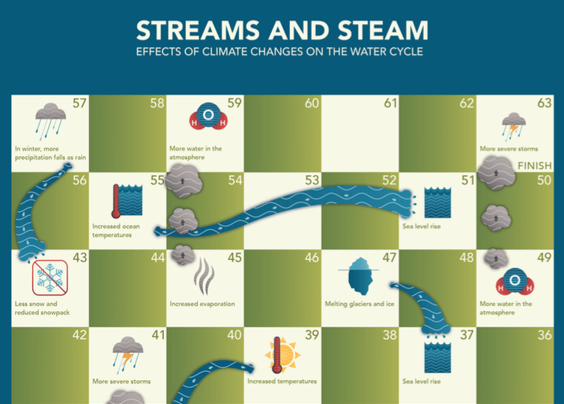
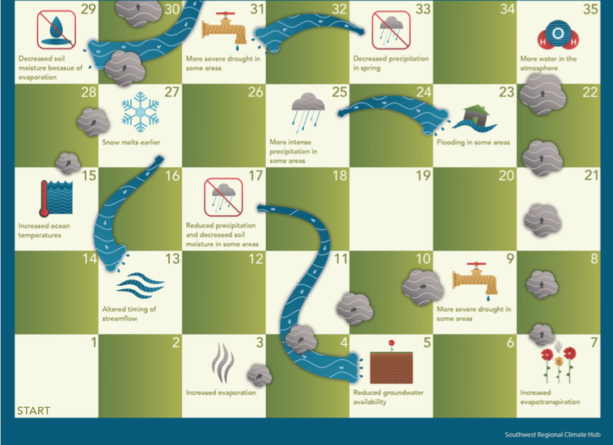
Notes:
This is the Streams and Steam game board. The game is played like Chutes and Ladders.

Slide 4
Rules of Play
Roll the die to determine who starts the game.
Player who rolls the highest number plays first.
Players follow in turn from left to right.
All players begin with their coin on the start space.
Roll die and move the coin the number of spaces indicated.
When a player lands on a square at the TOP of a stream, the player will “raft” down the stream by moving their coin down to the square at the bottom of the stream.
When a player lands on a square at the BOTTOM of a column of steam, the player will rise up the steam column by moving their coin up to the square at the top of the steam column.
The squares without pictures are regular squares and do not require any further action.
Two or more players may stop at the same square together.
The first player to cross into the finish space wins the game; an exact roll of the die is not required to win.
Notes:
Rules of the game:
-Roll the die to determine who starts the game.
-The player who rolls the highest number goes first.
-Players follow in turn from left to right.
-All players begin with their coin on the start space.
-Roll the die and move the coin the number of spaces indicated.
-When a player lands on a space that is at the top of a stream, they will “raft” down the stream by moving their coin to the square at the bottom of the stream. Move in the direction of the arrows, from the smaller to larger end of the stream.
-When a player lands on a space that is at the bottom of a column of steam, they will rise up the column of steam by moving their coin up to the square at the top of the steam column. Move in the direction of the arrows, from smaller to larger puffs of steam.
-The squares without pictures do not require any further action. The player will rest there until their next turn.
-Two or more players may stop at the same square together.
-The first player to cross into the finish space wins the game. An exact roll of the die is not required to win.

Slide 5
Effects of Climate Change
Increased rate of evaporation into atmosphere
More severe drought in some areas
Increased precipitation in some areas
Warmer winter temperatures
More precipitation as rain instead of snow
Snowmelt earlier, timing of streamflow
Source: www.epa.gov/climatechange/impacts-adaptation/water.html#watercycles
Notes:
-Because surface, air, and water temperatures on Earth are increasing, there is a higher rate of evaporation of water into the atmosphere. Warmer air holds more water, which changes precipitation patterns. Also, water vapor is a greenhouse gas, so more water in the atmosphere further enhances the greenhouse effect and changes the climate.
-We will experience more severe drought in some areas. As climate change intensifies, climate scientists predict less rainfall in the Mediterranean, southwest North America, and southern Africa.
-Earth will receive increased precipitation in some areas. More precipitation is predicted in Alaska and other high latitudes of the Northern Hemisphere and near the equator.
-As global surface temperatures continue to increase, most areas on Earth will have warmer winter temperatures.
-Warmer winter temperatures mean that more precipitation falls as rain instead of snow. Snowpack will be reduced, and there will be less water stored in snow to supply watersheds.
-With warmer winters and spring-like temperatures coming earlier, snow is melting earlier, altering the timing of streamflow. The increased temperature in springtime increases evaporation from surface water bodies, reducing overall streamflow. This generally means that less water is available during late spring and summer months when demand is highest for crops and general public use.

