Slide 1
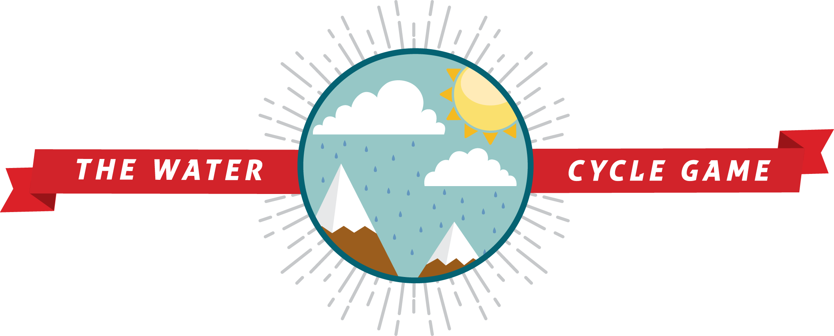
Southwest Regional
Climate Hub
Developed by the
Asombro Institute for Science Education (www.asombro.org)

Slide 2
The Water (Hydrologic) Cycle
Only a certain amount of water on Earth
Small amounts are lost and gained
Movement of water on, in, & above Earth
Changes states between liquid, vapor, & solid (ice and snow).
Source: water.usgs.gov/edu/watercycle.html
Notes:
Small amounts of water are lost and gained through geologic processes and space, but basically we have a fixed amount of water on Earth. This water is moved around through the living and non-living parts of Earth in the water cycle. The water cycle is the movement of water on, in, and above Earth. During the cycle, water changes state between liquid, vapor, and solid (ice and snow).

Slide 3
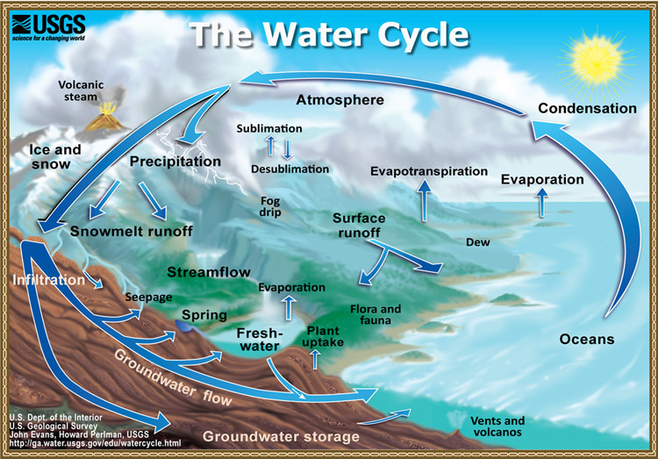
Source: water.usgs.gov/edu/watercycle.html
Notes:
This diagram shows the water cycle. The arrows show the movement of water from one location to another. For example, water evaporates from the ocean and condenses to form clouds in the sky; then it falls from the clouds as precipitation. Places that water is stored for some period of time are called reservoirs, and flows or pathways (denoted by arrows) are the routes water takes between reservoirs.

Slide 4
NOAA Ocean Explorer Video
http://oceanexplorer.noaa.gov/edu/learning/player/lesson07.html

Slide 5
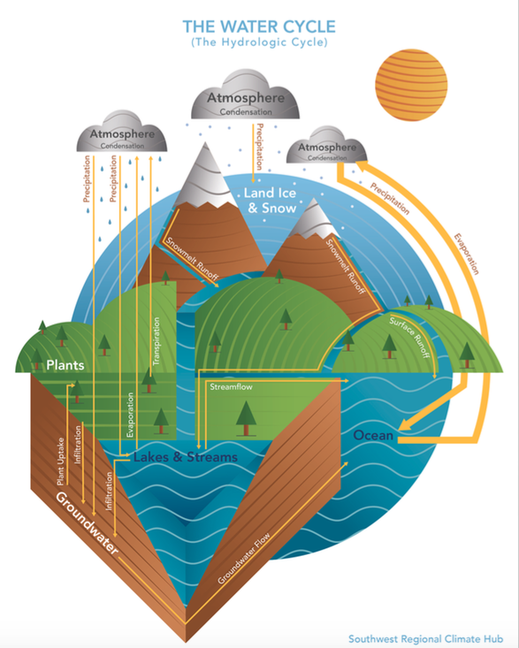
Water Cycle Game
Thin lines = 2 water drops (paper wads)
Thick lines = 5 water drops (paper wads)
State process by which water is moving
Notes:
The arrows indicate the movement of water from one location to another, and they are labeled with the processes by which water moves. The thickness of the arrows indicates the relative amount of water. In other words, the thicker the arrow, the more water that is moving to that location.

