Slide 1


Rice Crop Yield Prediction In India Using Improved Classification Technique
Guided By Prepared By
Prof M.B. Chaudhary Kolin Sukhadia Head Of Department Enrollment No : 170160702014
Department Of Computer Engineering Department Of Computer Engineering
Government Engineering College, Modasa Government Engineering College, Modasa

Slide 2
Topic Outline
Introduction
MSR Comment
Proposed method steps
Mathematical Terms and Formulas explanation
Existing method implementation
Proposed Method Implementation
Conclusion
References

Slide 3
Introduction
Improving the ability of farmers to predict crop efficiency in under various climatic situations like rainfall,temperature,cloud cover,vapour pressure and so on can help ranchers and different partners in settling on critical choices regarding agronomy and harvest decision.
The prediction of agricultural yield is a difficult and desirable task for every nation.There are many classification techniques like Support Vector Machine(SVM),Naïve Bayes, BayesNet,K Nearest Neighbour(KNN).
The current research use most rice producing
states(Haryana,Punjab,Tamilnadu,AndhraPradesh,Bihar).The dataset parameters are state name,district name, Rainfall, maximum temperature,minimum temperature, average temperature,reference crop evapotranspiration,vapour pressure,potproential evapotranspiration,diurnal temperature range,area,production,yield,class.

Slide 4
MSR Comment
Good work done.yet explanation of mathematical terms and formula should be clear.-mathematical terms and formula are explained.

Slide 6
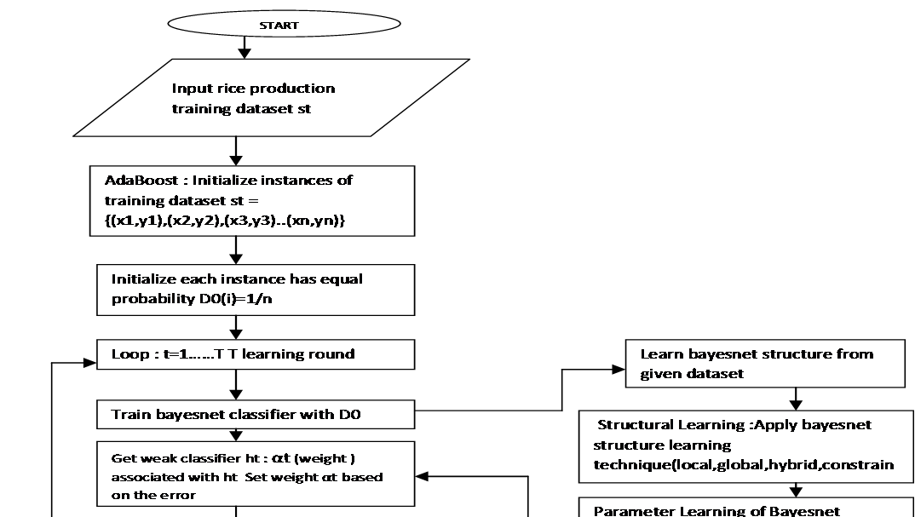

Slide 7
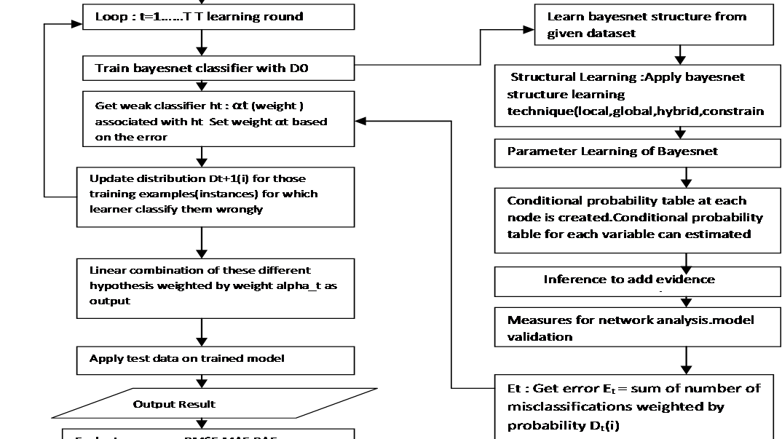

Slide 8
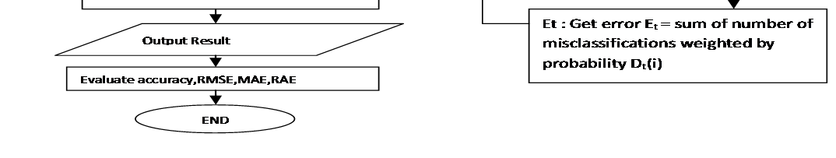

Slide 9

Proposed method steps
Given : (x1,y1),(x2,y2)….(xm,ym)
Initialize weights D₀(i)=1/m For t=1….T
Train bayesnet learner using distribution D_{t.}
Apply Bayesnet base learner,which return base classifier ht with low weighted error
Calculate
Where is misclassification error for the model.
D is weights of samples

Slide 10
Proposed method steps
y_{i} is actual output and is predicted output.
= 1 if i is misclassified and
= 0 if i is correctly classified.
Error equals the sum of the misclassification rate.

Slide 11

Proposed method steps
Set weight αt based on the error
α_{t} =
this strength α_{t} is used to decide weight of voting.

Slide 12
Proposed method steps
Update the distribution based on the performance
If i is misclassified then = -1 else if i is
classified correctly then = 1
z_{t} is normalization factor. z_{t} is choosen such that sum of probability is equal to 1.

Slide 13
Proposed method steps
Final classifier is linear combination of these different learning hypothesis.

Slide 14
Rice Crop Dataset Attributes
State name
District name
Area
Production
Precipitation(Rainfall)
Maximum Temperature
potential evapotranspiration

Slide 15
Rice Crop Dataset Attributes
vapour pressure
Minimum Temperature
Average Temperature
Reference Crop Evapotranspiration
Cloud cover
Diurnal temperature range
Yield
Class(low , high)

Slide 16
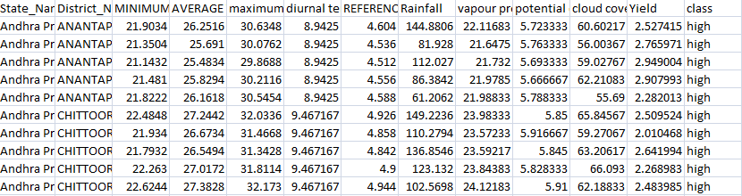
10 samples of dataset

Slide 17
Mathematical Terms and Formula
In this , there are 10 samples
D₁(i)=1/m
So D₁(i) = 1/10 = 0.1
D₁(1) = 0.1
D₁(2) = 0.1
D₁(3) = 0.1
D₁(4) = 0.1
D₁(5) = 0.1
D₁(6) = 0.1
D₁(7) = 0.1
D₁(8) = 0.1
D₁(9) = 0.1
D₁(10) = 0.1
So each samples have weight equal to 0.1

Slide 18
Mathematical Terms and formula
Now apply classifier bayesnet on weighted data :
Calculate

Slide 19
Mathematical terms
Where is misclassification error for the model.
D is weights of samples.
y_{i} is actual output and is predicted output.
= 1 if i is misclassified and
= 0 if i is correctly classified.
1,3,6,9 are misclassified

Slide 20
Mathematical terms
Set weight αt based on the error
αt =
where = 0.4

Slide 21
Mathematical terms
Update the distribution based on the performance
Z_{t} is normalization factor.
So D₂(1)= 0.1224745
0.1
0.20273255
-1
1

Slide 22
Mathematical terms
0.1
0.2027
1
1
So D₂(2) = 0.08164966

Slide 23
Mathematical terms
-1
0.1
1
0.2027
So D2(3) = 0.1224745

Slide 24
Mathematical terms
-1
-1
0.1
0.20273255
So D2(4) = 0.08164966

Slide 25
Mathematical terms
So in this way update distribution.

Slide 26
Zt is normalization factor

Slide 27
Mathematical terms
6 correctly classified,4 incorrectly classified.

Slide 28
According to this formula

Slide 29
Mathematical terms
So

Slide 30
Mathematical terms

Slide 31
Mathematical terms
Now again apply bayesnet classifier on weighted data :
2,4,5,7 are misclassified.

Slide 32
Mathematical terms
Set weight αt based on the error

Slide 33
Calculating z_{t}
Misclassified have probability 0.0833
Correctly classified having probability 0.125
Correctlyclassified having probability 0.0833

Slide 34
Mathematical terms

Slide 35
Mathematical terms

Slide 36
Weight comparision 2,4,5,7 instances are misclassified
No. | Distribution probability at t=1 | Distribution probability at t=2
1 | D₂(1) = 0.12 | D₃(1) = 0.09 (decrease)
2 | D₂(2) = 0.08 | D₃(2) = 0.12 (increase)
3 | D₂(3) = 0.12 | D₃(3) = 0.09 (decrease)
4 | D₂(4) = 0.08 | D₃(4) = 0.12 (increase)
5 | D₂(5) = 0.08 | D₃(5) = 0.12 (increase)
6 | D₂(6) = 0.12 | D₃(6) = 0.09 (decrease)
7 | D₂(7) = 0.08 | D₃(7) = 0.12 (increase)
8 | D₂(8) = 0.08 | D₃(8) = 0.06 (decrease)
9 | D₂(9) = 0.12 | D₃(9) = 0.09 (decrease)
10 | D₂(10) = 0.08 | D₃(10) = 0.06 (decrease)

Slide 37
Mathematical terms
On this updated distribution apply bayesnet classifier and calculate error.
Instances 2,3,4,5,7 are misclassified.

Slide 38
Output the final classifier
Final classifier is linear combination of these different learning hypothesis.
If the sum is positive, then the first class is predicted, if negative the second class is predicted.

Slide 39
Rice Crop Yield Prediction For most Rice Producing States
Andhra Pradesh
Bihar
Haryana
Punjab
Tamilnadu

Slide 40
Existing method
No. | Classifier | Classification accuracy
1 | Support Vector Machine | 88.0392
2 | Kstar | 66.6667
3 | KNN | 88.0392
4 | Bayesnet | 94.5098

Slide 41
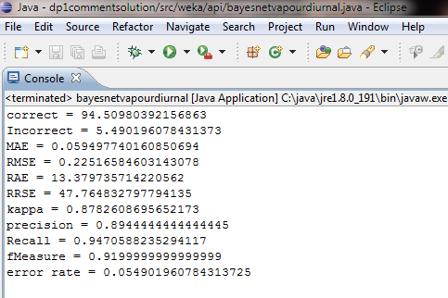
Existing method implementation figure 1.1: existing method output

Slide 42
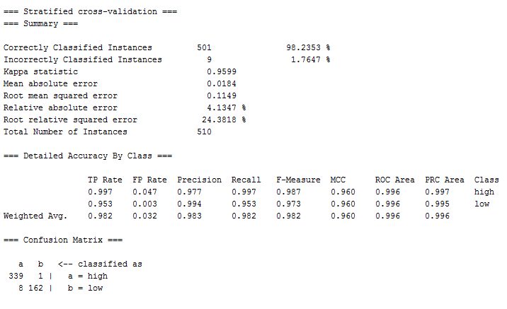
PROPOSED METHOD IMPLEMENTATION figure 1.2 : Proposed method output

Slide 43
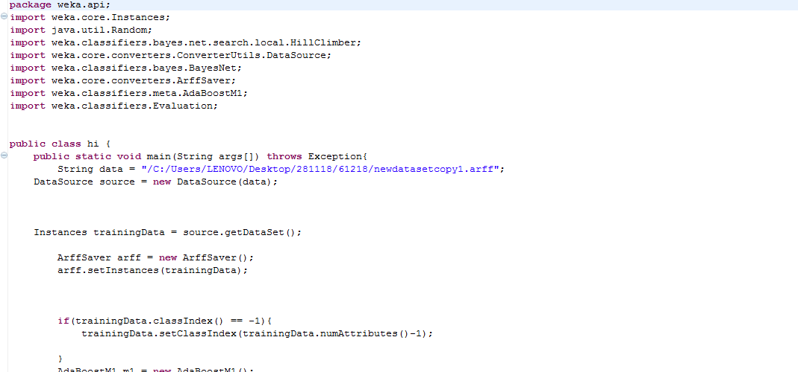
PROPOSED METHOD IMPLEMENTATION figure 1.3 : proposed method implementation

Slide 44
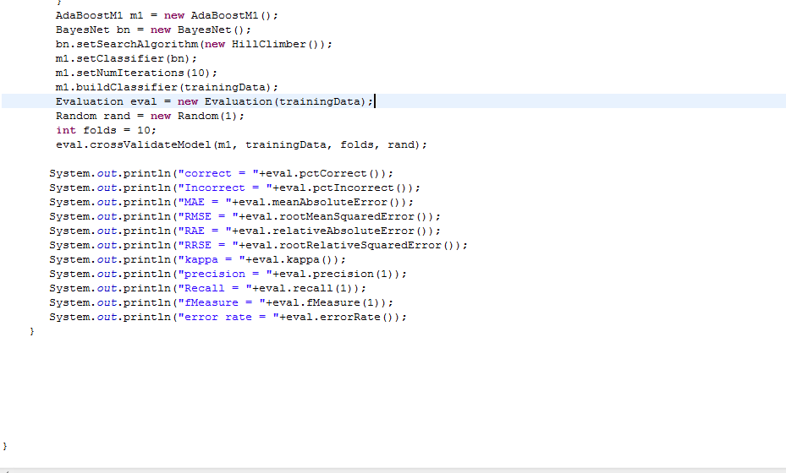
PROPOSED METHOD IMPLEMENTATION figure 1.4 : proposed method implementation

Slide 45
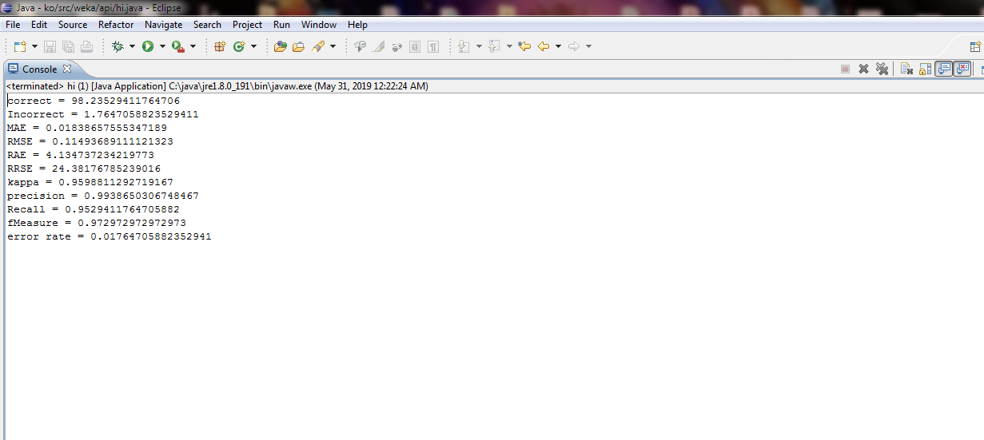
PROPOSED METHOD IMPLEMENTATION figure 1.5 : proposed method output

Slide 46
Accuracy Comparision Graph figure 1.6 : Accuracy Comparision Graph

Slide 47
Performance measure : Accuracy Comparision Table Table 1.1: accuracy comparision table
 | Existing Method | Proposed Method
Accuracy | 94.5098 | 98.2353

Slide 48
Root Mean Square Error comparision graph figure 1.7 : Root Mean Square Error comparision graph

Slide 49
Performance measure : Root Mean Square Error Comparision Table Table 1.2 : Root mean square error comparision table
 | Existing Method | Proposed Method
Root Mean Square Error | 0.2252 | 0.1149

Slide 50
Relative Absolute Error comparision graph figure 1.8 : Relative Absolute Error comparision graph

Slide 51
Performance measure : Relative Absolute Error comparision Table Table 1.3: Relative Absolute Error comparision table
 | Existing Method | Proposed Method
Relative Absolute Error | 13.3797 | 4.1347

Slide 52
Mean Absolute Error comparision graph figure 1.9 : Mean Absolute Error comparision graph

Slide 53
Performance measure : Mean Absolute Error comparision Table Table 1.4: Mean Absolute Error comparision Table
 | Existing Method | Proposed Method
Mean Absolute Error | 0.0595 | 0.0184

Slide 54
Rice Crop Parameters
State name
District name
Area
Production
Precipitation(Rainfall)
Maximum Temperature
Minimum Temperature
Average Temperature
Vapour pressure
Potential Evapotranspiration
Yield
Class(low , high)

Slide 55
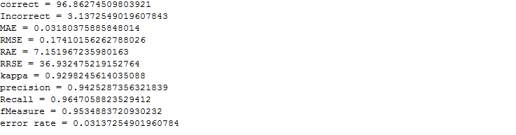
Rice Crop Parameters figure 1.10 : proposed method output

Slide 56
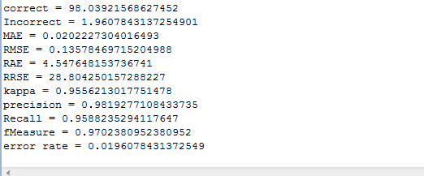
Add one more parameter(diurnal temperature range) in rice crop dataset figure 1.11 : proposed method output after adding diurnal temperature range parameter

Slide 57
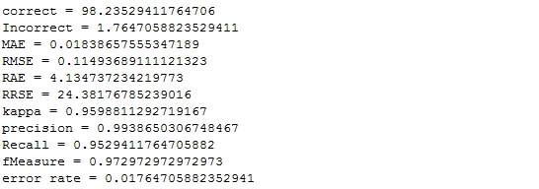
Add one more parameter (Reference crop evapotranspiration) in rice crop dataset figure 1. 12 : proposed method output after adding reference crop evapotranspiration parameter

Slide 58
Comparision table Table 1.5: comparision table
Performance measure | Proposed method output | Proposed method output after adding diurnal temperature range parameter | Proposed method output after adding One more parameter reference crop evapotranspiration
accuracy | 96.8627 | 98.0392 | 98.2353
MAE(Mean Absolute Error) | 0.0318 | 0.0202 | 0.0183
RMSE(Root Mean Square Error) | 0.1741 | 0.1357 | 0.1149
RAE(Relative Absolute Error) | 7.1519 | 4.5476 | 4.1347

Slide 59
State Wise Rice Crop Yield Prediction
State : Maharastra
Districts : Ahmednagar ,Amravati ,Aurangabad Beed/Bid Bhandara Bhandara ,Buldhana ,Chandrapur, Dhule ,Gadchiroli, Gondia ,Hingoli ,Jalana ,Jalgaon ,Kolhapur,Latur ,Nagpur ,Nanded ,Nasik,Osmanabad ,Parbhani ,Pune ,Sangli ,Satara Solapur,Wardha.

Slide 60
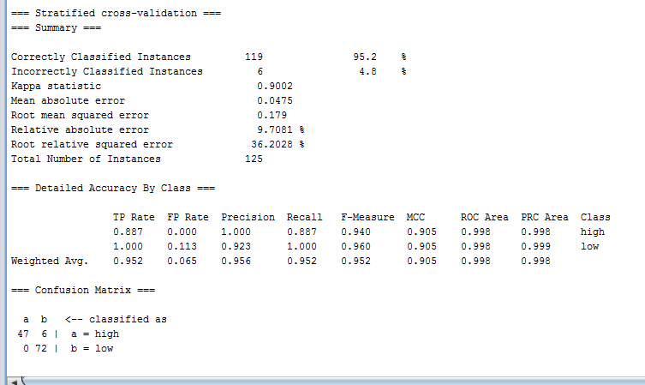
State Wise Rice Crop Yield Prediction using existing method

Slide 61
State Wise Rice Crop Yield Prediction using existing method
Accuracy = 95.2
Root Mean Square Error = 0.179
Relative Absolute Error = 9.7081
Mean Absolute Error = 0.0475

Slide 62
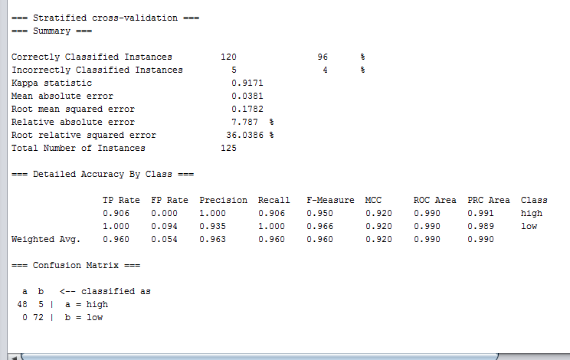
State Wise Rice Crop Yield Prediction using proposed method

Slide 63
State Wise Rice Crop Yield Prediction using proposed method
Accuracy = 96
Root Mean Square Error = 0.1782
Relative Absolute Error = 7.787
Mean Absolute Error = 0.0381

Slide 64
State Wise Rice Crop Yield Prediction accuracy,errors comparision table Table 1.6: Statewise rice crop yield prediction performance measure comparision table
Performance measure | Existing Method | Proposed Method
Accuracy | 95.2 | 96
Root Mean Square Error | 0.179 | 0.1782
Relative Absolute Error | 9.7081 | 7.787
Mean Absolute Error | 0.0475 | 0.0381

Slide 65
State Wise Rice Crop Yield Prediction accuracy,errors comparision graph figure 1.13: State Wise Rice Crop Yield Prediction accuracy,errors comparision graph

Slide 66
State Wise Rice Crop Yield Prediction accuracy,errors comparision graph figure 1.14: State Wise Rice Crop Yield Prediction accuracy,errors comparision graph

Slide 67
Performance Evaluation Metrics
Accuracy: It is defined as the overall success rate of the classifier[1].
Accuracy = (TP + TN) / (TP + FP + FN + TN)[1]
Where , True Positive (TP) depicts the number of instances where system detects for a condition when it is really present[1].
True Negative (TN) depicts the number of instances where system does not detect a condition when it is absent[1].
False Negative (FN) depicts the number of instances where system does not detect a condition when actually it is present[1].
False Positive (FP) depicts the number of instances where system detects a condition when it is really absent[1].

Slide 68
Performance Evaluation Metrics
RMSE(Root Mean Square Error): It is defined as the difference between the values predicted by the model and the actual values noted[1].
MAE(Mean Absolute Error): It is another factor in statistics which measures the difference between two continuous variables[1].
RAE(Relative Absolute Error): This measure gives the total absolute error between the variables[1].

Slide 69
conclusion
In rice crop yield prediction,various classification techniques are applied like bayesnet,support vector machine,naïve bayes,locally weighted learning etc.they all have some drawbacks like low accuracy and high classification errors like RMSE(Root Mean Square Error),MAE(Mean Absolute Error),RAE(Relative Absolute Error) on rice crop production datasets.To get more significant result and to get better classification accuracy,boosting technique Adaptive boosting technique is used with classification method bayesnet and that helps us to determine better accuracy of prediction of rice yield.

Slide 70
References
Shruti Mishra,Priyanka Paygude,Snehal Chaudhary,Sonali Idate"Use of Data Mining in Crop Yield Prediction", Proceedings of the Second International Conference on Inventive Systems and Control (ICISC 2018),pp. 796-802,2018
Umid Kumar Dey,Abdullah Hasan Masud,Mohammed Nazim Uddin,"Rice Yield Prediction Model Using Data Mining",International Conference on Electrical, Computer and Communication Engineering (ECCE),pp. 321-326,2017
Niketa Gandhi,Leisa J. Armstrong,Manisha Nandawadekar,"Application Of Data mining Techniques For Predicting Rice Crop Yield Semi-Arid Climate Zone Of India",2017 IEEE International Conference on Technological Innovations in ICT for agriculture and Rural Development,pp. 116-120,2017
Ayush Shah, Akash Dubey, Vishesh Hemnani, Divye Gala,D. R. Kalbande,"Smart Farming System: Crop Yield Prediction Using Regression Techniques",Proceedings of International Conference on Wireless Communication,pp. 49-56,2018
Niketa Gandhi, Leisa J. Armstrong, Owaiz Petkar, Amiya Kumar Tripathy,"Rice Crop Yield Prediction in India using Support Vector Machines",2016 International Joint Conference on Computer Science and Software Engineering (JCSSE)

Slide 71
References
Niketa Gandhi, Leisa J. Armstrong, Owaiz Petkar,"Predicting Rice Crop Yield Using Bayesian Networks",2016 Intl. Conference on Advances in Computing, Communications and Informatics (ICACCI),pp. 795-799,2016
Akter Hossain,Mohammed Nazim Uddin,Mohammad Arif Hossain,Yeong Min Jang,"Predicting Rice Yield For Bangladesh By Exploiting Weather Condition",2017 International Conference on Information and Communication Technology Convergence (ICTC),pp.589-594,2017
Niketa Gandhi, Owaiz Petkar, Leisa J. Armstrong,"Rice Crop Yield Prediction Using Artificial Neural Networks",2016 IEEE International Conference on Technological Innovations in ICT For Agriculture and Rural Development (TIAR 2016),pp.105-110,2016
Niketa Gandhi, Leisa J. Armstrong,"Applying Data Mining Techniques to Predict Yield Of Rice in Humid Subtropical Climatic Zone Of India",2016 International Conference on Computing for Sustainable Global Development,pp.1901-1906,2016

Slide 72
References
https://www.youtube.com/watch?v=PNglugooJUQ
Olugbenga Wilson Adejo,Thomas Connolly,"Predicting student academic performance using multi-model heterogeneous ensemble approach",Journal of Applied Research in Higher Education,Vol. 10 Issue: 1, pp.61-75
Sagar S. Nikam ,”A Comparative Study of Classification Techniques in Data Mining Algorithms”,ISSN April 2015.
Data Mining Algorithms: An Overview
Mrinal Pandey, S. Taruna,” A Comparative Study of Ensemble Methods for Students’ Performance Modeling”, International Journal of Computer Applications, Volume 103 – No.8, October 2014,pp.26-32.
https://www.youtube.com/watch?v=MRD67WgWonA
ADNAN MASOOD,"Bayesian Networks",A BRIEF INTRODUCTION

Slide 73
References
17. Friedman, N., Geiger, D. and Goldszmidt M. (1997),” Bayesian network classifiers”, Machine Learning 29, 139–164.
18. Castillo, G. (2006) ,”Adaptive Learning Algorithms for Bayesian Network Classifiers”, PhD Thesis, Chapter 3.
19. Bouckaert, R. (2007),” Bayesian Network Classifiers in Weka”,Technical Report
20. Heckerman, D. (1996),” A Tutorial on Learning with Bayesian Networks”, Microsoft Technical Report MSR-TR-95-06.
21. G. Cooper, E. Herskovits (1992),”A Bayesian method for the induction of probabilistic networks from data,”Machine Learning. 9(4):309-347.

Slide 74
References
22.Friedman, N., Geiger, D. and Goldszmidt M. (1997),” Bayesian network classifiers”, Machine Learning 29, 139–164.
23.Castillo, G. (2006) ,”Adaptive Learning Algorithms for Bayesian Network Classifiers”, PhD Thesis, Chapter 3.
24.Bouckaert, R. (2007),” Bayesian Network Classifiers in Weka”,Technical Report
25.Heckerman, D. (1996),” A Tutorial on Learning with Bayesian Networks”, Microsoft Technical Report MSR-TR-95-06.
26.https://en.wikipedia.org/wiki/Naive_Bayes_classifier

Slide 75
References
27.V. B. Nikam and B. B. Meshram, "Modeling Rainfall Prediction Using Data Mining Method: A Bayesian Approach", Fifth International Conference on Computational Intelligence, Modelling and Simulation, Seoul, 2013, pp. 132-136.
28.Niketa Gandhi, Leisa J. Armstrong, “Rice Crop Yield Forecasting of Tropical Wet and Dry Climatic Zone of India using data mining Techniques”, 2016 IEEE International Conference on Advances in Computer Applications (ICACA)
29.Rupanjali D. Baruah, R.M. Bhagat, Sudipta Roy, L.N. Sethi, ”Use of Data Mining Technique for Prediction of Tea Yield in the Face of Climate Change of Assam, India”, 2016 International Conference on Information Technology, pp. 265-269.
30. Robert E. Schapire,” Explaining AdaBoost”,pp. 1-16.

Slide 76
Thank
You

