Slide 1
Hackathon Project

Slide 2
PREPARED BY
N V HARINI - 899606
HALEEMA SADIYA - 899565
SUSHEEL SHARMA - 899596
NILOFER FATHIMA - 899547
V GEETHA NAGA SRIPRIYA - 899619

Slide 3
Roles & responsibilities
Members | Roles | Responsibilities
N V Harini | Team Lead | Components & PPT
Haleema Sadiya | Testing | Manual & Automation test cases
Nilofer Fathima | Automation | POM, POI, TestNG
Susheel Sharma | Automation | Maven & Jenkins
Geetha Naga Sripriya | Documentation | Reports & Documentation

Slide 4

Website used https://policybazaar.com/
Find Travel Insurance For Students
Find travel insurance plan for students, for 2 people (Age 22 & 21) & any European country, fill further dummy details & display three lowest international travel insurance plans with amount and insurance provider company
Get a Car Insurance quote, proceed without car number, keep filling details, give invalid email or phone number & capture the error message
Retrieve all Health Insurance menu items and store in a List; Display the same
Problem Statement

Slide 5
Implementation
Identified Scenarios for all three modules
Three modules includes travel insurance, car insurance and health insurance
Implemented automation using selenium
Added TestNG framework for each module and executed
Implemented code in the POM framework
Added html report to the POM model

Slide 6

Modules
Travel Insurance
Car Insurance
Health Insurance

Slide 7
Tools And Software Used:
Java (Language medium)
Eclipse IDE
Selenium Framework (Automation)
TestNG Framework
Maven Tool (Project build tool)
Apache POI (Data Driven framework)
Page Object Model (POM)
Extent HTML Report

Slide 8
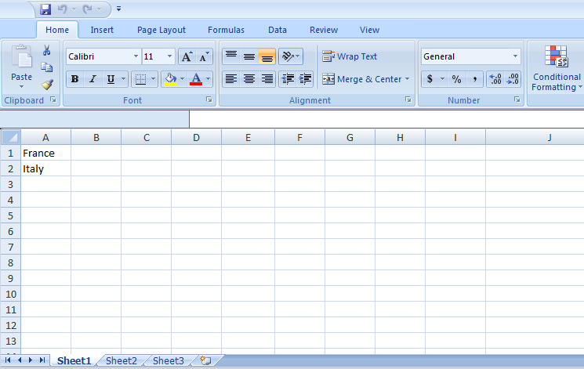
Input data from Excel file

Slide 9
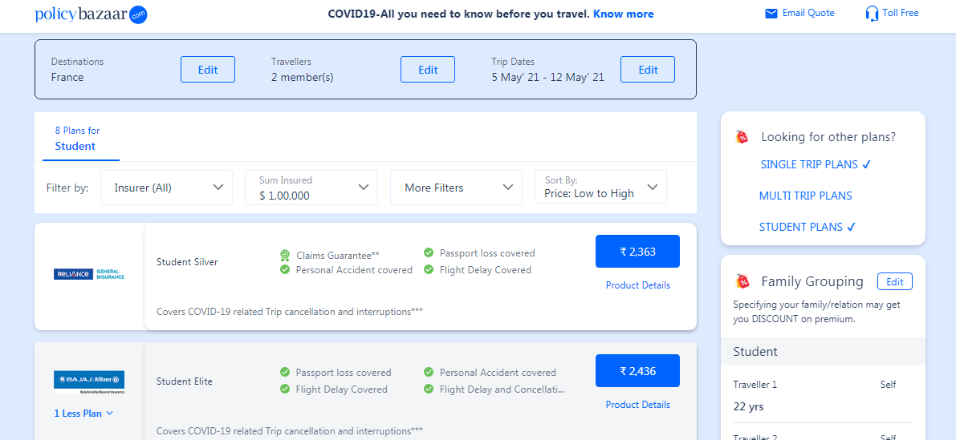
Output

Slide 10
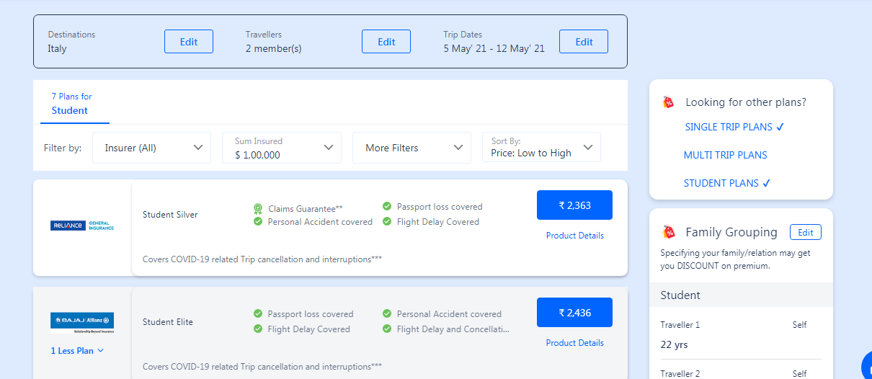

Slide 11
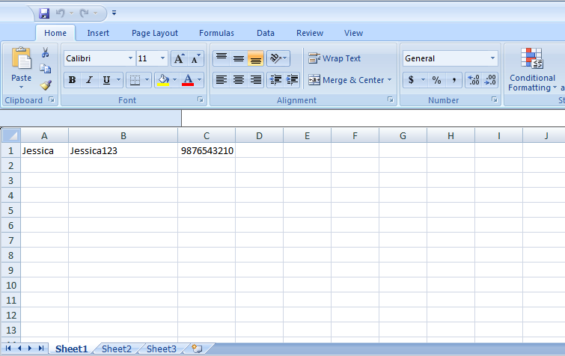
Input data from Excel file

Slide 12
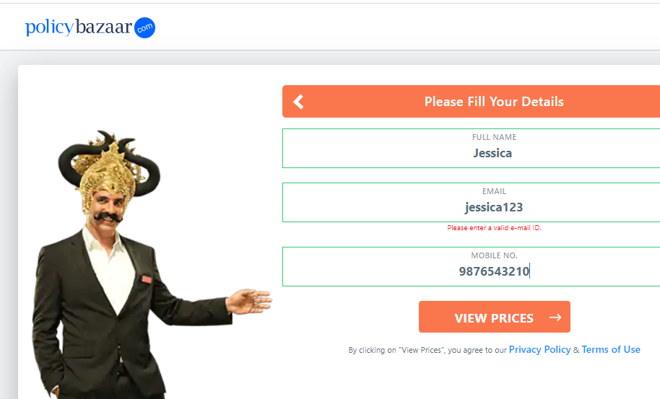

Slide 13
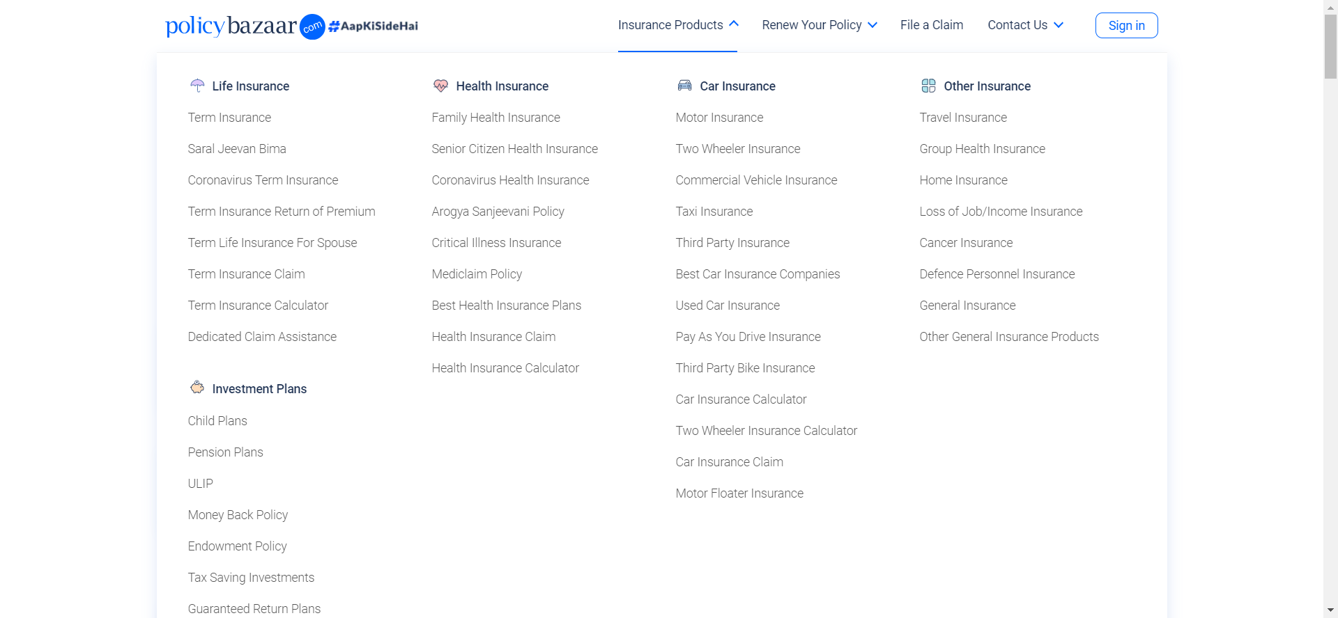

Slide 14
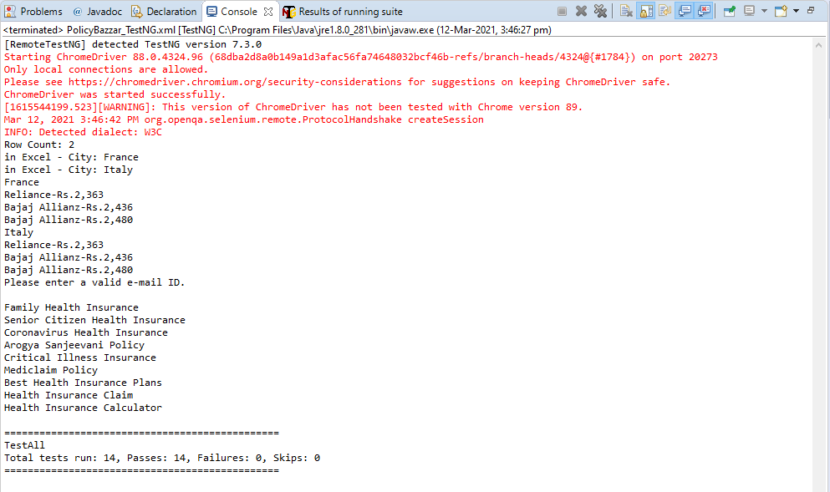
Console Output

Slide 15
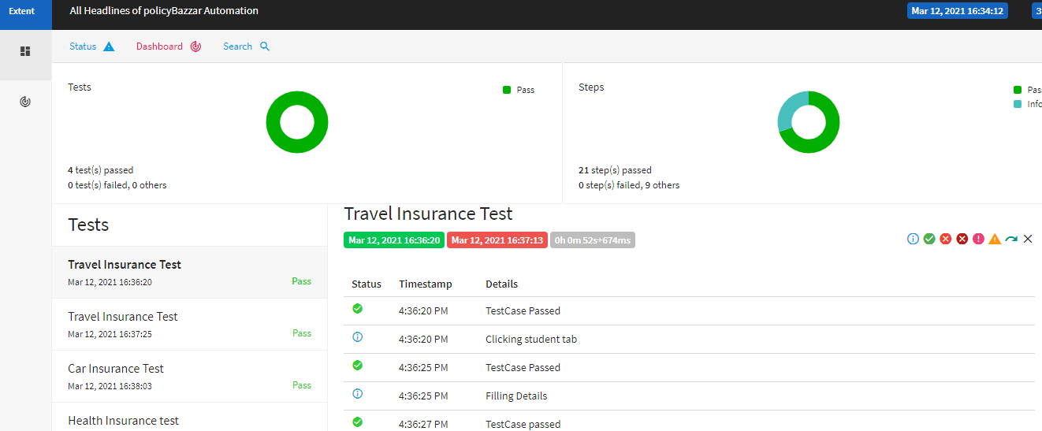
Extent report

Slide 16
Thank You

