Slide 1
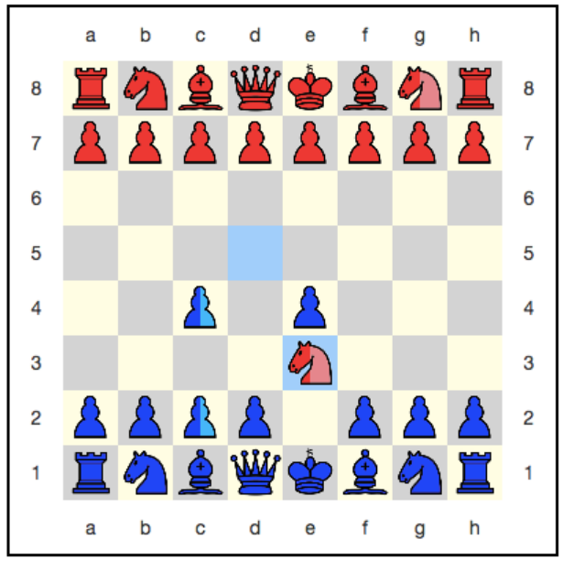
Quantum chess

Slide 2
Superposition
The main difference between quantum chess and normal chess is that in this the game is played between superposition of chess boards. So in quantum chess a peices cannot be at two different places at the same time but is present at one place only with a probability of 50%.
When superposition is created? - A peice can perform 2 type of moves :- 1) Normal move , 2) Quantum move
Normal move – Just a normal move by the peice . If the game is currently being superposed, then the move is made on all superposition boards . But it is not as simple as it looks .
Quantum move – With this you can enter a chessboard into a superposition . Make a move and stays in place . But when interaction will occur it will be decided which of the two parts of the superposition exists and which is not .
Note - In quantum chess there is no check mate but there is an option to surrender .
- Enemy figure cannot be eaten during a quantum move .

Slide 3
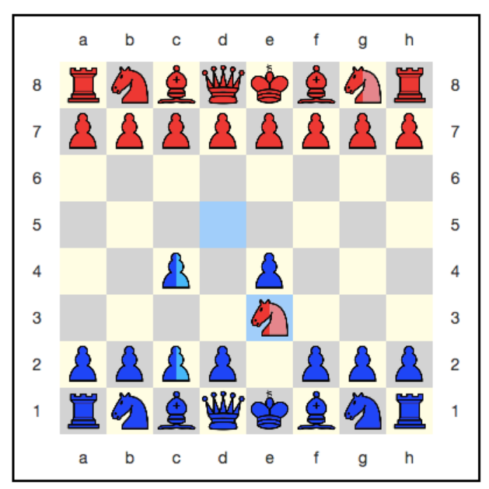
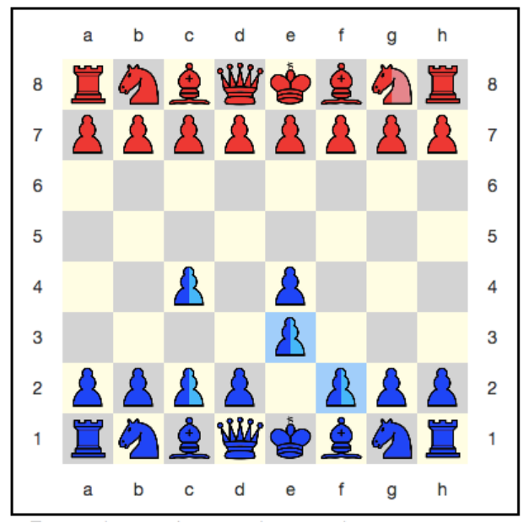
Dead or alive and Quantum immortality
After the pawn moves from f2 to e3 the red will lose half of their knight . On the board on which the red knight was on e3 , the pawn successfully ate it and moved to e3 . On the board, on which the knight was not there, the pawn could not make such a move, since she had nothing to eat. Therefore, it remained on f2 . Now the red horse is alive and dead at the same time .
Quantum immortality – As to win you need to eat the king there is no checkmate in quantum chess . There is a option to surrender because of quantum immortality . If in some case the king has no where to retreat then the player can use this . As the player can break up their king every move, and he will never be completely eaten .

Slide 4
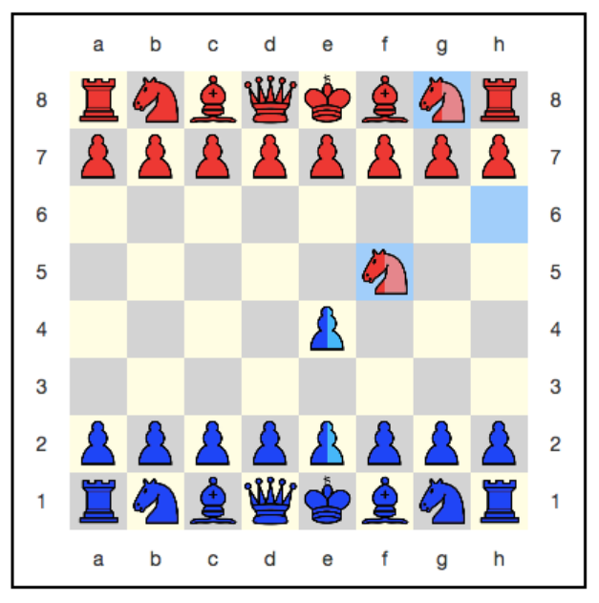
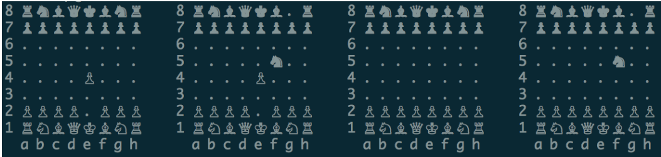
Collapse
If the blue pawn will move from e4 to f5 then -
To avoid common logical errors lets look at the complete chess engine .
The first and third boards do not conflict with anyone.
The second and fourth boards conflict with each other.
If horse dies then the fourth board is discarded, and the game continues on the superposition of boards with numbers 1, 2, 3 .
If the horse survived then the second board is discarded, and the game continues on the superposition of boards with numbers 1, 3, 4

Slide 5
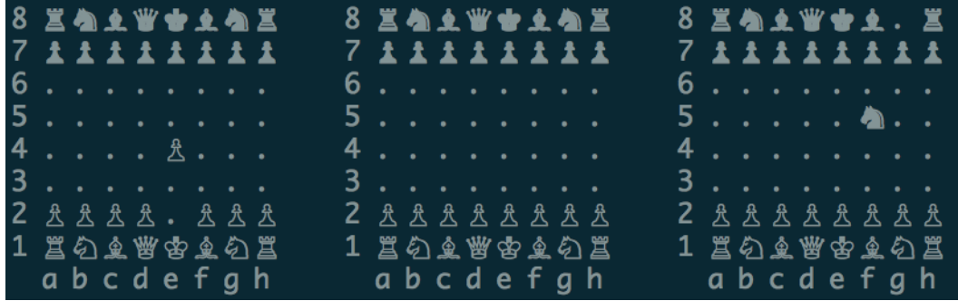
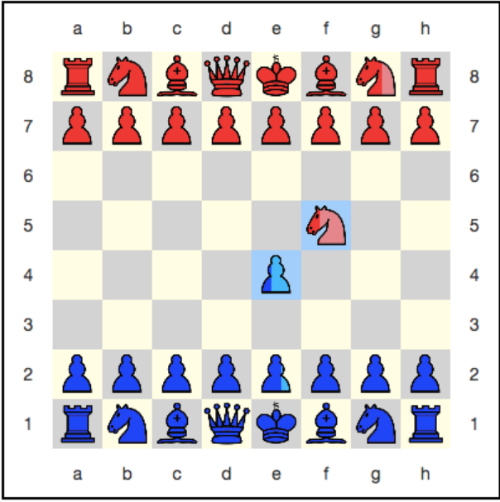
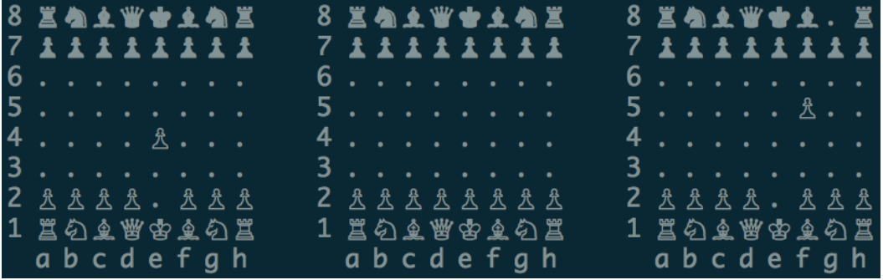
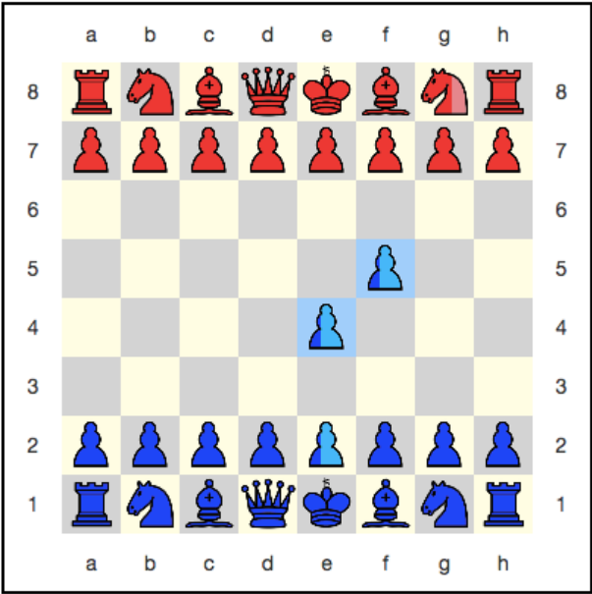
Collapse
Pawn – 2/3 prob at e2 and 1/3 prob at e4 . Earlier it was 50% at e2 .
Knight – The prob at f5 changed from 50% to 33.3% .
Pawn – Prob of 33.3% spread over e2,e4,f5 .
The horse is now in a superposition of the living and the dead, like Schrödinger's cat

Slide 6
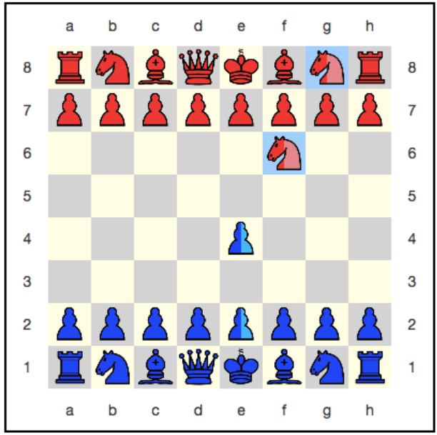
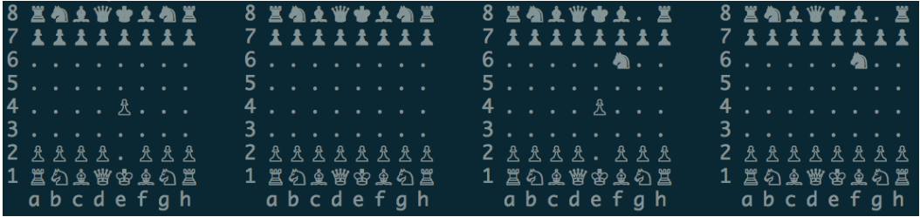
Entanglement in quantum chess
According to bohr we must make statements about the superposition of the particle + antiparticle system and not about superposition of its individual components
In order to translate the board into a state of chess entanglement, you need to pass one piece through another.
If the queen moves from d1 to f3 this is a normal move but is not possible on all 4 chess boards . Possible in board 1 and 3 .
In this case, the usual nonquantum move will introduce the blue queen into a superposition.

Slide 7
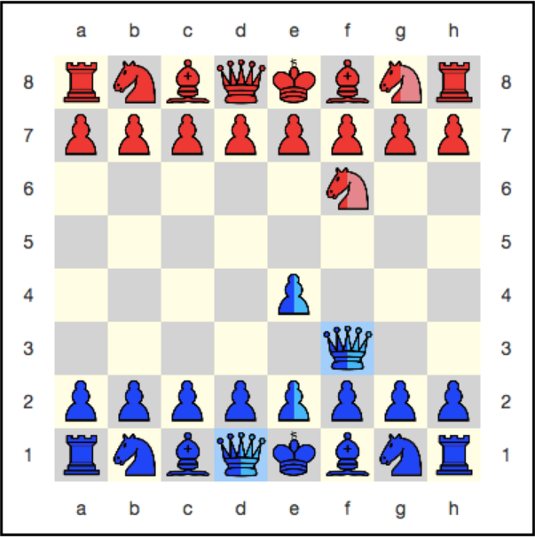
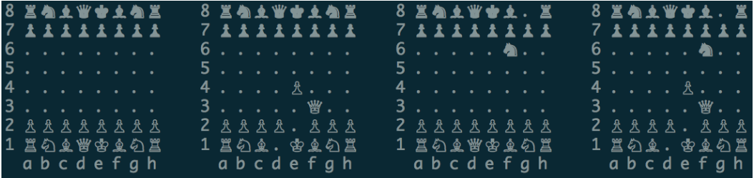
Entanglement in quantum chess
Queen – Probability of 50% spread over d1 and f3
Pawn – Probability of 50% spread over e2 and e4
But the point to be noted is that when the pawn is on e2 the queen is the queen is on d1 and if the pawn is on e4 the queen is on f3.
So the positions of the queen and the pawn are interconnected, similar to the particle and antiparticle impulses in the EPR paradox. The pawn and the queen are quantum entangled!
References - https://sudonull.com/post/20336-Quantum-Chess

Slide 8
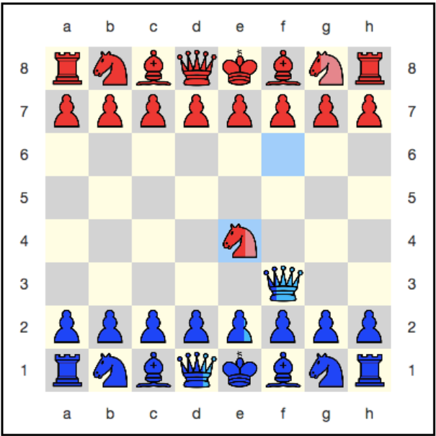
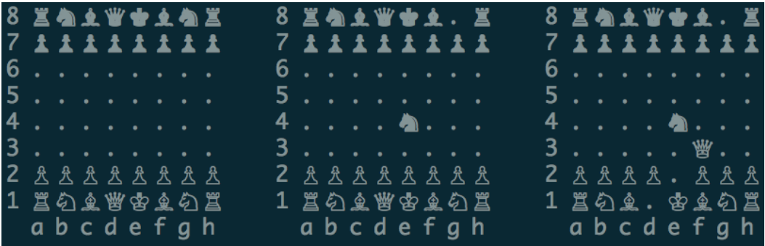
Use of Entanglement
Suppose the knight is moved from f6 to e4 then we assume the horse won and the chess engine will look like this .
And we can clearly see the probabilities of the pawn (66.7% at e2 and 33.3% eaten) instantly affected the probability of the queen.

