Slide 1

μChain

Slide 2
About μChain
μChain is a project being developed by 4 Informational Technology undergraduates from Manipal Institute Of Technology.
It revolves around implementing the idea of Electronic Health Records(EHR)using Blockchain and IPFS technology.
This eliminates the need for a 3rd party to have access to all your personal data and medical records and also provides with a single source of truth.

Slide 3
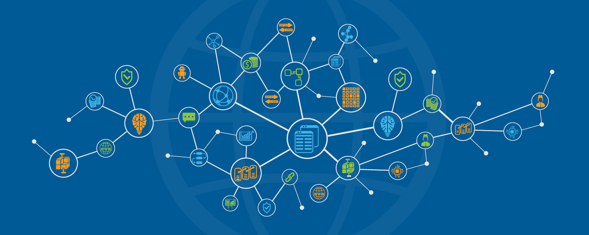
What is Blockchain?
Due to Bitcoin and other cryptocurrencies, many of you might have heard the term blockchain.

Slide 4
A blockchain is a continuously growing list of records, called blocks, which are linked and secured using cryptography.
By design, a blockchain is inherently resistant to modification of the data. It is “an open, distributed ledger that can record transactions between two parties efficiently and in a verifiable and permanent way”.”

Slide 5
Why Blockchain?
Electronic health records (EHRs) have been a long time coming, with blockchain touted as one of the technologies of promise, with a lot to offer in this field – specifically with relation to the minefield of issues relating to data privacy and patient autonomy.
Today, an individual patient’s medication data may exist in multiple systems – hospital EHRs, patient apps, pharmacies and so forth. Blockchain could allow these different entities to share and agree on a patient’s medication data, and subsequently allow for a “single source of truth.”

Slide 6
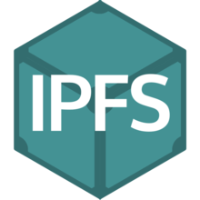
Why IPFS?
It is prohibitively expensive to store a lot of data on the Ethereum blockchain.
Thankfully, a solution to store data on decentralized network called the InterPlanetary File System (“IPFS”) is available. When looking up files in IPFS, you are asking the network to find nodes storing the content behind a unique hash.

Slide 7
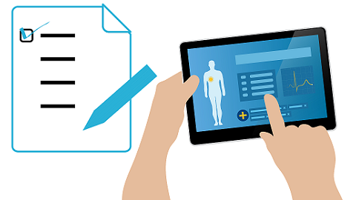
Our Work
We have used a combination of the two technologies to create a distributed ledger which stores the actual file on IPFS and its hash on the ethereum blockchain.
This timestamps and secures your content, without having to put the data on the chain itself.
This will make every record permanent, transferable and accessible which will prevent the medical records from being lost or modified.

Slide 8
Advantages
Complete decentralization of private data. Unhackable or breachable unlike the centralized server approach.
You can choose to sell your private data anonymously and make money instead of another 3rd company like Google or Facebook.
You decide what you share and with whom by setting up permissions.
All the medical data is stored under one roof and not distributed among different hospitals.
Ease of access.
Blendsin well with the Digital India Campaign.

Slide 9
Technicalities
We have used Solidity to write our smart contract on the Ethereum Blockchain.
The smart contract is responsible for setting up permissions for data access amongst doctors and patients.
We have used ipfs apis for storage.
We have also used React.js for linking up the work.

