Slide 1
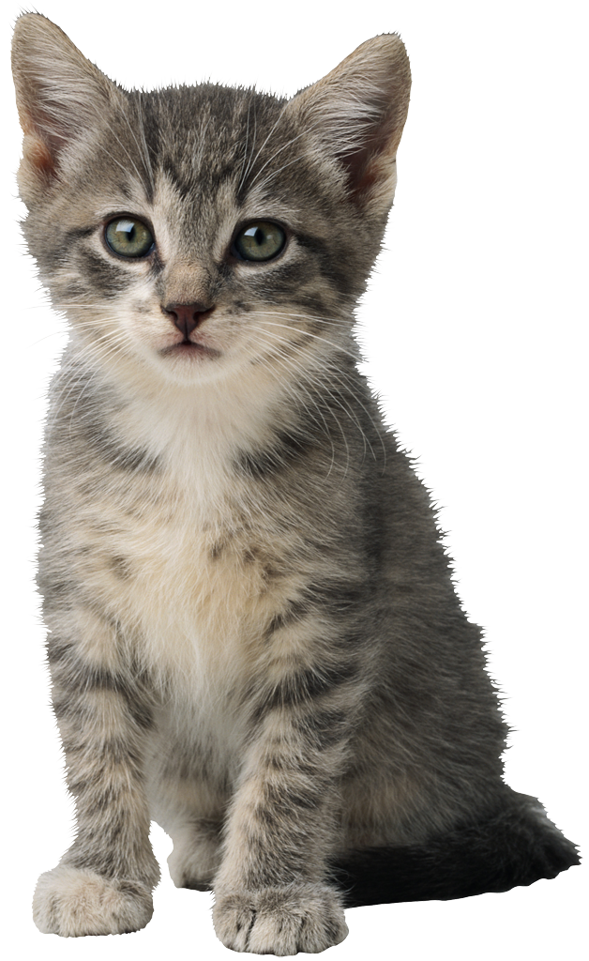
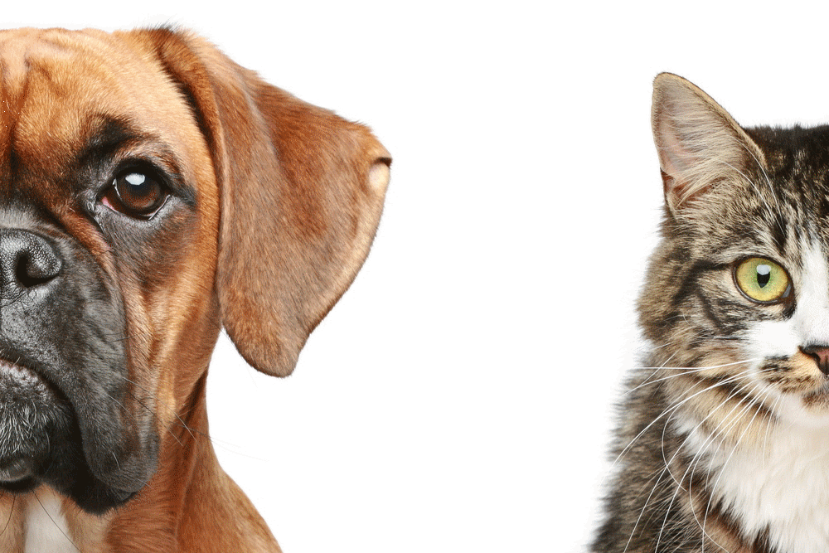
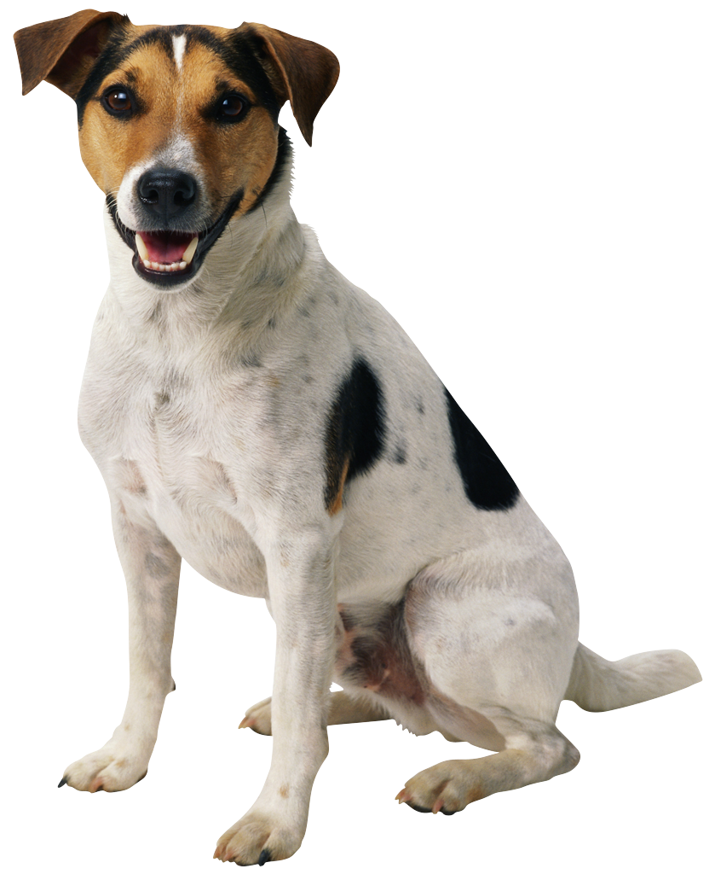
CATS? or DOGS?
Why not both?
HOME
ABOUT US
SIGN UP

Slide 2
ABOUT US
Are you an animal lover at heart? Do you have a cat, dog, or maybe even both? And do love sharing your pets with the world?
Well this is the place for you!
Catsordogs.html is the perfect place for all of you pet lovers out there who just cant stop posting pictures of those adorable little bundles of fur. Because let’s be honest, your Facebook friends probably love your pets, but after a certain point they will all start to get annoyed once you post the tenth picture of your cat in that adorable little hat. But not Here! This is exactly why we decided to create catsordogs.html! Here we love all your pet pictures no matter how many you share!
So join us today and add to the adorableness!
HOME
ABOUT US
SIGN UP

Slide 3
SIGN UP
username
password
confirm password
Already have an account?
LOG IN HERE
HOME
ABOUT US
SIGN UP

Slide 4
ITS TIME FOR YOU TO CHOOSE!
Cats!
Why not both?
Dogs!
HOME
ABOUT US
SIGN UP

