Slide 1
Bits

Slide 2

Notices
ASSIGNMENT 1 DUEE FRIDAY!!
  GET ON IT
Quiz DUE TOMORROW!

Slide 3
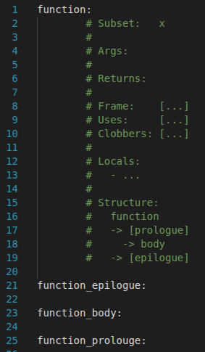
Asssignment
Frame: All registers placed on the stack ($s, $ra, $fp)
Uses: All registers used in function
Clobbers: All registers that lose their original value ($t, $a, $v)
Args: Names of function parameters
Locals: Names of local function variables and the register they are placed in
Structure: All labels defined in the function

Slide 4
Asssignment
Tips
Comment early, comment often
Count out stack registers before coding
Use constants (Note: dont go overboard)
Use line breaks to separate code blocks
Keep whitespace consistent
CONSISTENCY IS KEY

Slide 5
Base 10
Numbered 0 – 9
Easy for our brains to interpret
Inefficient method of storage computer data
Scientific Notation:

Slide 6

Base 2
Natural way computers store data
1 Byte = 8 bits
8 bits =
possible values
Base 2 | Base 10
0 | 0
1 | 1
10 | 2
11 | 3
100 | 4
... | ...
11111111 | 255

Slide 7

Base 2 → Base 10
Break down bit sequence into powers of 2
Mutiply bits by 2 to power of each position
Pos | 7 | 6 | 5 | 4 | 3 | 2 | 1 | 0
Bits | 1 | 0 | 0 | 0 | 1 | 1 | 0 | 1

Slide 8


Base 10 → Base 2
Power | Result
0 | 1
1 | 2
2 | 4
3 | 8
4 | 16
5 | 32
6 | 64
7 | 128
8 | 256
Break down the number into powers of 2
Iteratively find the highest power of 2 less than the result

Slide 9
Hex And Octal
Base 2
+Shows the values of individual bits
- Hard to interpret long sequences
Base 10
+ Easy to read and process
- Does not provide any sort of useful representation of the underlying bit sequence
Solution: Use Hexadecimal (Base 16) or Octal (Base 8)

Slide 10
Hex | Binary | Dec
0 | 0000 | 0
1 | 0001 | 1
2 | 0010 | 2
3 | 0011 | 3
4 | 0100 | 4
5 | 0101 | 5
6 | 0110 | 6
7 | 0111 | 7
8 | 1000 | 8
9 | 1001 | 9
A | 1010 | 10
B | 1011 | 11
C | 1100 | 12
D | 1101 | 13
E | 1110 | 14
F | 1111 | 15
Octal | Binary | Dec
0 | 0000 | 0
1 | 0001 | 1
2 | 0010 | 2
3 | 0011 | 3
4 | 0100 | 4
5 | 0101 | 5
6 | 0110 | 6
7 | 0111 | 7

Slide 11






Hex And Octal Conversions
Hex conversions: Split bit sequence into groups of 4
Octal Conversions: Split bit sequence into groups of 3
1
A
E
D
1
5
3
5
5

Slide 12



Hex And Octal Conversions | Q2
Break down the number into powers of 16/8
Iteratively find the highest power of 16/8 less than the result

Slide 13
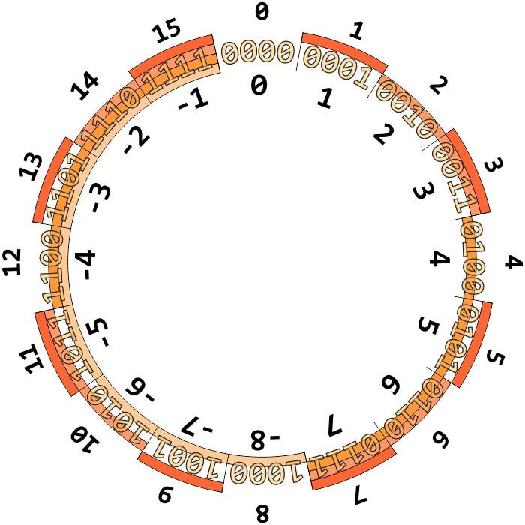
Integers | Q1
Signed integer types reserve half the encoding space for negative numbers

Slide 14
Bitwise Operations (OR)
OR
0 | 0 | 0
0 | 1 | 1
1 | 0 | 1
1 | 1 | 1
Outputs 1 when either or both inputs are 1
“Force bits to 1 when needed”
Symbol: |

Slide 15
Bitwise Operations (AND)
Outputs 1 only when both inputs are 1
“Keep relevant bits and discard others”
Symbol: &
Masking: To extract and process certain bits
Mask: A sequence of bits used to extract and process bits from the original sequence
AND
0 | 0 | 0
0 | 1 | 0
1 | 0 | 0
1 | 1 | 1
i.e. Extract the 4th and 8th bit from the following sequence
0001101101
Mask =
0010001000
&
0000001000

Slide 16
Bitwise Operations (XOR)
Outputs 1 only when both inputs are different
“Toggle specific bits”
Symbol: ^
XOR
0 | 0 | 0
0 | 1 | 1
1 | 0 | 1
1 | 1 | 0
i.e. Toggle the 4th and 8th bit from the following sequence
0001101101
int a = 10;
int b = 20;
a = a ^ b;
b = b ^ a;
a = a ^ b;
Mask =
0010001000
^
0010000000

Slide 17
Bitwise Operations (Shifting) | Q3 | Q4 | Q7 | Q8
Useful for moving bits into correct position in masks
In many scenarios it is inefficient/ineffective to type out masks bit for bit
i.e. Extract the 63rd and 64th bit in a bit sequence
Option 1: Type out two 1’s followed by 62 zeros
Option 2: Use bit shifting
WARNING:
Only apply shifting operations on unsigned variables in C
Signed variables react unpredictably to shifting operations
Mask =
11 << 63
1100000..000000
62 zeroes

