Slide 1
Floats & Negative Numbers

Slide 2

Notices
Quiz DUE TOMORROW!

Slide 3
Representing Negative Numbers
Sign Bit Representation
One’s Complement
Two’s Complement

Slide 4
Sign Bit Representation
Store integers normally
Use MSB to indicate sign
1 = positive | 0 = negative
i.e.
0101 = 5
1101 = -5
Simple implementation
Incompatible arithmetic operations:
0101 + 1101= 10010 (Not 0!!)

Slide 5
One’s Complement
Store positive integers normally
Negative integers represented as flipped sequence of bits for positive equivalent
i.e.
0101 = 5
1010 = -5
OneComplementSum(x, y):
return 1 + x + y
Compatible arithmetic operations
Two representations for 0
Nice Property: MSB will always indicate sign

Slide 6
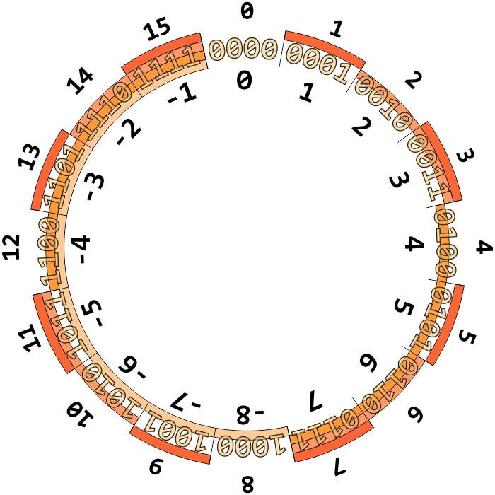
Two’s Complement
One’s complement but without the 2nd representation of 0
i.e.
0101 = 1 + 4 = 5
1101 = ?
Pos | 3 | 2 | 1 | 0
Bits | 1 | 1 | 0 | 1
$1\left(2^{0}\right)+0\left(2^{1}\right)+1\left(2^{2}\right)+1\left(−2^{3}\right)=1+4−8=−3$
Nice Property: MSB will always indicate sign
Completely Compatible arithmetic operations
Unique bit sequence for 0

Slide 7
Base 10 → Two’s Complement |Q4 | Q5 | Q6
If the number is positive [✔ ]
If the number is negative
  Find the positive representation
  Flip all bits to the left of the rightmost bit equal to 1
i.e. -6 in 8 bit two’s complement
6 = 0000 0110
-6 = 1111 1010
rightmost 1

Slide 8
Floating Point And Reals
An infinite number of real values
How to store all of them in a finite set of bits?
You can’t!

Slide 9
IEEE754
An establish standard on how to code decimal values into bits
Values rounded to the closest real number with a IEEE754 representation
  Limitations arise for precision and accuracy
Stores numbers in binary scientific notation
Introduces the concept of negative exponents

Slide 10
IEEE754
85.625
85
0.625
$1010101$
$1010$
Pos | 6 | 5 | 4 | 3 | 2 | 1 | 0 | -1 | -2 | -3 | -4
Bits | 1 | 0 | 1 | 0 | 1 | 0 | 1 | 1 | 0 | 1 | 0
$1010101.1010=1.0101011010∗2^{6}$
Exponent
Mantissa

Slide 11
IEEE754
IEEE754 Stores 3 things:
Sign
Mantissa
Biased Exponent = Exponent + 127
  Ensures stored exponent will always be positive
$1010101.1010=1.0101011010∗2^{6}$
Exponent
Mantissa
Why not just store the exponent in two’s complement?
Makes comparisons tricky
Faster to store exponent + bias
Sign = 0
Mantissa = 0101011010
Biased Exponent = 6 + 127 = 133 = 10000101
85.625 = 0010101101010000101
Not all numbers have an exact representation in IEEE754

Slide 12
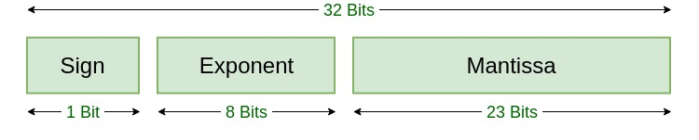
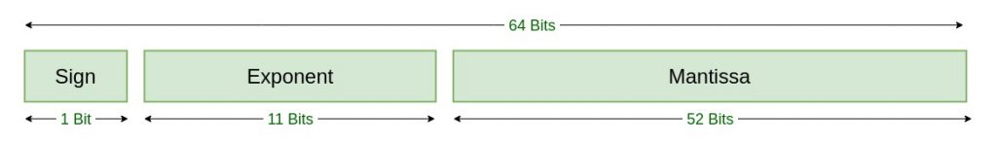
IEEE754

Slide 13
IEEE754 Special Values | Q1 | Q2
Value | Description | Single Precision Hex Value
0 | All 0’s | 0x00000000
Infinity | Exponent all 1’s. Mantissa all 0’s | 0x7F800000
-Infinity | Sign bit 1. Exponent all 1’s. Mantissa all 0’s | 0xFF800000
NAN | Exponent all 1’s. Mantissa not all 0’s | 0x7FC00000

Slide 14
Linux & C System Calls
Like assembly, we can make system calls in Linux
You’ve done this before! (stdio.h)
Older depreceated ways: libc, syscall

Slide 15
Streams
A stream is a flow of data you read from or write to, without worrying about where it actually comes from
Name | File Descriptor | Purpose
stdin | 0 | Input (keyboard and terminal)
stdout | 1 | Output (display, terminal)
stderr | 2 | Like stdout but only used to display error messages

Slide 16
libc Read & Write | Q3
Foundational system calls that read bytes and write bytes to and from a specific file descriptor

