Slide 1
More More MIPS

Slide 2

Notices
ASSIGNMENT 1 RELEASED!!
  DUE NEXT FRIDAY 6pm
Quiz DUE TOMORROW!

Slide 3
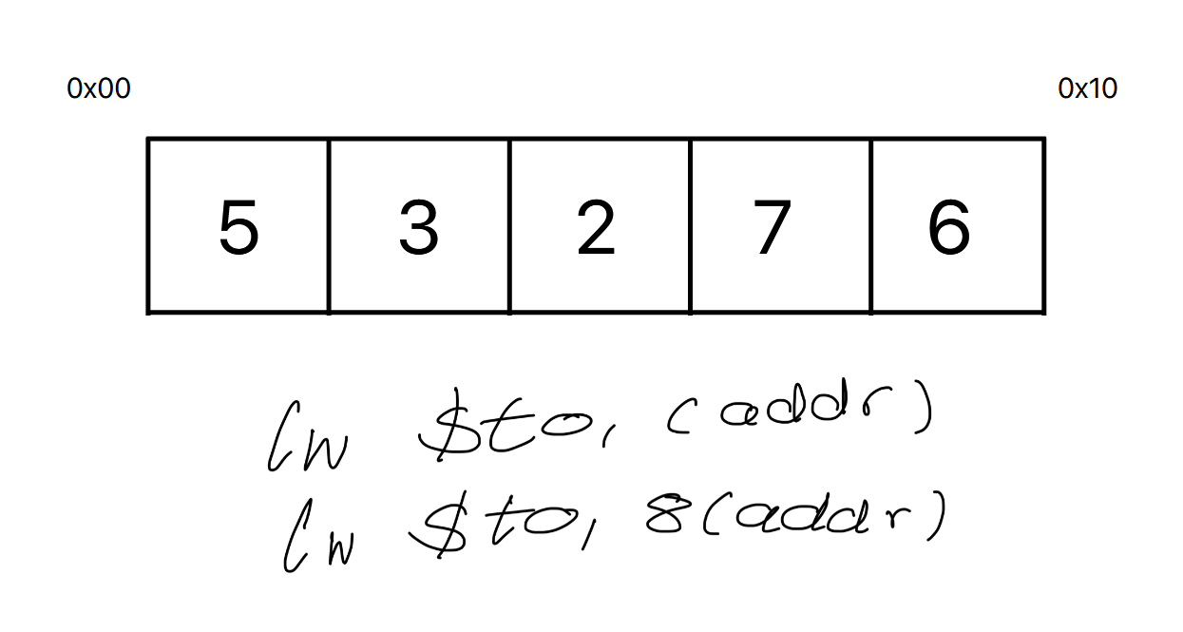

Arrays Recap
Offset
Beginning

Slide 4
2D Arrays
RAM is simply 1D array.
So, a 2D is “flattened” out in memory
1 | 2 | 3
4 | 5 | 6
7 | 8 | 9
1 | 2 | 3 | 4 | 5 | 6 | 7 | 8 | 9
lw and sw work identical in both 2D and 1D arrays
Address resolution equation is different

Slide 5
2D Memory Addresses | Q2 | Q5
5
&A[2][3]:
Offset?
13 elements
5 | 11 | 14 | 18 | 8
1 | 3 | 20 | 17 | 2
19 | 4 | 10 | 15 | 6
12 | 16 | 7 | 9 | 13
5 elements from row 0
5 elements from row 1
3 elements from row 2
2
i.e. 2 * 5 + 3
&A[2][3] = &A + 4 (5 * 2 + 3)
1
Or more generally:
3

Slide 6
Structs
Very similar to arrays
Store in .data
Determine the size of each field
Calculate any offsets
Store!
.data
sandwich:
.word 2 # bun size
.byte 1 # has meat?
.allign 2 # padding
.word 2 # patty size
.byte 'b', 'l', 't', '\0' # name
struct sandwich {
int bunSize;
bool hasMeat;
int pattySize;
char[4] sandwhichName;
}

Slide 7
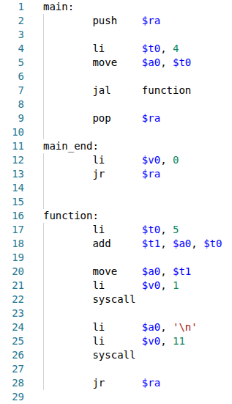
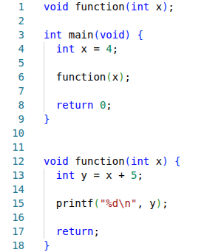
Functions
No prototyping in MIPS
jal instruction is equivalent to a function call
Function parameters placed in $a registers

Slide 8
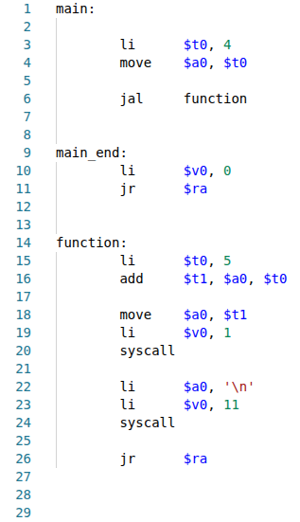


Issue 1: $ra
NON-TERMINATING PROGRAM!!!
SOLUTION: USE THE STACK!!!

Slide 9
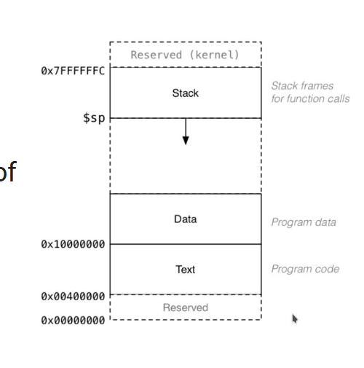


Push & Pop
Places the contents of register on stack. Decrements stack pointer by 4
Restores the value on the top of the stack to register. Increments stack pointer by 4
0. Any function that calls other functions must first place their $ra contents on the stack

Slide 10
Stacking $ra
Line 1: $ra = 0x12
Line 2: $ra = 0x12
Line 7: $ra = 0x34
Line 9: $ra = 0x12
Stack
0x12
Stack
0x34
Stack
Stack

Slide 11
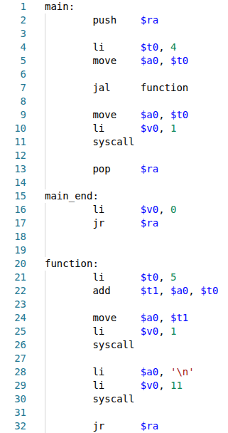
Issue 2: $t0
$t0 loses its original value
SOLUTION: USE push and pop!

Slide 12

$s Registers
1. Any function must use $s registers to store variables to be saved across function calls
2. Any function that wants to use make use of $s registers must first save them onto the stack

Slide 13
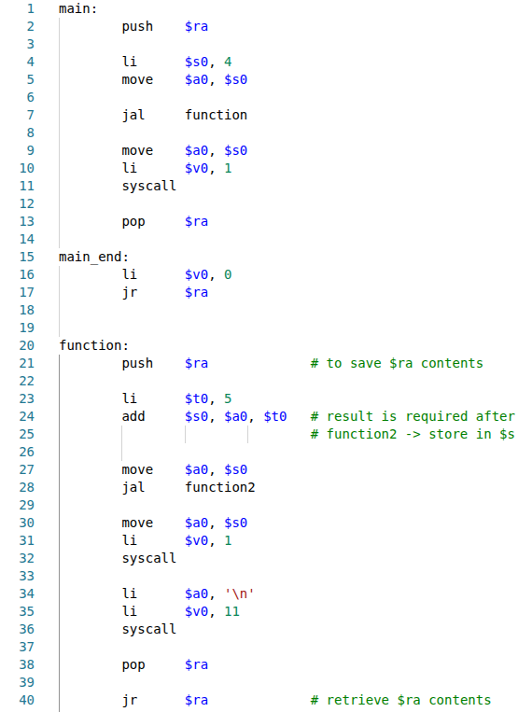
Issue 2.1: Clobbering $s registers
Update: function calls function2
Changes:
push & pop $ra in function
Use $s for important values
$s0 loses its original value
$s registers no longer guaranteed to save values
SOLUTION: USE THE STACK!!!

Slide 14
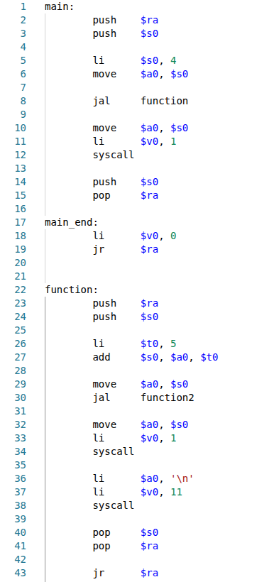
Issue 2.1: Clobbering $s registers
1. Any non-leaf function must use $s registers to store variables to be saved across function calls
2. $s Registers are guaranteed to retain initial values across function calls
3. To ensure rule 2, $s registers must:
  Be pushed to the stack before use
  Be popped offed the stack after use

Slide 15
Application Binary Interface
Register | Convention/Usage
$t | Used for normal operations
$s | Used for saved values
$a | Use as arguments for functions/syscalls
$v0 | Holds the return value of functions/syscalls
$ra | Holds return address for function/whole program

Slide 16
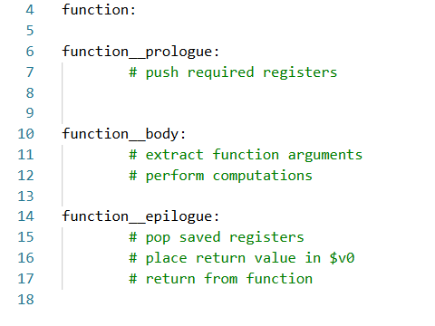
Function Structure

Slide 17
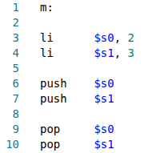
Push Pop Order | Q3 | Q6
Line 3 & 4:
  $s0 = 2
  $s1 = 3
Line 6:
  $s0 = 2
  $s1 = 3
Line 7:
  $s0 = 2
  $s1 = 3
Line 8:
  $s0 = 3
  $s1 = 3
Line 9:
  $s0 = 3
  $s1 = 2
Stack
2
Stack
3
2
Stack
2
Stack
4. Pop registers in the opposite order you push
Stack

