Slide 1
More Files, Directories & Text Encoding

Slide 2

Notices
ASSIGNMENT 2
  Due Friday W10
Quiz DUE TOMORROW!
myExperience out

Slide 3
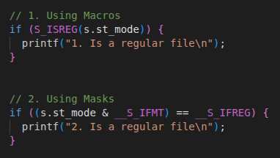
File Mode Q1 | Q2 | Q3 | Q4
Special
Group
Regular File
User Can Read/Write
Group ean Read
Others can Read
1000000110100100
File Type
User
Other
Check the file type using library macros or masks
__S_IFMT = 1111 000 000 000
__S_IFREG = 1000 000 000 000

Slide 4
chmod() | Q5
Updates the 16 mode bits for the provided file
Useful when changing file permissions (i.e. restircting user access to certain files)

Slide 5
ASCII
ASCII only encodes half the byte space (0 – 127)
Extended ASCII: Encodes the entire byte space (0 – 255)
  Added encodings for more control characters, and accented alphabetic characters

Slide 6
Unicode
~160,000 characters exist worldwide – languages, emojis, musical notation, mathematical symbols etc.
Unicode: A variable length encoding system for characters
Variable Length: Different characters require different number of bytes
Unicode defines 3 systems that can properly encode all characters:
  UTF-8: characters defined to be 8b, 16b or 32b
  UTF-16: characters defined tbe 16b or 32b
  UTF-32 : ALL characters are fixed 32b

Slide 7
UTF-8
UTF-8 is the most popular encoding system. Why?
Its the most space efficient
ASCII Compatible: All ASCII characters retain their regular encoding sequences
All other characters receive encodings that are 2-4 bytes long

Slide 8
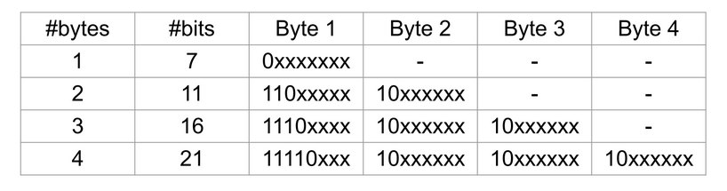
UTF-8 Encoding Scheme | Q7 | Q8

Slide 9
Directories | Q8
Like files, we can perform operations on directories
Function | Operation
opendir | Opens a directory
readdir | Reads next directory item
seekdir | Moves to a specific position in direcotry
telldir | Returns current position in directory
closedir | Closes directory

Slide 10
Environment Variables | Q9
Each running process has a set of variables available to it
C programs can access/set/update these variables

