Slide 1
MIPS

Slide 2

Census date next thursday!
Quizzes start next week
Help sessions start next week

Slide 3
Getting Started With MIPS(y)
A CPU type and associated assembly language
Executing MIPS programs:
    1521 mipsy [program_name] ← type into terminal
    mipsy web ← RECOMMENDED
Download VS code mipsy editor features extension

Slide 4
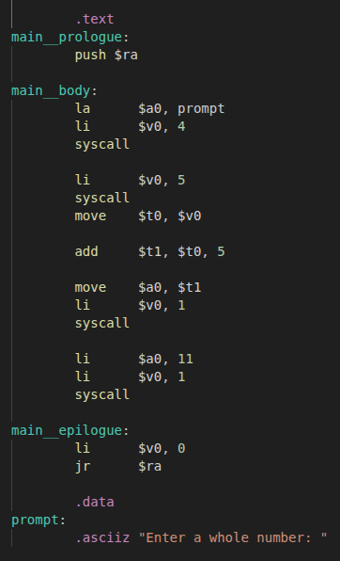
A Typical MIPS
Program
Labels
Registers
Directives
System calls
End of program

Slide 5
Registers | Q3
32 general purpose 32 bit registers from $0 - $31
Rules establish how certain registers should be used
# | Name | Notes
0 | zero | Always contains 0
1 | at | Reservered for assembler
2 | v0 | Reserved for expression evaluation and function results
3 | v1
4 | a0 | Reserved for arguments passed to functions and system calls
5 | a1
6 | a2
7 | a3
8 | t0 | Temporary storage
... | ...
15 | t7
# | Name | Notes
16 | s0 | Saved storage
... | ...
23 | s7
24 | t8 | More temporary storage
25 | t9
26 | k0 | Reserved for operating system
27 | k1
28 | gp | Global pointer
29 | sp | Stack pointer
30 | fp | Frame pointer
31 | ra | Return address
We’ll only be focusing on the 13 registers that are bolded for the next 2 weeks

Slide 6
System Calls
A call to the opearting system while a program is running to complete a special task:
  User input
  File operations (open, close, read, write)
  Printing values
Represented using the syscall instruction in MIPS

Slide 7
Directives
Changes how a program is handled by the assembler
Directive | Description
.text | The instructions under this directive are stored in the text section of memory
.data | The instructions under this directive are stored in the data section of memory
.ascii “string” | Stores the provided string without the null terminator in the next available section in data
.asciiz “string” | Stores the provided string with the null terminator in the next available section in data
We’ll look at more directives in the coming weeks

Slide 8
Labels
A name given to a location in the program
Useful for jumping to and from certain sections of code (loops, conditions)
Can be used to access memory in the data section

Slide 9

Terminating a MIPS program | Q4

Slide 10
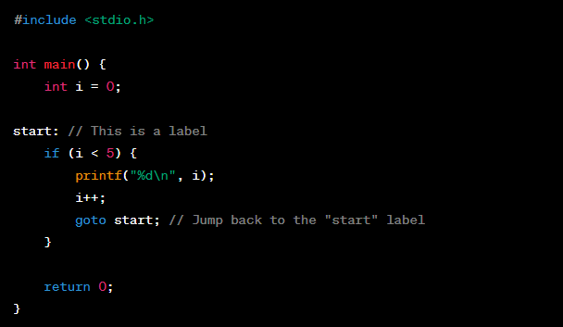
goto and Labels in C
Labels are not exclusive to MIPS/assembly code
Traditionally used with the goto to immediately jump to a section of code
No longer used (Link)

Slide 11
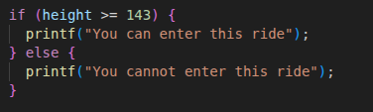
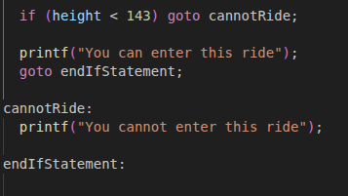
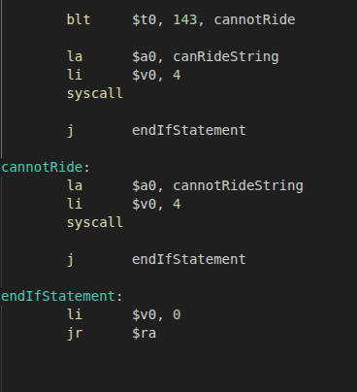
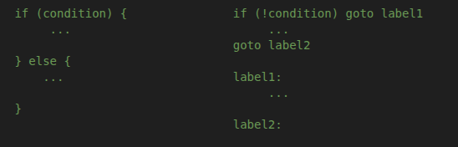
Conditional Statements & Jump Instructions | Q5 | Q6

Slide 12
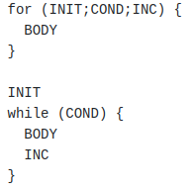
For Loops vs While Loops
FOR loops are more succinct WHILE loops (Packs intialisation and increment into the condition statement)
Any FOR loop can be rewritten as a WHILE loop:

Slide 13
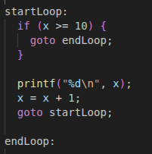

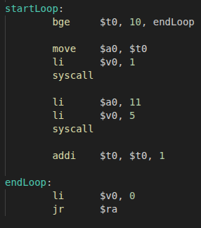
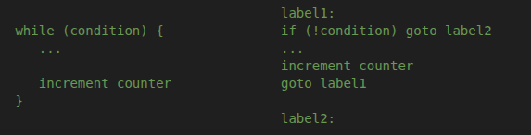
Loops In MIPS | Q7 | Q9

Slide 14

MIPS(y)
MIPSY Interactive (run 1521 mipsy in terminal)
MIPSY Web
Line by line debugging (Check out mipsy editor features)
Breakpoints (Check out mipsy editor features)
Printf debugging

