Slide 1
Processes & Threads

Slide 2

Notices
ASSIGNMENT 2
  Due on FRIDAY!
Quiz DUE TOMORROW + NEXT WEEK!

Slide 3
Processes
Any running instance of an executable program
E.g ls, ./hello_world, chrome, etc
A processes’s is defined by its
  Open file descriptors
  Current memory content
  Current CPU register values
  Arguments (Command Line Arguments)
  Environment
Each process has a unique ID (pid)
Each process has a parent process which created it
Each process can create children processes

Slide 4
Process Info
C Functions
  pid_t getpid()
  pid_t getppid()
Shell Commands
  ps
  w
  top
  kill

Slide 5

Scheduling Processes in C

Slide 6
Ending Processes in C | Q2
- Places current program on hold until child process finishes executing

Slide 7
Process Calling Structure In C
Declare environ
Set up args and pid buffer
Call posix_spawn (and check return value for errors)
Declare status variable
Call waitpid (and check return value for errors)
Check status to ensure child process executed correctly

Slide 8
Scheduling Processes in C
System() → Vulnerable to security exploits (Shell command injection)
Fork() + exec() (Inconvenient)
posix_spawn() (Modern standard)

Slide 9
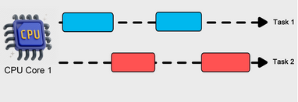
Scheduling & Multitasking
How much CPU time does a process get?
OS handles process scheduling for us
Allotted CPU time depends on:
  Process importance
  How many other processes are waiting
  The resources requested by the process
OS switches between processes for us

Slide 10
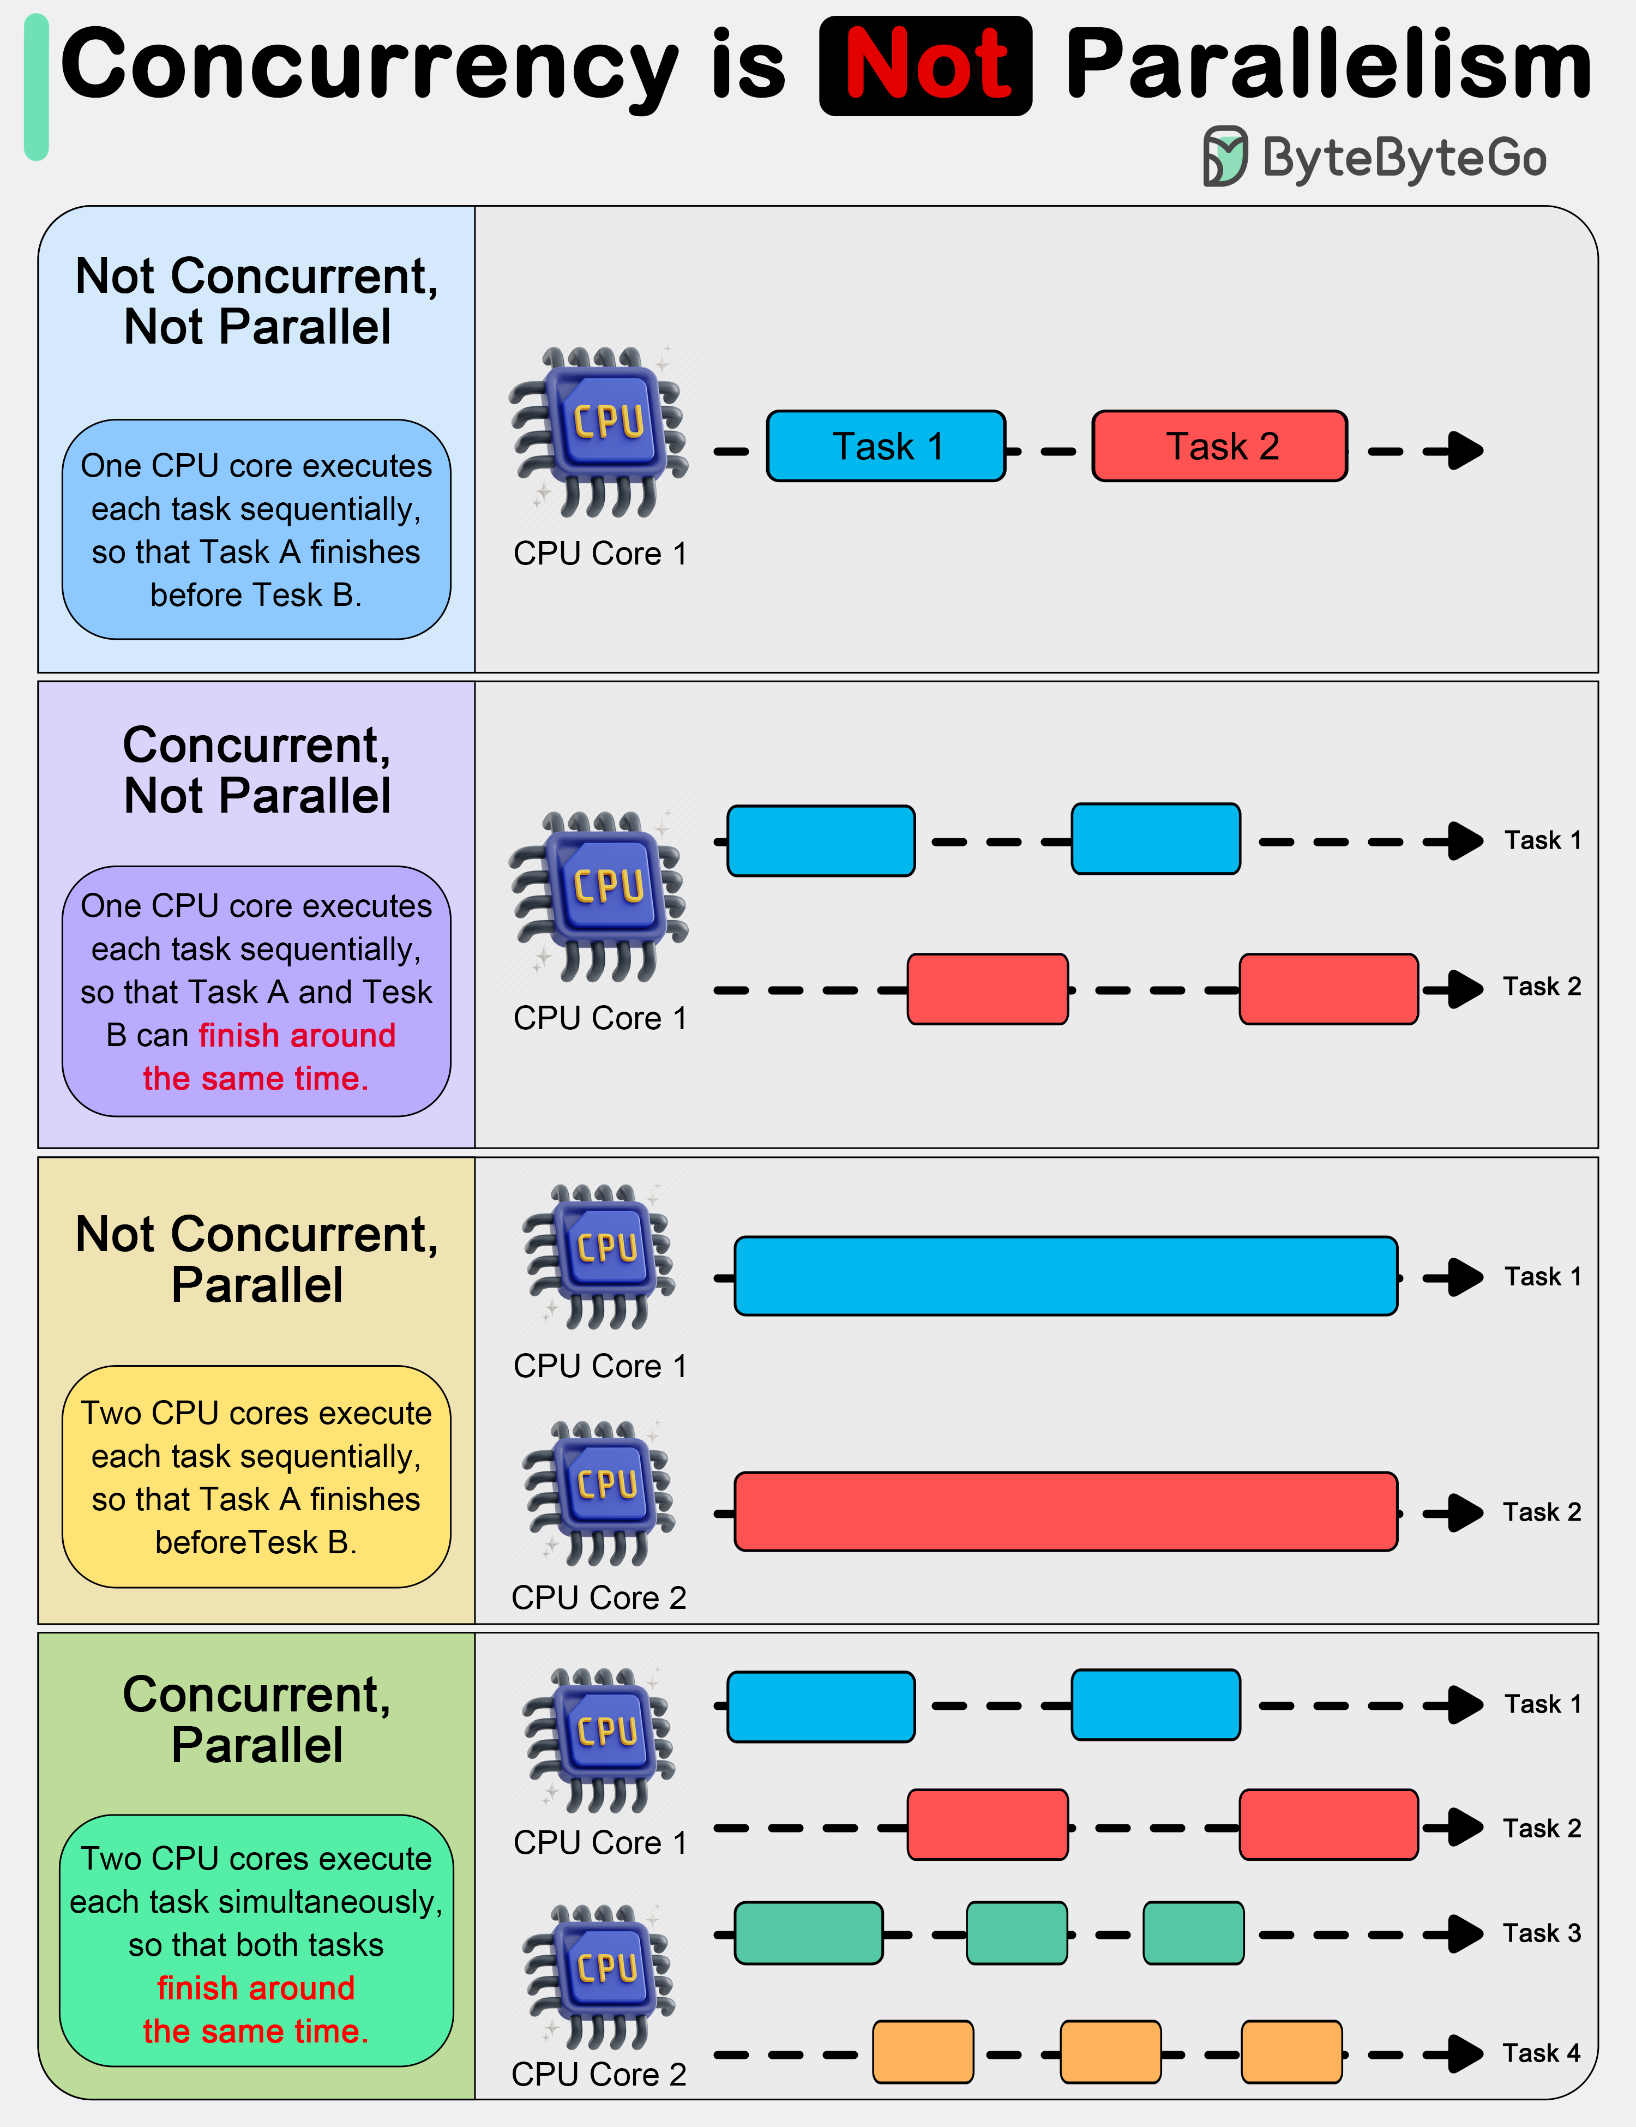
Q3 - Concurrency & Parallelism
Context Switch!

Slide 11
Sharing Information Between Processes
Sharing memory between 2 running processes is an intensive process
A communication relay has to be set up and mechanisms such as pipes, sockets and shared memory segments have to be established
Context switching is expensive!
Need a lightweight alternative to processes for scenarios where communication is required

Slide 12
Threads
A sequence of execution
Typically each process has only 1 thread
Multiple threads within the same process share:
  global variables
  heap space
  environment variables
  file descriptors
Threads do not share:
  Stack space (local variables)
  Register values

Slide 13
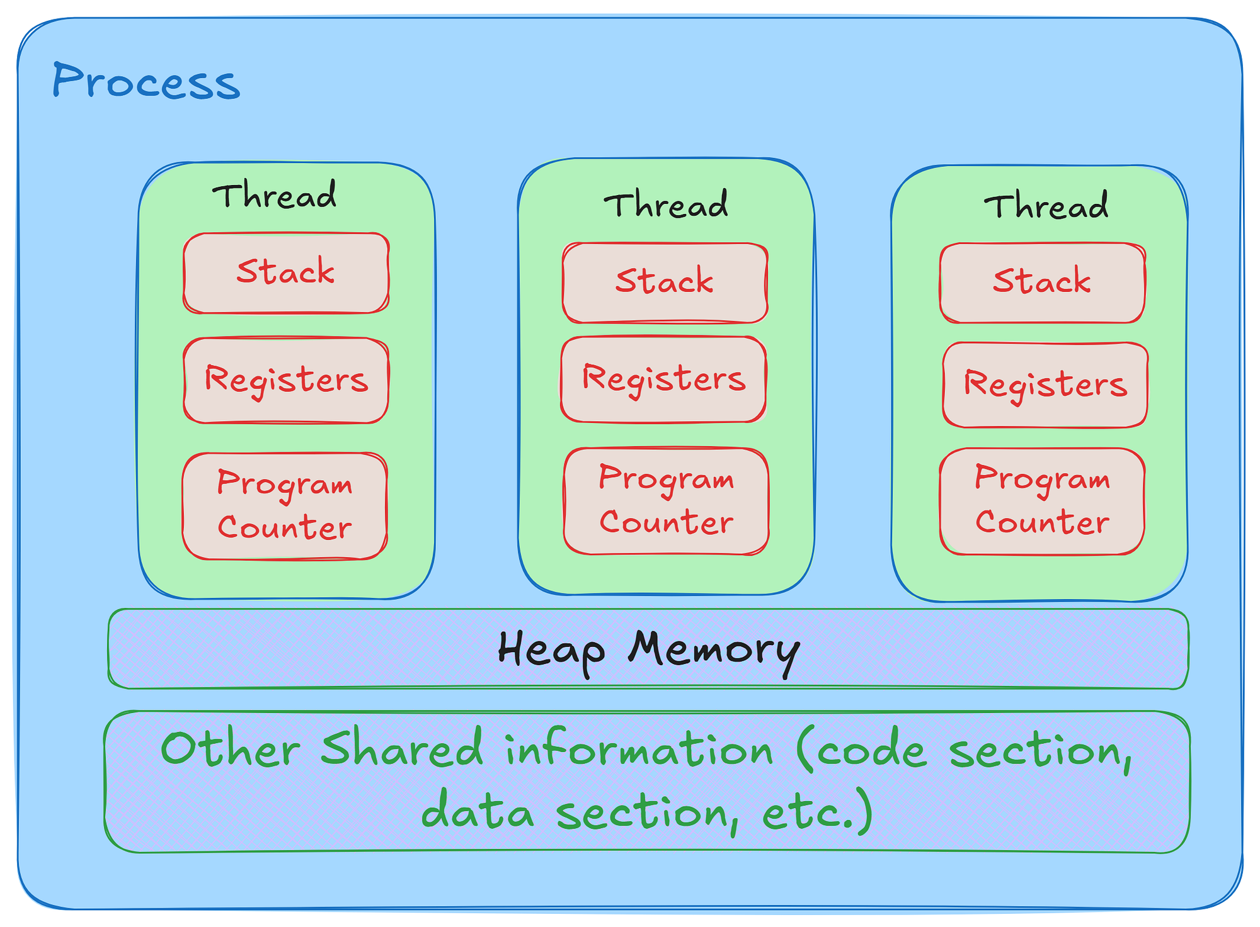
Threads

Slide 14
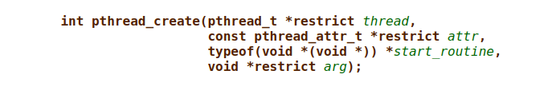
Threads
Concurrent function execution

Slide 15
Threads
Blocks until thread finishes executing

Slide 16
Threads
Close thread immediately

Slide 17
Q5 | Q6 | Q7
If main returns, all threads terminate

Slide 18
Threads And Synchronization
- Coordinating threads is especially tricky when multiple threads attempt to read and write to the same memory region

Slide 19
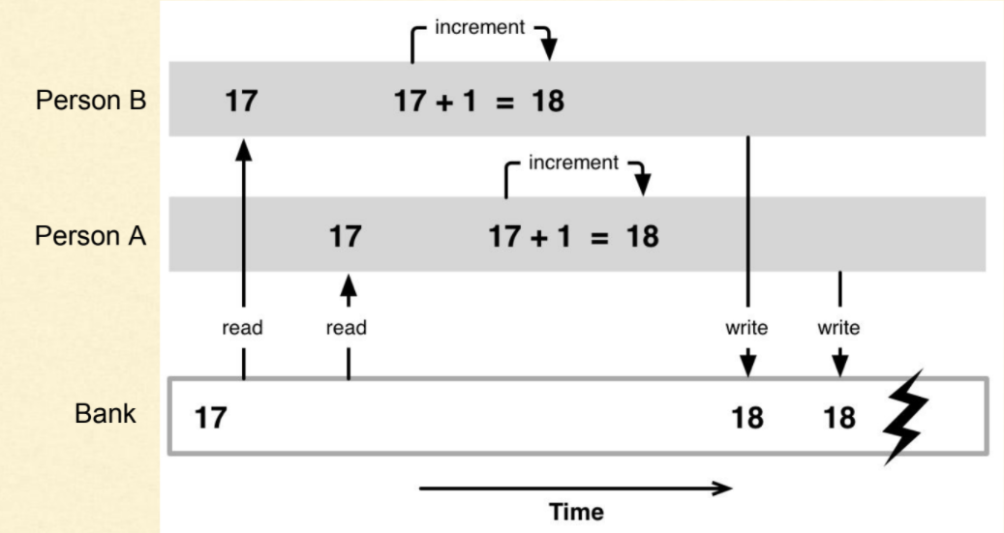
Race Conditions

Slide 20
Solutions | Q8 | Q9 | Q10
Mutex (Includes oveheads + undermines parallelism)
  We encounter deadlocks
Atomics
  Data types that have indivisible operations that are guaranteed to avoid race conditions

Slide 21
Exam Info
3 Hour exam
10 questions
For Cr/D aim to finish Q1-5 in 1.5 – 2h
Q1
Q2
Q3
Q4
Q5
Q6
Q7
Q8
Q9
Q10
Simple mips/ files / bitwise
1 UTF8 q
1-2 harder files q’s
1 hard MIPS q
1 processes q
1 threads q
Exam Prep:
  Revise Labs
  PRAC EXAMS

Slide 22
Where To From Here?
Like MIPS and low-level programming?
- COMP2121: Microprocessors & Interfacing
Want to learn more about the the terminal?
- COMP2041: Software Construction TOols
Interested in threads/file operations?
- COMP3231/COMP3891: Operating Systems
- COMP9242: Advanced Operating Systems
Wanna know how compilers work?
- COMP3131: Programming Languages & Compilers
How about a freebie?
- COMP3511 / COMP3411 / COMP4920
My personal recs (biased to low-level content)
COMP3891 – Extended Operating Systems
COMP3331 – Computer Networks
COMP9242 – Advanced Operating Systems
COMP3131 – Programming Languages & Compilers
COMP3222 – Digital Circuits & Systems
COMP6991 – Solving Modern Programming Problems With Rust

