Slide 1
MIPS

Slide 2
aNnOuNcEmEnTs

Slide 3
Memory Layout Of A C Program
The OS allocates each C program a block of memory:
[0x0000...]
[...0xFFFF]
Code
Data
Heap
Stack
Code | ro section where instructions are stored
Data | global variables, static variables
Heap | dynamic memory
Stack | local variables, function parameters, etc.

Slide 4
Q2/Q3/Q4/Q5/Q6

Slide 5
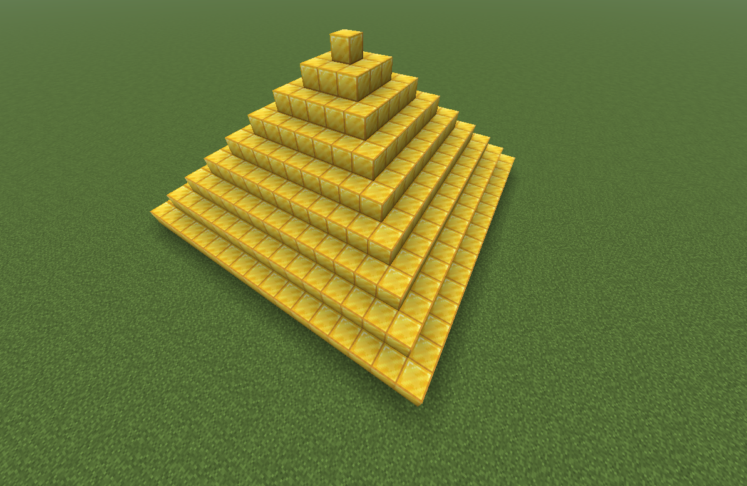
Recursion
Technical Definition: A method of solving a computational problem where the solution depends on solutions to smaller instances of the same problem
Practical Definition: An instance where a function makes a call to itself

Slide 6
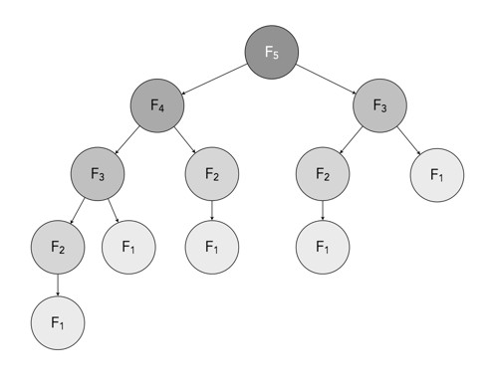

Recursion: Fibonacci
A sequence where each number is the sum of two proceeding numbers
Base Cases
$$F\left(n\right)= \left\{\begin{aligned}0 n=0, \\ 1 n=1, \\ F\left(n −1\right)+F\left(n −2\right) otherwise\end{aligned}\right.$$
Recursive Step
Determine base cases and recursive equation before coding up a solution!!!

Slide 7
Q7/Q8/Q9

Slide 8
The C Compilation process
C Source Code
Normal code (.c)
Pure C
Cleaner .c file (.i)
Assembly Code
Lower-level code (.s)
Object Code
Unlinked machine code (.o)
Machine Code
1s and 0s
(exe)

