Slide 1
A Look At C

Slide 2

C Revision + Recursion workshop Week 2 online – Details TBA soon

Slide 3
C Strings
String: A general name given to a null terminated sequence of characters
String Literal: Text delimted by double quotes
Character Array: A sequence of characters stored in an array

Slide 4
C Strings
Whats the difference between these variables?
char *s1 = “Hello”;
char s2[] = {‘H’, ‘e’, ‘l’, ‘l’, ‘o’, ‘\0’};
char s3[] = {‘H’, ‘e’, ‘l’, ‘l’, ‘o’};
char s4[] = “Hello”;

Slide 5
Memory Layout Of A C Program |Q2 |Q3 |Q4 |Q5 |Q6 | Q8 | Q9
The OS allocates each C program a block of memory:
[0x0000...]
[...0xFFFF]
Code
Data
Heap
Stack
Code | ro section where instructions are stored
Data | global variables, static variables
Heap | dynamic memory
Stack | local variables, function parameters, etc.

Slide 6
Recursion
Technical Definition: An instance when a functions value for a particular set of inputs depends on the functions output for simples inputs
Practical Definition: An instance where a function makes a call to itself

Slide 7

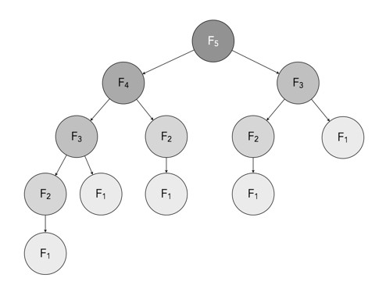
Recursion: Fibonacci | Q7 | Q8 | Q9
A sequence where each number is the sum of two proceeding numbers
0, 1, 1, 2, 3, 5, 8, 13, 21, 34,…
Base Cases
Recursive Step
Determine base cases and recursive equation before coding up a solution!!!

Slide 8
The C Compilation process
C Code
Normal code (.c)
Pure C
Cleaner .c file (.i)
Assembly Code
Lower-level code (.s)
Object Code
Unlinked machine code (.o)
Machine Code
1s and 0s
(exe)

