Slide 1
C Programming 4_bitwise_operations

Slide 2
Dec, Hex, Oct, Bin
char dec = 123;
char hex = 0x7b; // or 0x7B
char oct = 0173;
char bin = 0b1111011;
printf("%d == %d == %d == %d", dec, hex, oct, bin);
printf("%d == %x == %o == ?", dec, hex, oct);

Slide 3
Bitwise Operators
& | AND (И)
| | OR (ИЛИ)
>>, << | Shift (Сдвиг)
~ | NOT (Отрицание, НЕ)
^ | XOR (Искл. ИЛИ)

Slide 4
Bitwise Operations
a = 3, b = 7
a & b a | b
a ^ b ~a
a << 5 b >> 2

Slide 5
AND (И) &
a = 3, b = 7
a & b = 3
3 = 00000011
7 = 00000111
&= 00000011
a | b | &
0 | 0 | 0
0 | 1 | 0
1 | 0 | 0
1 | 1 | 1

Slide 6
OR (ИЛИ) |
a = 3, b = 7
a | b = 7
3 = 00000011
7 = 00000111
| = 00000111
a | b | |
0 | 0 | 0
0 | 1 | 1
1 | 0 | 1
1 | 1 | 1

Slide 7
XOR (Исключающее ИЛИ) ^
a = 3, b = 7
a ^ b = 4
3 = 00000011
7 = 00000111
| = 00000100
a | b | ^
0 | 0 | 0
0 | 1 | 1
1 | 0 | 1
1 | 1 | 0

Slide 8
NOT (Отрицание) ~
a = 3
~a = -4 (252)
3 = 00000011
~ = 11111100
a | ~
0 | 1
1 | 0

Slide 9
Shift (Сдвиг) >>, <<
a = 3
a << 2 = 12
a << 2 >> 3 = 1
3 = 00000011
<< 2= 00001100 = 12
>> 3= 00000001 = 1

Slide 10
Shift (Сдвиг) >>, <<
char a = 5;
char c = a >> 1; // = 2
>> 00000101
00000010
char a = 5;
char c = a << 1; // = 10
<< 00000101
00001010
char a = -5;
char c = a >> 1;// = -3;
>> 11111011
11111101
char a = -5;
char c = a << 1; // = -10
<< 11111011
11110110

Slide 11
Shift (Сдвиг) >>, <<
int a = 0xBAADF00D
(a >> 24) << 8 = ?

Slide 12
Shift (Сдвиг) >>, <<
int a = 0xBAADF00D
(a >> 24) << 8 = ? 0x000000BA
0x0000BA00

Slide 13
Shift and &
unsigned int a = 0x00C0FFEE;
unsigned char c;
c = (a & 0x000000FF); // тоже что и (a & 0xFF)
printf("first byte of a = %x\n", c); // c == 0xEE
c = ((a >> 8) & 0x000000FF);
printf("second byte of a = %x\n", c); // c == 0xFF

Slide 14
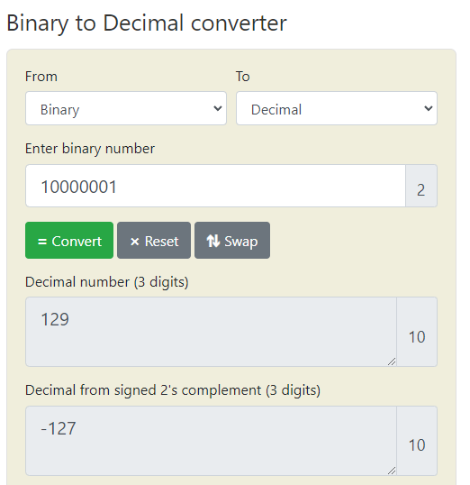
Signed and unsigned values
unsigned
signed

Slide 15
?
char a = 17, b = 6
a & b = ?
a | b = ?
a ^ b = ?
a << b = ?
~-5 = ?

Slide 16
Answer
char a = 17, b = 7
a & b = 1
a | b = 23
a ^ b = 22
a << b = 0
~-5 = 4

Slide 17
print binary
char dec = 123;
char hex = 0x7b; // or 0x7B
char oct = 0173;
char bin = 0b1111011;
printf("%d == %x == %o == ?", dec, hex, oct);

Slide 18
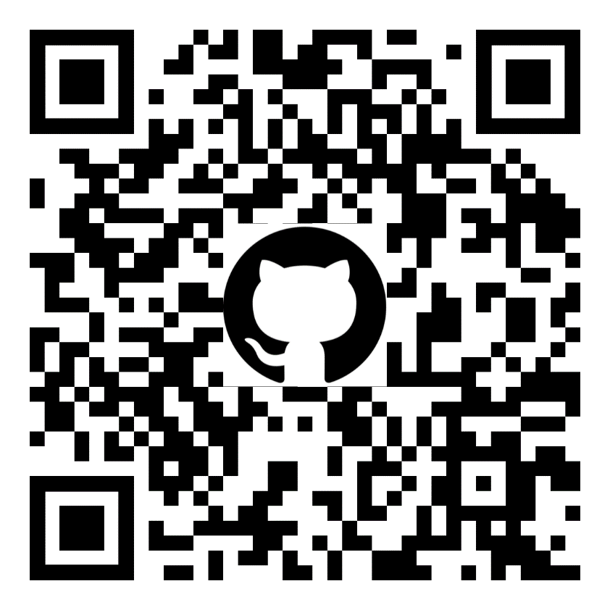
Github
https://github.com/kruffka/C-Programming

