Slide 1
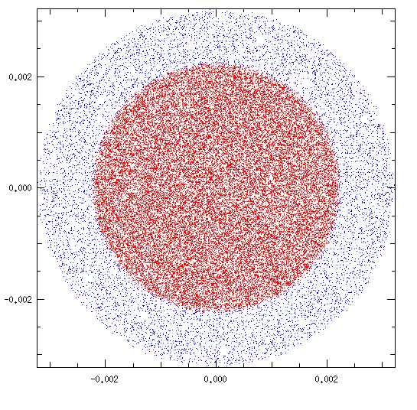



Beam core/halo
Nonlinear Field
β
Y [m]
s
$$\left[\begin{matrix}1 & 0 \\ −k & 1\end{matrix}\right]$$
$$\left[\begin{matrix}1 & 0 \\ −k & 1\end{matrix}\right]$$
$$\left[\begin{matrix}1 & 0 \\ −k & 1\end{matrix}\right]$$
axially-symmetric thin lens kick
X [m]

