Slide 1

Using Interpretive Structural Modeling to Identify and Quantify Interactive Risks
ASTIN 2007
Orlando, FL, USA
Rick Gorvett, FCAS, MAAA, ARM, FRM, PhD
  Director, Actuarial Science Program
  State Farm Companies Foundation Scholar in Act. Sci.
  University of Illinois at Urbana-Champaign
  Co-Author: Ningwei Liu, PhD
  Country Insurance & Financial Services

Slide 2
Concept
Using computer-assisted processes to better understand and visualize risk interrelationships
  Interpretive Structural Modeling
  Analytic Hierarchy Process
An additional question: What would be the most useful visualization framework with respect to risk interactions?

Slide 3
Interpretive Structural Modeling (ISM) Background
Malone, 1975:
ISM “is used here to refer to the systematic application of some elementary notions of graph theory in such a way that theoretical, conceptual, and computational leverage is exploited to efficiently construct a directed graph, or network representation, of the complex pattern of a contextual relationship among a set of elements.”

Slide 4
ISM Background (cont.)
Management and interpretation of input from individuals or groups
Computer-assisted learning process
Group members consider “priorities” between pairs of items
Network analysis / graph theory
Better understanding of direct and indirect relationships among a system’s components

Slide 5
ISM Background (cont.)
Literature:
  Warfield, John, 1976, Societal Systems: Planning, Policy and Complexity, John Wiley
  Warfield, John, 1973, “An Assault on Complexity,” Battelle Monograph 3
  Warfield, John, 1974, “Structuring Complex Systems,” Battelle Monograph 4
  Malone, David, 1975, “An Introduction to the Application of Interpretive Structural Modeling,” Proceedings of the IEEE, 63(3)

Slide 6
ISM Background (cont.)
Directed graph (“digraph”)
  Example:
1
2
3
4

Slide 7
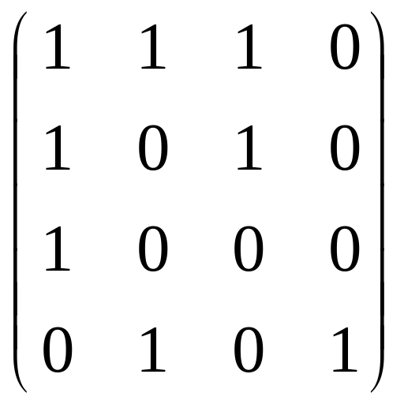
ISM Background (cont.)
Binary matrix representation (“adjacency matrix”): can we go from one node to another in one step?
Ending Node:
1
2
3
4
1
2
Starting Node:
3
4

Slide 8
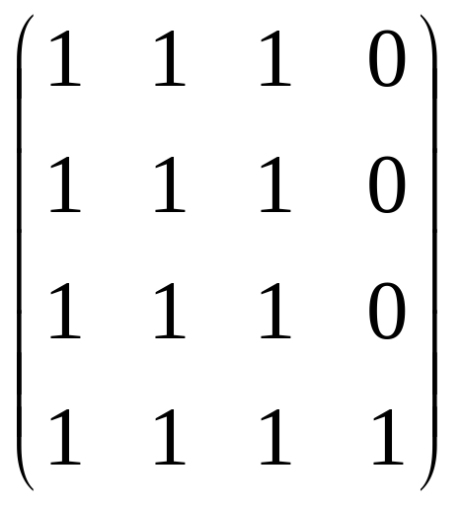
ISM Background (cont.)
Connections between elements (“reachability matrix”): can we go from one node to another in any number of steps?
Ending Node:
1
2
3
4
1
2
Starting Node:
3
4

Slide 9
ISM Background (cont.)
Restructured hierarchical digraph
  Example:
1
2
3
4

Slide 10
ISM Procedure – Steps Associated with ERM Application
Organize an ISM implementation group
Identify and select the relevant risks to which the firm is subject
- Risks = elements of the system
Determine the adjacent matrix of directed relationships
Determine the reachability matrix
Decompose the risks hierarchically

Slide 11
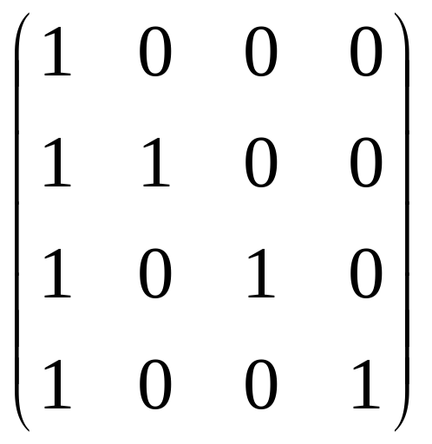
ISM Application: Risk Example # 1
Suppose personal auto riskiness (R₁) is a function of three factors(R₂, R₃, and R₄ )
  R₁ = risk or cost of auto exposure (ultimate parameter of the system)
  R₂ = age
  R₃ = gender
  R₄ = location
1
2
3
4
1
2
Reachability Matrix:
3
4

Slide 12
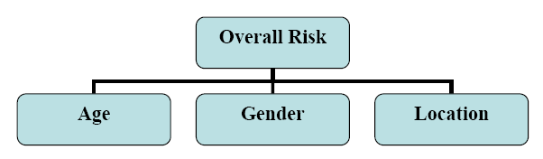
ISM Application # 1 (cont.)
Hierarchy of the system:

Slide 13
Analytic Hierarchy Process (AHP)
Background
Thomas Saaty: AHP as an effort to reflect the human thought process
A synthesis of a series of pairwise comparisons
Can be used to evaluate relative qualities of different products in a multi-attribute environment
Saaty, 1980, The Analytic Hierarchy Process, McGraw-Hill

Slide 14
AHP Procedure – Steps Associated with ERM Application
Establish a structural hierarchy
- E.g., via an ISM process
Establish comparative judgments
- Priorities among the risk factors at each level
- Express individual comparative judgments into ratio
scale measurements
Synthesize priorities and evaluate consistency
- Eigenvector ➔ relative weights / importance of factors

Slide 15
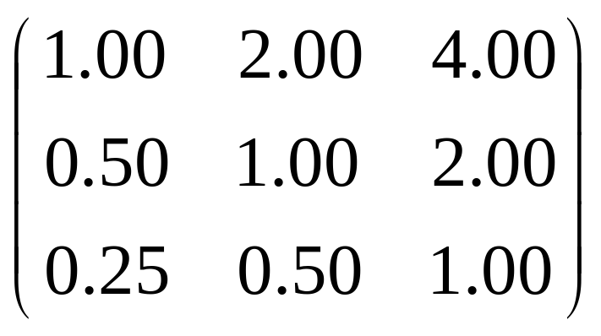
AHP Application: Risk Example # 1
Comparison matrix for the second level of risk factors (R₂, R₃, and R₄ )
  R₂ = age
  R₃ = gender
  R₄ = location
2
3
4
2
Comparison Matrix C:
3
4

Slide 16
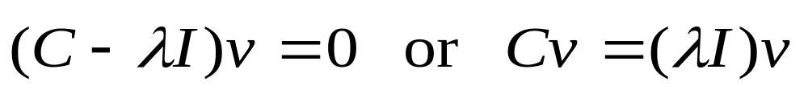
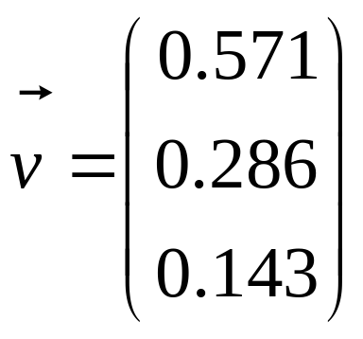
AHP Application # 1 (cont.)
Calculate the relative importance of each risk factor – that is, calculate the eigenvector v of comparison matrix C

Slide 17
ISM & AHP Application –
Risk Example # 2
Expanded version of Example # 1 – more risk factors
R₁ = age
R₂ = gender
R₃ = location
R₄ = marital status
R₅ = distance driven
R₆ = socioeconomic class
(R₇ is the overall risk)

Slide 18
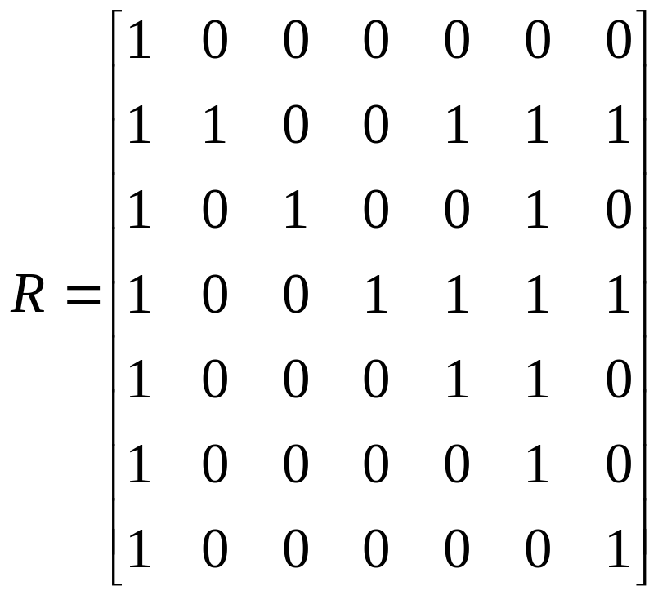
ISM & AHP Application # 2 (cont.)
Suppose we have determined the following reachability matrix R:

Slide 19
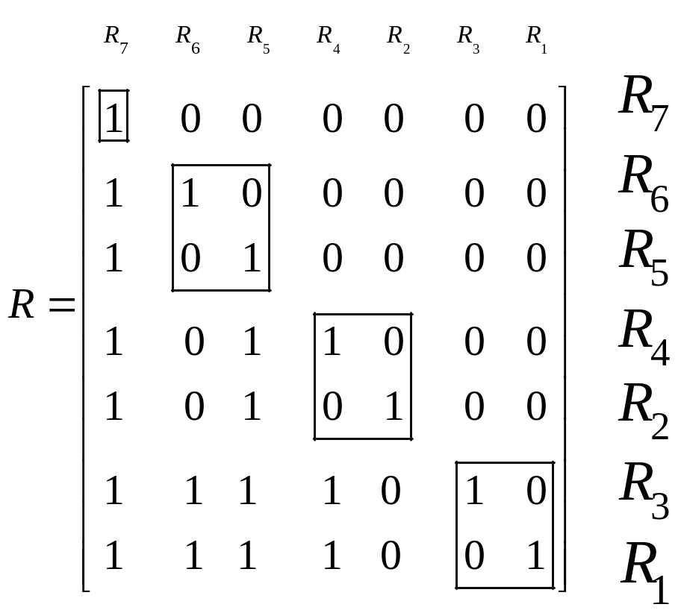
ISM & AHP Application # 2 (cont.)
We can rearrange the rows and columns to better see level groupings:

Slide 20
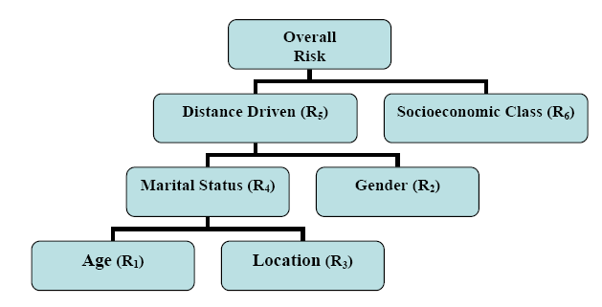
ISM & AHP Application # 2 (cont.)
Hierarchy of the system:

Slide 21
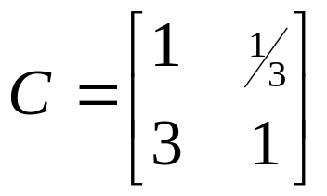
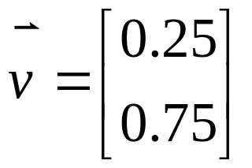
ISM & AHP Application # 2 (cont.)
AHP on the second level (marital status and gender), for example:
If (hypothetically),
Then:

Slide 22
Conclusion
Issues:
  How should risk relationship data be collected and survey questions framed?
  How would you suggest these risk interrelationships be visualized?
“The revolutionary idea that defines the boundary between modern times and the past is the mastery of risk”
- Peter Bernstein, Against the Gods

