Slide 1
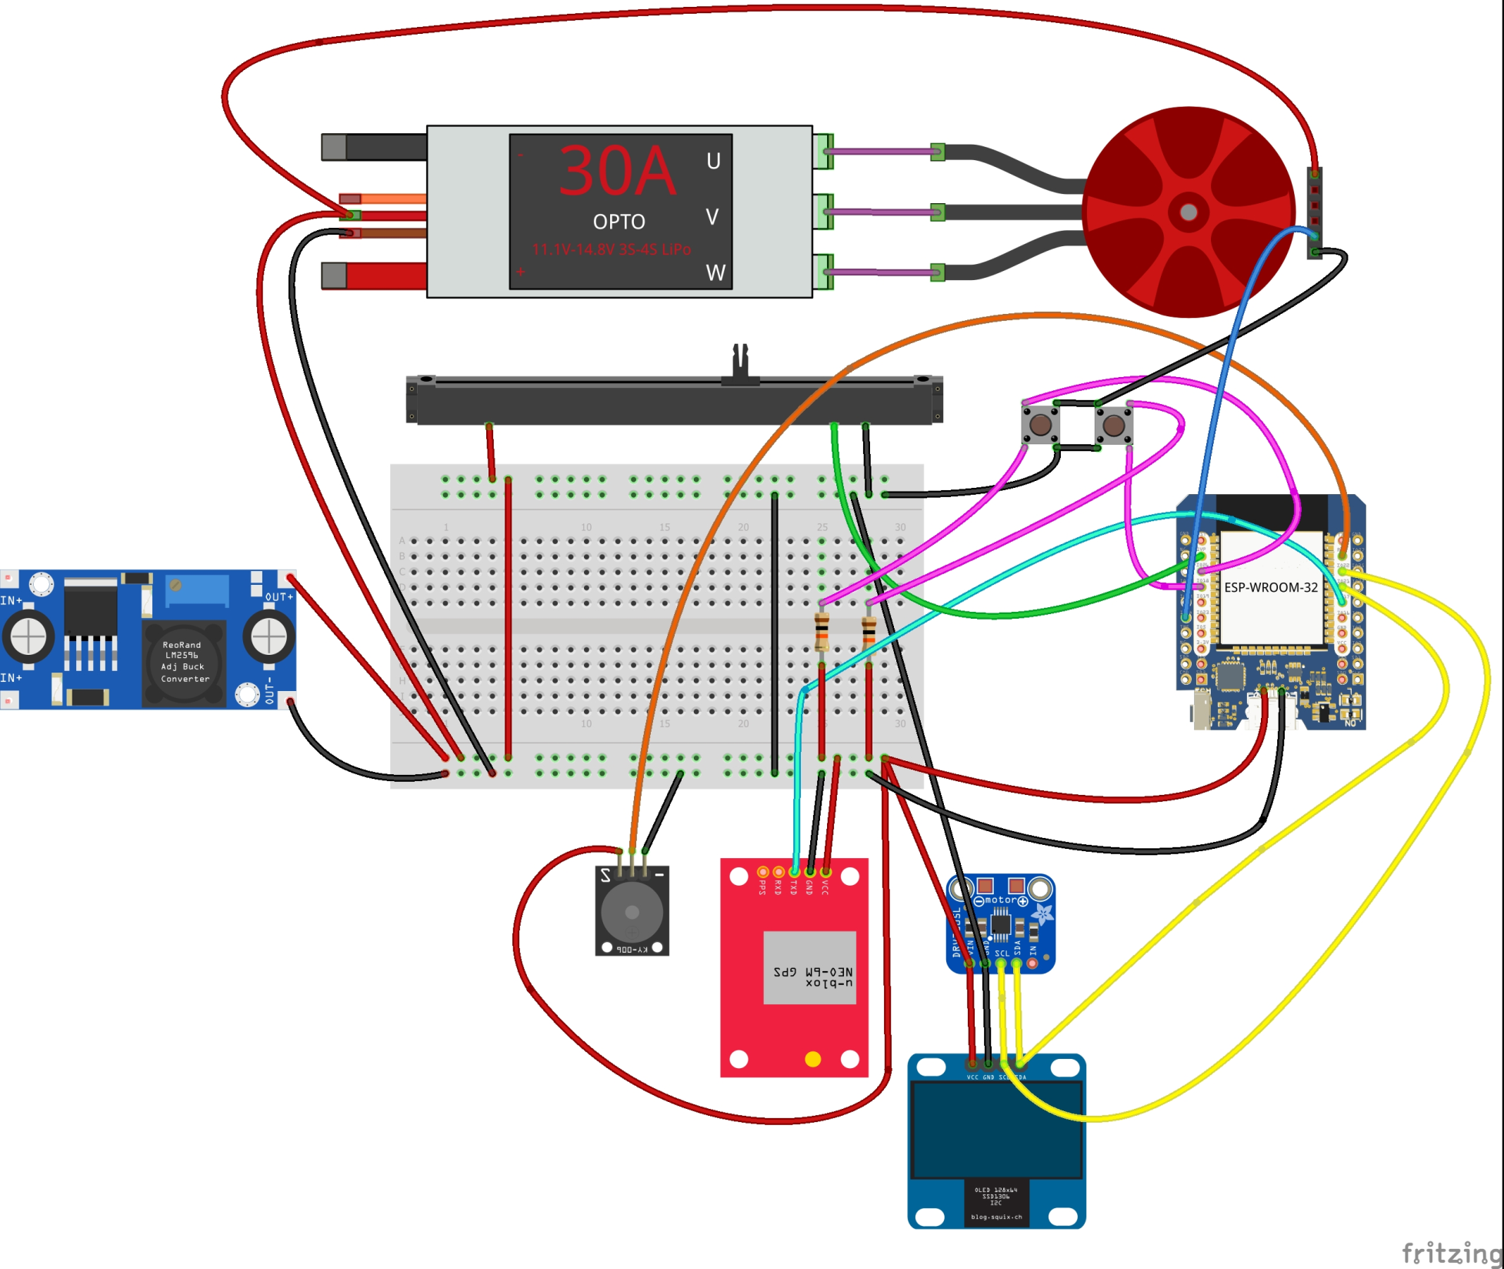
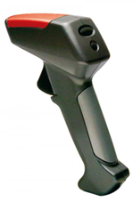

Brushless DC motor
-
+
300A ESC
6S 22.2V
U
V
W
Battery
6S 22000mAh
2pcs in series
44.4V connected
To ESC and one to
DC-DC
Wemos ESP32
22.2V DC – 5V DC converter fed from one
battery
U-blox
Neo-6m GPS
Scalextric controller
Contains potentiometer
Buttons and OLED
128x64 OLED I2C

