Slide 1


Subject: Summer Internship (3170001) Prepared By: Krunal J Mistry Enroll No: 190280107070
Under the guidance of
Prof Hetal Gevariya Sagar Jasani
(Internal Guide) (External Guide)

Slide 2

Project Title: Recommendation System with Sentiment Analysis

Slide 3
Anaconda Distribution
Anaconda is a distribution of the Python and R programming languages for scientific computing (data science, machine learning applications, large-scale data processing, predictive analytics, etc.), that aims to simplify package management and deployment.

Slide 4

Data Pre-processing
NumPy : which stands for Numerical Python, is a library consisting of multidimensional array objects.Using NumPy, mathematical and logical operations on arrays can be performed.

Slide 5
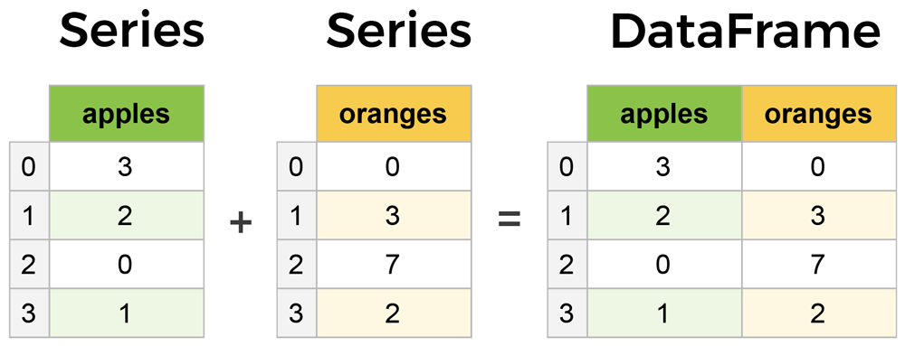
Pandas
Pandas is a fast, powerful, flexible and easy to use open source data analysis and manipulation tool, built on top of the Python programming language.
Series & DataFrame

Slide 6
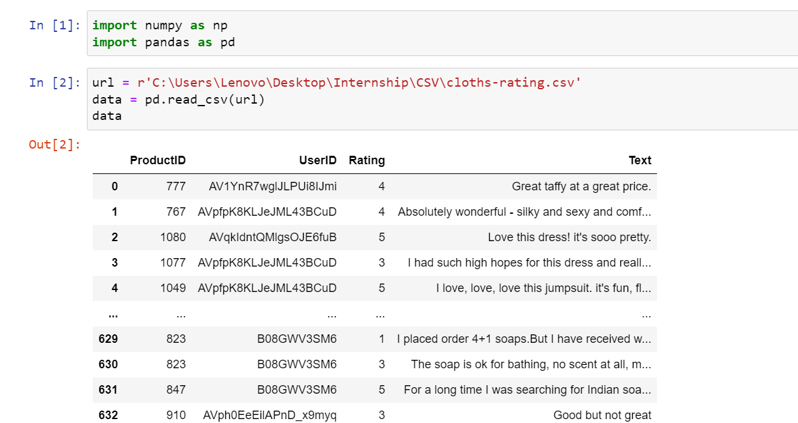

Slide 7
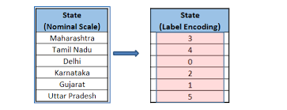
Feature Extraction
Encoding
Label Encoding: Label Encoding refers to converting the labels into numeric form so as to convert it into the machine-readable form. Machine learning algorithms can then decide in a better way on how those labels must be operated.

Slide 8
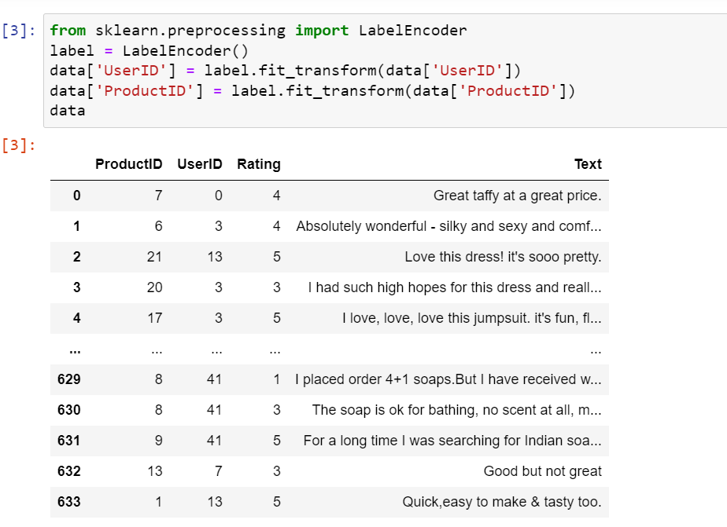

Slide 9
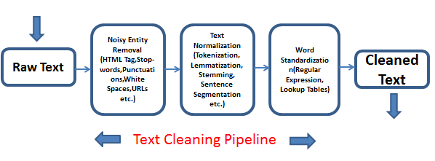
Text Cleaning

Slide 10
Noisy Entity Removal
TextBlob is a Python (2 and 3) library for processing textual data.
It provides a simple API for diving into common natural language processing (NLP) tasks such as part-of-speech tagging, noun phrase extraction, sentiment analysis, classification, translation, and more.

Slide 11
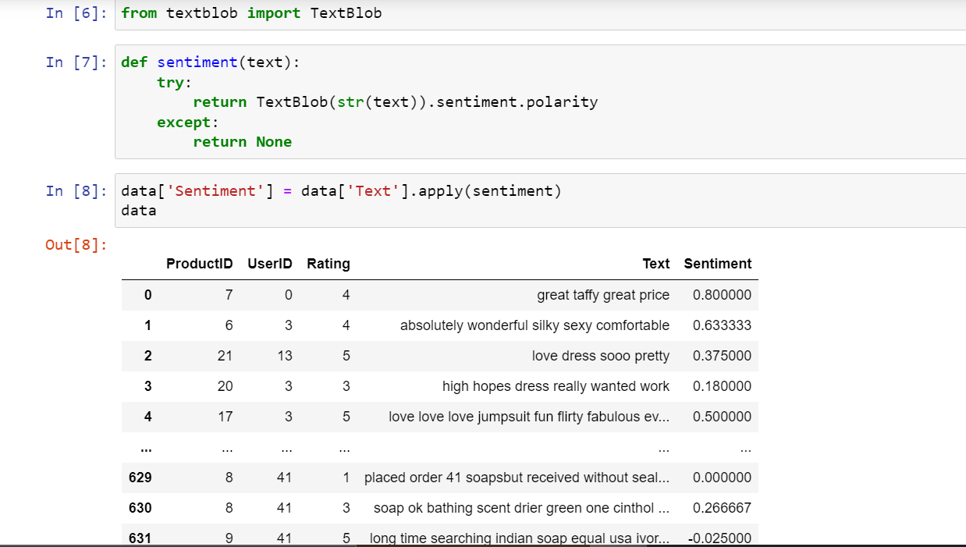
TextBlob

Slide 12
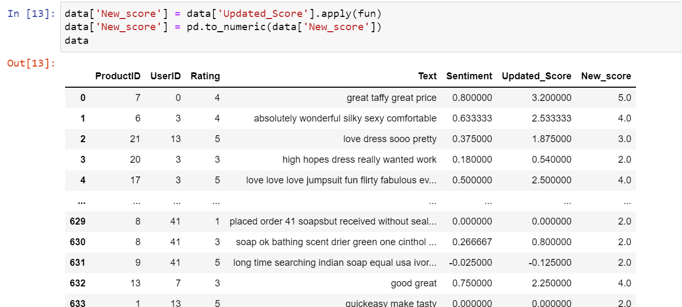

Slide 13
Model Building
Here is step by step on how to compute K-nearest neighbors KNN algorithm:
Determine parameter K = number of nearest neighbors.
Calculate the distance between the query-instance and all the training samples.
Sort the distance and determine nearest neighbors based on the K-th minimum distance.

Slide 14
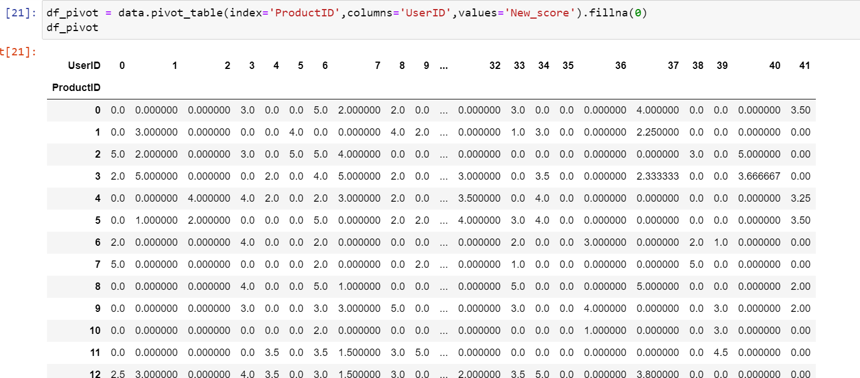
Pivot Table

Slide 15
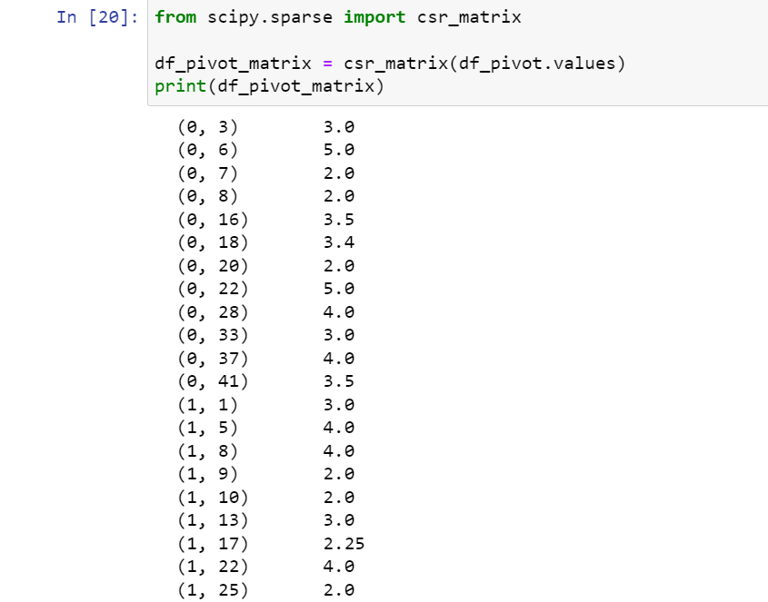
CSR Matrix

Slide 16
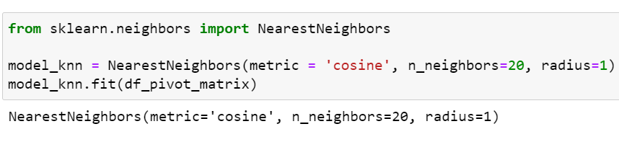
K-Nearest Neighbors Model Feeding

Slide 17
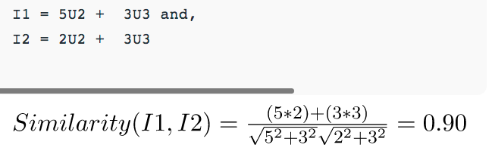
Similarity Measure
Cosine Similarity:
Item to Item Similarity: The very first step is to build the model by finding similarity between all the item pairs. The similarity between item pairs can be found in different ways. One of the most common methods is to use cosine similarity.

Slide 18
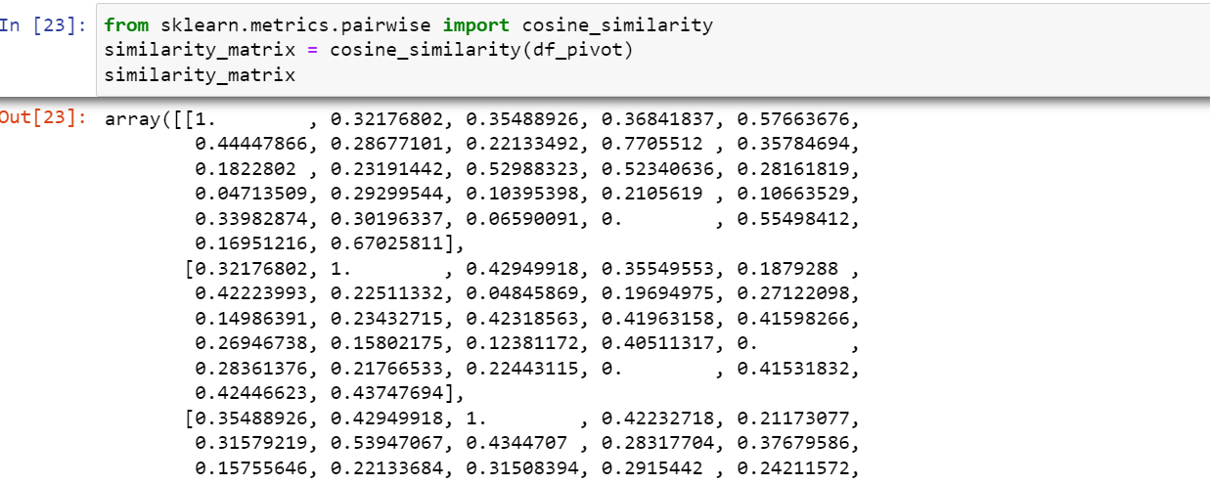
Cosine Similarity

Slide 19
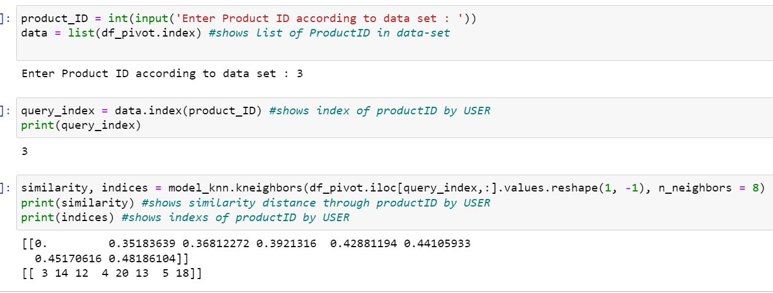
Behavior of our Model on Test Input

Slide 20
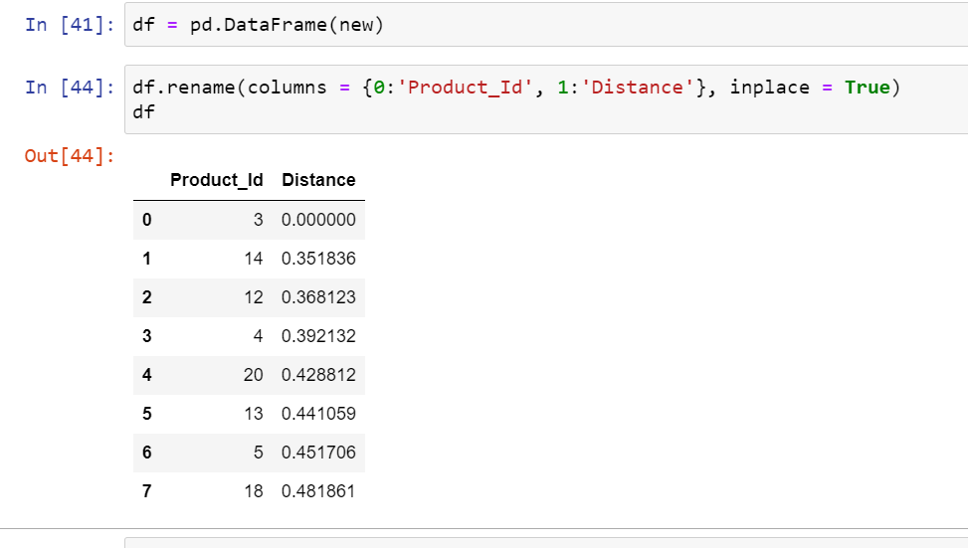
Product – Distance DataFrame

Slide 21


