Slide 1
IT445 : Software Group Project-IV Object Detection Using Android Application
Prepared by
Sanket Golakiya(16IT025)
Krunal Bhavsar (16IT010)

Slide 2
Content
What is Object Detection?
Application of Object Detection
Work Flow
TensorFlow?
Application Presentation
Future plan
Reference

Slide 3
What is Object detection?
Object Detection is the process of finding real-world object instances like car, bike, TV, flowers, and humans in still images or Videos.
It allows for the recognition, localization, and detection of multiple objects within an image which provides us with a much better understanding of an image as a whole.

Slide 4
Ways to implement object detection
Object Detection can be done via multiple ways:
Feature-Based Object Detection
Viola Jones Object Detection
SVM Classifications with HOG Features
Deep Learning Object Detection

Slide 5
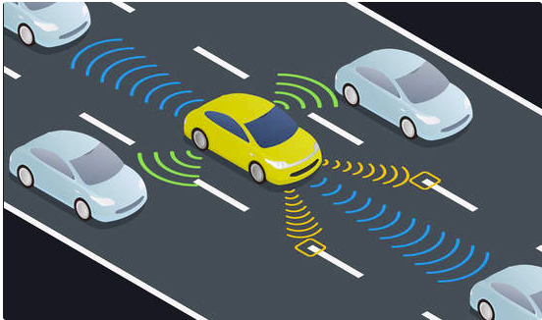
Applications
Self driving car

Slide 6
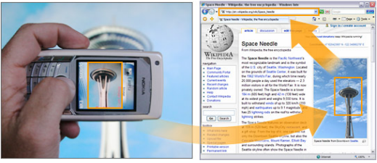
Cont.
Object Recognition as Image Search

Slide 7
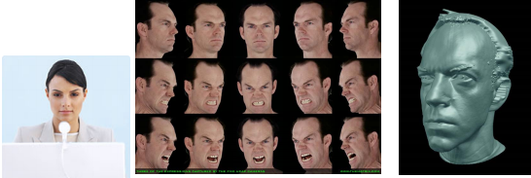
Cont.
Facial Recognition

Slide 8
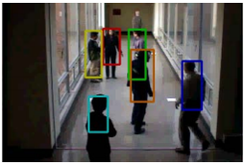
Cont.
People Counting

Slide 9
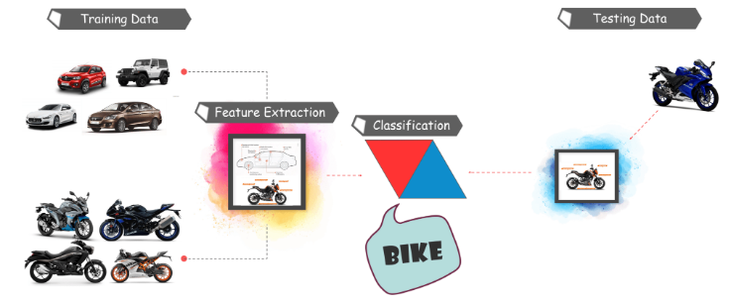
Work Flow

Slide 10
TensorFlow Lite
Tensorflow is Google’s Open Source Machine Learning Framework for dataflow programming across a range of tasks.
TensorFlow is a free and open-source software library for dataflow and differentiable programming across a range of tasks.
Deploy machine learning models on mobile and IoT devices. TensorFlow Lite is an open source deep learning framework for on-device inference.

Slide 11
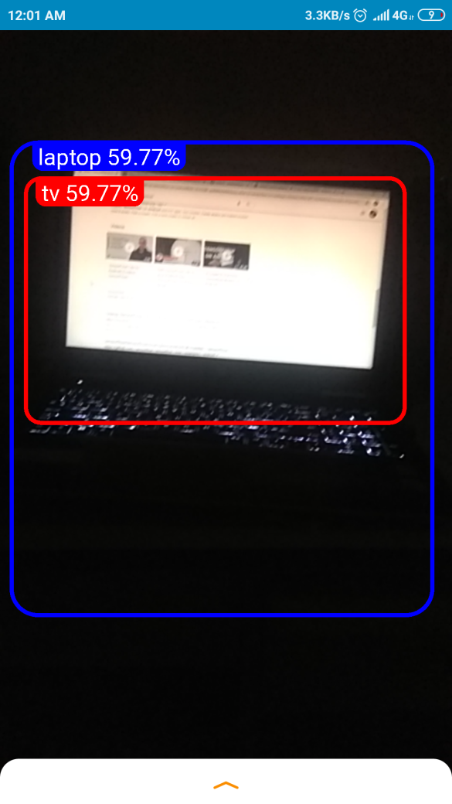
Application Presentation

Slide 12
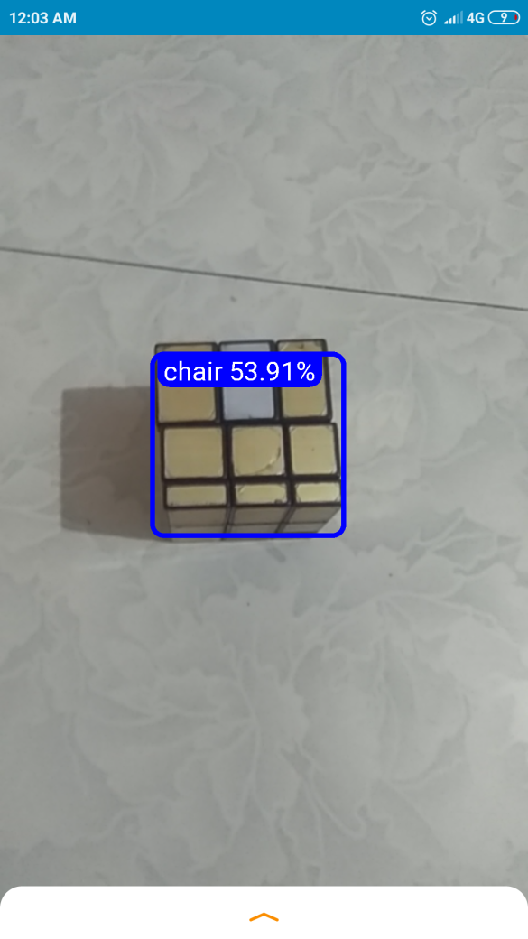
Application Presentation

Slide 13
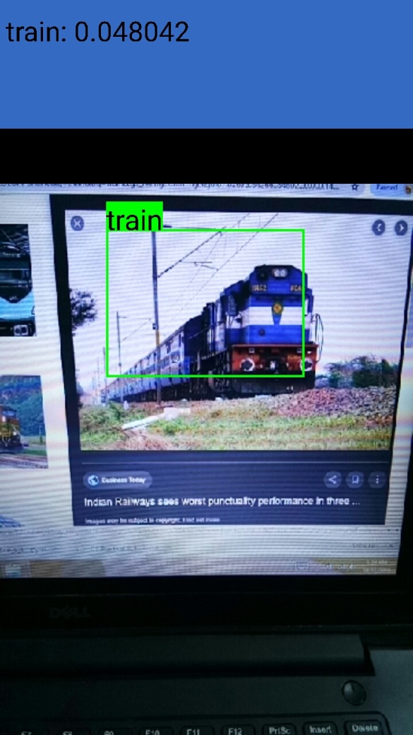

Slide 14
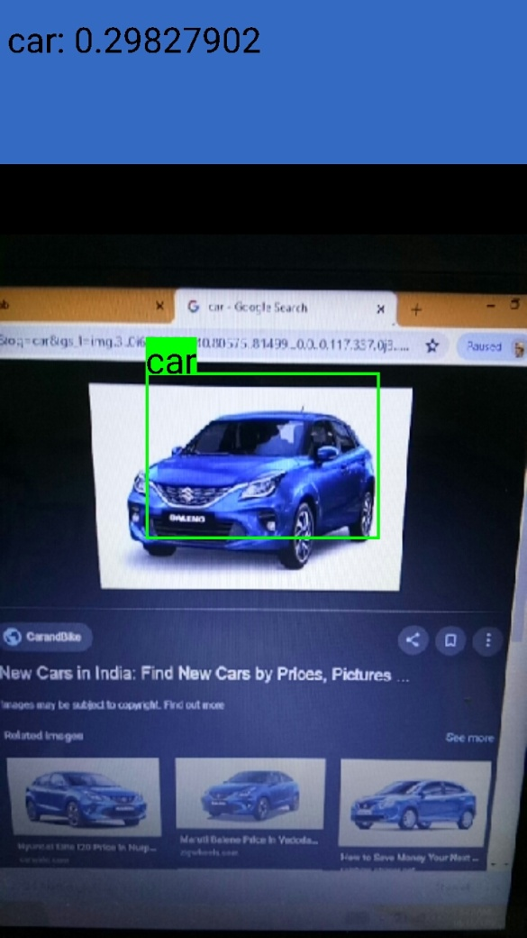

Slide 15
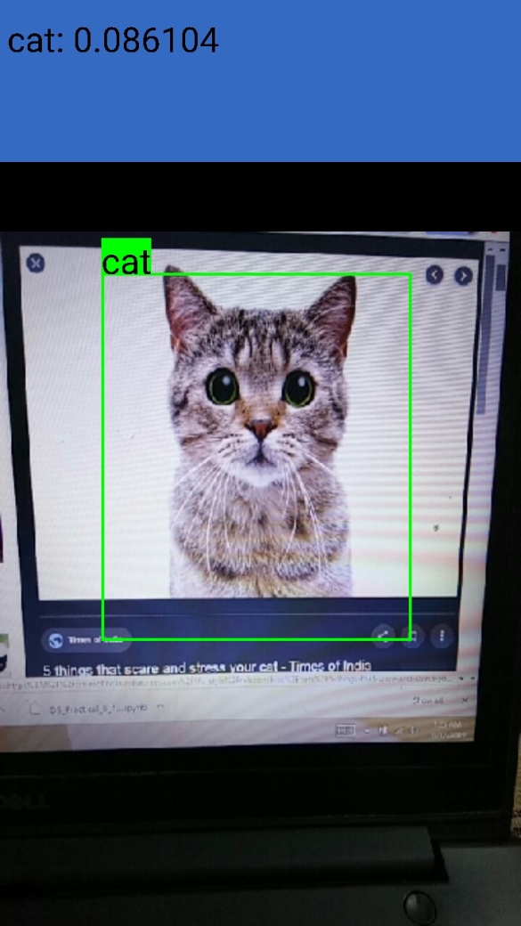

Slide 16
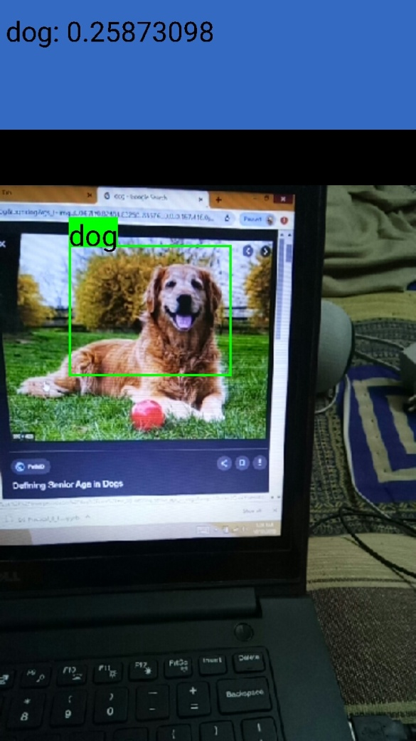

Slide 17
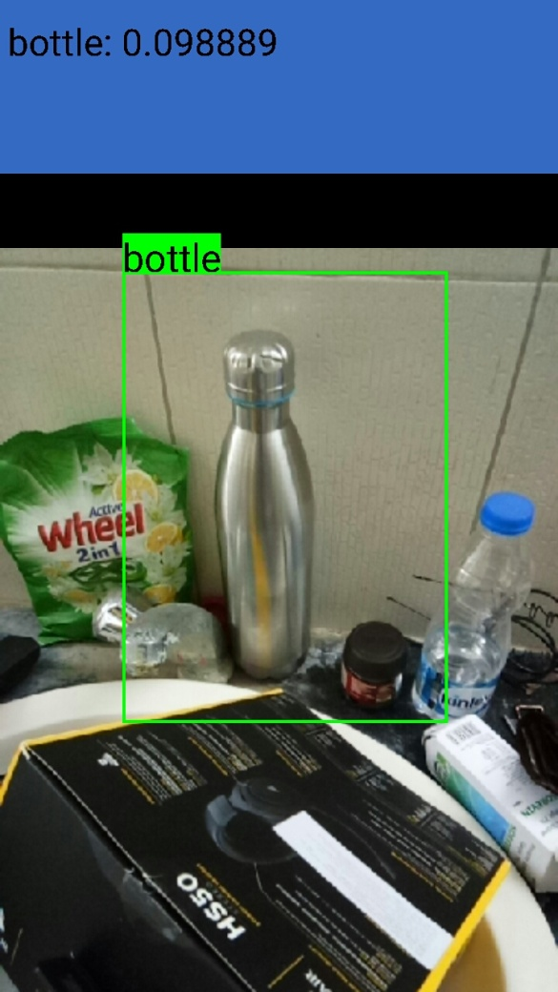

Slide 18
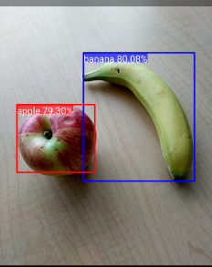
Future Plan

Slide 19

Future Plan

Slide 20
References
https://www.tensorflow.org
https://medium.com/tensorflow/
https://www.edureka.co/blog/tensorflow-object-detection-tutorial/

Slide 21
Thank You...

