Slide 1

Data Blocks: Hybrid OLTP and OLAP on Compressed Storage
using both Vectorization and Compilation
Authors: Harald Lang, Tobias Mühlbauer, Florian Funke, Peter Boncz, Thomas Neumann, Alfons Kemper
(June 2016, Conference: SIGMOD)
Prepared by Guided by
Meet Shah (202011047) Prof. Minal Bhise
Krunal Mehta (202011051)
Dhirubhai Ambani Institute of Information and Communication Technology

Slide 2
Outline
Introduction
Our Contribution
Data Blocks
Data Blocks Flow
Data Structures
Algorithm
Experimental Setup
Block Diagram
Experimental Results
Conclusions
References

Slide 3
Introduction
Motivation
Data is increasing rapidly
Handle large amounts of data efficiently
Summarize data to scan less amount of data
Objective
Improve query performance in hybrid OLAP-OLTP database system by data summarization
without affecting query efficiency
Scope
Relational Database
OLTP (Online Transaction Processing)
OLAP (Online Analytical Processing)

Slide 4
We developed method to divide data into hot and cold chunks and implemented
Truncation Compression technique for cold chunk compression
We designed Positional Small Materialized Aggregate (PSMA) lookup table proposed
by the paper, to store range for each delta value
By using min - max value of column, we determined weather to skip Data Block or not
Even if Data Block can’t be skipped, scan range will be narrow down with the help of
PSMA lookup table
Above concepts were implemented by us to increase efficiency of query evaluation and
reduce main memory utilization
Our Contribution

Slide 5
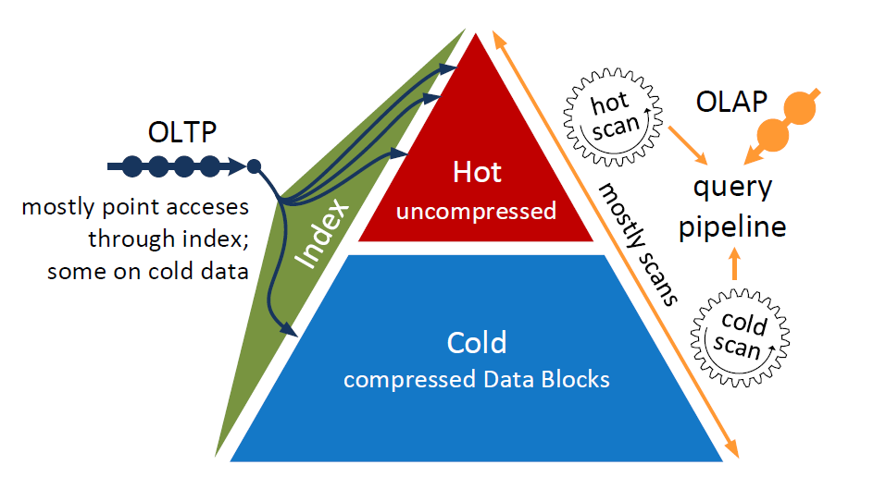
Types of databases
Online Transaction Processing (OLAP)
Online Analytical Processing (OLAP)
Hybrid OLTP and OLAP
Data division
Hot Data : Frequently accessed
Cold Data : Not-Frequently accessed
Data Blocks
Designed for cold data (mostly read)
Immutable and self-contained
Optimally compress cold data
Data Blocks I
Fig.1. Data Blocks

Slide 6
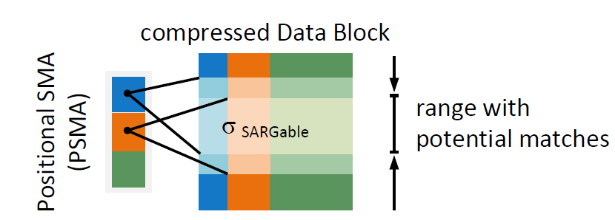
Compression schemes
Single value compression
Ordered dictionary compression
Truncation compression
PSMA
Lightweight indexing
Extension of traditional SMAs (min/max-indexes)
Narrow scan ranges in a Data Block
Data Blocks II
Fig.2. PSMA

Slide 7
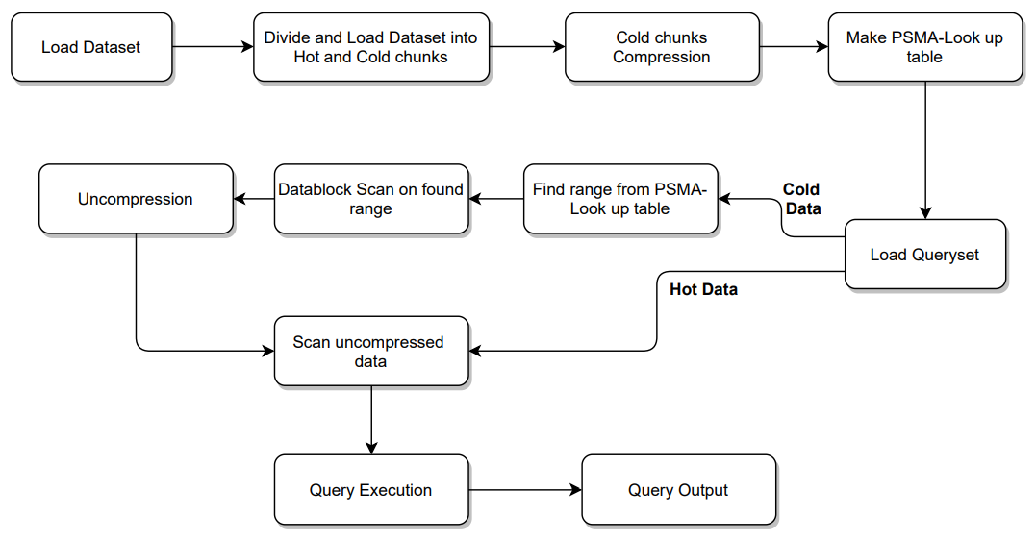
Data Blocks Flow
Fig.3. Data Blocks Flow

Slide 8
Data Structures I
Table1. Key-Value List
min_cold | 0
max_cold | 65536
min_hot | 65536
max_hot | 200000
partition_start_date | 1994-12-30
Table2. Lineitem_Cold Table (Compressed)
l_orderkey | l_partkey | l_suppkey | l_linenumber | l_quantity | l_extendedprice | l_discount | l_tax | l_returnflag | l_linestatus
89173 | 4190 | 5 | 17 | 19756.89 | 0.04 | 0.01 | A | F | 89173
148071 | 3100 | 5 | 29 | 32453.03 | 0.05 | 0.06 | A | F | 148071
176498 | 1533 | 5 | 16 | 25191.84 | 0.06 | 0.02 | R | F | 176498
64313 | 1832 | 5 | 37 | 47260.47 | 0.06 | 0.02 | R | F | 64313
4641 | 4642 | 2 | 6 | 9273.84 | 0 | 0.08 | A | F | 4641
l_shipdate | l_commitdate | l_receiptdate | l_shipinstruct | l_shipmode | l_comment
1 | 1994-12-26 | 1995-01-01 | DELIVER IN PERSON | REG AIR | inal packages haggle carefully
11 | 1994-11-17 | 1995-02-04 | COLLECT COD | MAIL | l requests hagg
12 | 1994-12-27 | 1995-01-12 | DELIVER IN PERSON | SHIP | kages cajole carefully
14 | 1994-12-29 | 1995-01-31 | DELIVER IN PERSON | FOB | deas use blithely! special foxes print af
19 | 1994-12-08 | 1995-02-10 | NONE | TRUCK | sits wake furiously regular

Slide 9
Data Structures II
Table3. Lineitem_Hot Table
l_orderkey | l_partkey | l_suppkey | l_linenumber | l_quantity | l_extendedprice | l_discount | l_tax | l_returnflag | l_linestatus
359 | 11158 | 6161 | 2 | 18 | 19244.7 | 0 | 0.03 | A | F
391 | 121586 | 6611 | 1 | 14 | 22506.12 | 0.09 | 0.02 | R | F
12101 | 1596 | 1597 | 2 | 25 | 37439.75 | 0.04 | 0.04 | A | F
930 | 99635 | 2145 | 4 | 21 | 34327.23 | 0.06 | 0.02 | A | F
10722 | 113068 | 5580 | 6 | 6 | 6486.36 | 0.09 | 0.03 | R | F
l_shipdate | l_commitdate | l_receiptdate | l_shipinstruct | l_shipmode | l_comment
1995-01-27 | 1995-03-18 | 1995-01-31 | DELIVER IN PERSON | RAIL | unusual warthogs. ironically sp
1995-02-11 | 1995-02-03 | 1995-02-13 | TAKE BACK RETURN | TRUCK | escapades sleep furiously about
1995-02-13 | 1995-03-02 | 1995-02-14 | COLLECT COD | REG AIR | al, final foxes about the ir
1995-02-16 | 1995-03-03 | 1995-03-13 | DELIVER IN PERSON | SHIP | foxes. regular deposits
1995-02-12 | 1995-04-02 | 1995-02-21 | NONE | FOB | eas. carefully special deposits
Table4. PSMA Lookup Table
Index | offset | limit | no_of_records
0 | 0 | 2497 | 2497
1 | 2497 | 4979 | 2482
2 | 4979 | 7470 | 2491
3 | 7470 | 9910 | 2440
4 | 9910 | 12506 | 2596

Slide 10
1. Start
2. Load Dataset
3. Initialize variables according to Data Structures
4. Divide data into hot data and cold data
a. Sort Lineitem Table on l_shipdate attribute
b. Insert data into Lineitem_Cold Table and Lineitem_Hot Table according to Data Structures variables
5. Compress cold data using truncation compression scheme
a. Extract min and max of l_shipdate from Lineitem_Cold Table
b. Calculate and store delta value of l_shipdate for all tuples by subtracting min value from it
6. Make PSMA Lookup Table for cold data
a. Find number of entry in PSMA Lookup Table by subtracting min l_shipdate from max l_shipdate
b. Insert index of each entry as delta value
c. Insert offset value of each entry by calculating number of records of all previous entries
d. Insert number_of_records value of each entry by calculating number of tuples present in
Lineitem_Cold Table
e. Insert limit value of each entry by addition of offset value and number_of_records value
Algorithm I

Slide 11
7. Load Queryset
8. For all queries in Queryset do
If Data Block = cold
Find out range from PSMA Lookup Table
Data Block scan on found range
Uncompress data
Scan uncompressed data
Else
Scan uncompressed data
End if
Query Output
End-for
9. Stop
Algorithm II

Slide 12
Experimental Setup
Dataset and Queryset
Benchmark TPC-H Dataset: Decision support benchmark
Business oriented queries
Size of the dataset : 21 MB
No. of tuples : 0.2M
Software and Hardware Setup
RAM : 8 GB
Processor : core i5
Hard Disk : 2TB
PostgreSQL : 10.14
Python : 3.9
Additional modules : psycopg2,matplotlib
Evaluation Parameters
Algorithm Execution Time (AET): Calculates execution time of each algorithm.
Query Execution Time (QET): Calculates execution time of each query.

Slide 13
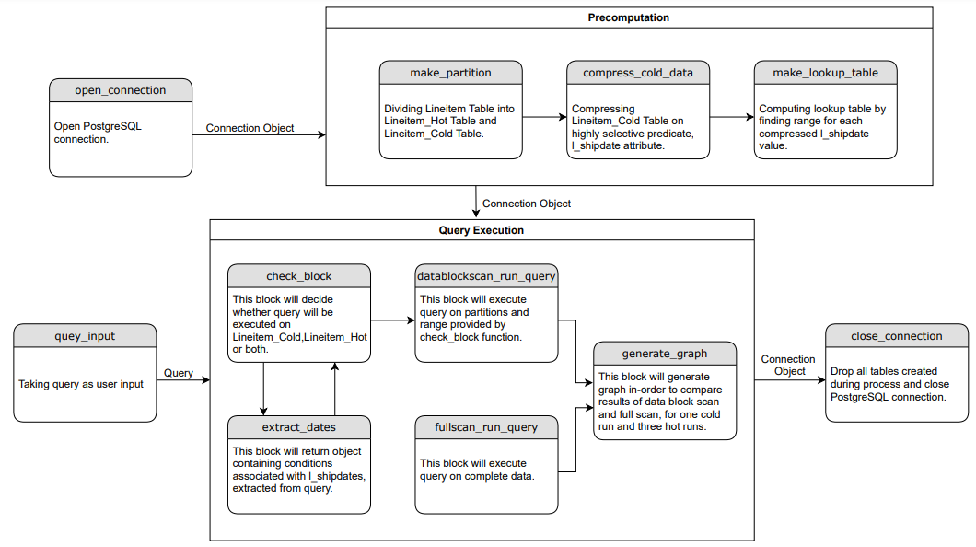
Block Diagram
Fig.4. Block Diagram

Slide 14
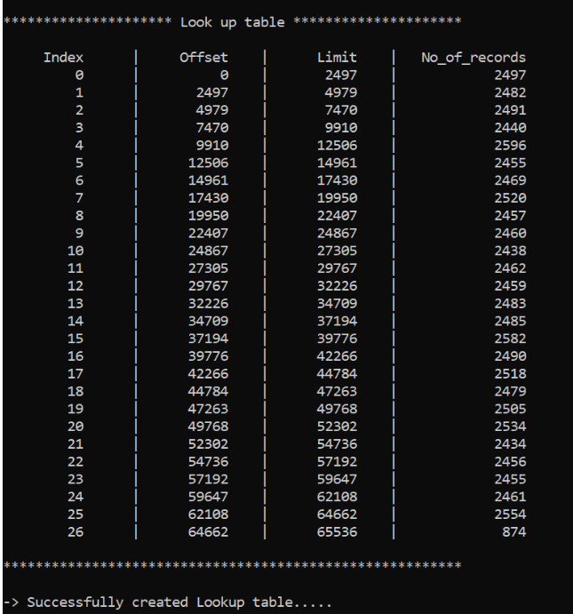
Experimental Results I
PSMA Lookup Table
Implementation
For each delta value as index, it contains:
offset
limit
no_of_records
Fig.5. PSMA Lookup Table Implementation

Slide 15
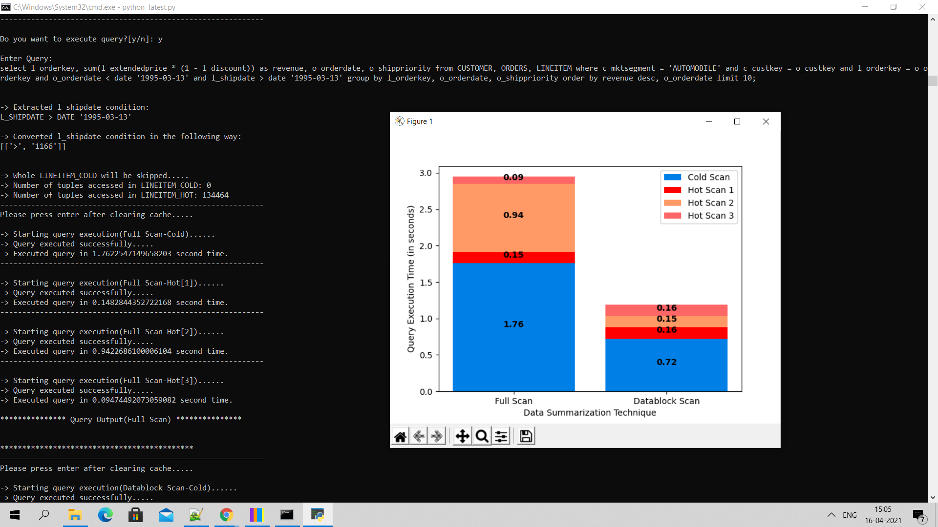
Experimental Results II
Query Execution (OLAP-Q3)
Query 3 will be performed on only on Lineitem_Hot Table
Fig.6. QET

Slide 16
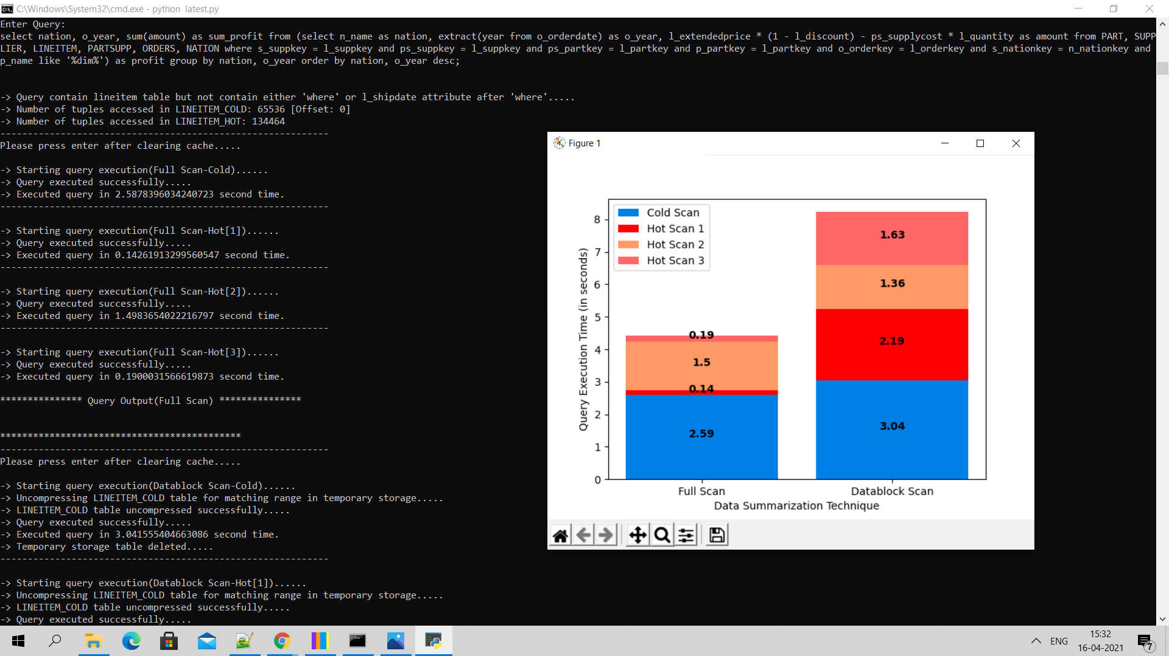
Experimental Results II
Query Execution (OLAP-Q9)
Query 9 will be performed on both Lineitem_Hot and Lineitem_Cold Tables.
Fig.7. QET

Slide 17
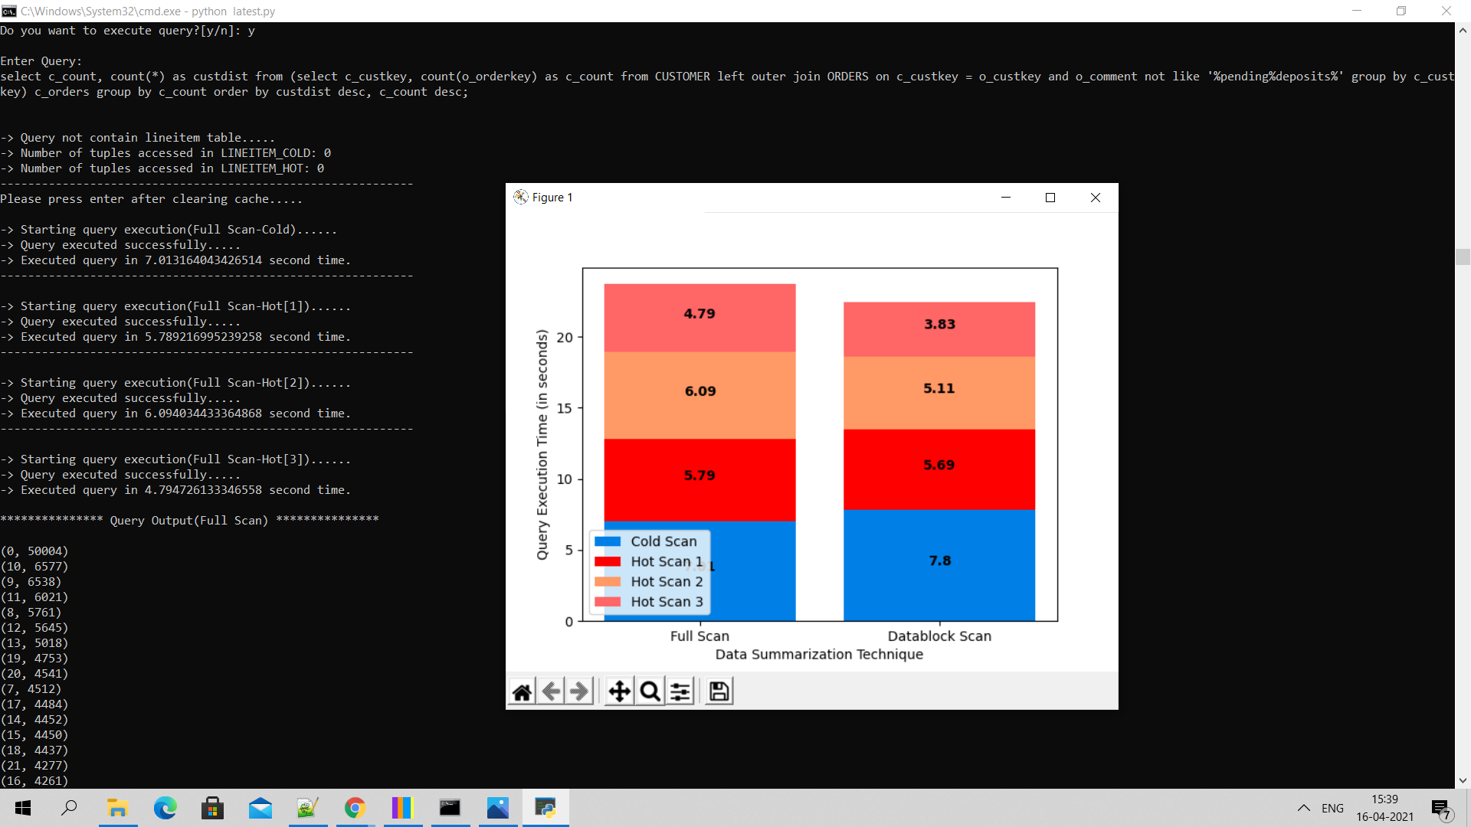
Experimental Results II
Query Execution (OLAP-Q13)
Query 13 will be performed on none of the Lineitem_Hot and Lineitem_Cold Tables.
Fig.8. QET

Slide 18
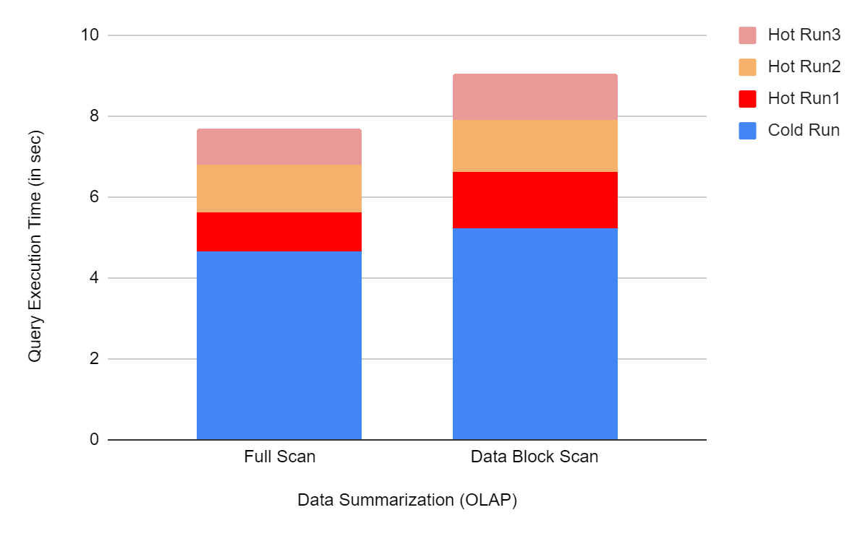
Experimental Results III
AET
AET of the data blocks experiment is recorded as 69.89 seconds. For each query, algorithm is executed once for cold run and thrice for hot run for both full scan and data block scan.
Data Summarization (OLAP)
QET for OLAP is shows average QET for both full scan and data block scan for all 22 OLAP TPC-H benchmark queries.
Fig.9. Average QET OLAP

Slide 19
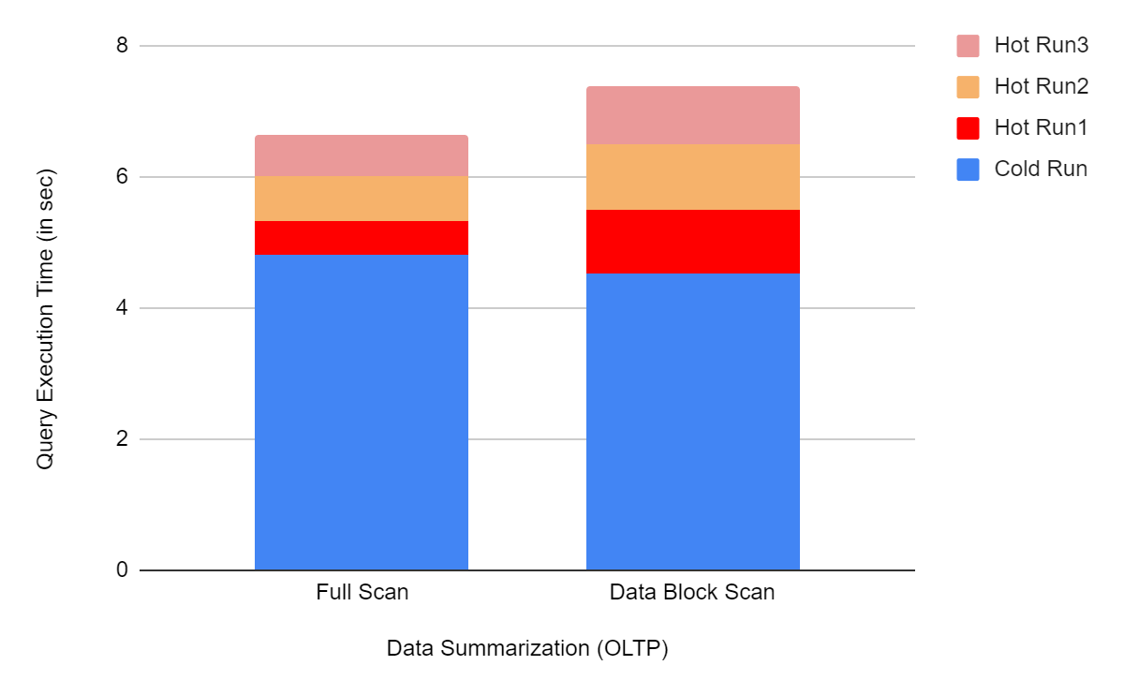
Experimental Results IV
Data Summarization (OLTP)
QET for OLTP shows average QET for
both full scan and data block
Scan for all 22 modified OLTP
TPC-H queries.
Fig.10. Average QET OLTP

Slide 20
Conclusion
We observe that when a query has to access Lineitem_Cold Table for evaluation, its overhead increase due to first uncompressing required cold data and then executing a query on that.
In the case when the query does not need to access Lineitem_Cold for evaluation it performs better as it skips Lineitem_Cold Table data and only executes a query on Lineitem_Hot Table data.

Slide 21
References
H. Lang, T. Muhlbauer, F. Funke, P. Boncz, T. Neumann, A. Kemper, Data Blocks: Hybrid OLTP and OLAP on Compressed Storage using both Vectorization and Compilation, SIGMOD, 2016, pp. 311-326.
TPC-H Dataset and Queryset: http://www.tpc.org/tpch/
Python: https://www.python.org/downloads/windows/
PostgreSQL: https://www.postgresql.org/download/

Slide 22
Thank
You
Presented by
Meet Shah (202011047)
Krunal Mehta (202011051)

