Slide 1

Tic-Tac-Toe
Programming SEC 2023

Slide 2
Overview
A simple, yet fun Tic-Tac-Toe game.
Online multiplayer feature
Played on <insert where to play>
PIN authenticated

Slide 3
Technologies
JavaScript
React
And CSS

Slide 4
Design and Planning
Initial concept of a simple but clean design
Traditional game mechanics
Turn-based game.
Feedback from team members

Slide 5
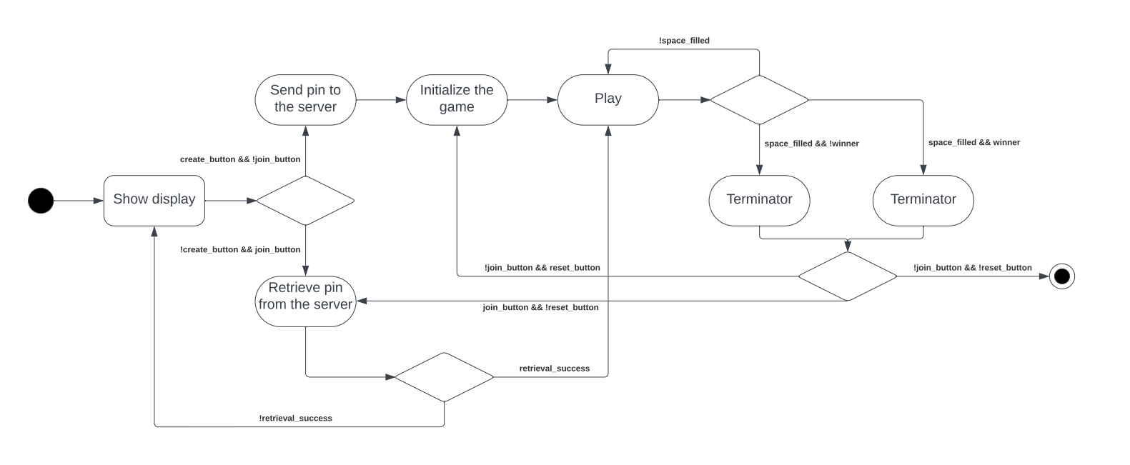
Implementation

Slide 6
User Interface
<Add Screenshots of the UI here!>

Slide 7
Testing
<Include a Demo?>

Slide 8
Conclusion
<What else that can be done in the future>
Questions

