Slide 1
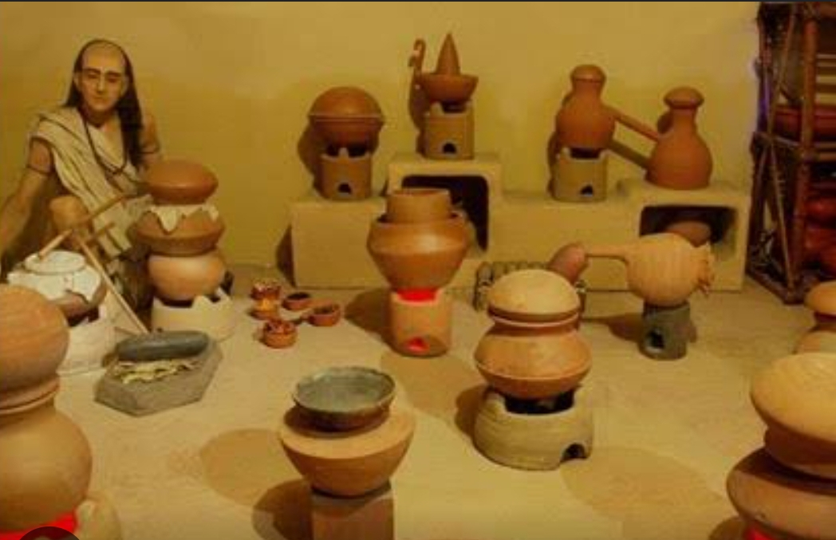
USES OF CHEMICAL APPARATUS IN ANCIENT INDIA
Ancient Indians achieved great progress in alchemy (the older form of chemistry). Alchemical treatises of ancient India refer to various types of 'Yantras’
Ancient Indians achieved great progress in alchemy . Earliest distillation of alcohol can be traced back to the archeological finds at Taxila.
Out of the numerous alchemical texts, written between the ninth and the fourteenth century AD, some give alchemical ideas, while others are devoted to alchemy. Like ,
Rasahrdayatantra by Govind Bhagwatpad, Srasaratnakara by Siddha Nityanatha, Rasaratnasamuccaya by Vagbhatta,

Slide 2
- There are several other works like Dhatukalpa, Dhatumanjari, Dhatumaranam, Rasgrantha, Rasakalpalata, Rasanibhandha, Suvaranatantra, whose authorships and dates have not yet been established.
--Nagarjuna was the most prominent scholar in the field of Indian alchemy.
-Rasashala, a typical alchemical laboratory of Nagarjuna is recreated in ‘Our Science & Technological Heritage of India’ gallery at National Science Centre, Delhi.
-In ancient india chemistry had various names like Rasayana sastra, Rasatantra , Rasakriya or Rasavidya. And it included metallutgy , medicine, manufacture of cosmetics, glass, dyes & inks and all.
-Ancient Indians applied that knowledge of chemistry in various walks of life.

Slide 3
There are various chemical apparatus which are safely stored in museum’s.
1. Swedani Yantra : In ancient times, people were using swedani yantra for continuous slow heating of ingrediants.
- Procedure : A pot with boiling water has its mouth covered with a piece of cloth and the substance to be steamed is placed on it, and a second pot is arranged in an inverted position over the rim of the first.
2. Patana Yantra : Patana Yantra was an apparatus used for sublimation and distillation.
-Procedure : Two vessels are adjusted so that the neck of the one fits into that of the other . The junction of the necks is luted with a composition made of lime, raw sugar, rust of iron, and buffalo’s milk.
3. Adhahpatan Yantra : The Adhahpatan Yantra was a modification of the Patana yantram, an apparatus used for sublimation and distillation.
-Procedure : The bottom of the upper vessel is smeared with the substance, the vapour or essence there of condensing into the water of the lower one. Heat is applied on the top of the upper vessel by means of the fire of dried cow-dung cakes.

Slide 4
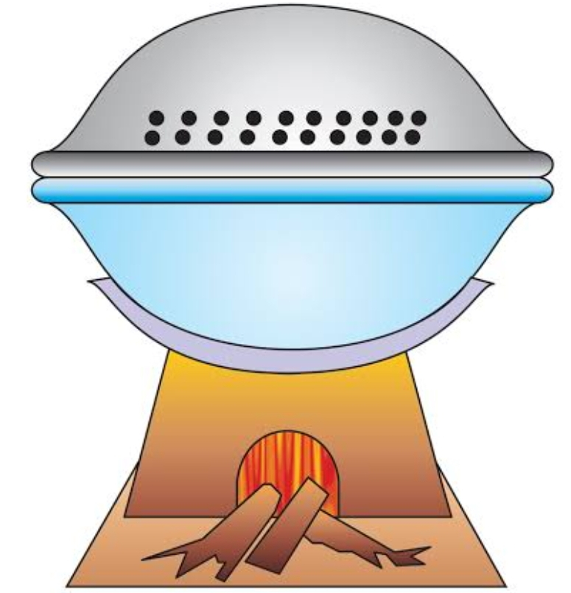
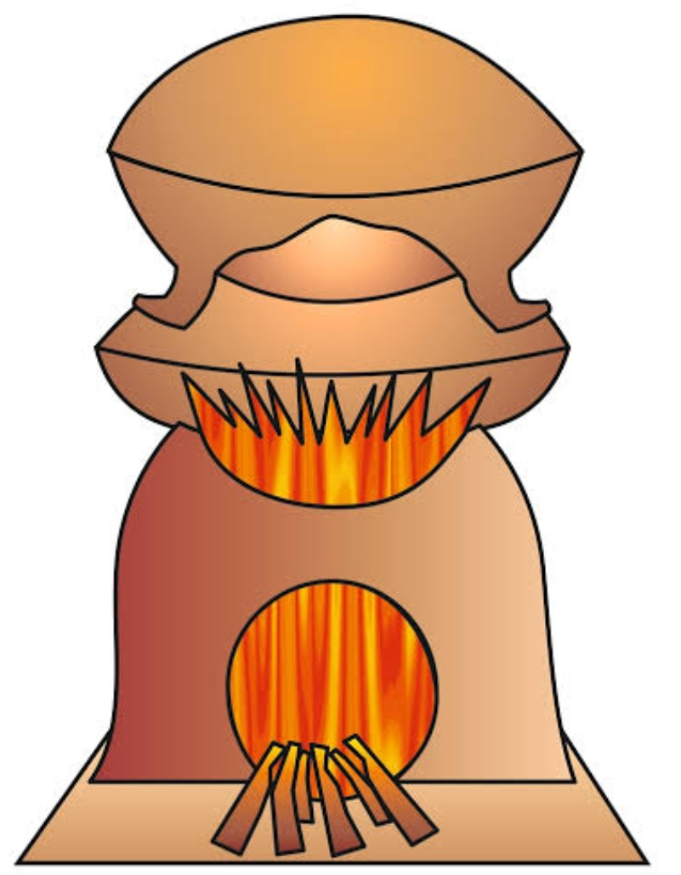
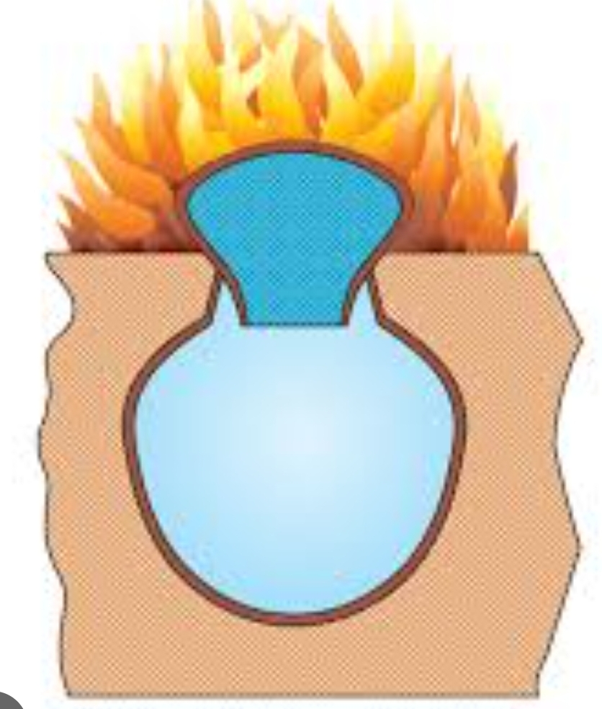
Swedani Yantra
Adhah Patan Yantra
Patana Yantra

Slide 5
4. Kosthi Yantra: This apparatus, Kosthi Yantra, was mainly used for extracting mineral.
-procedure: This apparatus has a special furnace of angulas in width and one hasta (18”) in length and one hasta in height. Two Mushas (crucibles used in the laboratory) are taken, one of which has a lid with a hole. The Musha with the lid is filled with ore and is fixed upside down on the furnace, surrounding the upper Musha is filled with hard charcoal made of Bamboo, Khadira, Madhuka and Badari wood. A fire is lit in the charcoal and has to keep raging, by blowing air with the help of bellows. Gradually the essence of the mineral gets collected in the lower pot.
5. Dola Yantra: The Dola Yantra was mainly used for causing the chemical to perspire by exposing them to medicated steam.
-procedure: In this yantram, a vessel filled with some liquid substance to half of its capacity is taken. Two holes are made opposite to each other near the mouth of the vessel. A rod is then arranged through the two holes across the mouth. A bundle containing the material which is boiled is suspended into the liquid by tying it at the middle of the rod. Then the vessel is heated as required.

Slide 6
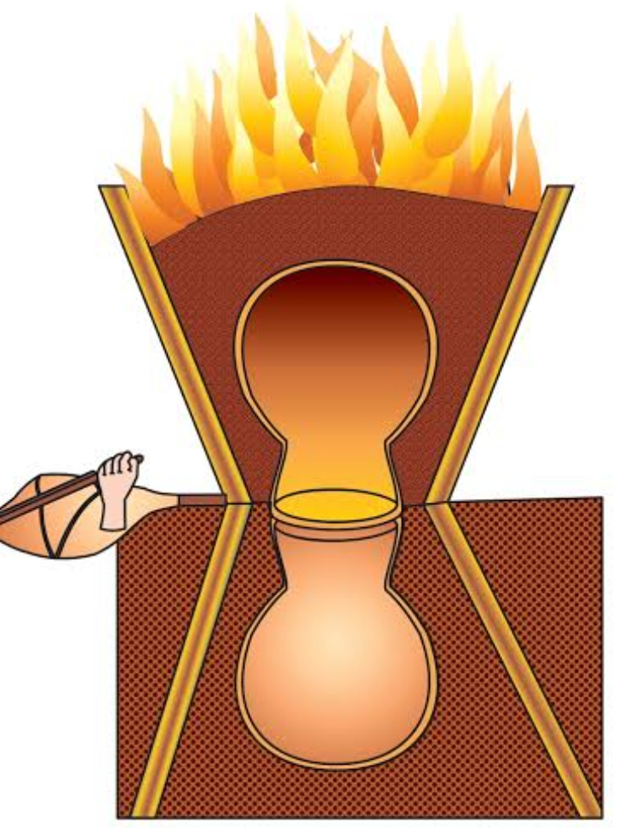
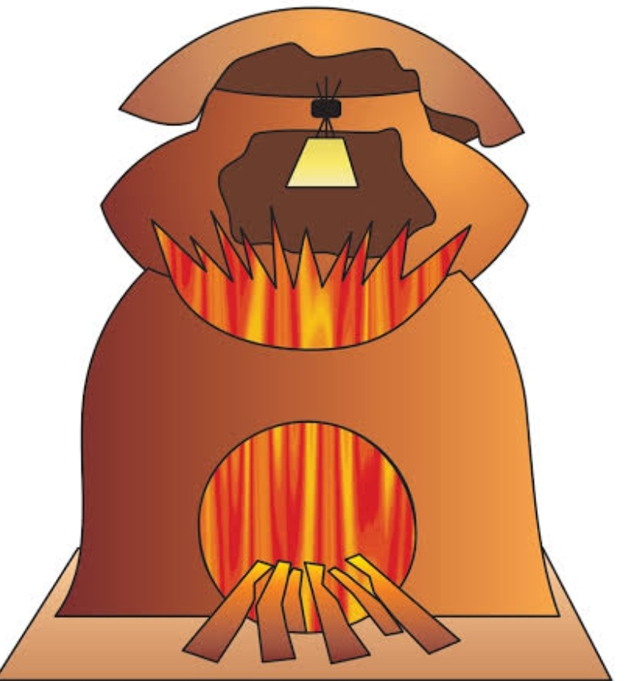
Kosthi Yantra
Dola Yantra

Slide 7
6. Taptkhal yantra: Taptkhal or Tapta Khalla Yantra was used for slow heating of Mercury.
7. Tiryakpatan Yantra : The Tiryakpatan Yantra was used for purification of mercury.
- Procedure: Mercury is kept in a long vessel, with a bent tube at its neck. The lower end of the tube should be inserted into the body of another vessel containing water. The mouth of these two vessels and joints are closed with clay and cloth etc. A blazing fire is placed under the first vessel. The mercury falls into the water in the second vessel. Cold water is poured constantly on the second vessel to get sublimated mercury.
8. Anya Bhudar Yantra : Mercurial products are generally processed through this apparatus.

Slide 8
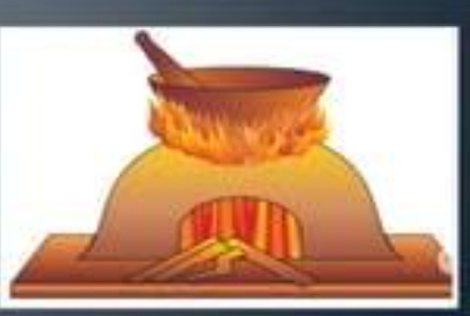
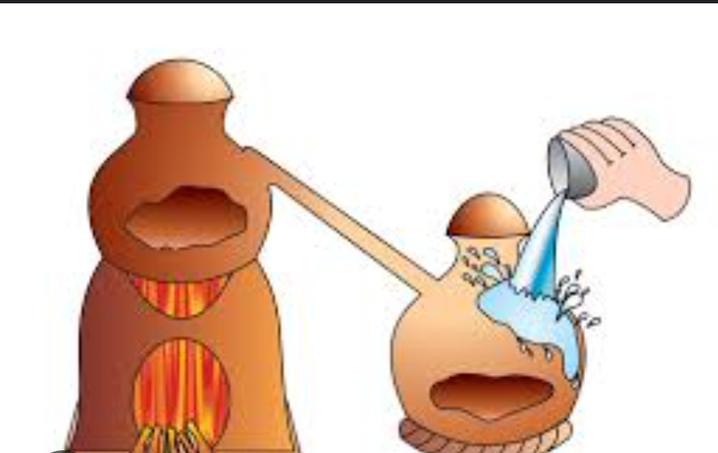
Taptkhal Yantra
TiryaKpatan Yantra

Slide 9
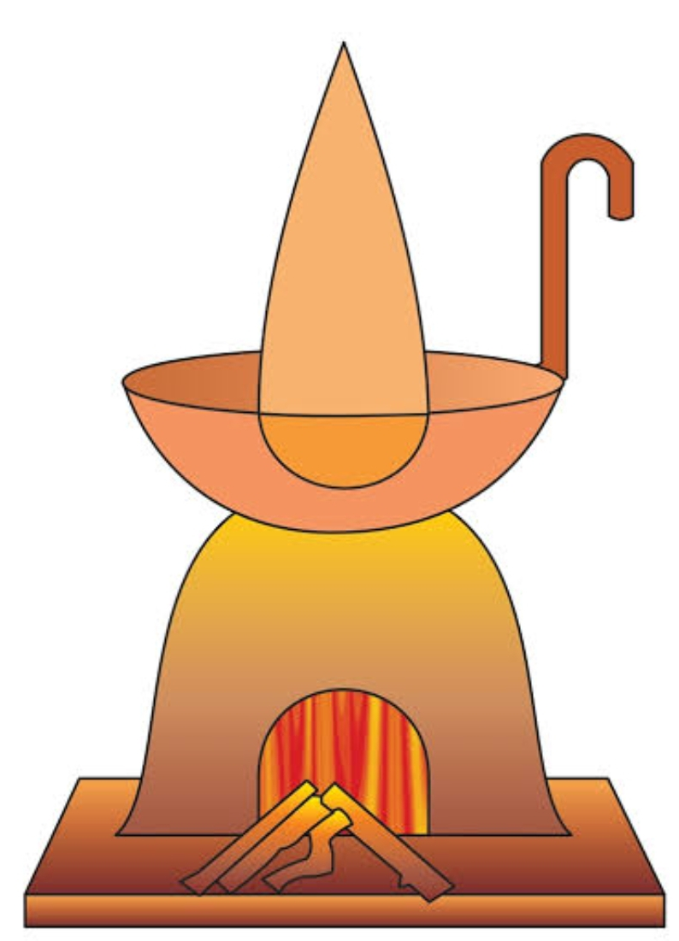
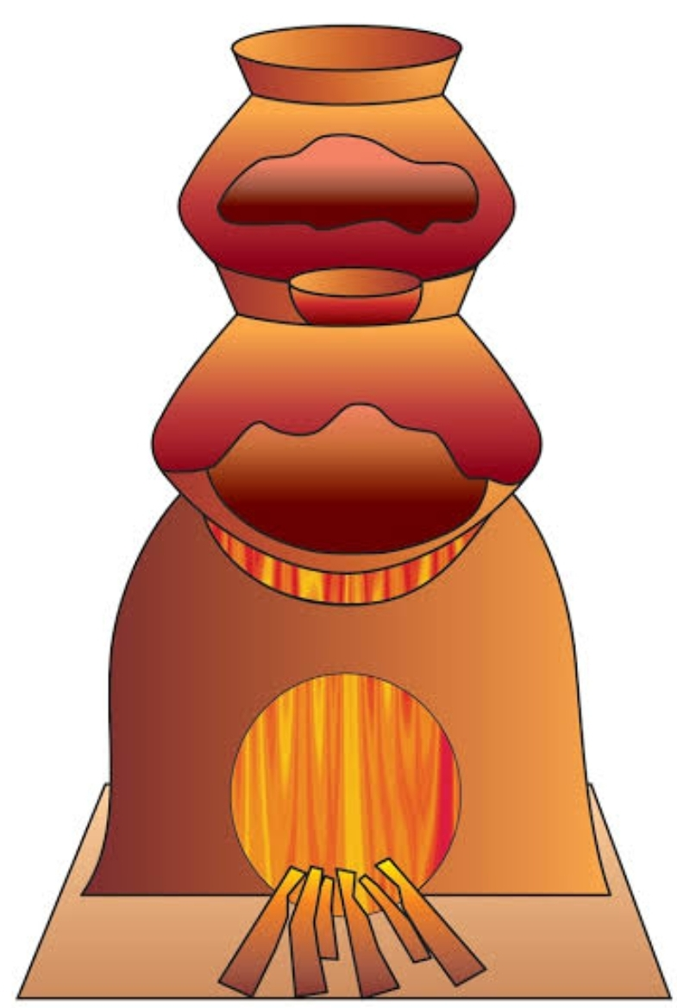
9. Palika Yantra : Palika Yantra is a round shaped vessel with a bend vertical or horizontal arm to handle it. The apparatus is generally used in drawing out oil and small quantity of medicinal liquid.
10. Urdhavpatan Yantra : It was used for sublimation of mercury. The substance is heated in lower pot and the upper one is kept cooled for deposition of sublimate.
Conclusion :
The science of Indian chemistry progressed with use of more and more metals, herbs, precious, stones and new extraction processes.
There were many apparatus like glass, copper, iron, silver and gold , which are discovered in ancient time and helpful for present time .
In present time of india technology is developed because of ancient chemical apparatus usage and its authors books.
Palika Yantra
Urdhavpatan Yantra

