Slide 1



Wells Fargo India & Philippines (WFIP) Campus Analytics Challenge - 2021
TEAM ANALYZER
COLLEGE : MBA IIT KANPUR
PRESENTED BY:
RAHUL TRIPATHI
RAMANDEEP KHATKAR
SHREYAS SHOUCHE

Slide 2
EXECUTIVE SUMMARY
OBJECTIVES
01
The purpose of Classification is to predict whether we should approach the client for Loan or not.
OUTCOME
02
Increase Revenue of the firm while considering risk aspect into consideration and how can the strategy be improved for different communication techniques
(Cost-Benefit Analysis)
IMPLEMENTATION
03
Creation of model which can segment customers for loan approvals of 10% of their current balance

Slide 3
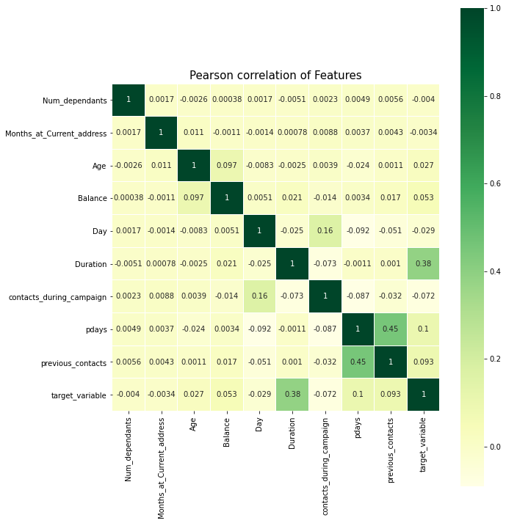
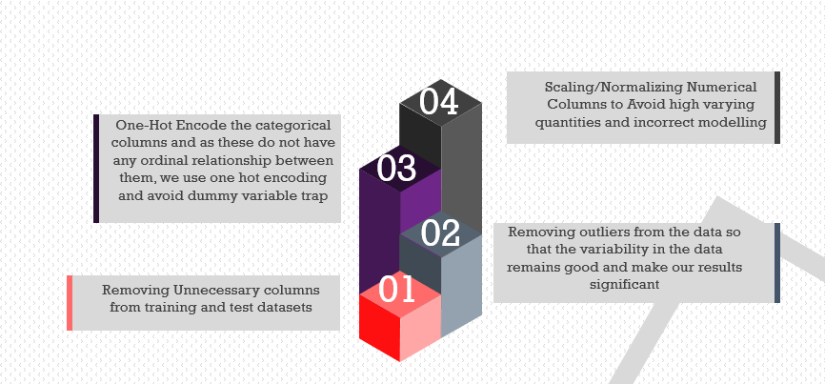
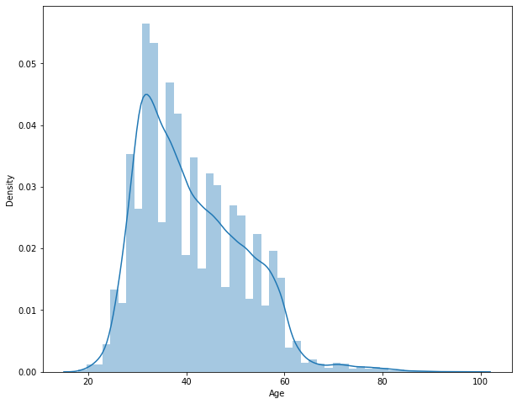
Data Preprocessing and EDA
In the train data for poutcome variable 81% data comes under unknown category, this makes model building tricky since we are unaware about the previous campaign outcome of most customers and among them 90% were labelled not to be approached this makes data biased
And in test data as well there are around 81% unknown in poutcome.
Balance, Age in test and train have same distribution
For many customers balance was observed to be NEGATIVE still they were given loan.

Slide 4
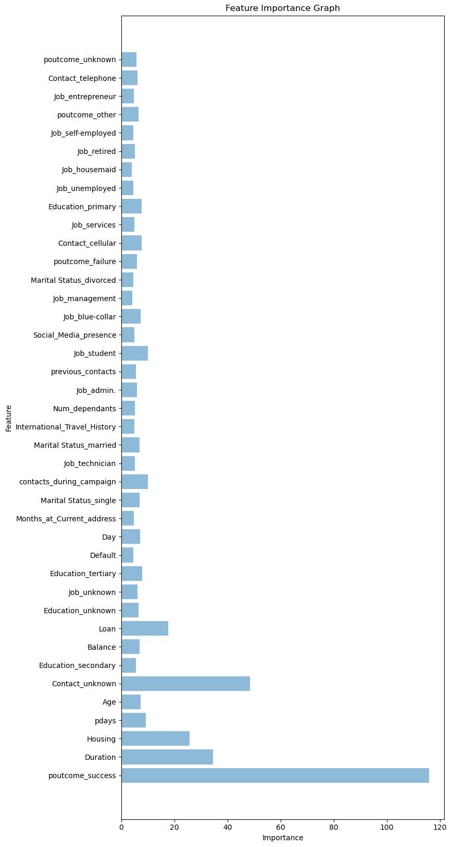
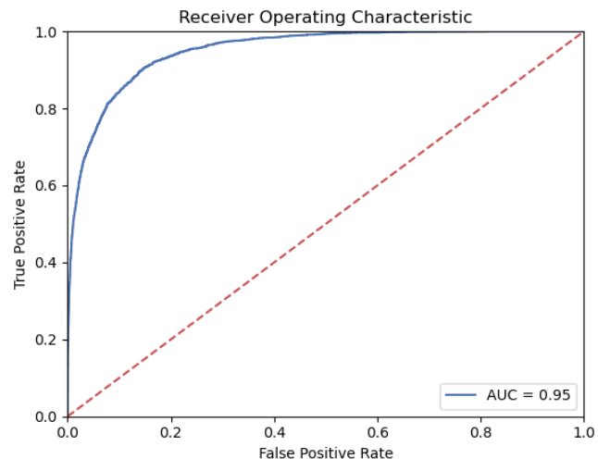
MODELLING
The preprocessed data for the project was then divided into training and validation data 4:1 ratio, to understand the accuracy of the models
To further validate models, metrics such as sensitivity, specificity, f1score, AUC ROC curve were used
We considered human error as proxy for bayes error to check whether we need to work on bias or variance.
After performing Hyper Parameter tuning the XGBoost model gave highest accuracy on train 0.99 and on validation 0.95
XGBoost Model was chosen as final model
This model is used on Test dataset to generate the outcome variable ‘target_variable‘, we should contact or
From total of 45211 Customer IDs, only 3991 customers were selected for Approaching the customer
Among these 3991 customers we were able to conclude that only 39 customers were coming under default category, so the default rate is only 1%

Slide 5
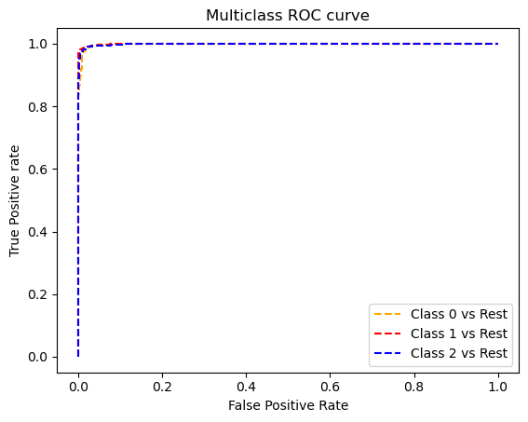
Cost-Benefit Analysis
For this analysis we have considered contact communication channel as dependent variable, and done multiclass classification on train data to check for the accuracy of the model and then determined the communication channel on test data
The XGBoost classifier worked great over here and provided highest accuracy for train data and for validation data accuracy of 0.9341 is observed
From the above table its observable that for targeting customers we will get highest profit for the unknown or 3rd party communication channel followed by telephone channel and at the last cellular
Whilst it is also visible that the success outcome, we will get max profit when the mechanism is cellular, as most of the data is available in this segment.
Total Profit is 579,324 USD for the overall campaign

Slide 6
Sensitivity Analysis
Assumption Considered
The profits from all the negative balance account holder is Zero
15% interest rate annually is considered for loan application
loan can be given maximum of 10% on annual average balance amount
Minimum Loan amount that can be availed is 200 USD
01
SENSITIVITY
For sensitivity calculation values from 0 to 100 are considered
Interest Rate to be considered is from 5% to 20%
We can observe that at 0 minimum loan amount we can get profitable at 10% interest rate
02
Strategic Decisions to be considered
03
We will get highest profit when the 20% interest rate even the 0 minimum amount is considered
Also we can see that the even the minimum amount increase to 100 USD we will get lower profitability

Slide 7
CONCLUSION
B
No more than 4 calls should be made to the same potential client
C
To reduce risk and generate profit minimum loan amount should be
A
Focus the marketing campaign during the months of March, September, October and December
After implementing all the models, we saw that the model that gave the best performance was XGBoost with RandomizedSearchCV .
D

Slide 8
THANK YOU

