Slide 1
Search Engines Project
TREC CDS 2014
Krunal Shah
CSC 849

Slide 2
TREC Clinical Decision Support 2014
In order to make biomedical information more accessible to physicians, and to anticipate their medical information needs, the Text Retrieval Conference (TREC) initiated the Clinical Decision Support (CDS) track to extract relevant medical documents.
Physicians often have difficult time in searching for the biomedical documents related to the problem of the patient.
So TREC CDS 2014 focuses on retrieving most relevant biomedical documents.

Slide 3
About TREC CDS 2014
About 733138 medical documents in NXML format.
Each document has an article-id through which it is identified
<article-id pub-id-type="pmc">3148967</article-id>
TREC CDS 2014 provides 30 different evaluation topics each containing a summary and a description.

Slide 4
Main task in TREC CDS
Indexing
Query Processing
Query Generation
Retrieving relevant documents

Slide 5
Indexing
Inverted Index is created using Indri.
The Krovetz Stemmer is used for Morphological Normalization.
Fields included during Indexing were: article-id, article-title, abstract, body, reference-list.

Slide 6
Query Selection
There are two options for the query selection among the topics
Description
Summary
‘Summary’ is being used as the query.

Slide 7
Query Processing
There are two main steps in query processing
MeSH On Demand
MeSH Entry Terms

Slide 8
MeSH On Demand
Medical Subject Headings(MeSH) is the National Library of Medicine's controlled vocabulary thesaurus.
It consists of sets of terms naming descriptors in a hierarchical structure that permits searching at various levels of specificity.
MeSH on Demand identifies MeSH Terms in your text using the NLM Medical Text Indexer (MTI) program. After processing, MeSH on Demand returns a list of MeSH Terms relevant to your text

Slide 9
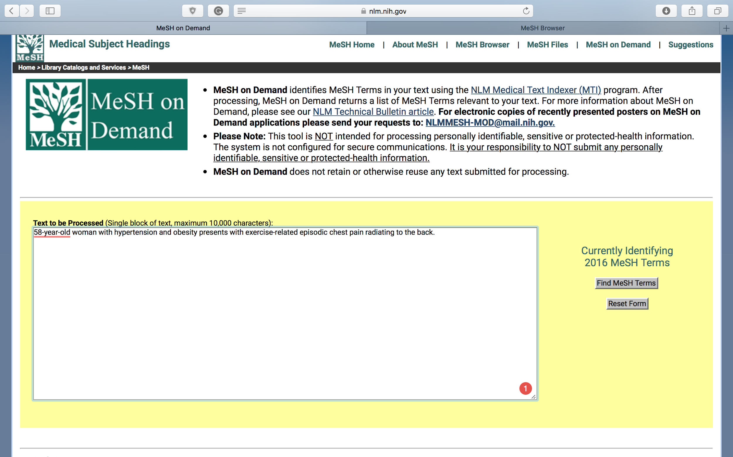

Slide 10
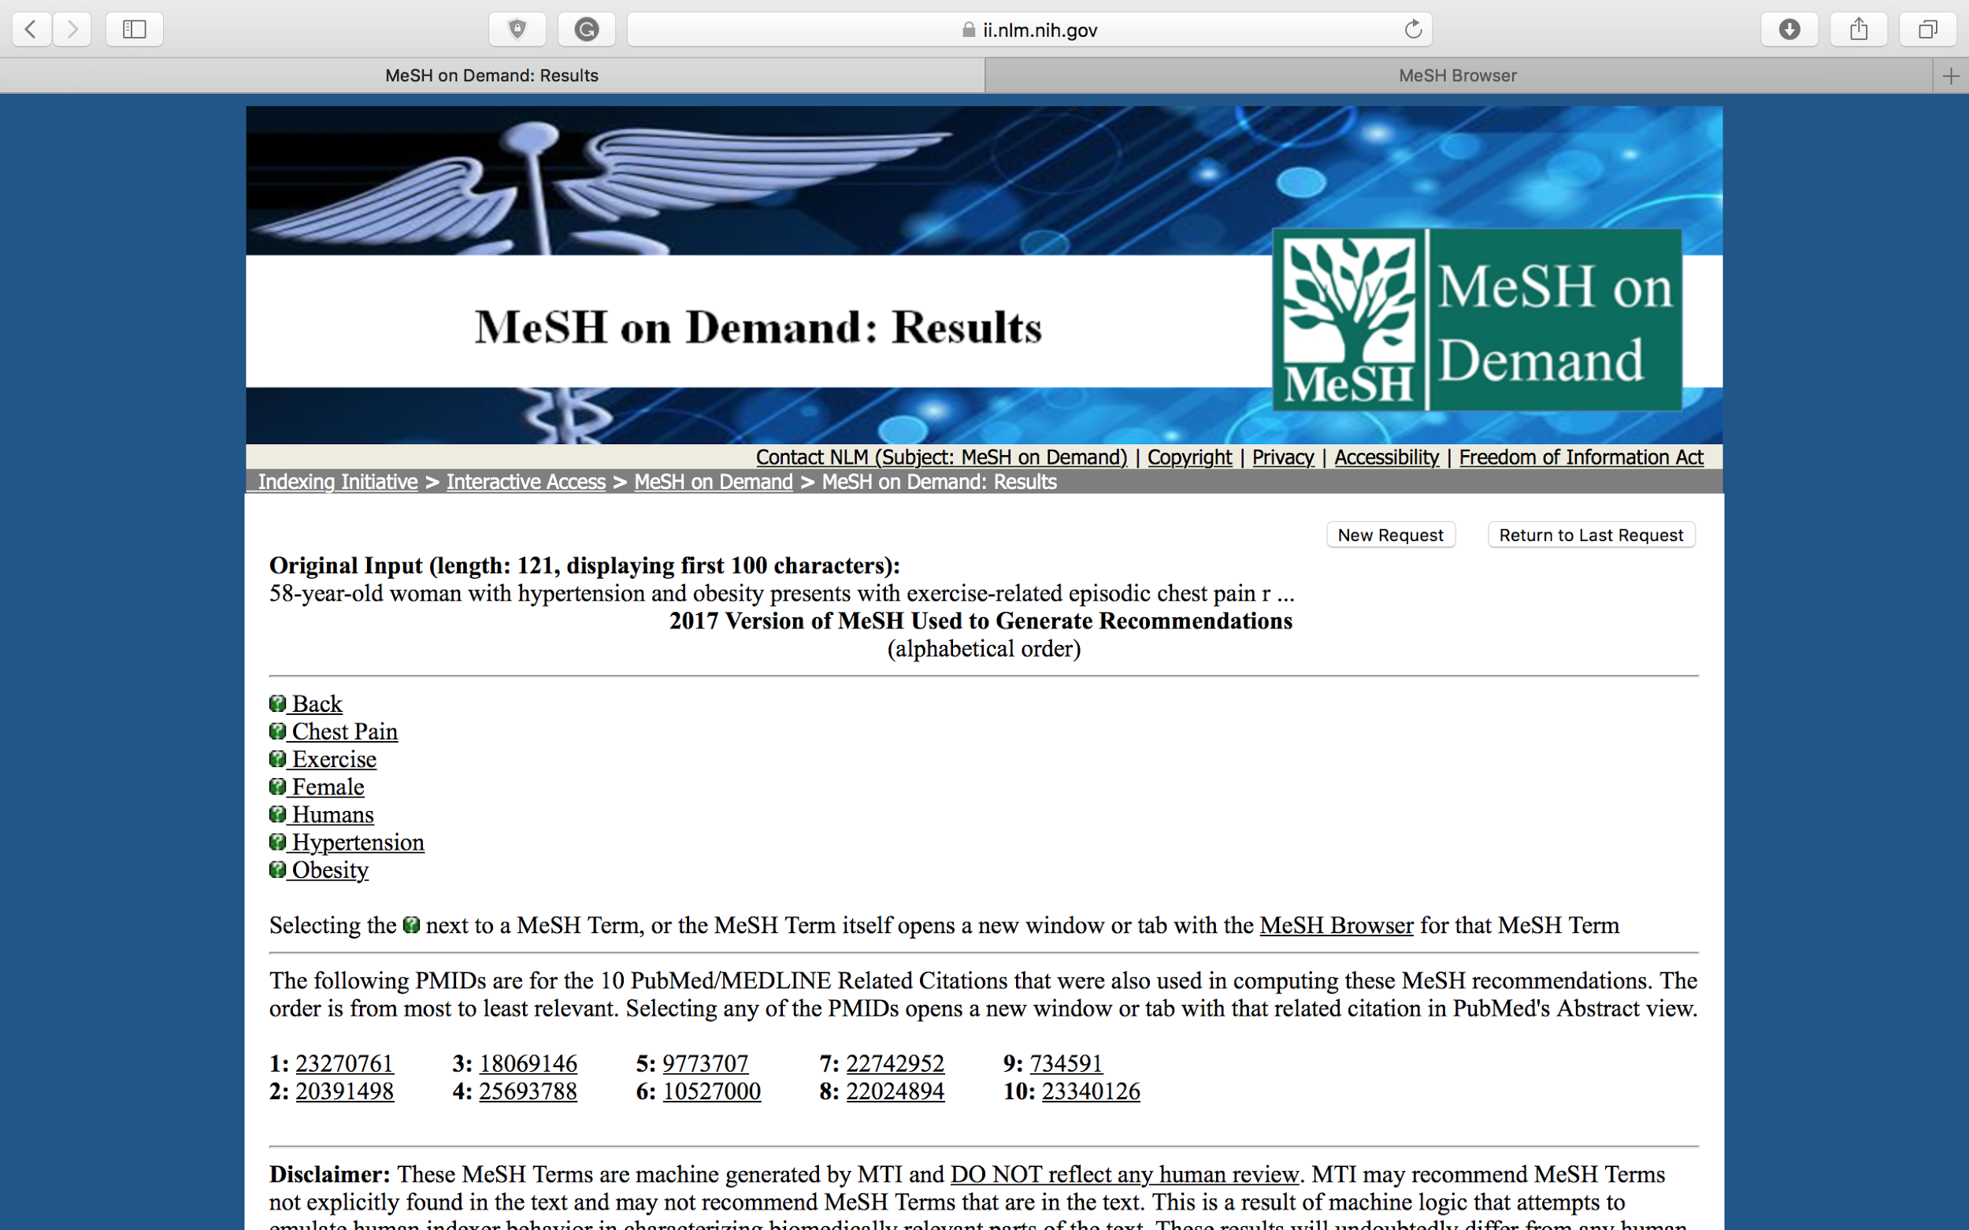

Slide 11
MeSH Entry Terms
Other similar terms possible for that query.
Entry terms, sometimes called "See cross-references" in printed listings, are synonyms, alternate forms, and other closely related terms in a given MeSH record that are generally used interchangeably with the preferred term for the purposes of indexing and retrieval.

Slide 12
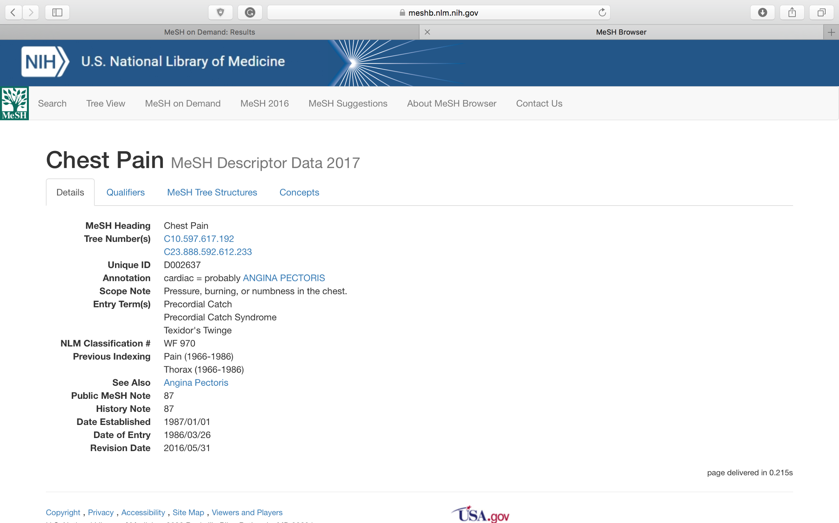

Slide 13
Query Generation
#combine() method is used to combine the synonym queries generated by all the terms.
Each term is given the same weight of 1
If there are two words for a single term they are given unordered window of 2 i.e uw2()

Slide 14
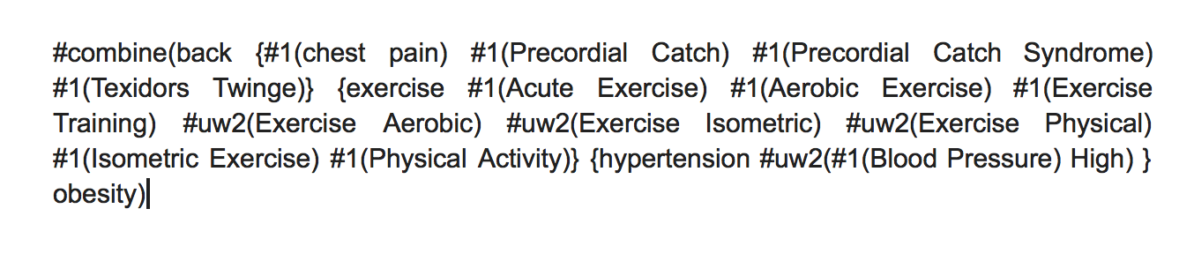

Slide 15
Running the Query
IndriRunQuery is used to run the query generated through the above process and it gives a list of relevant files.
The documents retrieved can be viewed either by DumpIndex or https://www.ncbi.nlm.nih.gov/pubmed

Slide 16
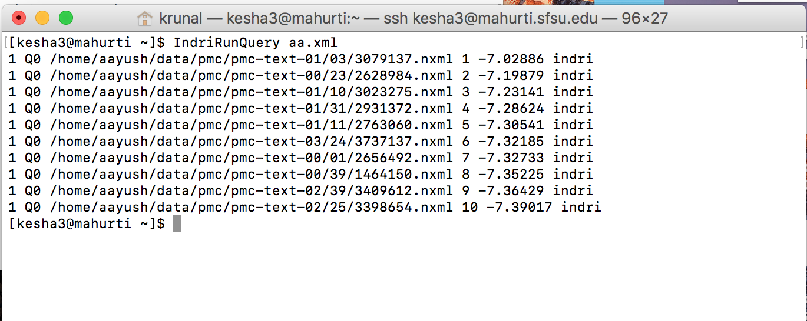

Slide 17
Future Work
Using MetaMap tool
Assigning weights to terms
Using MeSH as a tool
More on Query Processing

Slide 18
References
San Francisco State University at TREC 2014: Clinical Decision Support Track and Microblog Track
https://www.ncbi.nlm.nih.gov/pubmed
https://www.nlm.nih.gov/mesh/MeSHonDemand.html
https://www.nlm.nih.gov/mesh/mbinfo.html
Query Refinement: Negation Detection and Proximity Learning Georgetown at TREC 2014 Clinical Decision Support Track

Slide 19
Thank you

