Slide 1
TriePDC: Parallel Text Pattern Matching
Krunal Murlidhar Kumbhare
19BCE1210
Parallel and Distributed Computing

Slide 2
Brief overview
The process of pattern matching at line speeds is a memory and computation intensive task. It requires dedicated hardware algorithms.
I have worked on making an application which would efficiently search a directory by indexing using multiprocessing and searching using Trie data structure.

Slide 3

Trie Data Structures
Tries are ordered tree data structure that use the ”thumb indexing” method of dictionaries to store and retrieve information.
Information is stored in tries as paths from root node to the leaf nodes and information is retrieved by traversing to the leaf nodes through the root node.
Trie based schemes perform search by looking at multiple bits at a time. This feature determines the degree of the trie.

Slide 4

Searching for a pattern requires partitioning address bits into sections of ‘m’ bits and addressing different levels of mary trie. The Trie depth is given by equation-
where X is the degree of the trie.

Slide 5
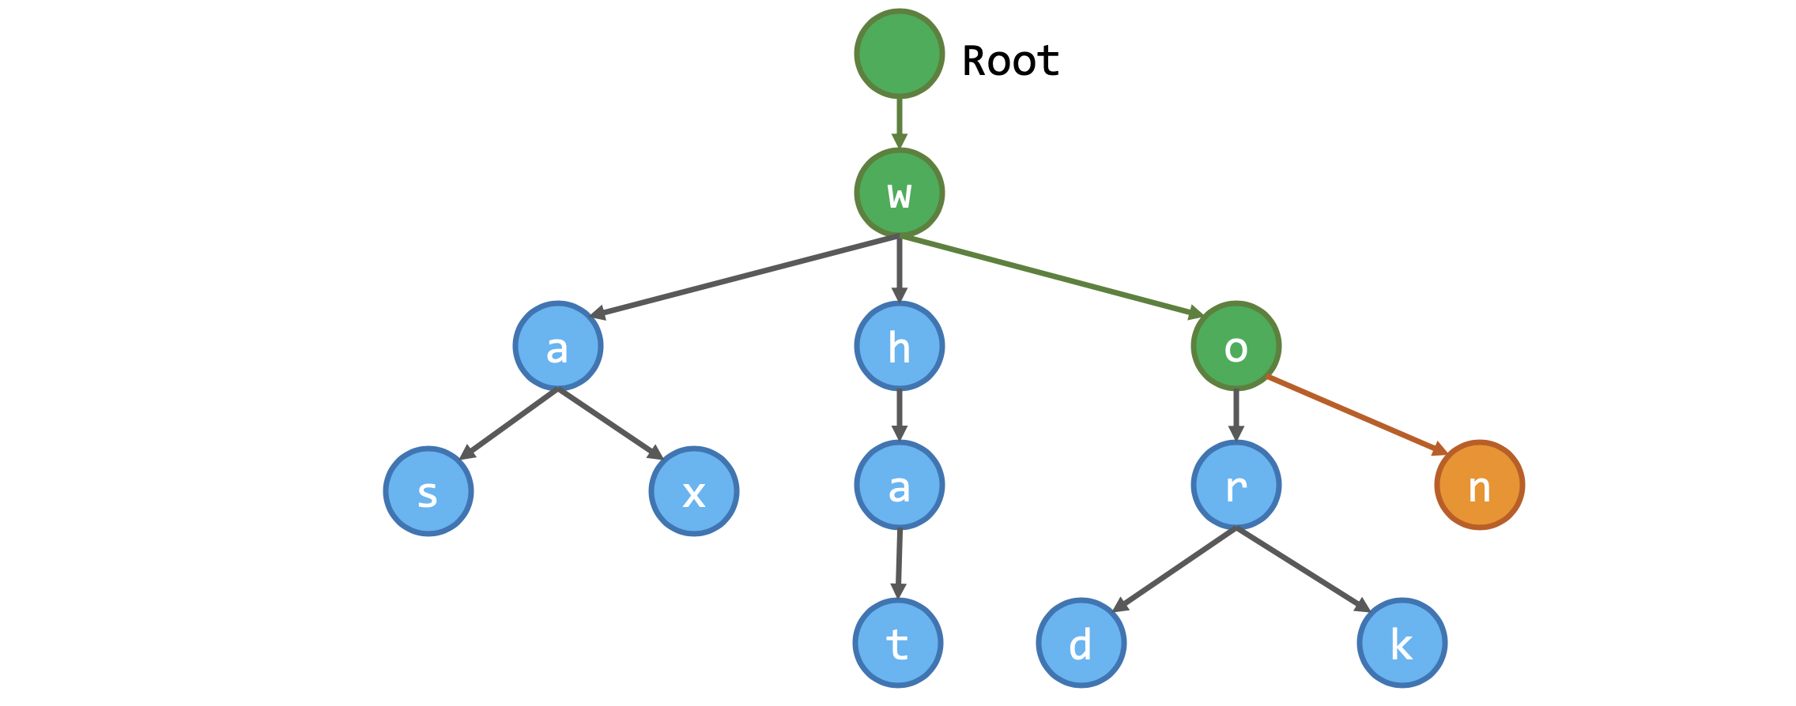
Example for Trie data structure
Was
What
Wax
Word
Work
won

Slide 6
Algorithm for storing indexed data
The texts from text files in the current directory are read.
Characters like '.', ''', ',', ';', etc. are removed.
The cleaned text from step 2 is stored in a variable.

Slide 7
The structure of the JSON ( data.json) is as follows:
{ word: {
"File": {
"filename1.txt": {
"Line": [ i1, i2, i3, ..., in]
},
"filename2.txt": {
"Line": [ j1, j2, j3, ..., jn]
},
}
}
}
4. Multiprocessing concept is used to index the files efficiently.
Texts from read files in this directory ( which is in a variable) is taken to different processes using multiprocessing
Then the data is stored in JSON file in the above format by each process.

Slide 8
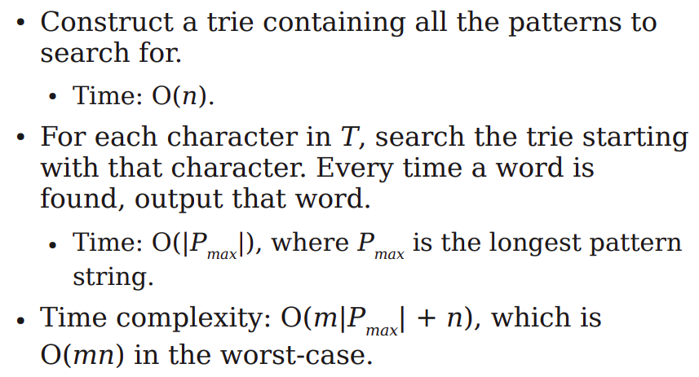
Pattern Matching Algorithm
The data from JSON ( data.json) is read.
The Trie eases the process of searching.
If match is found then file name along with line numbers of word is returned.

Slide 9
Other applications
Pattern searching
Word autocomplete
Sentiment analysis
Search engines
Data analytics

Slide 10
References
https://ieeexplore.ieee.org/document/4252902
https://web.stanford.edu/class/archive/cs/cs166/cs166.1146/lectures/09/Small09.pdf

Slide 11
Thank you for your time!

