Slide 1


A PROJECT ON FLIGHT DATA ANALYSIS AND FLIGHT DELAY PREDICTION
Submitted in partial fulfilment for the award of PGDiploma in Big Data Analytics from IACSD(Pune)
PRESENTED BY : Krunal Padade & Sujit Nair
UNDER THE GUIDANCE OF : Mr. Akshay Tilekar, Data Scientist, Data Axle, Pune

Slide 2

Uncertain Weather

Slide 3
Introduction
In the last few years, air travel has become a common, easy and affordable mode of transport.
Over 100,000 commercial flights operate on a daily basis, around 200,000 flights arrive delayed each year which causes huge losses for airlines as well as their customers.
Flights can be delayed due to various reasons, one of them being, extreme weather conditions.
Predictive Machine Learning Model of a Classifier Using flight and weather information.

Slide 4
Goal and Scope
The goal is to examines the impact of various weather conditions on the arrival delay for 15 domestic flights in the United States.
It uses a machine learning model to classify and predict the arrival delays of various flights in 15 different airports during the years 2016 - 2017.
The machine learning engine’s Classification algorithms are then evaluated with standard metrics and hence compared.

Slide 5
Requirements
Packages used :
Pandas
Numpy
Sklearn
Seaborn
Matplotlib
Framework used :
Flask
Gui interface :
HTML
CSS

Slide 6
Project Summary
Understanding of business need
Collection of data
Understanding of flight data
Preparing data for modeling
Creating predictive models
Creating Web UI with Flask
Model Deployment

Slide 7
Bussiness Problem Statement
Crowded airspace becoming unpredictable
Rescheduling of air space operations because of weather
Bad customer satisfaction for residents
Sudden surge/decrease in the airfare
Solution :
Delay Prediction

Slide 8
Data
Data source :
Flight : The flight data has been sourced from the ”On-Time” database of the TranStats data library
Weather : The weather data has been sourced from World Weather Online.
Data content:
Weather features of 15 different airports for calender year 2016 and 2017
Flight features of 15 different airports
Data understanding :
Available variables
Relationships
Data Preperation :
Missing values
Outliers
Redundant variables

Slide 9
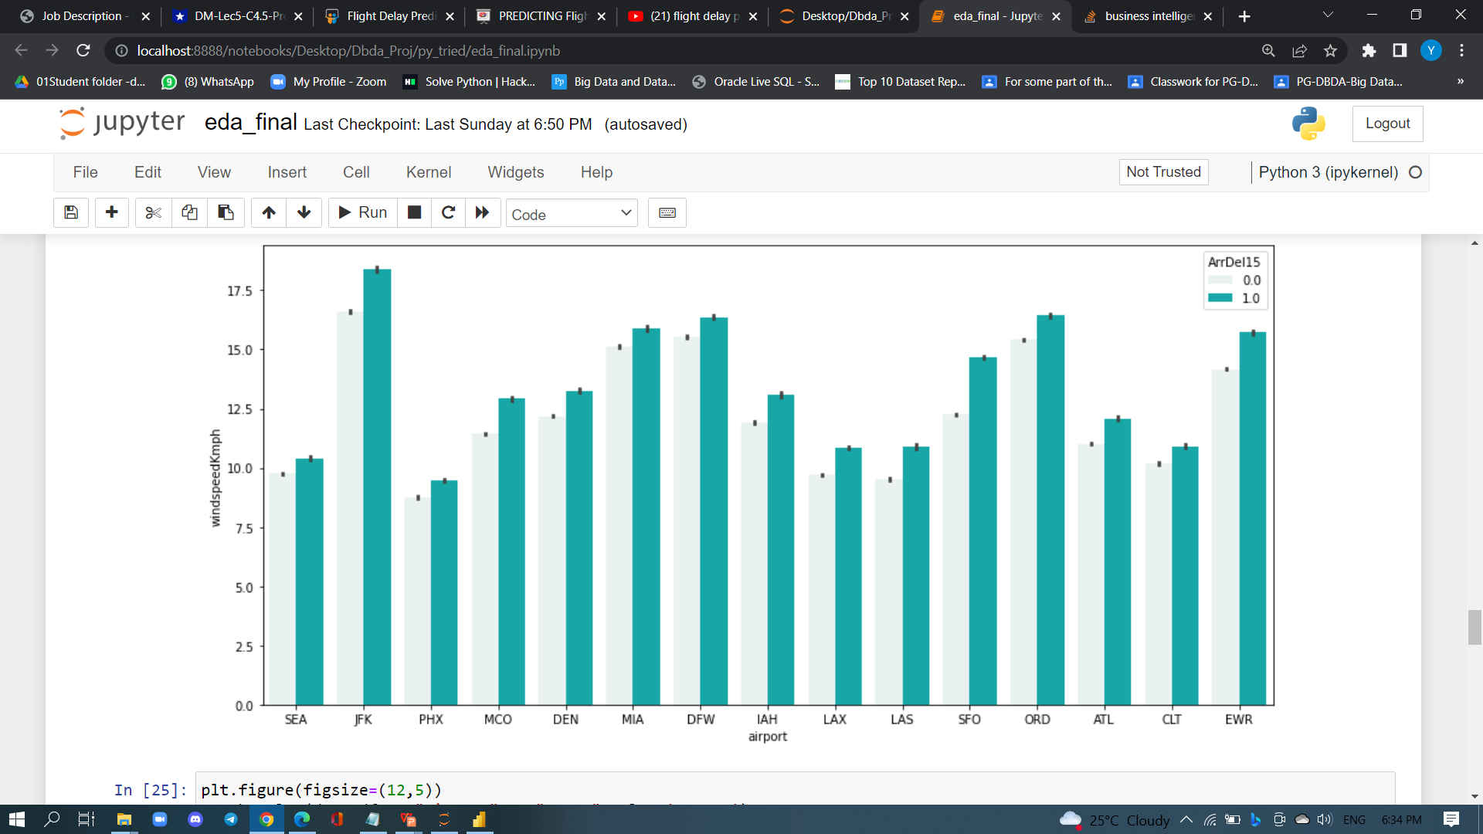
Preliminary Findings- Airports Vs Delay Vs Windspeed
Highest Average windspeed at JFK airport
Flights are getting delay when windspeed is high

Slide 10
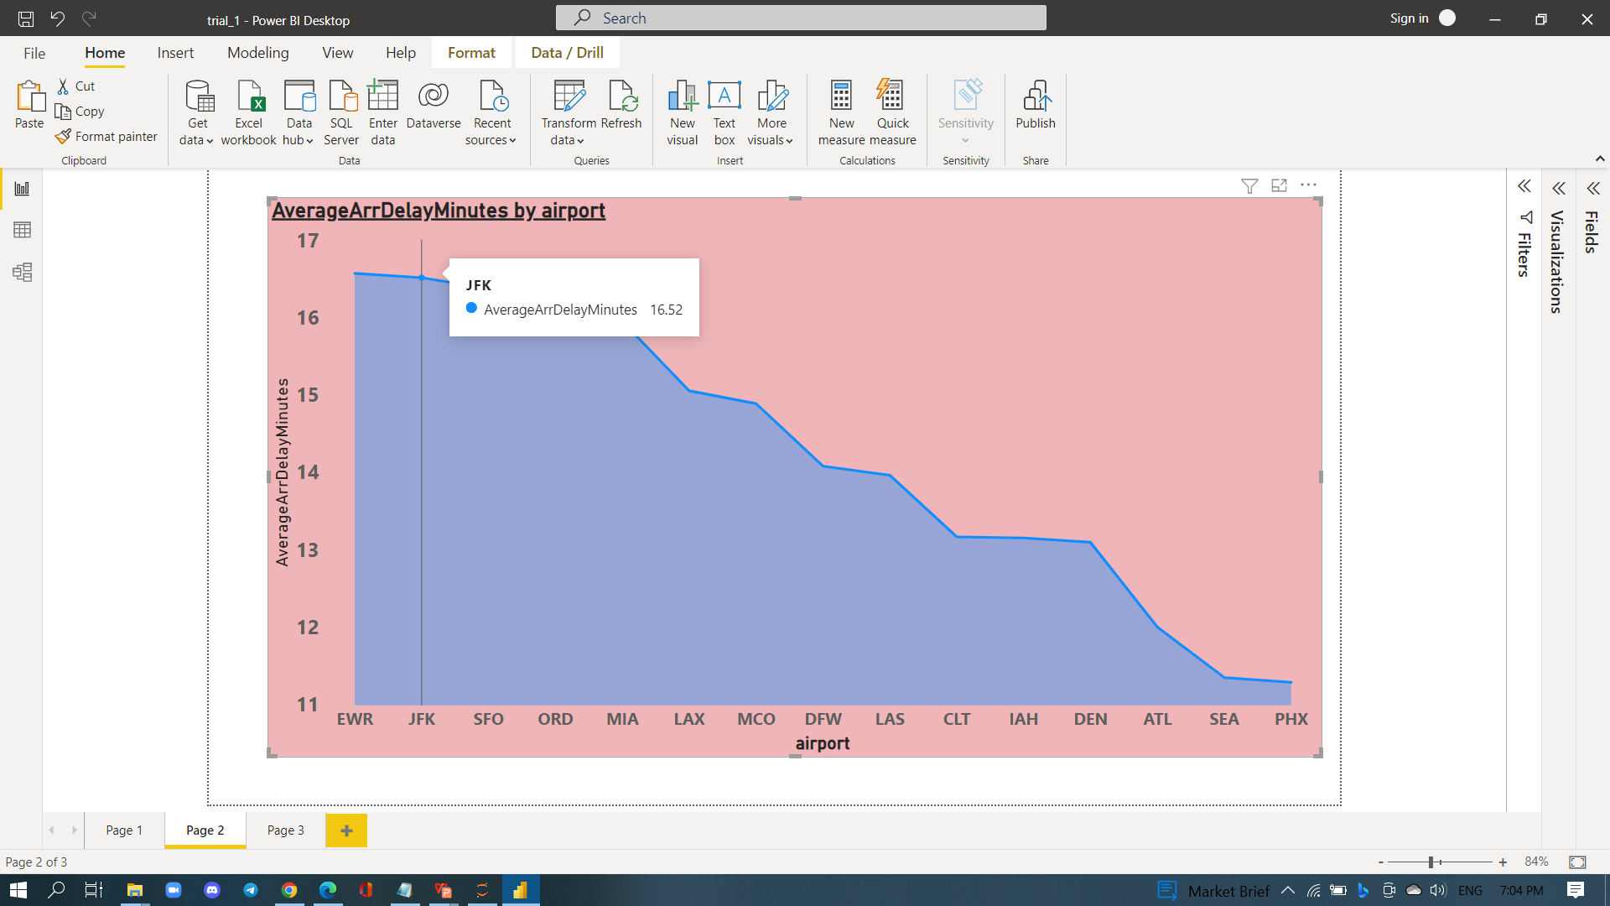
Preliminary Findings- Minutes Vs Delay
This airport has highest windspeed and almost highest delay in minutes
Average minutes are high for high windspeed airports

Slide 11
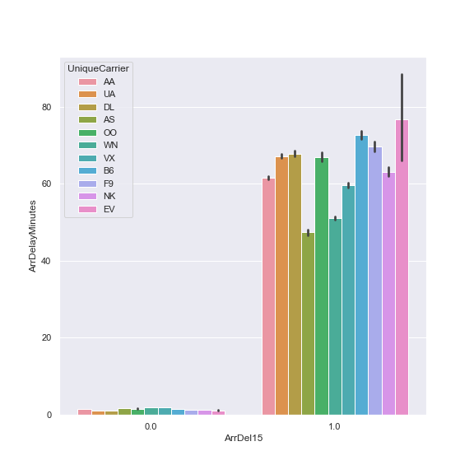
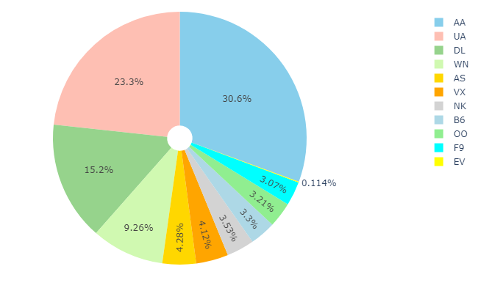
Preliminary Findings- Airlines vs Delay
Flight is not preferred as it had high delay in minutes

Slide 12
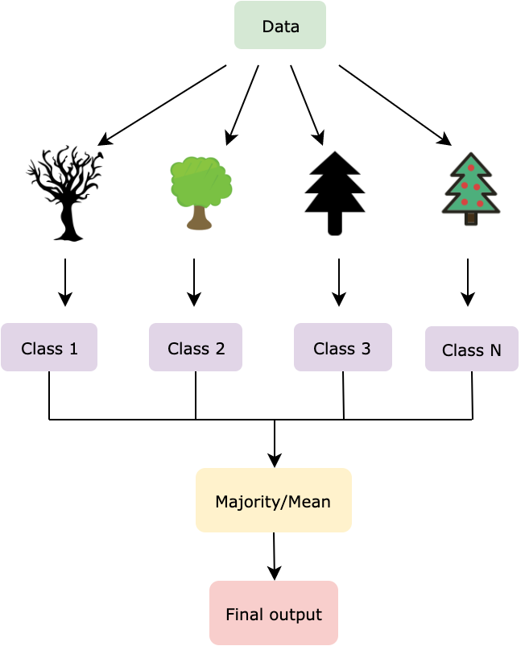
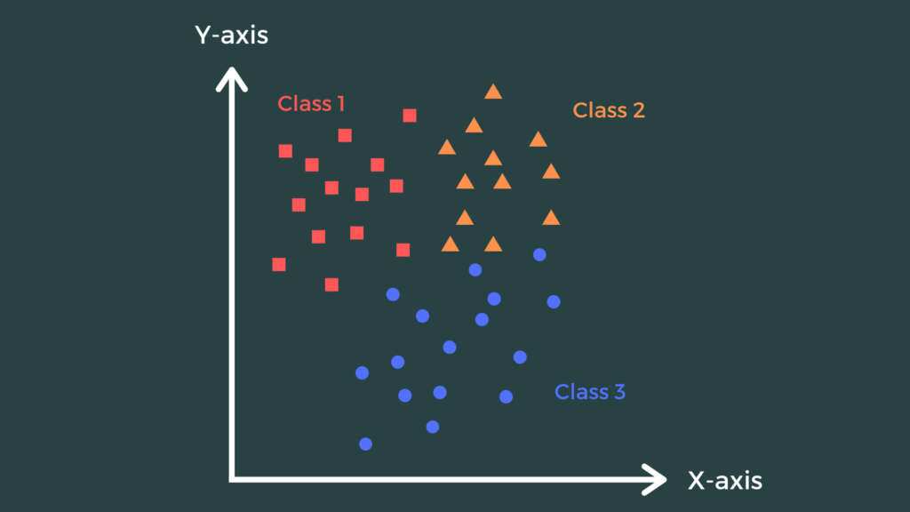
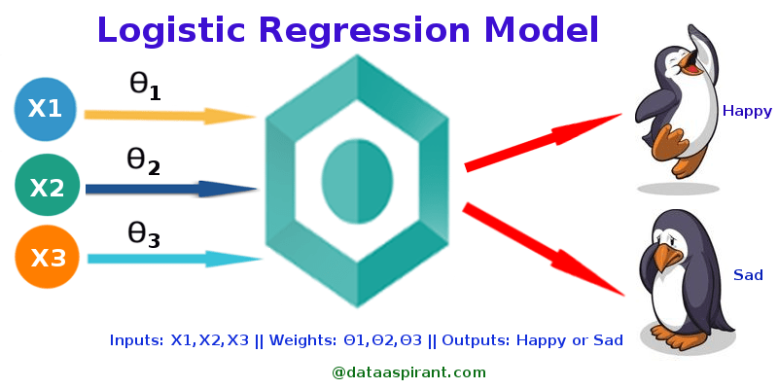
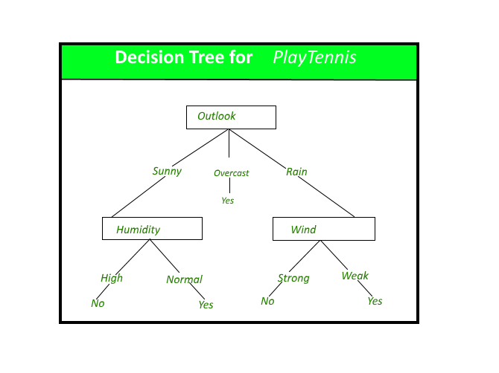
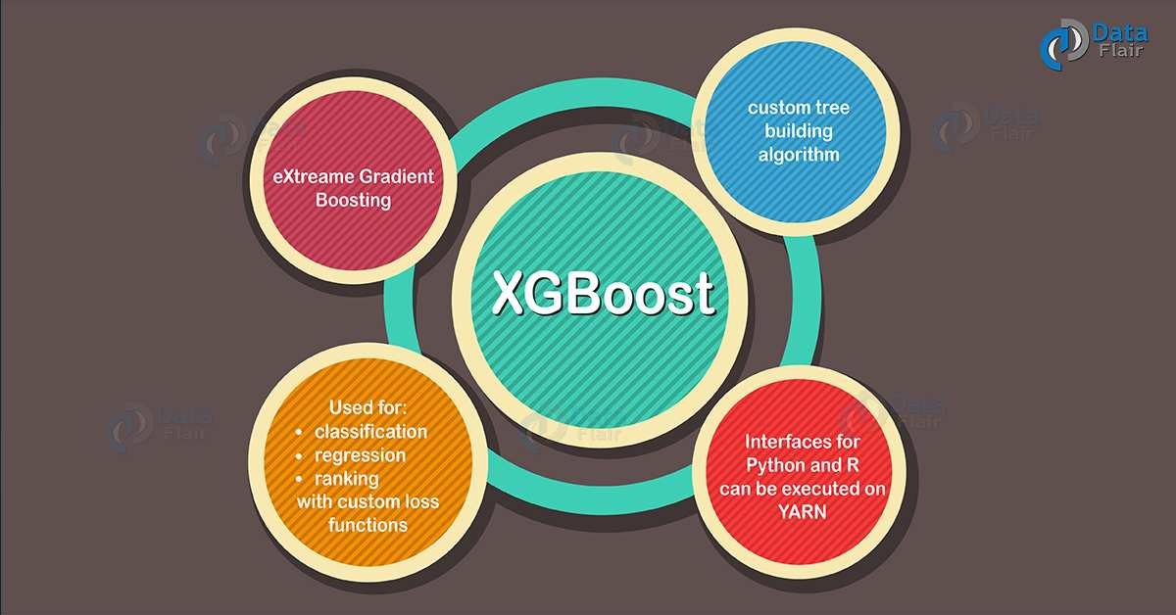
Models
Classification :
KNeighbors Classifier
Logistic Regression
Random Forest
Decision Trees Classifier
XGBoost Classifier

Slide 13
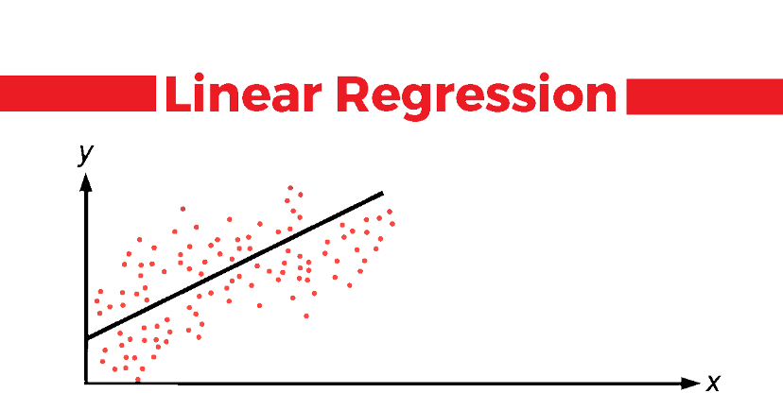
Models
Regression :
Linear Regression
XGboost Regrssor
Random forest Regressor
Decision trees Regressor

Slide 14
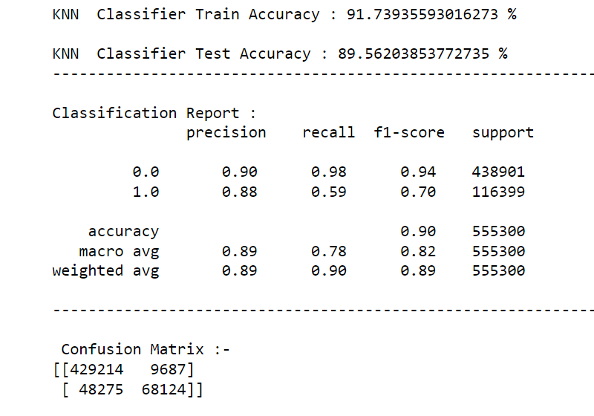
KNeighbors Classifier

Slide 15

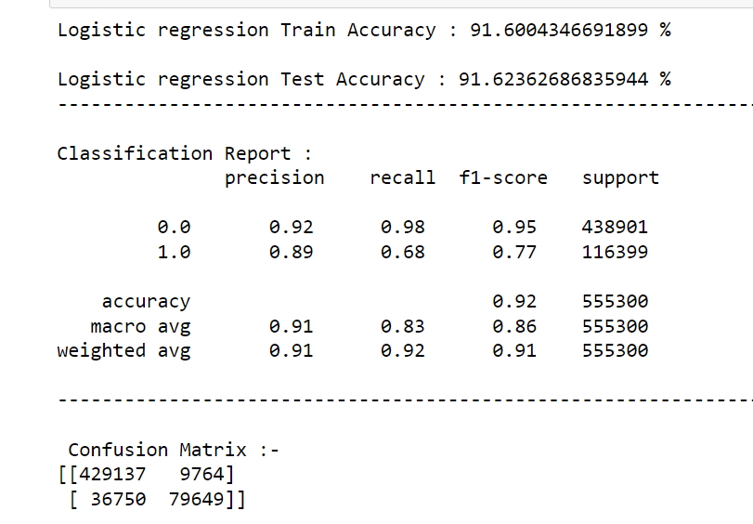
Logistic Regression

Slide 16
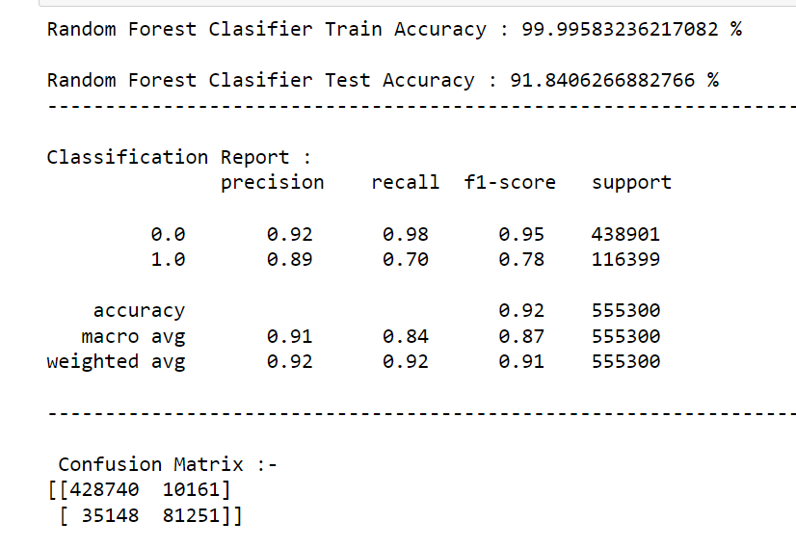
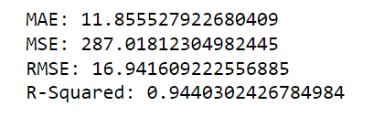
Random Forest

Slide 17
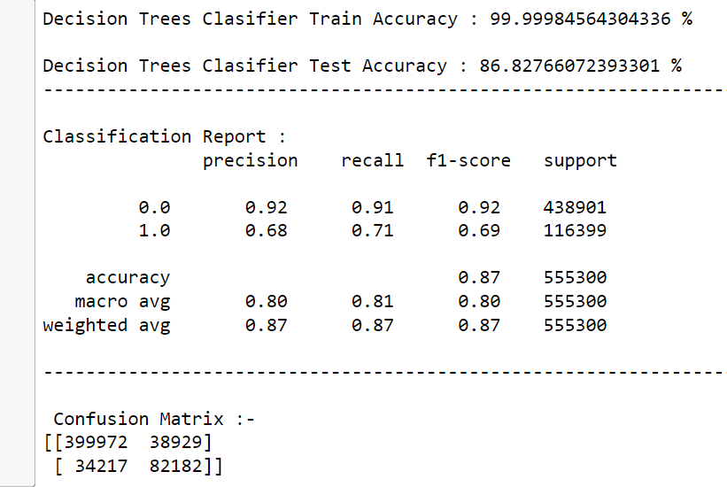
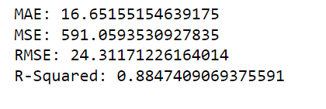
Decision Trees

Slide 18
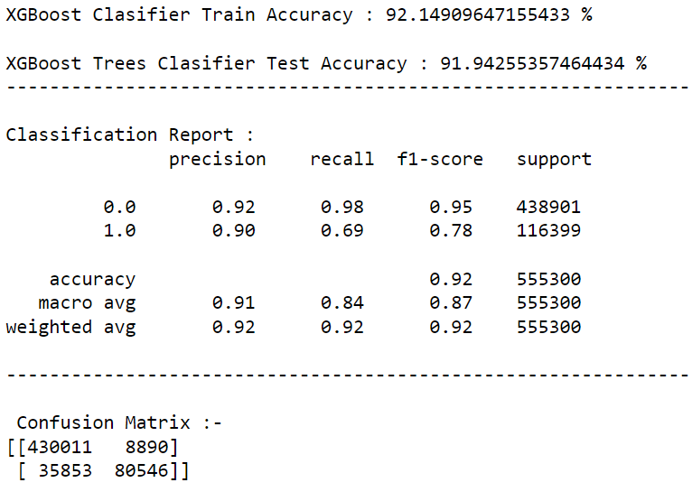
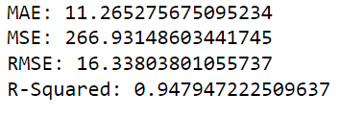
XGboost

Slide 19
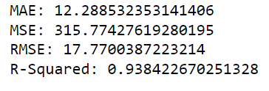
Linear Regression

Slide 20
Evaluation Of Predictive Models
Classification :
Confusion Matrix
classification_report
accuracy_score
Regression Matrx :
MAE
MSE
RMSE
R-Squared

Slide 21
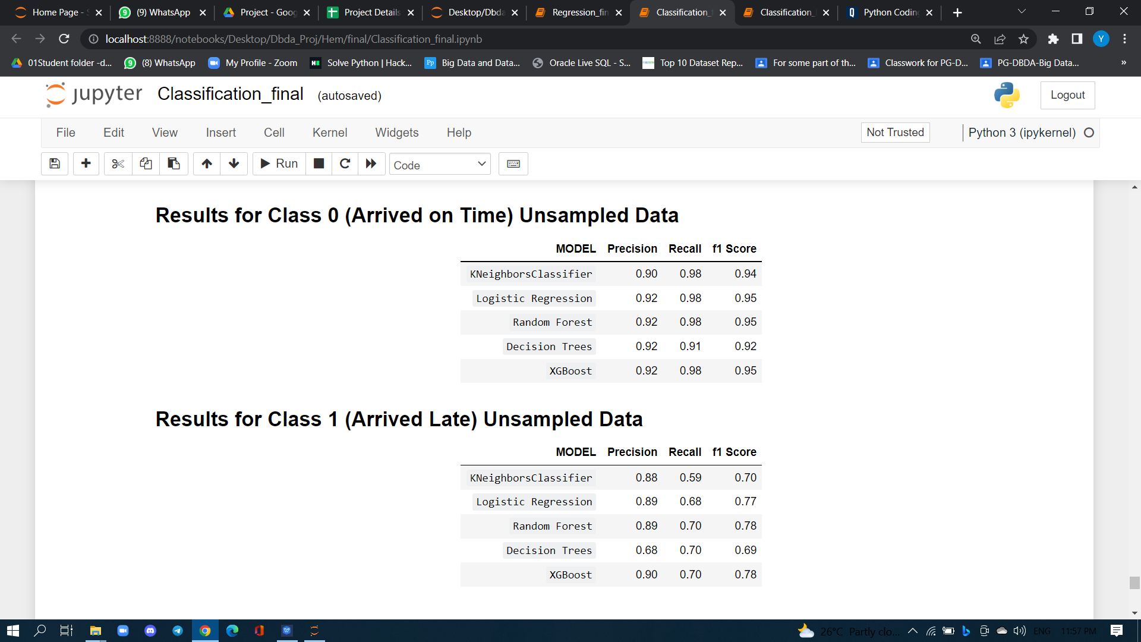
Flight Delay Classification Results

Slide 22
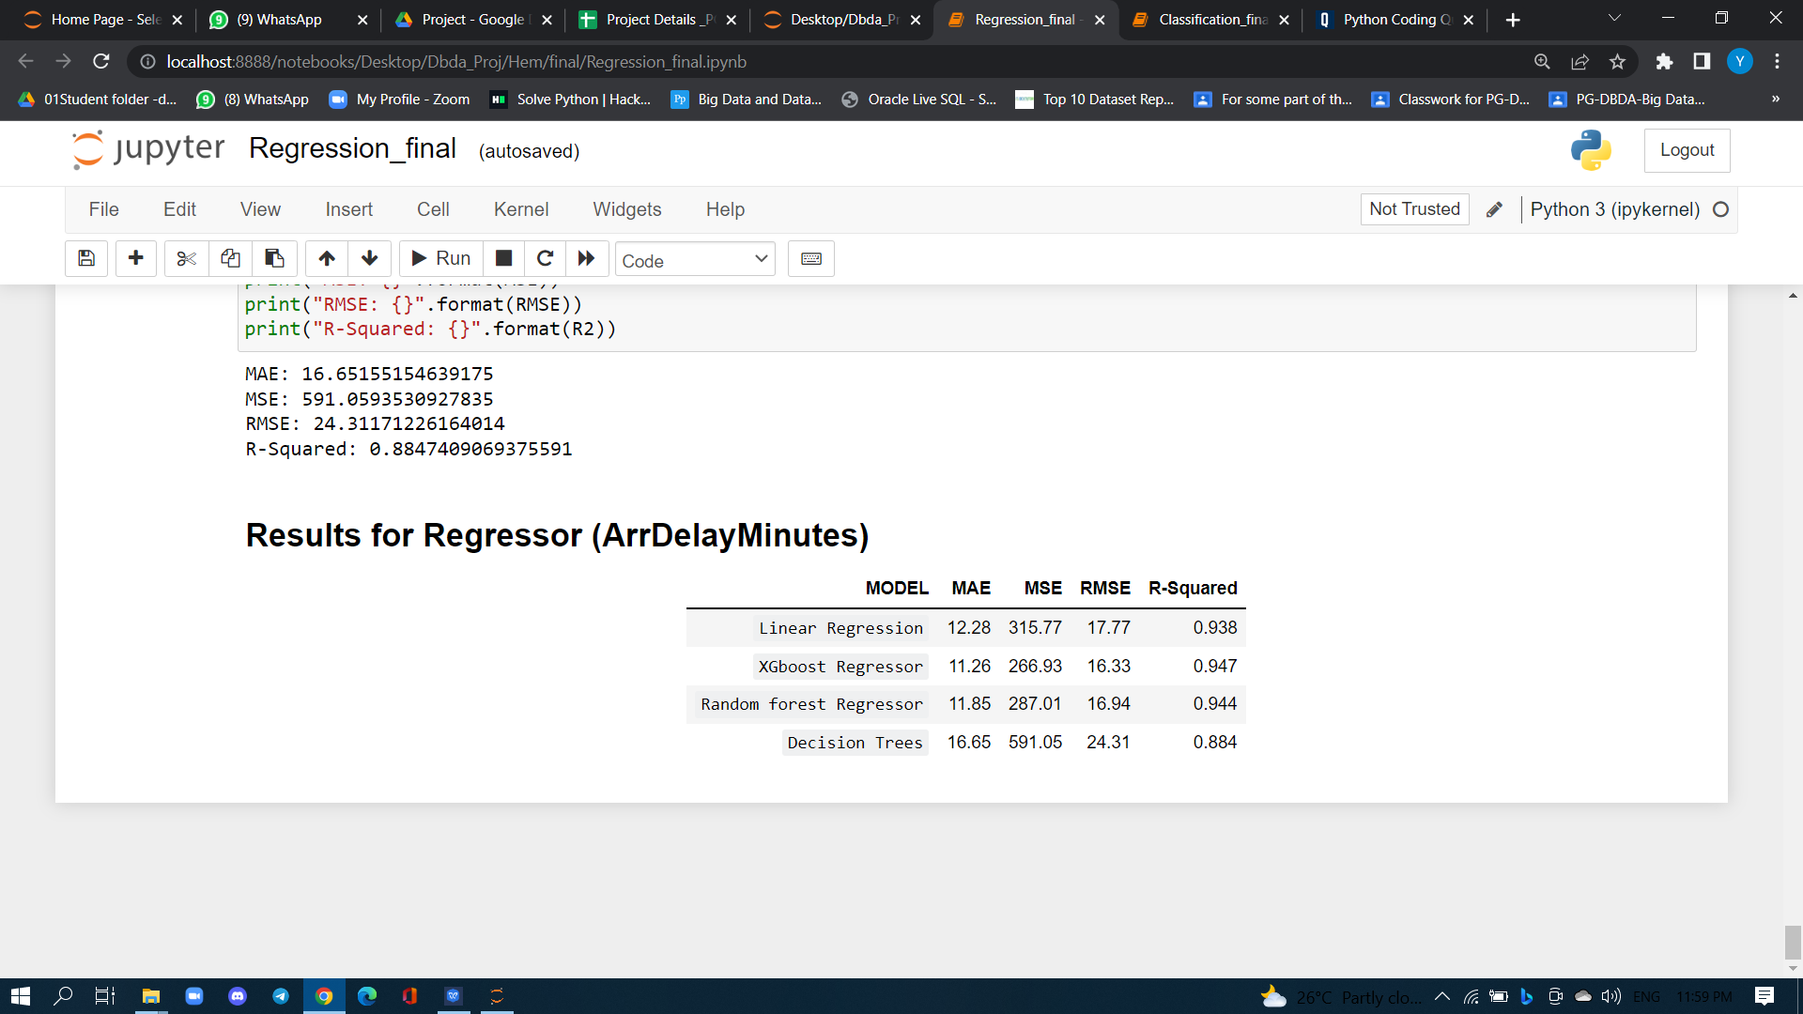
Flight Delay Regression Results

Slide 23
Web UI With Pickle And Flask
Using flask framework the web UI can be designed
Flask framework helps in creating the rest server and applying http method onto the model building

Slide 24
Flow Diagram
Data merging
Algorithm
Data merging
Data merging
Model Building
Model Building
Dataset
Model Building
Dataset
Dataset
WebUI
WebUI
Deployment
Deployment
User

Slide 25
Control Flow Diagram
Enter Input
Departure date
Arrival date
Flight origin
Flight Destination
Select Airlines
START
Predict delay
ML Algorithm
Display prediction
STOP

Slide 26
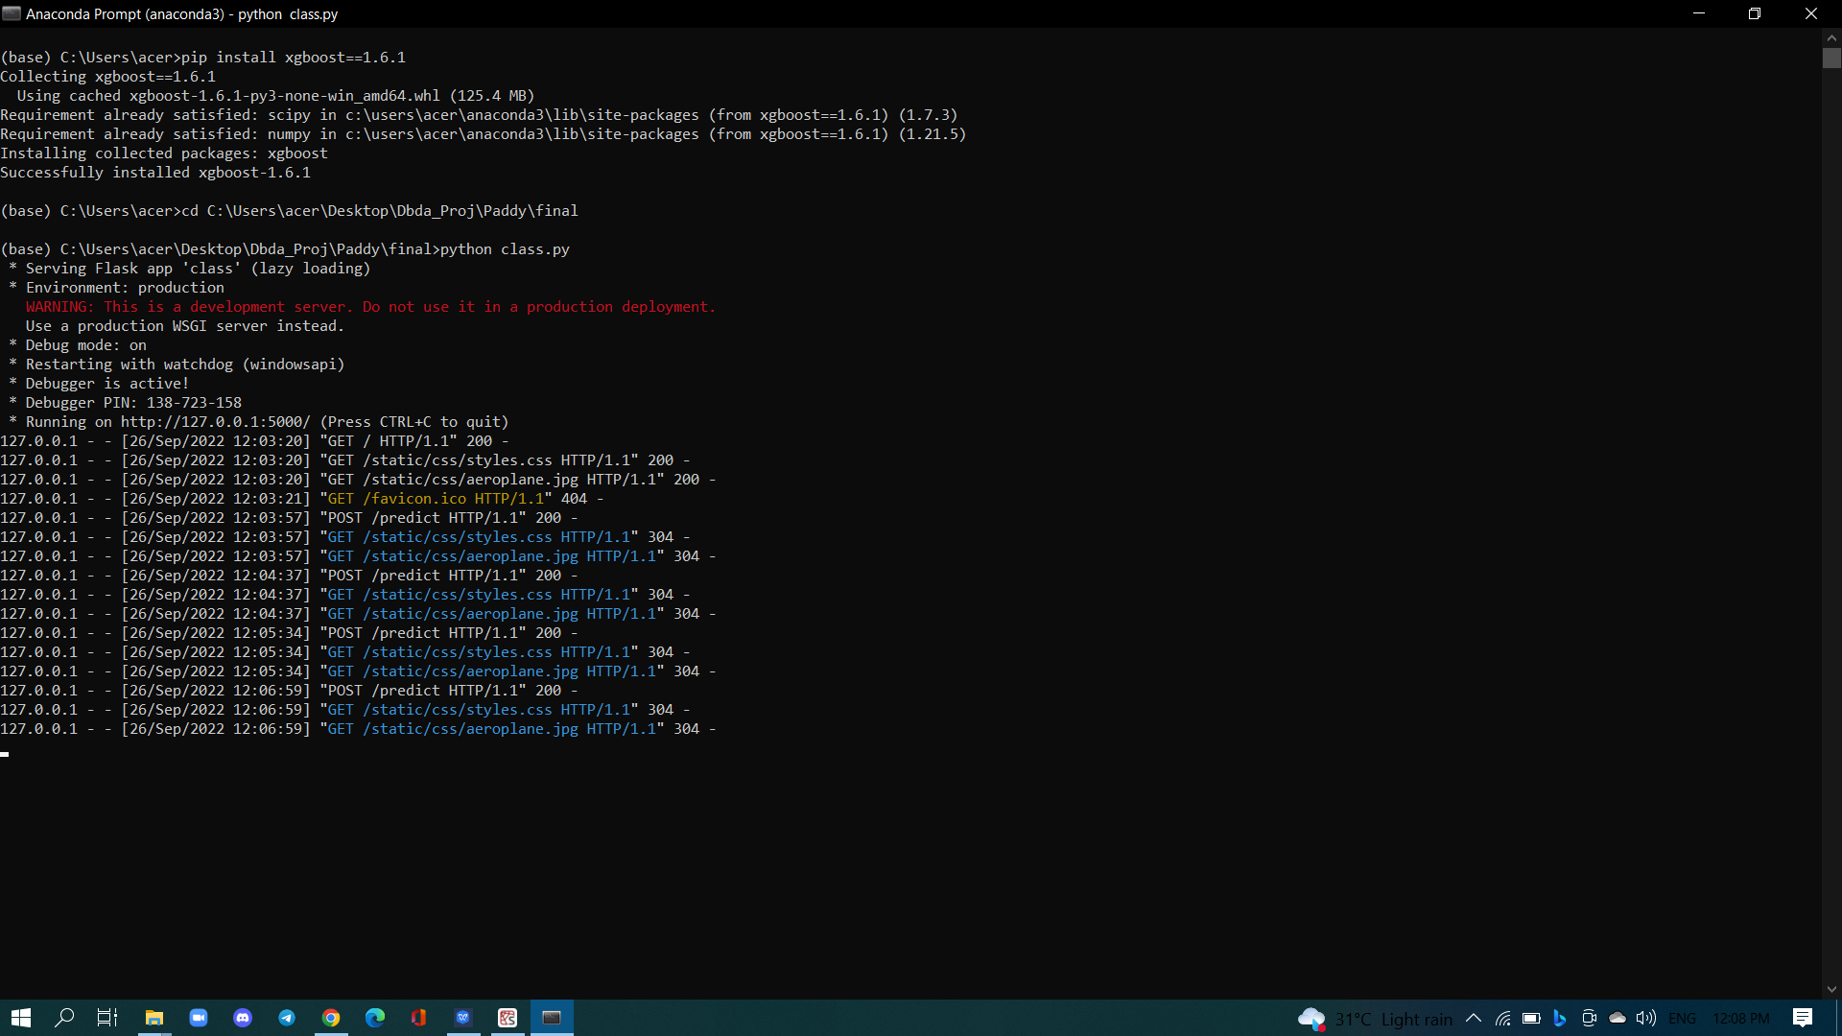
Command Prompt

Slide 27
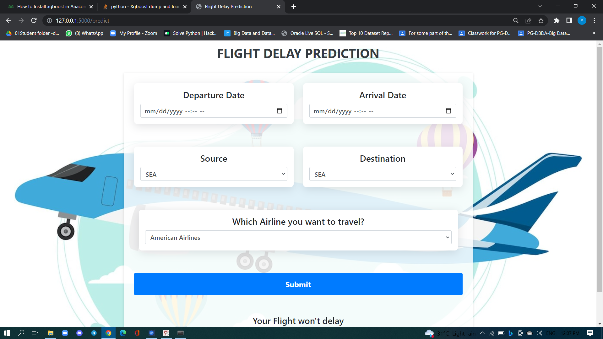
Input Page

Slide 28
Output Page

Slide 29
Thank You

