Slide 1


BDM 1034
Sentiment analysis
Project milestone 2
Presented by: Group 6

Slide 2


CONTENT
01
MASTER DOC SLIDES
02
DATA PREPROCESSING
03
FEATURE ENGINEERING
04
MODEL BUILDING
05
MODEL INTERPRETABILITY
06
MODEL EVALUATION AND HYPERTUNING PROCEDURES

Slide 3




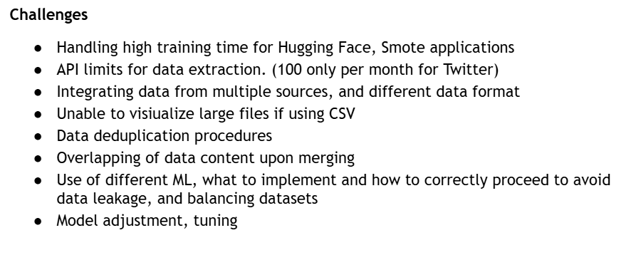



MASTER DOC SLIDES AND LEARNINGS

Slide 4






DATA PREPROCESSING
Embedding generation
Tokenization
Text normalization
We transformed the text into numerical vectors that capture its semantic meaning, enabling easier analysis and comparison.
We split the text into individual units, such as words or subwords, to facilitate further processing and analysis.
We have removed the stop words, user handles and transformed emojis to text for better prediction

Slide 5
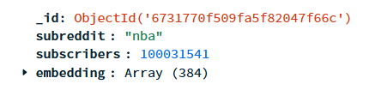
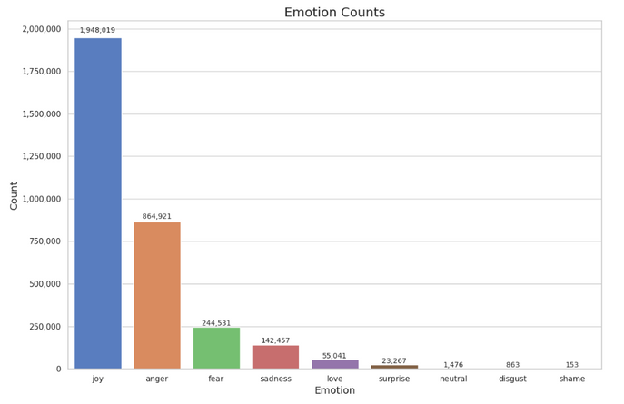
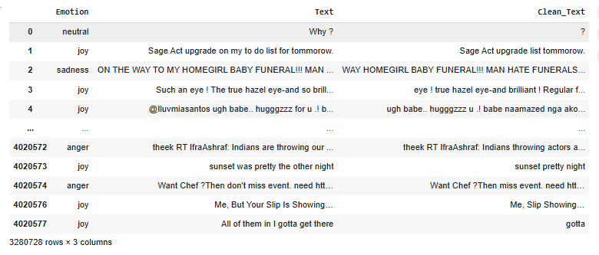
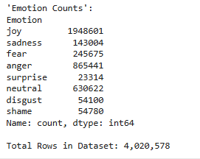
FEATURE ENGINEERING AND DATA PREPARATION
What are your Features?
Identifying relevant features
Using pre-built model to identify emotions
Truncate long inputs
Dividing huge dataset into smaller chunks
Then finally combining all divided dataset into one file
EDA on combined dataset
Duplicate dropping , counts
Identifying Imbalanced text
Stop words removal using Neattext
Cleaning of text to remove userhandles

Slide 6

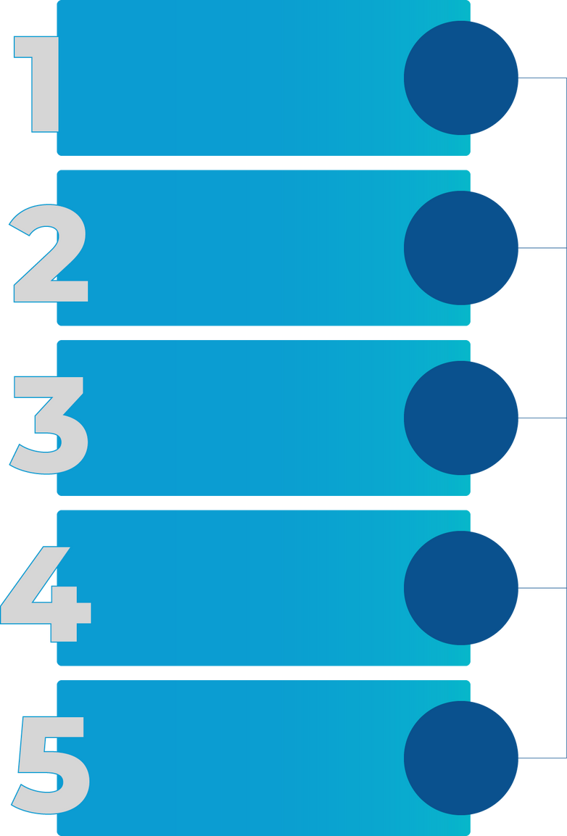
MODEL BUILDING
Unlabeled Data
We began with raw text data like tweets and retweets, titles, and scores
We used a pre-trained model from Hugging Face to automatically label the data.
Label Generation
Train-test split
We divided the data into 70% for training and 30% for testing the model.
One emotion stood out from the rest, so we balanced the data by reducing the number of instances in the majority class
Undersampling
Model Training
We then trained our own model on the labeled data.

Slide 7


MODEL INTERPRETABILITY
LOGISTIC REGRESSION
SVM
RANDOM FOREST
Training accuracy: 86.3%
Test Accuracy: 79.92%
AUC: 0.78
Training accuracy:88.32%
Test Accuracy : 84.09%
AUC : 0.84
Training accuracy: 92.35%
Test Accuracy: 88.6%
AUC: 0.86

Slide 8

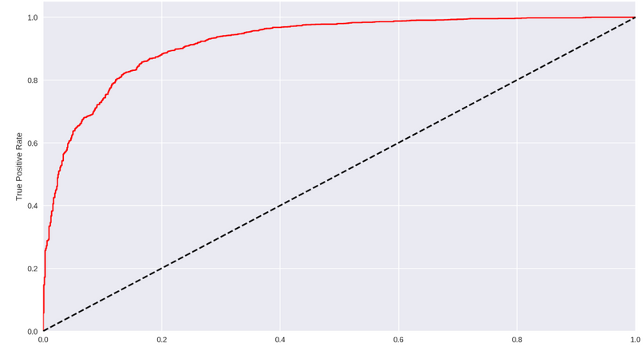
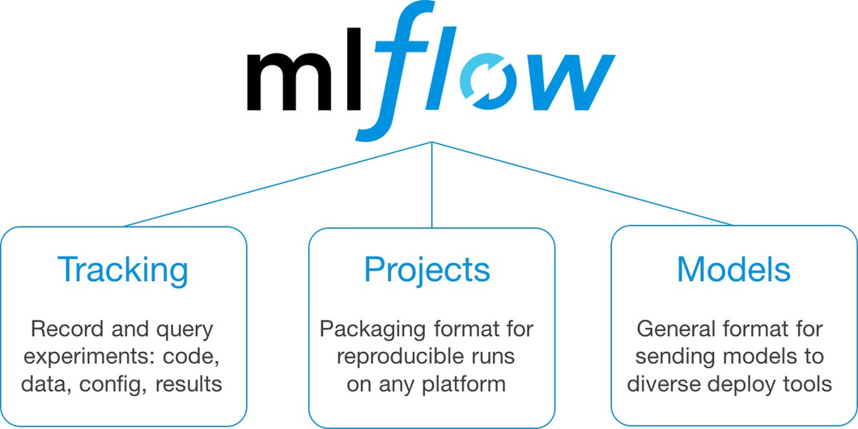
MODEL EVALUATION AND HYPERTUNING PROCEDURES
ROC AUC of the Random Forest model is the highest
Hyperparameter tuning done on the models:
Outlier optimization
Used GridSearchCV

Slide 9



THANK YOU!
80%
From: Group 6

