Slide 1

Milestone -2
Agents and Frameworks: The Future of AI Systems
Notes:
Good Morning everyone. Thank you for being here. My name is Komal Nandal and my partner’s name is Ridham Patel, and today We are excited to present our group’s milestone project on AI Agents and Frameworks. We’ve entered a new era of AI—one where intelligent agents are no longer just tools, but collaborators.
This presentation will walk you through what AI agents are, why they matter, how frameworks help build them, and explore some of the most powerful frameworks available today. We'll also show how these agents operate step by step, and give examples from real-world applications.

Slide 2

Project Members
Yorbis Daniel Alarcon Rojas : C0941168
Krunal Patel : C0936008
Ridham Patel : C0935656
Gustavo Vera Suarez : C0917164
Het Patel :
C0933081
Komal Nandal : C0938518
Mahek Ghanchi : C0937254
Kamali Patel : C0933954
Sang sun Lee : C0905412
Notes:
This project was made possible through the efforts of our entire team, including Yorbis, Gustavo, Mahek, Krunal, Het, Kamali, Riddham, Sangsun, and myself—Komal. Each member contributed valuable research and insights into this rapidly evolving field

Slide 3
Defining AI Agents: Perception to Action
AI agents are autonomous entities capable of intelligent behavior. They operate through a core cycle of perception, reasoning, and action.
Component
Description
Key Function
Perception
Agents gather data from their environment.
Interpreting diverse inputs.
Reasoning
They process information to make decisions.
Planning and problem-solving.
Action
Agents then execute chosen responses.
Generating outputs or commands.
Notes:
Let’s begin by defining what we mean by an AI agent. An AI agent is an autonomous system capable of perceiving its environment, reasoning to make decisions, taking action, and even learning from feedback
This process mimics how humans operate. We take in data through our senses, think about it, take action, and learn from the results. In the same way, AI agents use sensors, logic, memory, and tools to behave intelligently in dynamic environments.
At its core, the agent lifecycle is about perceiving inputs, planning, executing, and learning. And thanks to advances in large language models, agents today are more than just responsive—they're proactive, contextual, and continuously improving.

Slide 4


Defining AI Agents: Perception to Action
At its core, an AI agent is an entity designed to perceive its environment, make decisions, take actions to achieve specific goals, and learn from feedback. This cyclical process of perception, action, and learning is fundamental to intelligent behavior. In the era of LLMs, agents are transforming from static knowledge bases into dynamic, interactive systems capable of complex task execution.
Traditional Agents
Modern LLM Agents
Historically, AI agents often functioned within predefined rules and limited scopes, primarily responding to direct queries. They were largely reactive, operating without complex reasoning or adaptation.
Today, LLM-powered agents can reason, plan, and autonomously learn. They use language models as their central decision-making component, allowing them to interact with APIs, tools, and even other agents to accomplish intricate tasks.
Static Q&A bots
Rule-based systems
Goal-oriented systems
Limited autonomy
Tool integration (APIs, web)
Adaptive learning
Notes:
Let’s understand how AI agents have evolved over time—from simple tools to intelligent systems.
🔙 In the past, AI agents were very limited. They followed predefined rules, and their job was mostly to answer direct questions or follow basic commands. These were your typical static Q&A bots or rule-based systems, with very little flexibility.
For example, if you asked a question outside their script—they’d just say “I don’t know” or give a generic response.
🤖 Today’s agents are much more powerful. Thanks to Large Language Models, agents can now:
Understand goals,
Make decisions,
Use APIs and tools,
And even learn and adapt over time.
Modern agents don’t just react—they reason, plan, and act based on complex inputs. They work with other systems, pull in data from the web, and continuously improve their performance.
📌 So, to sum it up:
Traditional agents were reactive and rigid,
Modern agents are goal-driven, tool-using, and adaptable.
This shift is what makes AI agents so useful today—especially in business, automation, and decision-making tasks.

Slide 5




The Virtual Intern: A Real-World Analogy
To better understand the capabilities of modern AI agents, imagine a virtual intern. This intern is not just a chatbot but an intelligent entity capable of understanding natural language instructions, leveraging various tools, making autonomous decisions, and coordinating with other agents or humans. This analogy highlights the multifaceted nature and increasing sophistication of AI agents.
Understands Language
Uses Tools
Interprets natural language instructions and complex queries effectively.
Integrates with external tools like Google Search, Python, Excel, or internal databases to gather information or perform actions.
Makes Decisions
Coordinates & Learns
Reasons and plans based on prior knowledge, context, and immediate feedback.
Collaborates with other agents or human stakeholders and improves performance through continuous learning and error correction.
Notes:
To help us better understand what a modern AI agent is like, let’s compare it to something familiar—a virtual intern.
Think of this intern not just as a chatbot, but as someone who can:
Understand what you ask,
Use online tools or apps,
Make smart decisions,
And even work with others to get things done.
Let’s break this down into 4 key roles:
💬 Understands Language This intern—or agent—can understand complex natural language instructions. So instead of clicking buttons or filling out forms, you just say what you need, and it figures it out.
⚙️ Uses Tools Just like a real intern might open Google, use Excel, or check a database, an AI agent can connect to external tools and apps to find or process information.
💡 Makes Decisions It’s not just following rules. This agent uses context, knowledge, and feedback to make smart decisions—like choosing the best approach to a task or adjusting its strategy on the fly.
🤝 Coordinates & Learns And like a good team player, it can work with other agents or humans, and learn from past mistakes to do better next time.
So overall, this analogy shows us that AI agents today are becoming much more than bots—they’re intelligent, tool-using, decision-making collaborators.

Slide 6
Why Agent Frameworks Are Indispensable
Building complex AI agents from scratch presents significant challenges, including managing memory, planning intricate sequences of actions, and integrating diverse tools. Agent frameworks provide the essential scaffolding and reusable components necessary to streamline development, accelerate deployment, and ensure robust, scalable agent systems.
Accelerated Development
Complex State Management
Frameworks offer pre-built modules for common agent functionalities, enabling faster prototyping and deployment.
They provide robust mechanisms for managing agent memory, context, and long-term planning across multiple interactions.
Multi-Agent Coordination
LLM & Tool Interfacing
Frameworks facilitate the coordination of multiple specialized agents, enabling complex task decomposition and collaborative problem-solving.
They simplify the integration of Large Language Models with external APIs, databases, and various operational tools.
Notes:
Creating a powerful, intelligent agent from scratch isn’t easy. You’d have to manage memory, plan tasks, handle tools, and make everything work together. That’s a huge challenge.
Agent frameworks help by giving you ready-made building blocks to speed things up and keep everything organized.
Here are the four biggest benefits:
🚀 1. Accelerated Development Frameworks come with pre-built modules—so you don’t have to start from zero. This makes it easy to build and test agents quickly, which is great for rapid development or prototyping.
🧠 2. Complex State Management Agents need to remember things across multiple steps and conversations. Frameworks make it easier to manage memory and context, especially for long-term tasks or ongoing chats.
🤝 3. Multi-Agent Coordination Some projects need multiple agents working together—each doing a different job. Frameworks help coordinate this teamwork, like dividing tasks and combining results. This is perfect for solving complex problems.
🔌 4. LLM & Tool Interfacing Modern agents often need to use APIs, databases, or online tools. Frameworks make it much easier to connect these tools with language models like GPT.
So in short, frameworks save time, reduce complexity, and allow us to build more powerful and flexible AI systems without starting from scratch.

Slide 7





Core Capabilities of Advanced AI Agents
AI agents possess a suite of core capabilities that enable their autonomous and intelligent behavior. These capabilities range from interpreting their environment to learning from past experiences, forming the foundation for sophisticated decision-making and action execution in dynamic environments.
Perception
Planning
Action/Execution
Understanding user input, sensory data, or external information.
Breaking down complex goals into manageable sub-tasks and outlining a sequence of actions.
Performing concrete operations such as calling APIs, conducting searches, or interacting with external systems.
Self-Improvement
Learning from feedback, mistakes, and new data to refine future responses and performance.
Notes:
This slide shows the core abilities that make AI agents intelligent and useful.
For an agent to behave like it “knows what it’s doing,” it needs these four key skills:
👁 Perception This is how the agent understands the world—through user input, sensory data, or external information. It’s like the agent’s eyes and ears, helping it make sense of what's going on.
📋 Planning Once it knows the situation, the agent needs a plan. It breaks big tasks into smaller steps, just like we would when solving a problem or completing a project.
🛠 Action/Execution This is where the agent takes action. It might call an API, search for something online, or update a database. Basically, this is how it gets things done.
🧠 Self-Improvement The best agents don’t just act—they learn from their mistakes. Over time, they get better by adjusting their responses based on feedback or new data.
Together, these four abilities form the foundation of how modern AI agents work—seeing, thinking, acting, and learning.

Slide 8





Diverse Types of AI Agents
The landscape of AI agents is diverse, with various types designed for specific functionalities and levels of autonomy. From agents that react instantly to current inputs to complex multi-agent systems that coordinate roles, each type serves a unique purpose in the broader AI ecosystem, driving innovation in different application domains.
Understanding these distinctions is crucial for designing effective agent-based solutions for specific problems.
Deliberative Agents
Plan actions before acting, considering potential outcomes. Example: LangChain agents.
Reactive Agents
Respond instantly to current input without extensive planning. Example: Siri, ChatGPT.
2
1
Goal-Based Agents
3
Focused on fulfilling long-term objectives through sequential actions. Example: AutoGen agents.
5
Self-Improving Agents
4
Utilize feedback to continuously refine their responses and strategies. Example: DSPy.
Multi-Agent Systems
Teams of specialized agents collaborating to achieve complex tasks. Example: CrewAI.
Notes:
This slide highlights the different types of AI agents, each designed for a specific purpose and level of autonomy.
Understanding these types helps us choose the right kind of agent for the right task.
Let’s quickly go over each of the five main types:
🔹 1. Reactive Agents These are the simplest type. They respond immediately to input—no planning, just reaction. Think of Siri or ChatGPT: you ask a question, and they give an answer right away.
🔹 2. Deliberative Agents These agents think before they act. They analyze the situation, consider different outcomes, and then choose a response. An example would be a LangChain agent that uses tools and plans steps to reach a goal.
🔹 3. Goal-Based Agents These agents focus on achieving long-term goals. They break down big tasks into smaller ones and work through them step-by-step. A good example is AutoGen agents, which are designed to complete complex sequences of tasks.
🔹 4. Multi-Agent Systems Here, multiple agents work together—each with a different role or skill. They collaborate, communicate, and solve problems as a team. CrewAI is a great example of this.
🔹 5. Self-Improving Agents These agents learn from experience. They use feedback to get better over time, just like how a human might improve after practice. An example is DSPy, which allows agents to improve their performance without retraining.
So to summarize:
Some agents react quickly,
Some plan ahead,
Some pursue long-term goals,
Some collaborate,
And some learn and evolve.
Knowing the difference helps us build smarter systems based on the problem we're trying to solve.

Slide 9
The Agent Pipeline: From Query to Output
A typical AI agent operates through a sophisticated pipeline that transforms a user query into a final, coherent output. This process involves multiple stages, from understanding intent and planning actions to executing steps, reflecting on progress, and iterating as needed. This iterative loop ensures that agents can handle complex tasks and adapt to dynamic information.
1. Receive User Query
The agent receives an input, which can be a natural language command or data.
2. Understand Intent
The LLM analyzes the query to determine the user's underlying goal and context.
3. Plan Actions
The agent devises a step-by-step plan, which may involve searching, calculating, or calling APIs.
4. Execute Step-by-step
The planned actions are executed, often interacting with external tools or data sources.
5. Reflect & Decide Next Step
The agent evaluates the outcome of its actions and decides if further steps are needed.
6. Generate Final Output
A comprehensive and relevant response or action is produced for the user.
Notes:
Now I’ll walk you through the Agent Pipeline—this is the process an AI agent follows to turn a user’s input into a final, meaningful response.
It’s a step-by-step journey, and understanding it helps us see how agents work under the hood.
🔹 Step 1: Receive User Query The agent starts by receiving an input. This could be a simple command or a question in natural language.
🔹 Step 2: Understand Intent Next, the agent uses a language model to understand what the user really wants. It looks at the context, tone, and goal behind the message.
🔹 Step 3: Plan Actions Now, the agent creates a plan. This could include looking up information, calling an API, or doing calculations—whatever is needed to complete the task.
🔹 Step 4: Execute Step-by-Step The agent then carries out the steps, one by one. It may interact with external tools, search the web, or access a database.
🔹 Step 5: Reflect & Decide Next Step After executing, the agent takes a moment to evaluate what happened. Did it get the right result? Does it need to adjust or try something else?
🔹 Step 6: Generate Final Output Finally, it prepares a clear and relevant response—this is what the user sees. It could be an answer, a file, a summary, or an action taken.
So, this pipeline helps agents stay flexible, smart, and responsive—especially when tasks are complex or involve multiple steps.

Slide 10






Key Takeaways & Future Directions
AI agents represent a paradigm shift in how we interact with and develop intelligent systems. Frameworks are crucial enablers, providing the tools and structures needed to build these sophisticated agents effectively. The journey from static bots to autonomous, learning entities is well underway, promising a future of more intuitive, powerful, and adaptable AI solutions.
The integration of multi-agent systems and continued self-improvement mechanisms will further unlock new possibilities.
Autonomous AI
Agents drive a shift towards truly autonomous, goal-oriented AI systems.
Frameworks are Key
Essential for rapid development, complex management, and seamless integration.
Collaboration & Learning
Multi-agent systems and self-improvement define the next generation of AI.
Notes:
Let’s wrap this section up by looking at the big picture—where AI agents are headed and why frameworks are so important moving forward.
At the top of the slide, we see that AI agents are changing the way we interact with technology. We’re no longer just giving instructions—we’re building systems that understand, reason, act, and improve on their own.
This triangle diagram breaks down the future into three key ideas:
🔺 Autonomous AI At the top, we have Autonomous AI. This means agents are becoming truly independent—they can set goals, make decisions, and complete tasks without constant human input. This is the ultimate goal: smart systems that can work on our behalf.
🟪 Frameworks Are Key Right in the center is the foundation that makes all of this possible—frameworks. They help us build agents quickly, manage their memory and tools, and integrate everything smoothly. Without frameworks, creating these systems would be slow and complex.
🟦 Collaboration & Learning At the base is collaboration and learning. This is where things get exciting—agents will not only work together but also learn from experience. Multi-agent systems that can communicate, share tasks, and improve over time will be the future of intelligent automation.
So to sum up:
AI agents are moving toward autonomy,
Frameworks make it all possible,
And learning + teamwork will define the next generation of AI.

Slide 11

Navigating the LLM Framework Landscape
This section highlights key LLM agent frameworks—LangChain, DSPy, AutogenStudio, AutoAgent, CrewAI, and Agent S. Each offers unique strengths for building intelligent, goal-driven applications. We will explore how these frameworks empower developers and researchers to create more capable and autonomous AI systems.
Notes:
Now that we understand what agents are and how they operate, let’s dive into six powerful frameworks enabling them.
We’ll be introducing 6 of them and then deep diving into 2.

Slide 12

LangChain: The Modular LLM Orchestrator
Key Features:
Ideal For:
Chains: Sequences of LLM calls and logic.
Conversational agents.
Agents: Dynamically choose tools based on intent.
Data pipelines (RAG systems).
Tools: External functions for agents.
API-enhanced chatbots.
Memory: Retains context across conversations.
Enterprise automation.
Retrievers/RAG: Integrate external knowledge bases.
Example Use Case:
A "Research Assistant" agent that reads PDFs, summarizes them, and answers questions with citations.
Notes:
Next, let’s look at LangChain, one of the most popular frameworks for building smart, language-based agents.
You can think of LangChain as a toolbox that helps you connect large language models like GPT with other tools, APIs, and memory—all in a structured and reusable way.
🧩 Key Features
Chains: These are step-by-step flows that combine logic with LLM calls—like a workflow that follows specific rules.
Agents: These can dynamically choose the right tools based on what the user is asking.
Tools: LangChain supports external tools like Google Search, Python functions, and even databases.
Memory: It helps agents remember context from earlier in the conversation.
Retrievers/RAG: This means you can connect your agent to external knowledge sources—like documents, websites, or databases—to answer questions more accurately.
💼 Ideal For LangChain works well for:
Conversational agents, like smart chatbots.
RAG pipelines, where retrieval is combined with generation.
API-enhanced assistants, that use web tools or databases.
And enterprise automation, where complex workflows need reliable agents.
📘 Example Use Case Imagine a “Research Assistant” agent. It can:
Read long PDFs,
Summarize them,
And then answer your questions—with proper citations.
This makes LangChain great for anything that needs reasoning, memory, and reliable access to external information.
So in summary, LangChain helps developers build flexible and powerful agents using a modular and well-supported structure.

Slide 13





DSPy: Declarative Self-Improving Python
Declarative Design
Training-Free Optimization
Define what you want, not how to achieve it.
Uses demonstration-based learning to improve output quality.
Compositional Reasoning
Instrumentation
Chains logic, explanations, and answers for complex tasks.
Evaluate, fine-tune, and compare module outputs efficiently.
DSPy excels in research workflows, self-improving agents, and AI tutors. An example is an AI tutor that learns to give better feedback over time using self-evaluation techniques.
Notes:
Now let’s look at DSPy, which stands for Declarative Self-Improving Python. This is a framework that focuses on helping agents get smarter over time—with very little manual training.
💡 Declarative Design Instead of writing out exactly how to do a task, you simply tell DSPy what you want. For example, you don’t code step-by-step instructions—you say “Summarize this text clearly,” and DSPy figures out the best way to do it. This makes development faster and cleaner.
⚙️ Training-Free Optimization This is a big benefit. DSPy doesn’t need you to train models from scratch. It improves by learning from examples—called demonstrations. This means you can keep upgrading your agent’s output by just showing it better ways to respond.
🧠 Compositional Reasoning DSPy can chain together logic and explanations for more complex tasks. So instead of just giving an answer, it can also explain why—and even combine different modules to handle multi-step reasoning.
🧪 Instrumentation This means you can measure how well your agent is performing. DSPy lets you compare outputs, tune the logic, and make improvements based on feedback.
📘 Example A great example is an AI tutor built with DSPy. At first, it gives basic feedback. But over time, it learns from student responses and its own mistakes—so it improves how it explains and helps students. This makes it great for research, learning systems, and any agent that needs to evolve.
So in short, DSPy is perfect when you want an agent that learns, adapts, and improves itself—without needing full retraining or deep technical setup.

Slide 14




AutoAgent: Simplified Task Automation
Key Features
Ideal For
Example Use Case
Minimal configuration.
Workflow automation.
An AutoAgent logs into a job site. It scrapes and filters listings. Daily reports are sent via email.
API and web browsing.
Task runners (scrape, parse, store).
Task automation loops.
Non-technical users building agents.
Built-in tools for files, scraping, email.
Notes:
Now let’s talk about AutoAgent—a tool designed to make automation super simple, even for people who don’t have a technical background.
It’s great for doing repetitive tasks automatically—like scraping websites, working with files, or sending emails.
🔧 Key Features AutoAgent doesn’t require a lot of setup. It has:
Minimal configuration, so it’s easy to start.
It supports web browsing and APIs, meaning it can search the web or pull data from online services.
It runs in loops, meaning it can do tasks again and again automatically.
Plus, it has built-in tools for working with files, scraping data, and sending emails.
🚀 Ideal For AutoAgent is perfect for:
Workflow automation—like gathering data, processing it, and sending it somewhere.
Running tasks like scraping, parsing, or storing information.
And it’s great for non-technical users—people who want to build smart agents without writing a lot of code.
📬 Example Use Case Let’s say you want a bot to check a job site every day.
AutoAgent can:
Log into the site,
Scrape job listings,
Filter them,
And email you the results every morning.
Simple, useful, and saves a lot of time.
So overall, AutoAgent is about making automation accessible and easy to use—whether you’re a developer or not.

Slide 15
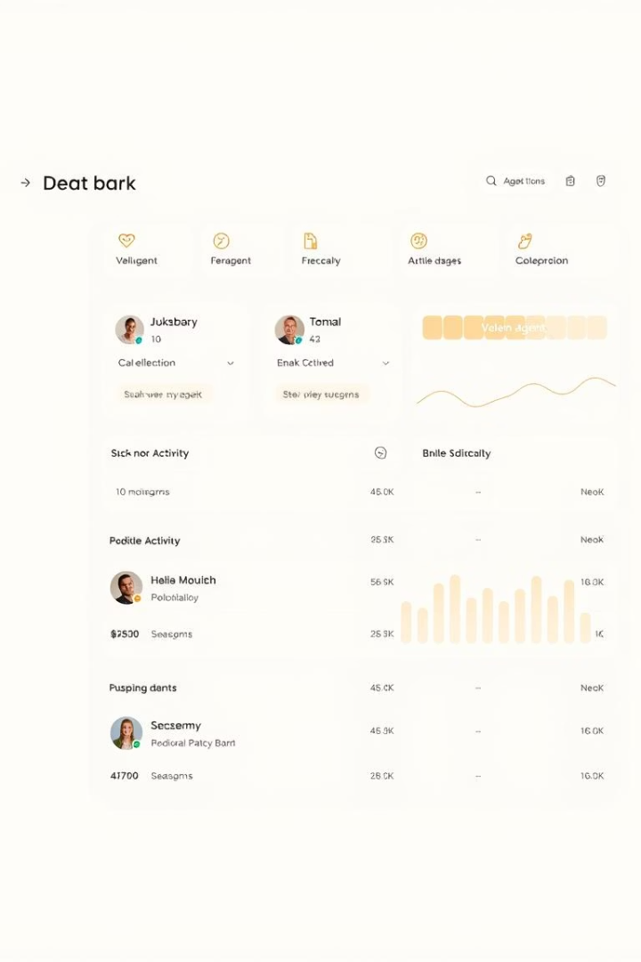




AgentScope (OpenAI Enterprise Tooling)
Observability & Logging
Track agent activities and system health.
Prompt tracking & versioning
Manage and version prompts for auditability.
Controlled execution loops
Ensure agents operate within defined parameters.
Supports team-based agent workflows
Facilitate collaboration in multi-agent environments.
Notes:
This slide is about AgentScope, a tool developed by OpenAI to help manage intelligent agents—especially in big companies.
You can think of AgentScope as a dashboard or control center for keeping track of your agents and making sure they’re working the way they should.
Here are the main features:
✅ Observability & Logging This just means you can see what your agents are doing—track their actions and make sure everything is running smoothly.
✅ Prompt Tracking & Versioning When you change an agent’s prompt, you can save different versions and go back to them later. This is useful when you want to improve your agent or check what’s working best.
✅ Controlled Execution Loops This feature sets limits on what agents can do. It prevents them from going too far or running in endless loops.
✅ Supports Team-Based Workflows You can have multiple agents working together as a team, each doing a different task. AgentScope helps you manage and coordinate them easily.
The image on the right shows what the dashboard might look like. It’s a simple way to see all your agents and what they’re currently working on.
So in short, AgentScope is a powerful tool for making sure agents are safe, trackable, and well-coordinated—especially in professional or enterprise environments.

Slide 16




What is AutoGen Studio?
Visual Development
Microsoft AutoGen
A visual tool for multi-agent LLM workflows.
Built on Microsoft's AutoGen framework.
Simplifies Design
Democratizes AI
Simplifies agent creation, customization, and interaction.
Aims to democratize AI workflow design for all.
Notes:
Let’s take a closer look at what makes AutoGen Studio such a powerful and accessible tool for building AI agents.
Visual Development: AutoGen Studio stands out for offering a visual interface for developing multi-agent LLM workflows. This means you don’t need to write complex code to manage interactions between different agents. You can visually design how agents work together, making the process more intuitive and collaborative.
Microsoft AutoGen: It’s built on Microsoft’s AutoGen framework, which is a robust and scalable foundation for creating agent-based systems. This ensures compatibility, performance, and integration with the Microsoft ecosystem.
Simplifies Design: One of the biggest benefits is how it simplifies agent creation. From customization to interaction flows, it reduces the complexity involved in building smart agents. Whether you're a developer or a product designer, this makes your work faster and more accessible.
Democratizes AI: Most importantly, AutoGen Studio aims to democratize AI—making powerful AI tools accessible to everyone, not just those with a deep technical background. It empowers students, startups, educators, and even non-tech professionals to participate in AI innovation.
Together, these features make AutoGen Studio not just a tool, but a platform that bridges the gap between complex AI development and real-world usability."

Slide 17

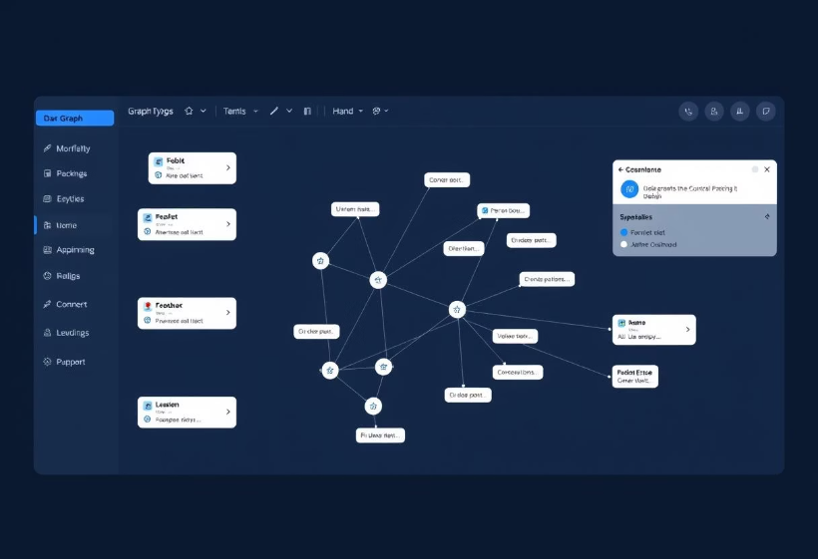
AutoGen Studio Interface
Graph-based interface for visualizing workflows.
Drag-and-drop components for easy design.
Real-time feedback for workflow adjustments.
Integrated code editor for advanced customization.
Notes:
"Now let’s walk through the user interface of AutoGen Studio, which makes it incredibly intuitive to build and manage multi-agent workflows.
First, what you see here is a graph-based interface. This allows users to visually map out how agents interact with one another — a perfect way to understand complex workflows at a glance.
It supports drag-and-drop components, so instead of writing lines of code, you can simply add agents, functions, or logic blocks onto the canvas and connect them.
The system offers real-time feedback, meaning any changes you make to the flow — like updating prompts or logic — are immediately reflected, which really helps with rapid iteration.
And for those who want deeper control, there’s an integrated code editor. This allows you to fine-tune behaviors, add custom scripts, or tweak any backend logic directly from within the interface.
Overall, the interface is designed for both beginners and advanced users — making it a powerful yet approachable platform for building AI-powered agent pipelines."

Slide 18
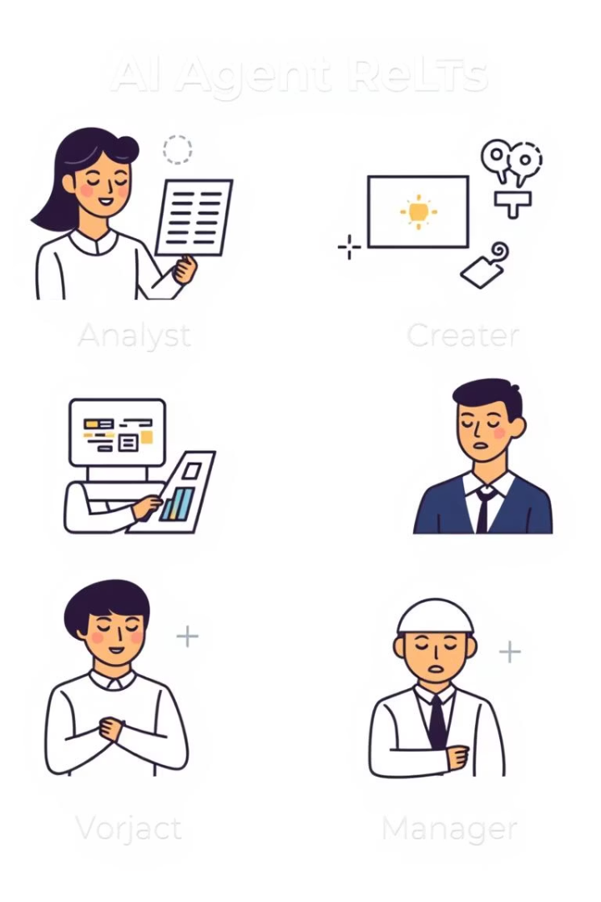




AutoGen Studio Agents
Customizable Roles
LLM Support
Collaboration
Agents have customizable roles, skills, and knowledge.
Supports various LLMs like GPT-4 and Gemini.
Agents communicate and collaborate on tasks.
Diverse Examples
Examples: Data Analyst, Content Creator, Project Manager.
Notes:
"This slide gives us a deeper understanding of the capabilities and flexibility of agents within AutoGen Studio.
On the left, we see four major capabilities that make AutoGen agents truly powerful:
Customizable Roles Agents can be tailored with specific roles, skills, and knowledge. For example, you can create an agent to behave like a data analyst, customer support assistant, or content writer — each with unique behavior and responses.
LLM Support The system is compatible with top-tier large language models like GPT-4 and Google’s Gemini, so you have the flexibility to choose the model that best fits your needs or budget.
Collaboration Agents don’t work in isolation — they communicate and collaborate to complete tasks. For instance, a 'Research Agent' can gather data, and a 'Writer Agent' can then use that data to draft a report — all automatically.
Diverse Examples The platform supports a wide range of use cases — from data analysis and project management to content creation. It’s built for versatility, allowing you to apply AI to almost any workflow.
On the right, we have illustrations of agent roles: Analyst, Creator, Project Manager, and others. These visuals represent how agents can take on human-like functions within your workflows — not to replace humans, but to assist and scale productivity.
Overall, the takeaway here is: with AutoGen Studio, you’re not just using AI—you’re designing collaborative AI teams."

Slide 19
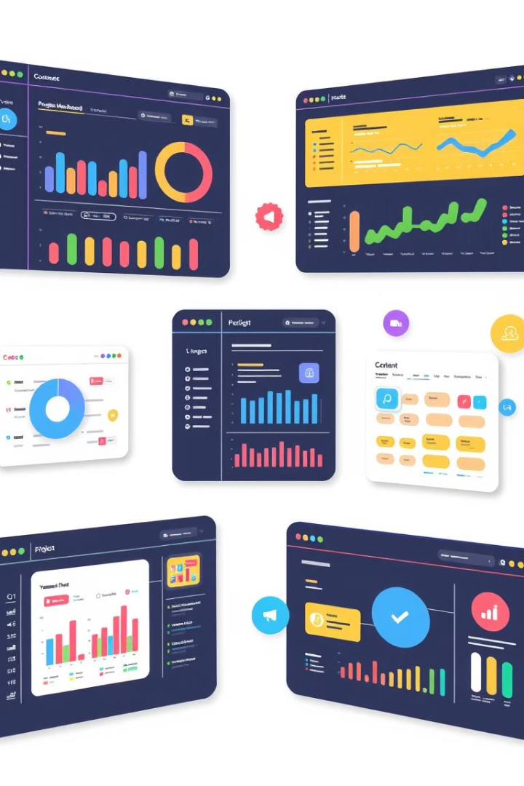




AutoGen Studio Use Cases
Data Analysis
Automating complex data analysis tasks.
Content Generation
Generating marketing content with multiple agents.
Project Management
Streamlining project management workflows.
Chatbots
Building customer service chatbots with diverse expertise.
Notes:
"This slide showcases four major use cases where AutoGen Studio really shines. Let’s quickly walk through them:
Data Analysis AutoGen can automate complex data workflows, such as cleaning, visualizing, and even interpreting large datasets. For example, you can assign agents to pull data from sources, generate visualizations, and deliver summaries — saving hours of manual work.
Content Generation With multiple agents working together, you can build dynamic content pipelines — whether it’s social media captions, blog drafts, or ad copy. One agent can research the topic, another can write, and another can polish the tone or add SEO keywords.
Project Management Agents can also help streamline team workflows by tracking progress, assigning tasks, or generating reports. Think of them as intelligent project coordinators that keep things on track without micromanagement.
Chatbots Lastly, AutoGen is powerful for creating multi-skill chatbots. You can build agents that handle customer service, technical support, or onboarding — all with specialized knowledge and a consistent tone.
The key point is that AutoGen Studio is flexible — it’s not just for developers or analysts. Anyone building automated workflows can benefit."

Slide 20

How AutoGen Studio Works
Agent Design
Tool Integration
Conversation Engine
User Input
Users define goals and initial prompts.
Configure custom roles and capabilities.
Connect agents to executors and web search.
Agents collaborate through dynamic chat.
Final Output
Results are delivered, logged, or exported.
Notes:
"This slide illustrates the workflow of how agents operate in AutoGen Studio, from setup to final output.
Step 1 – Define Goals and Prompts Everything begins with the user. You define the overall goal — for example, generate a report or analyze a dataset — and provide the initial prompts that guide agent behavior.
Step 2 – Configure Roles and Capabilities Next, you customize each agent by assigning specific roles. This includes their knowledge base, skills, and how they’re expected to contribute in the task — like assigning one agent as a researcher and another as a summarizer.
Step 3 – Connect Agents to Tools You then link these agents to executors, such as web search, file handlers, or APIs. This gives them the ability to take action, gather data, or interact with external systems.
Step 4 – Collaboration through Dynamic Chat Once everything is set, agents communicate and collaborate with each other dynamically in real-time chat — just like a virtual team working together.
Final Step – Results Delivery The outcomes are then delivered to you, whether in the form of text, visual dashboards, files, or logs. You can choose to export them or feed them into another pipeline for further automation.
In short, AutoGen Studio brings structure to agent workflows — it turns a collection of LLMs into a coordinated, goal-oriented system."

Slide 21
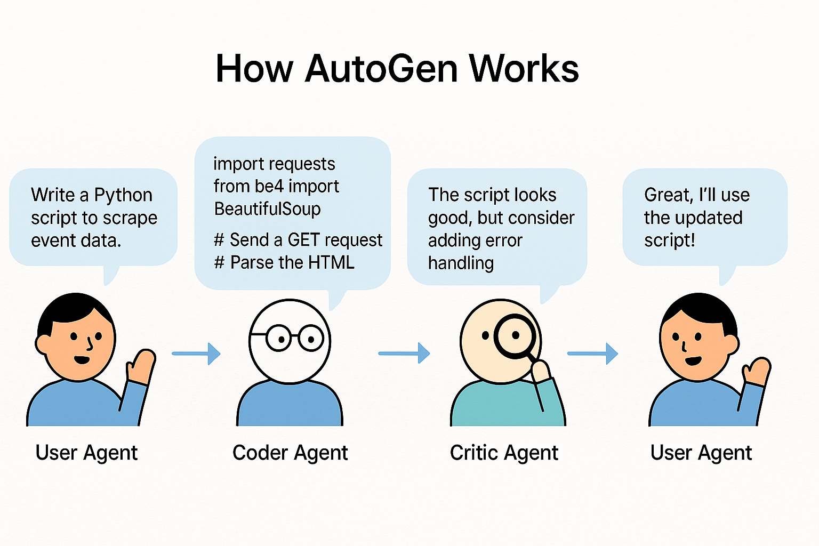
Notes:
"Let me walk you through how AutoGen operates using this simple example.
AutoGen is a framework that allows multiple AI agents to collaborate in a structured way to solve a task.
Here, the task starts with the User Agent—this is you, the human or a user proxy. The user initiates a request: ‘Write a Python script to scrape event data.’
The request is passed on to the Coder Agent, whose role is to generate the code. In this example, the coder uses Python with libraries like requests and BeautifulSoup to write a basic script for web scraping.
Next, the generated code goes to the Critic Agent. This agent reviews the output—almost like a peer reviewer. It doesn’t just accept the code blindly; instead, it provides helpful feedback. For example, it suggests adding error handling to make the script more robust.
Finally, the revised and improved script returns to the User Agent, who accepts the final output and proceeds to use the script.
So essentially, what you're seeing here is a small autonomous team of agents—each with a specific role—collaborating through conversations to produce high-quality work with minimal human input.
This modular and cooperative agent design is what makes AutoGen ideal for solving complex, multi-step problems."

Slide 22

What is CrewAI?
Orchestration Framework
Open-source framework for orchestrating agent crews.
Collaborative Problem-Solving
Focuses on collaborative problem-solving with specialized roles.
Task Management
Offers tools for defining tasks and managing execution.
Complex Applications
Designed for complex AI-driven applications.
Notes:
This slide introduces the concept of agent orchestration, especially as implemented in frameworks like CrewAI.
Orchestration Framework At the core, CrewAI provides an open-source orchestration layer that manages multiple agents — referred to as a ‘crew’. Think of it like a control room where every AI agent has a specific role, and the framework ensures they work together smoothly.
Collaborative Problem-Solving The framework supports role-based collaboration, meaning each agent can be assigned a different specialty — like a planner, researcher, or executor. This allows agents to divide and conquer tasks intelligently, just like a well-functioning team.
Task Management CrewAI also includes tools for defining and tracking tasks. You can assign tasks to individual agents, monitor progress, and control the flow of information — enabling seamless execution across different agents.
Complex Applications This setup is ideal for complex, multi-step AI applications — from customer service automation to end-to-end content pipelines and decision support systems. If you're building an app that needs planning, generation, reasoning, and feedback, CrewAI can handle that entire lifecycle.
In short, CrewAI is designed not for single-agent tasks, but for coordinated multi-agent missions — where structure, collaboration, and oversight are critical."

Slide 23








CrewAI Key Features
Tools and Expertise
Role-based agent definition: tools, tasks, and expertise.
Task Delegation
Efficient task delegation and coordination.
Execution Flexibility
Supports concurrent and sequential task execution.
Knowledge Retention
Context sharing and knowledge retention among agents.
Notes:
"This pyramid represents the four foundational principles of effective multi-agent collaboration in systems like CrewAI or AutoGen Studio.
Let’s walk through each layer:
Knowledge Retention (Base Layer) At the foundation, we have context and memory. Agents must be able to retain and share knowledge across tasks. For example, if one agent collects data and another analyzes it, the context must carry over seamlessly.
Execution Flexibility Next, agents should be able to handle tasks either sequentially or concurrently. Some tasks may depend on others, while some can happen in parallel — this flexibility is key to efficiency and performance.
Task Delegation This is all about coordination. The system should be able to delegate the right task to the right agent at the right time — just like a smart project manager. It ensures no confusion, no overlap, and optimal productivity.
Tools and Expertise (Top Layer) Finally, at the top of the pyramid is specialization. Each agent should be equipped with the right tools, domain knowledge, and skills to perform its assigned function. This turns a group of agents into a high-functioning team.
Together, these layers form a robust architecture for AI teamwork — one where agents aren't just acting alone, but working together efficiently toward a common goal."

Slide 24
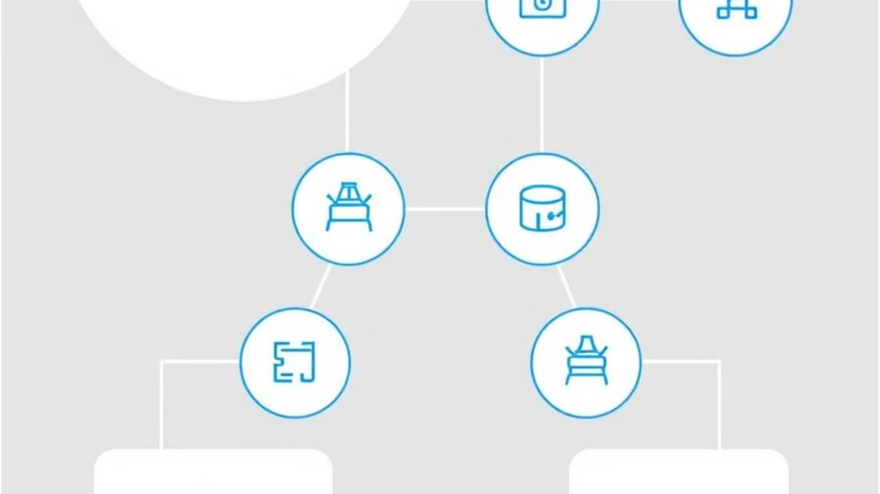




CrewAI Architecture
Crew
Agent
Task
Tools
A team of agents working towards a common goal.
An individual with specific skills and tools.
A specific objective assigned to an agent.
External resources available to agents.
Notes:
"This slide introduces the core components of CrewAI's architecture, which is designed to orchestrate multiple intelligent agents working together.
Crew At the highest level, a Crew is a team of agents that collaborates toward a shared objective. Just like a human team, each member has a specific role, but they’re all aligned toward one final goal.
Agent An Agent is the individual unit within the crew. Each agent is equipped with specific skills, knowledge, and tools tailored to a certain task — like a researcher, analyst, or executor.
Task Tasks are the assignments given to agents. Every agent in the crew receives a defined task to perform — whether it's fetching information, generating content, or making decisions. This structure ensures clear responsibilities and minimizes overlap.
Tools Agents don’t work alone — they use external tools like APIs, databases, file systems, or search engines. These tools empower agents to act, fetch data, or even trigger actions in the real world.
Altogether, this architecture is designed to support modular, scalable, and intelligent teamwork between AI agents. And the best part? It’s open-source and adaptable — you can create a crew for almost any workflow."

Slide 25




How CrewAI Orchestrates Multi-Agent Tasks
Define Agents
Assign specialized roles and skills to each agent.
Assign Tasks
Set clear, specific objectives for each agent's contribution.
3
Crew Executes
Agents collaborate dynamically using advanced LLMs.
Final Output
A unified, high-quality aggregated result is delivered.
Notes:
"This slide walks us through the step-by-step execution process in CrewAI, from agent setup to the final result.
Define Agents First, we begin by defining each agent in the crew. We assign them specific roles, skills, and tools based on what we want them to do — for example, a data collector, a summarizer, or a visualizer. Just like forming a team, each member has a job they’re best suited for.
Assign Tasks Next, we assign tasks to these agents. Each task is tied to a clear and measurable goal, ensuring agents know exactly what’s expected of them. This step removes ambiguity and keeps the workflow aligned with the overall objective.
Crew Executes Once the tasks are defined, the agents begin collaborating dynamically using their built-in logic and advanced LLMs. This is where the magic happens — agents communicate, delegate sub-tasks, and work in sync just like a real team would.
Final Output At the end, you receive a unified, high-quality output. All individual results from agents are aggregated into a cohesive final product — whether it’s a report, insight, or decision.
This streamlined flow makes it easy to go from an idea to a working, intelligent system powered by multiple agents."

Slide 26
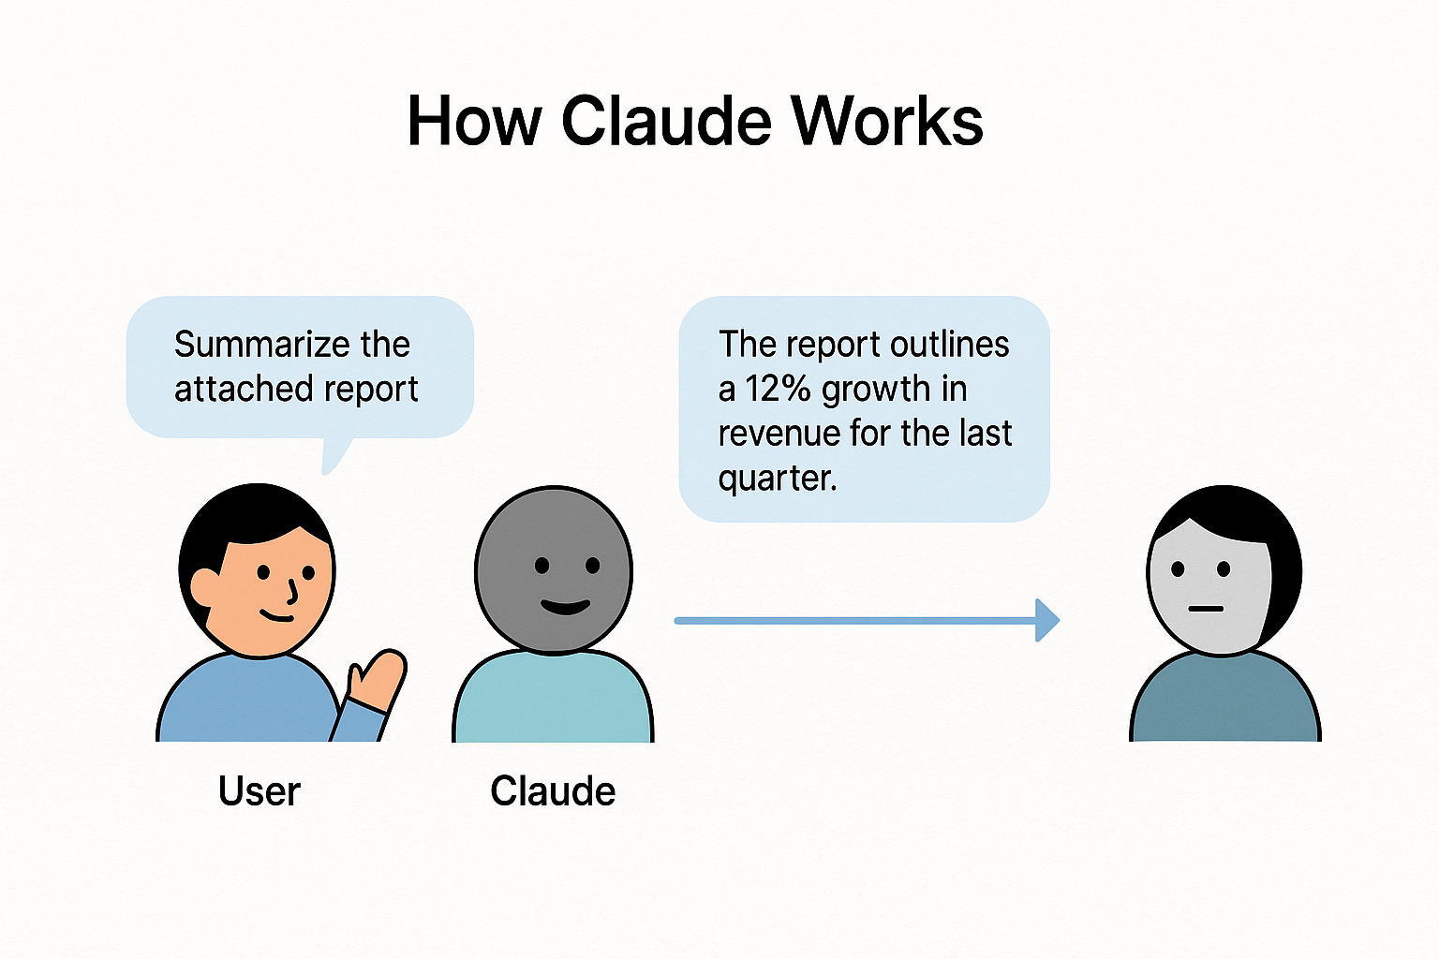
Notes:
"This slide shows how Claude, an AI assistant by Anthropic, works.
In this example, the user asks Claude to summarize a report. Claude reads the content and gives a short, clear response: 'The report outlines a 12% growth in revenue.'
Claude is designed to be helpful, honest, and safe. It’s trained to follow rules and give thoughtful answers, even for complex tasks like summarizing or explaining information.
So, while it may look like a normal chatbot, Claude actually understands large amounts of information and gives reliable, well-written answers—quickly and clearly."

Slide 27

Thank You
We appreciate your time and attention today. We are now ready to answer any questions you may have.
Notes:
To wrap up…
AI agents are no longer just responsive bots. They’re becoming autonomous, adaptive systems capable of reasoning, learning, and collaborating.
Frameworks like LangChain, DSPy, AutoGen Studio, AutoAgent, and CrewAI are critical enablers—they allow us to build smart agents without reinventing the wheel.
The future lies in:
Multi-agent collaboration,
Continuous self-improvement,
And frameworks that are easy to use, yet extremely powerful.
Thank you so much for your time and attention. I’m happy to take any questions you may have

