Slide 1
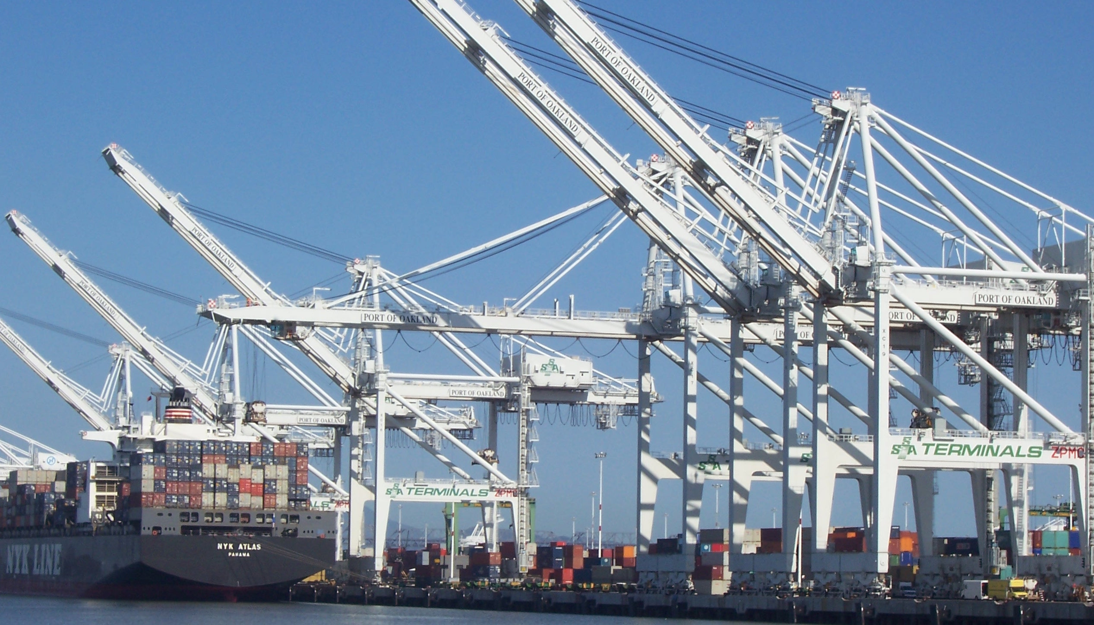

Pivotal Cloud Foundry
Architecture & Operations
Paul Hopper / Platform Architect
phopper@pivotal.io

Slide 2




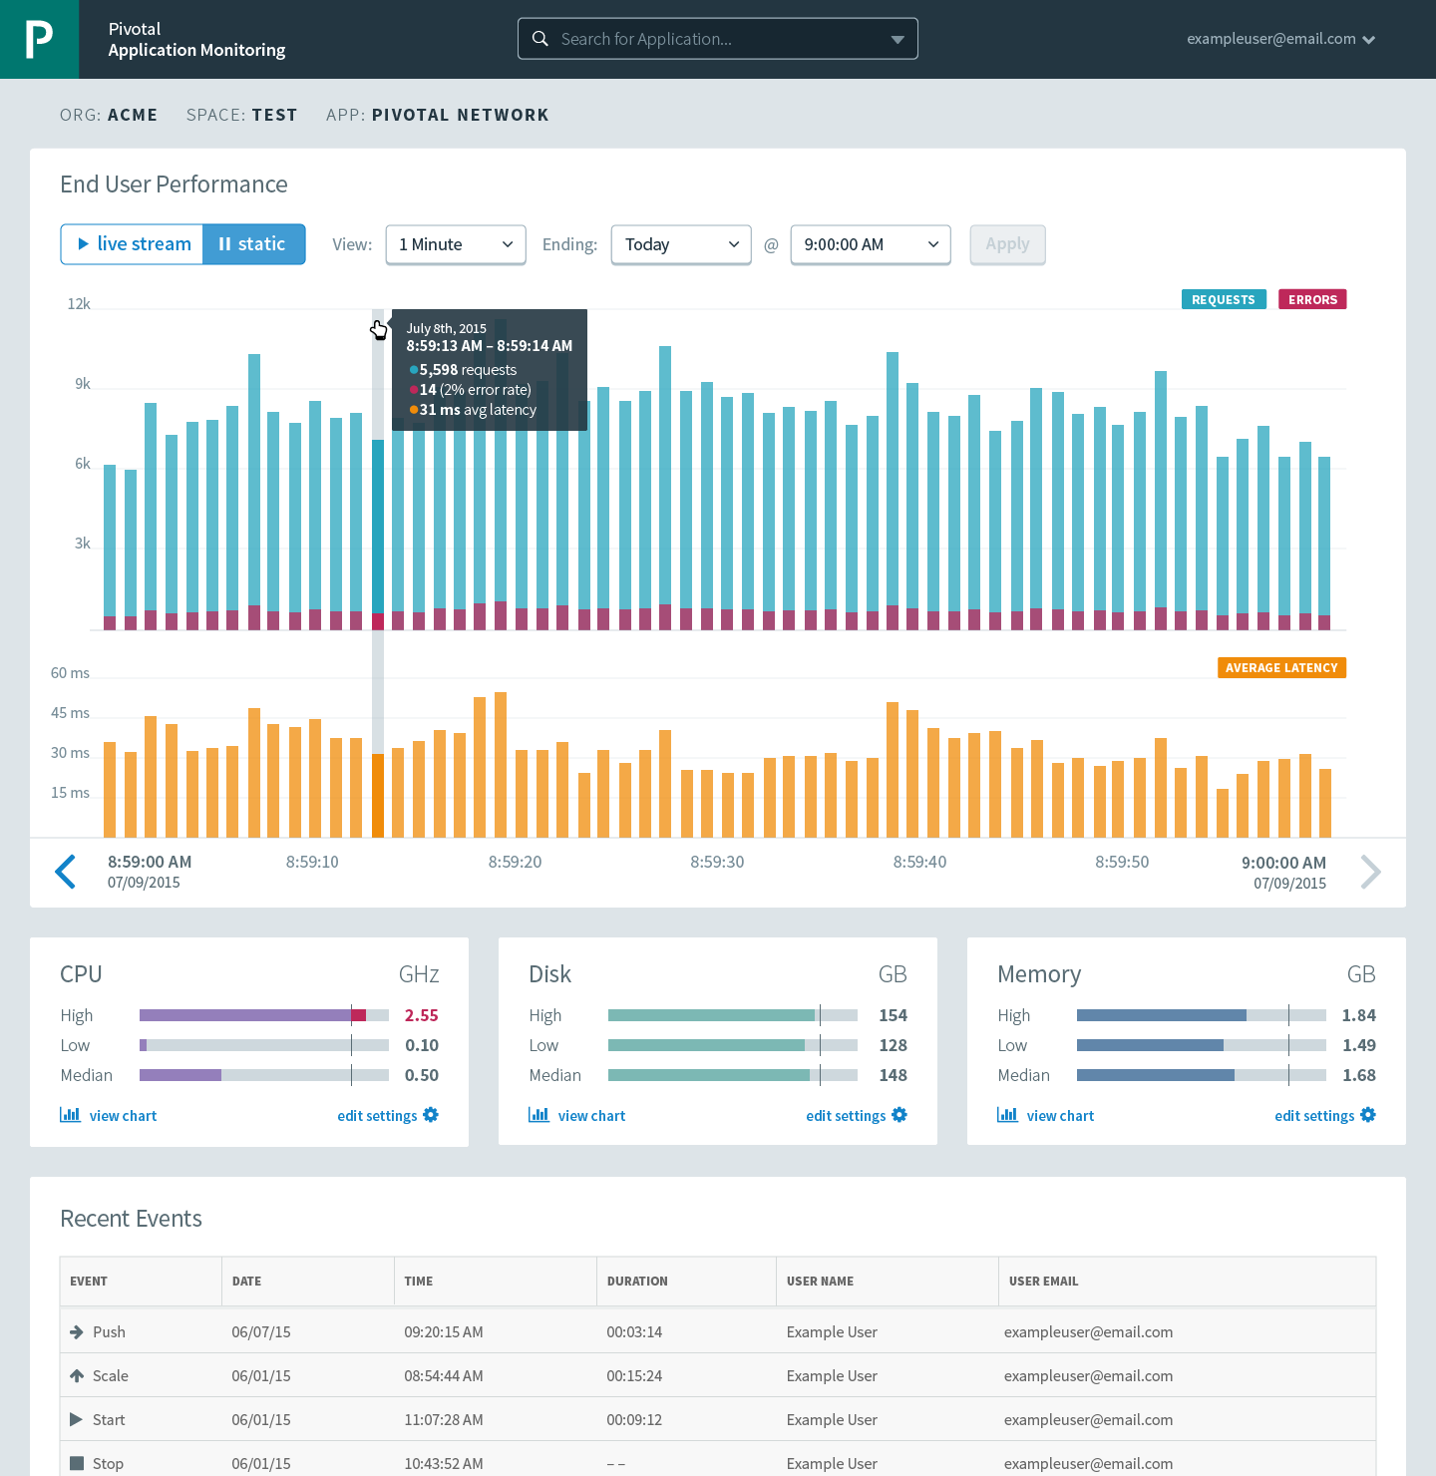




Cloud Foundry: An Application-centric Platform
Mobile Services
Centralized Log Management
Networking
& Load Balancing
Auto-Scaling
APM & Tracing
APPLICATION
Health management
Full Stack CI/CD platform
Notes:
So Spring Boot/Cloud meant create apps fast – But Dev & Ops is asking Day2 questions -
How do you do logging, routing, apm, scaling, and lifecycle management of all these apps.
Enter CF Runtime
best in class container management
integrated agentless logging
with APM
auto scaling
Effortless runtime with minimum human operational overhead. We run 1000s of apps and 10,000s containers on PWS with 6 guys.
But we realized that stopping there wasn't enough

Slide 3



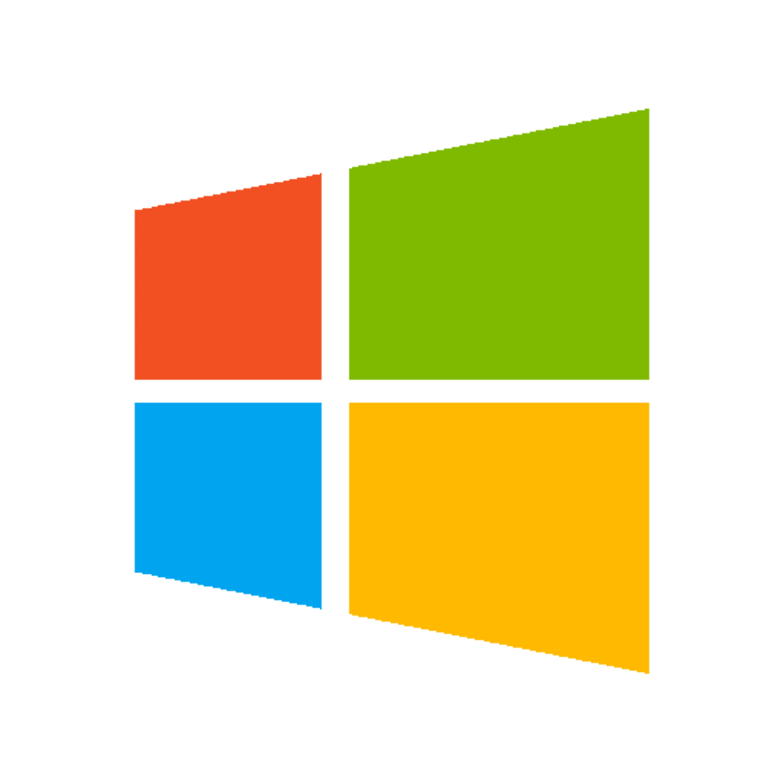

A Multi-Cloud 3rd Platform: Cloud Foundry
Jenkins Service
(CI)
Elastic
Container
Runtime
Agile Microservices
Redis
MySQL
Rabbit MQ
DataStax
Cassandra
Elastic managed runtime service integrated into leading data services; all scaled and managed by CF BOSH
Cloud Foundry BOSH
Multi-Cloud Declarative Service Deployment, Operations
Azure
Notes:
Here we have a birds eye view of PCF
-- Deployed over your favorite IaaS solution is our Elastic Runtime – a set of microservices that defines PCF
-- Several application services are integrated into the platform like Jenkins, Messaging, Caching, Hadoop, etc, the list is always growing!
-- The deployment is managed by OSS Cloud Foundry BOSH which we simplify via Ops Manager, a web based management interface
----
When I can, I like to whiteboard this picture – interactive.
Start with the elastic runtime
Managed by BOSH
IaaS agnostic
Other services/clusters managed by BOSH – KV Store, … and even partners, i.e. Jenkins.

Slide 4

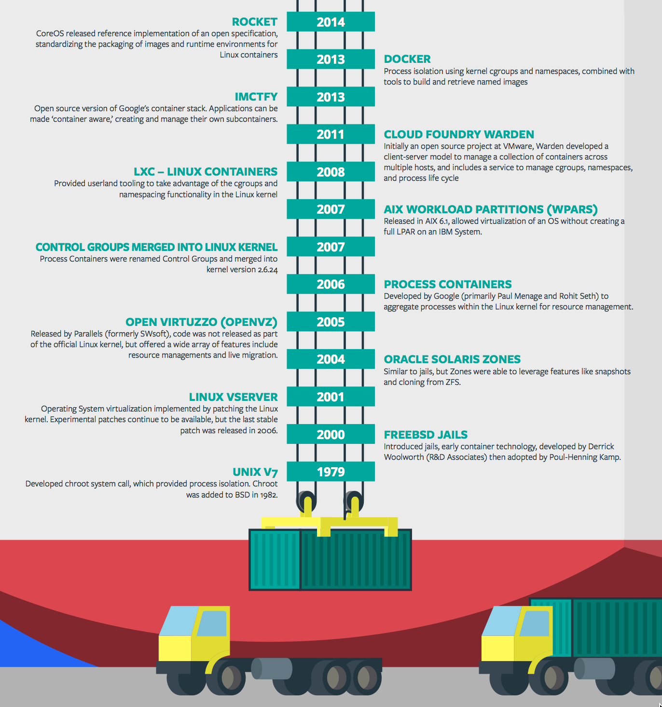
Containers - History
CONTAINERS!!!!
Containers are not new
CF has used containers since it’s inception
CF supports multiple container technologies as first class citizens including Docker, Warden, Garden and runC
Notes:
History of Docker
- 2006 Google to use containers they built cgroups and namespaces and pushed it to the Linux kernel
- cgroups and namespaces give you isolation (Resource Isolation and Namespace isolation)
- dotCloud and LXC fragmentation
- libcontainer created to address application portability and standard API across linux distros BUT controlled by Docker
- Open Container Project (Docker/dockerfile, CoreOS/appc). Standardiized on runC
- Standardizing the file format (dockerfile + appc = filesystem)
- Standardizing the runtime (libcontainer = runC)
- Container (Isolation + Files/metadata + Processes)

Slide 5

Container Isolation
shared resources
resource isolation
kernel
namespace isolation
Cell
process F
process A
process E
process B
process D
process C
tenant 1
tenant 2
tenant 3
Notes:
----- Meeting Notes (2/10/16 13:49) -----
modify to represent the cell, and change tenants to containers

Slide 6


Container Isolation
CPU
resource isolation
namespace isolation
cgroups
process D
process F
process F
process E
process A
process E
process B
process D
process C
A Linux kernel feature that limits, accounts for, and isolates the resource usage of a collection of processes
tenant 1
tenant 2
tenant 3
Notes:
Cgroups - A Linux kernel feature that limits, accounts for, and isolates the resource usage of a collection of processes

Slide 7
Container Isolation
PID
2
3
4
2
2
3
resource isolation
namespace isolation
PID namespace
process F
The PID namespace provides isolation for the allocation of process identifiers (PIDs), lists of processes and their details.
process A
process E
process B
process D
process C
tenant 1
tenant 2
tenant 3
Notes:
PID namespace - provides isolation for the allocation of process identifiers (PIDs), lists of processes and their details.

Slide 8
Customize the Container Experience
Buildpacks
Containers
Developer brings customized app
Developer brings customized app
Platform buildpacks provide standard runtime*
Developer brings runtime container image
Platform provides fixed OS container image
Developer brings container OS image
Platform provides fixed host OS Kernel
Platform provides fixed host OS Kernel
App container
* Devs may bring a custom buildpack
Notes:
Kubernetes doesn’t have buildpacks

Slide 9

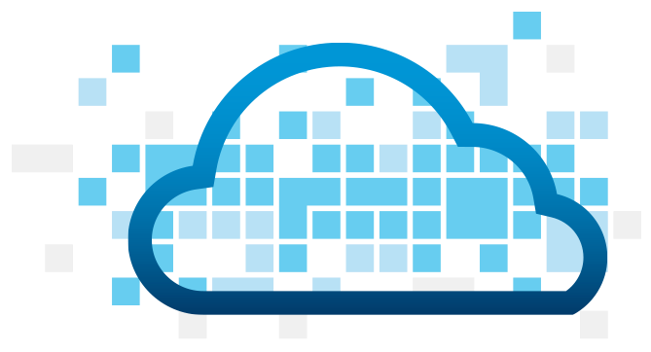
Application Containers and Scaling
LRP
Deploy Request
LRP
Scale Request
Blobstore
Cloud Controller
Cloud Controller Bridge
BBS / etcd
Access App
Service
credentials
CELL Auction
Brain
DB
Auctioneer
Router
Converger
CELL
CELL
CELL
Desired
Actual
Executor
Rep
Executor
Rep
Executor
Rep
Runtime

