Slide 1
COMPUTER ORGANIZATION AND ARCHITECTURE
College Name: Birla Vishwakarma Mahavidyalaya Engineering College
Department Name: Computer Gia
Subject: Computer organization and architecture
Group Members:
1. Patel Krupa 20CP301
2. Vasava Prachi 20CP302

Slide 2
Overview
Introduction
Features
Snapshots

Slide 3
Introduction
This Project is aimed to developing an Arkanoid game using Graphics in c++.
This game is made very simple and Interactive for use.

Slide 4
features
In this game three Lives are Provides for User.
Game can be played using Keyboard.
When user hit Bricks then 5 Point added in Score and when loosing a ball user can loose 20 points.
In this game user can select Game mode when he or she can choose Fast, Medium and Slow level.

Slide 5
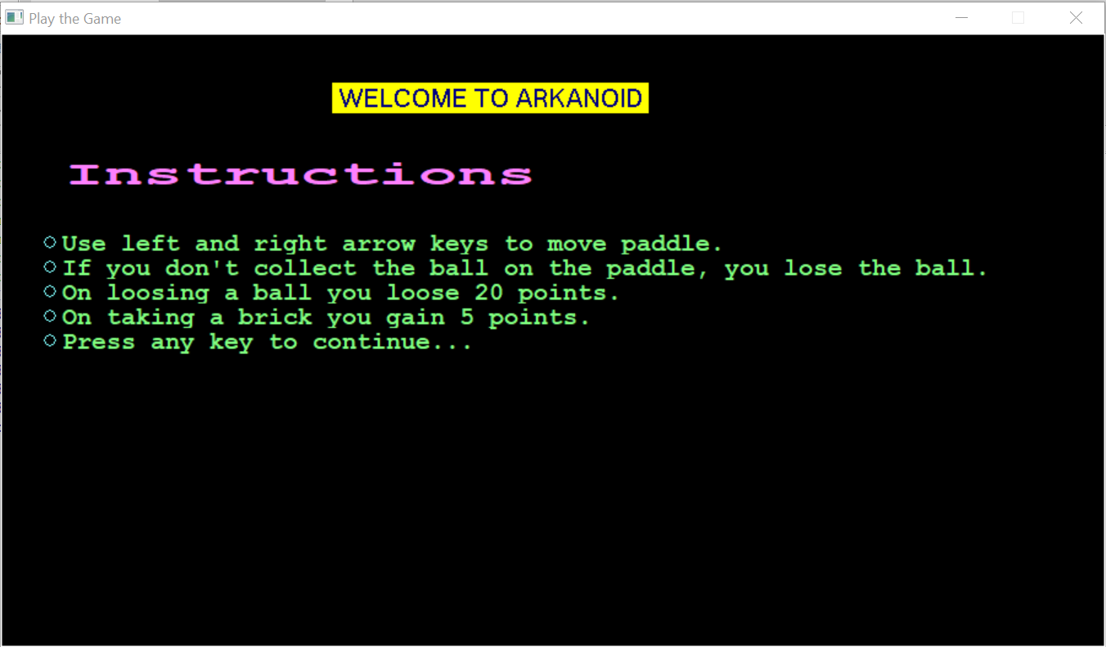
Snapshots
This is our Homepage of Arkanoid Game.

Slide 6
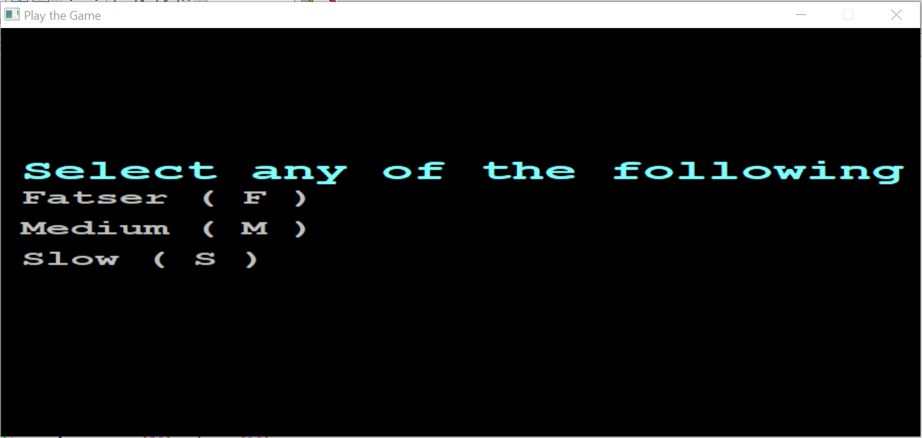
Snapshots
So here user can select game mode.

Slide 7
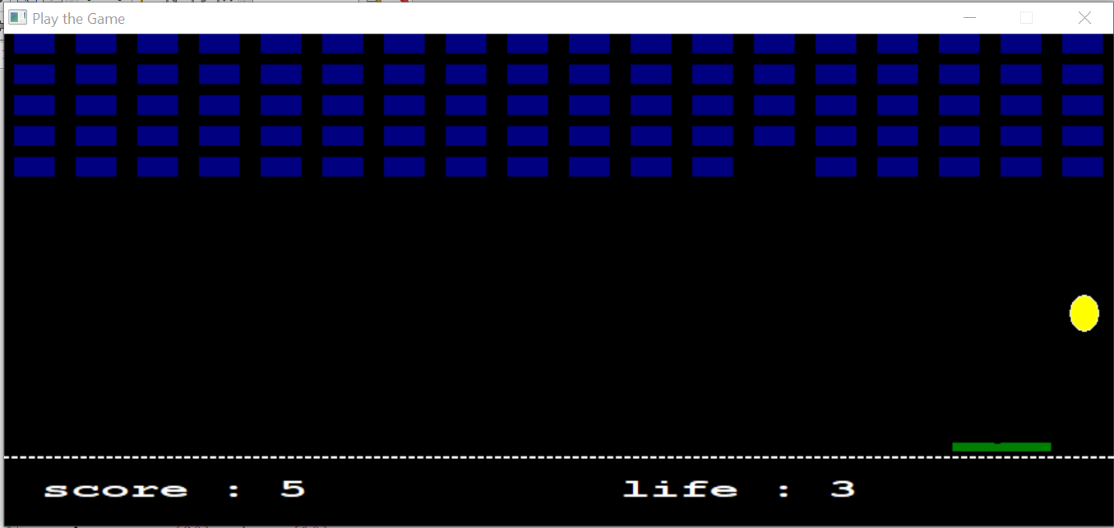
Snapshots
Arkanoid Game

Slide 8
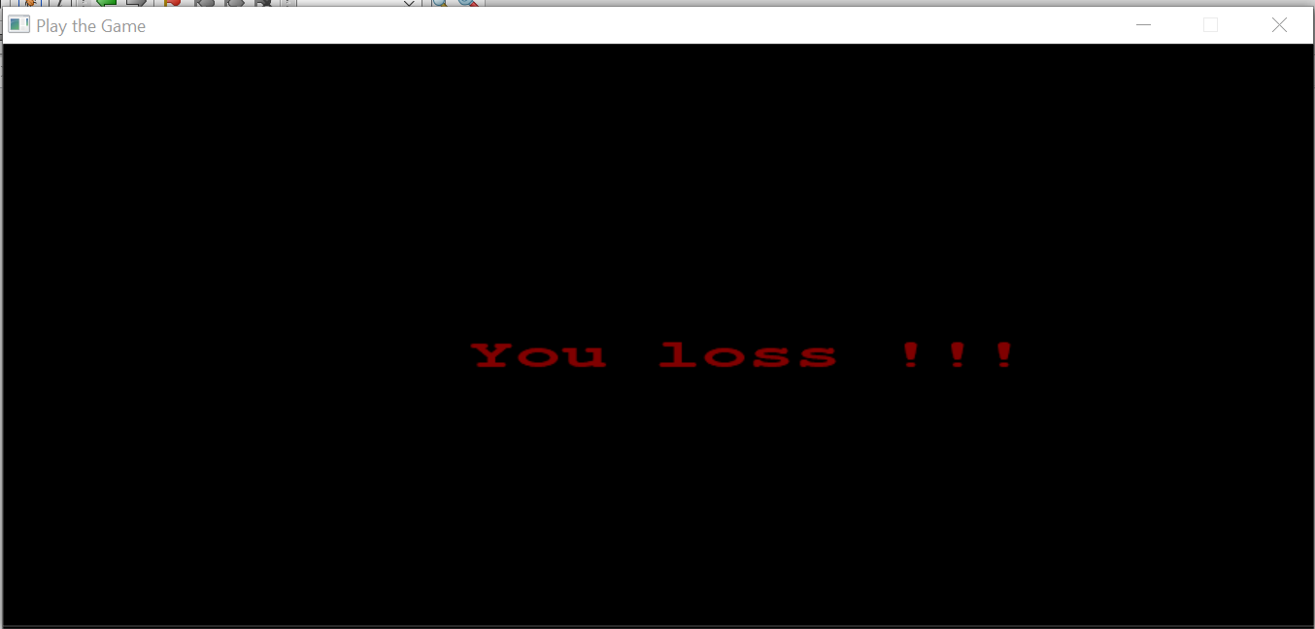
Snapshots
When user Loss three Bolls then game is finished and this message Display on screen.

