Slide 1

CVM MANAGEMENT
COLLEGE NAME: B & B INSTITUTE OF TECHNOLOGY
DEPARTMENT NAME:COMPUTER SFI
GROUP MEMBERS:-
PATEL KRUPA A. 176050307025
VASAVA PRACHI B. 176050307040
SHAH BANSARI A. 176050307048
GUIDED BY :- BHAVIK M. PATEL

Slide 2

TOPIC WE HAVE COVERED…..
LOGIN MODULE
APPLICATION HOME PAGE
LAST YEAR CUT OFF
PLACEMENT
KEY DATES
SCHOLARSHIP
COLLEGES
RESULT
MAP
MANAGEMENT QUOTA ADMISSION PROCESSS
CVM ADMIN PANEL

Slide 3
LOGIN MODULE
This Application Provides User Login. User Can Show Last Year Cutoff , Placement Details, Colleges Details, Important News About Admission, Inter-college Events Etc.

Slide 4

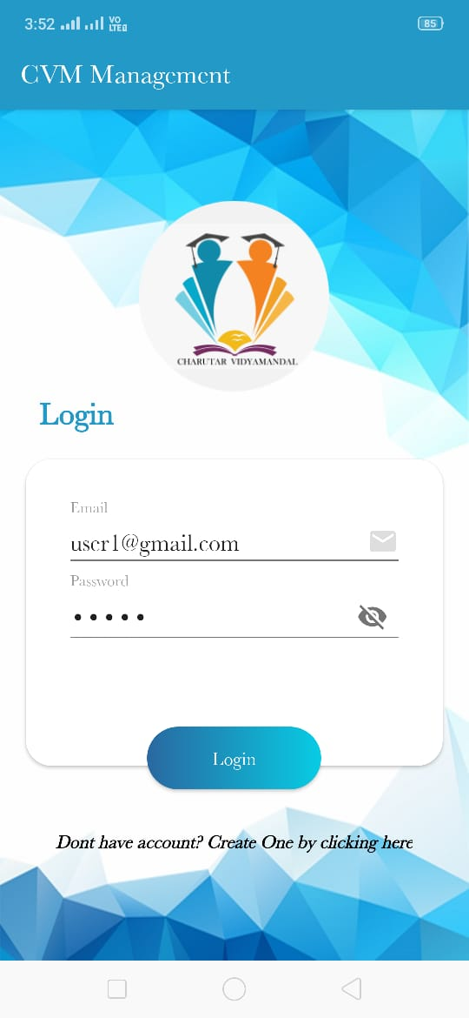
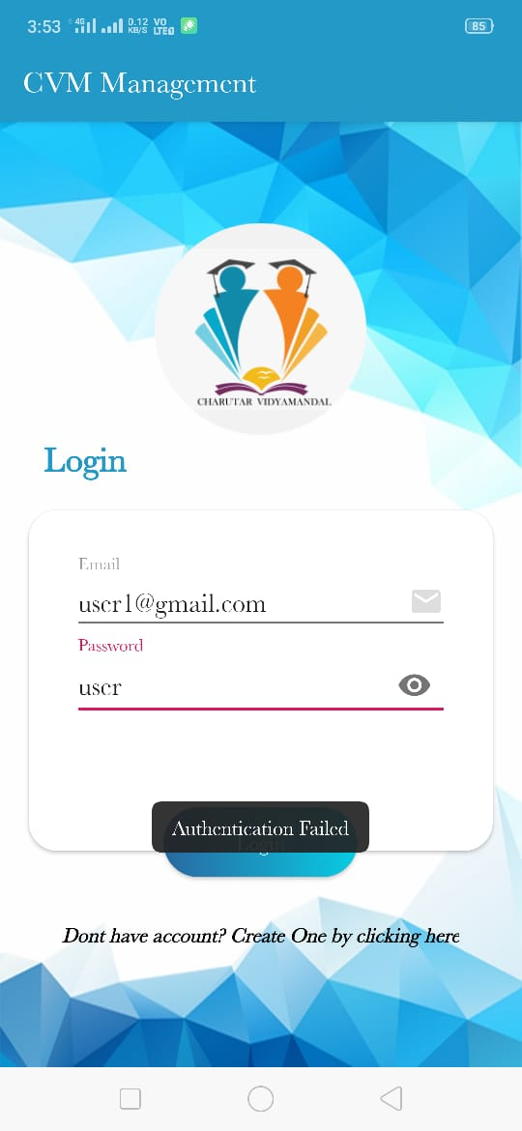
LOGIN PAGE

Slide 5
Application home page
Application Home Page Contains Last Year Cutoff Module, Placement Module, Key-dates Module, Admission Process Module, Scholarship Module, Colleges Module, Result Module And Maps Of Different CVM Colleges.

Slide 6
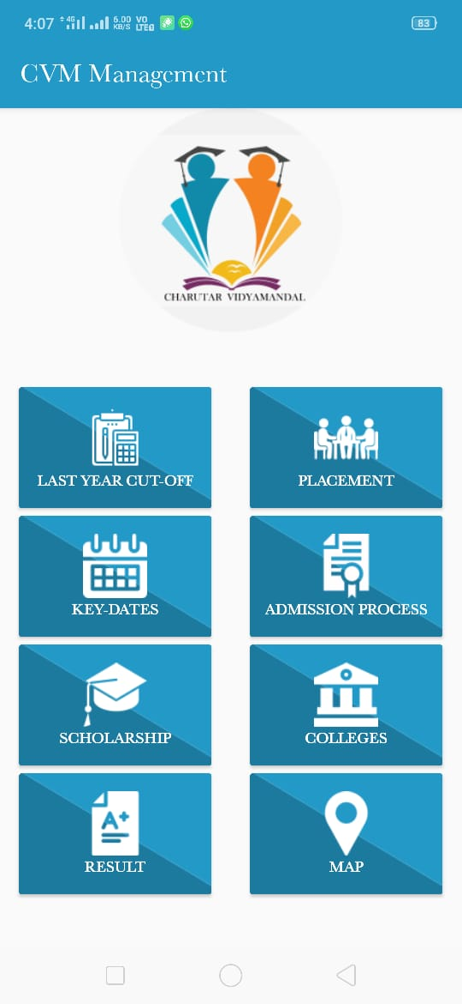
home page

Slide 7
Last Year Cut-off MODULE
This Application Provides A Module In Which Students Can Enter Their Marks And Select The Course Then It Shows The College List If They Are Eligible Based On Last Year Cut-off.

Slide 8
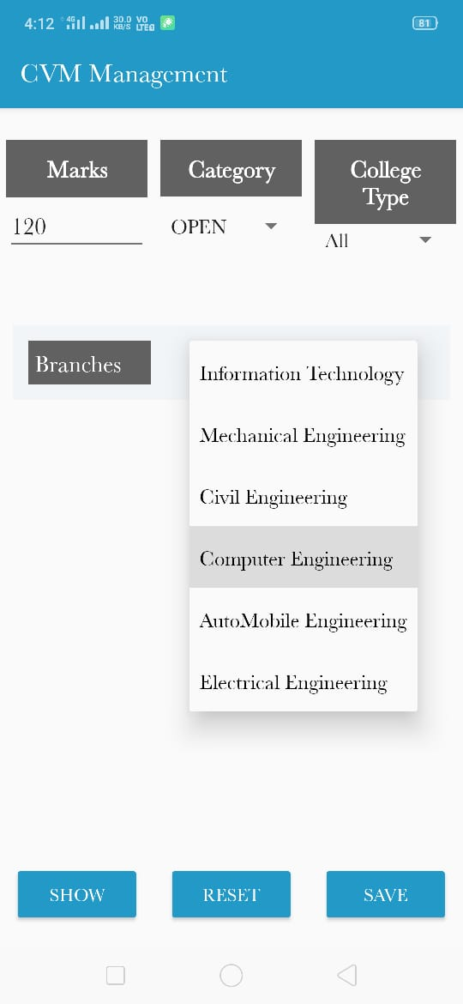
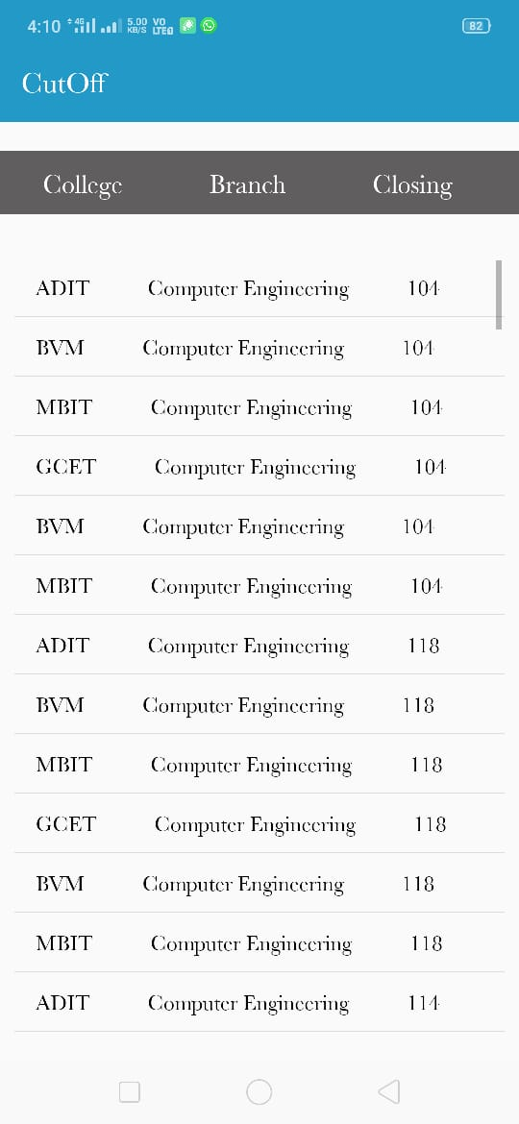
Last year cut- off PAGE

Slide 9
Placement MODULE
This Application Provides Information Of Placement Of Different College. It Shows How Many Students Selected And In Which Company.

Slide 10
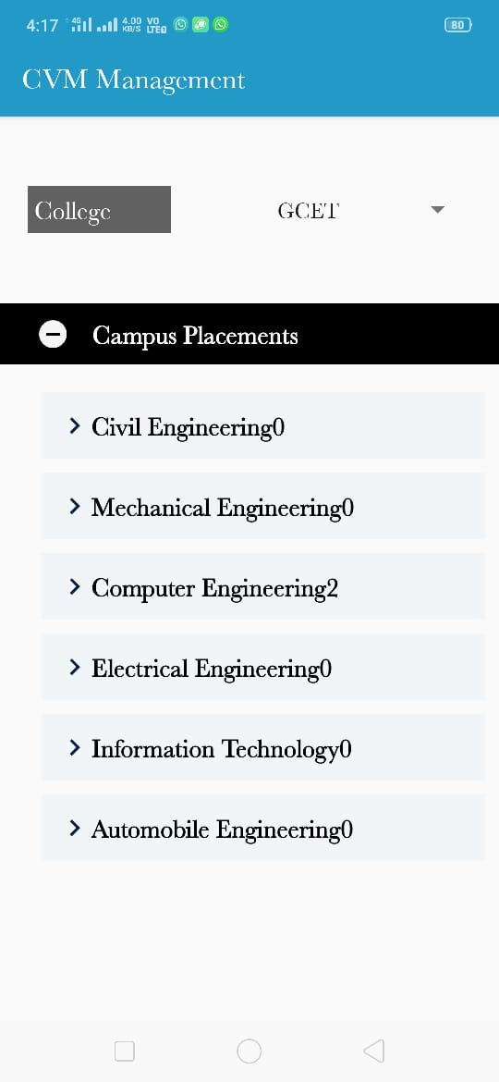
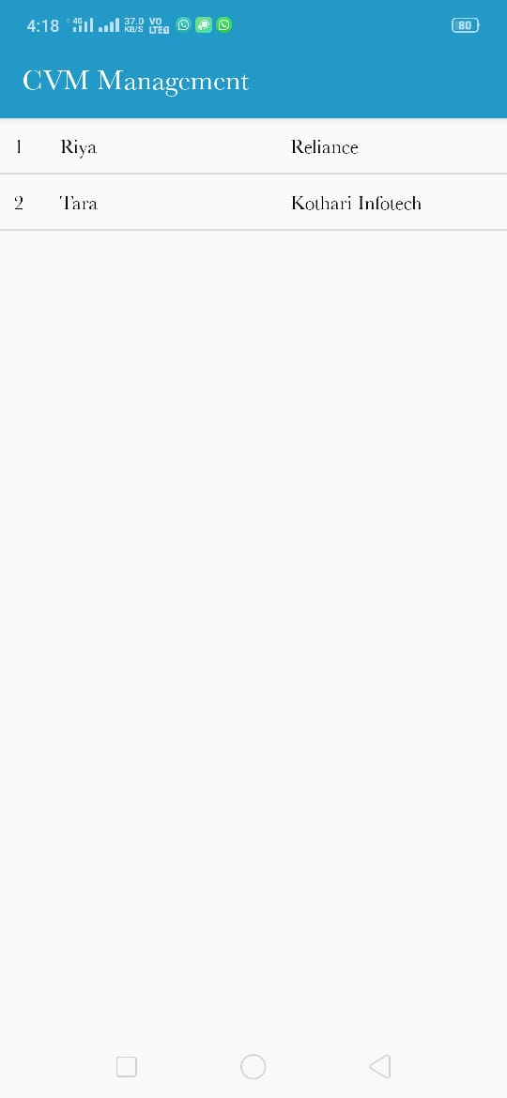
Placement PAGE

Slide 11
Key-dates MODULE
This Application Shows Information Of Events Held In Different CVM Colleges.
It Also Shows Inter-college Events And Provide News As Per Key Dates Such As Management Quota Online Admission Process, Exam Dates Etc.

Slide 12
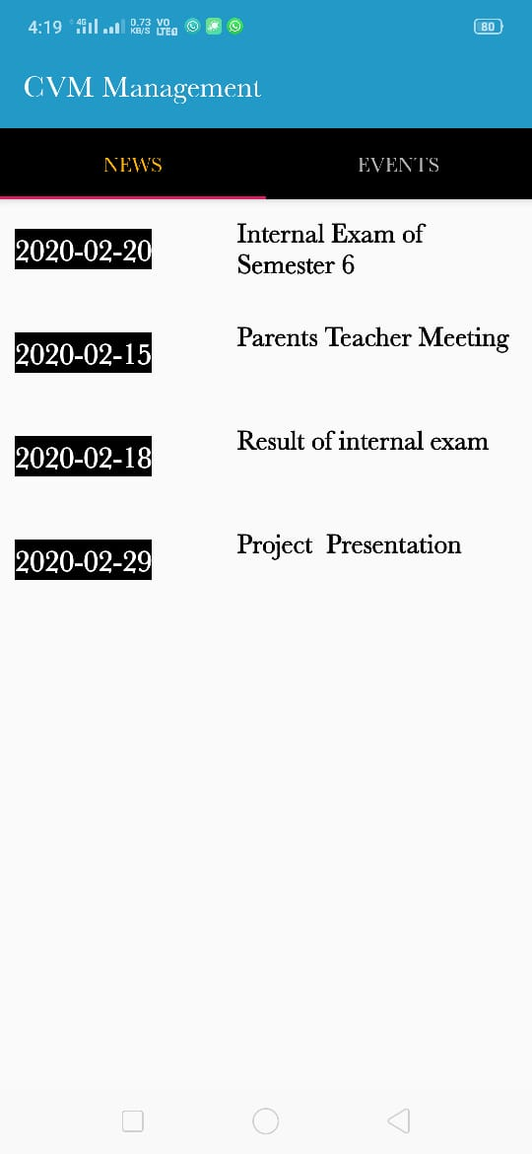
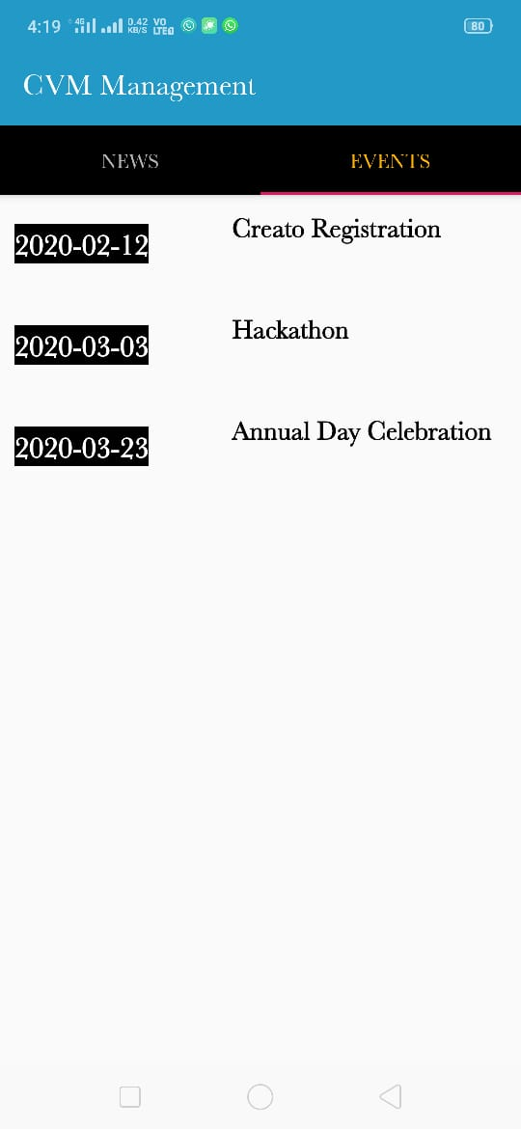
Key-dates PAGE

Slide 13
scholarship MODULE
In This Application User Can Search Scholarship By Their Category And Application Provides Information Of Different Types Of Scholarship And Link.

Slide 14
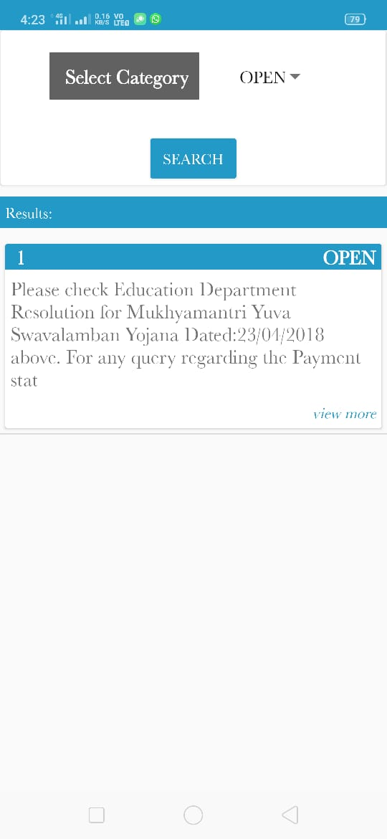
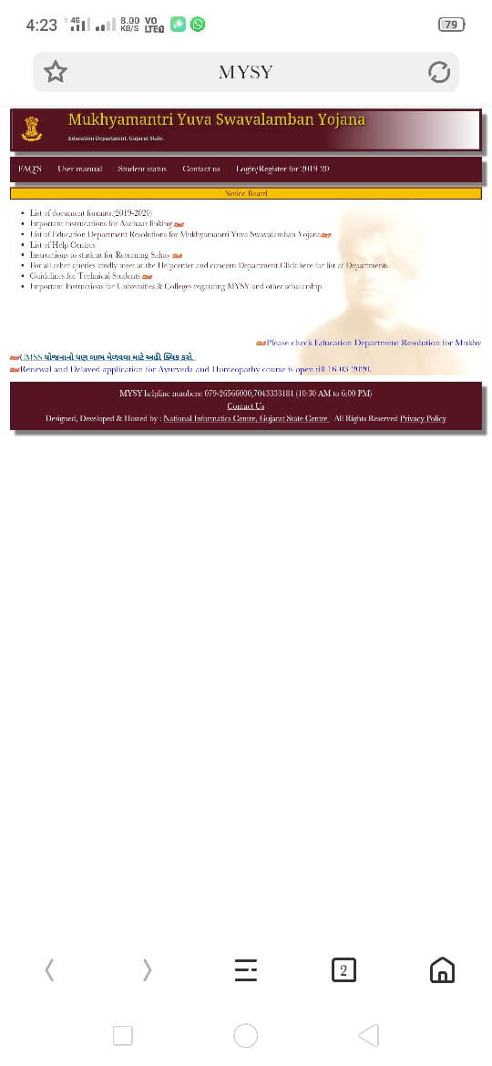
scholarship PAGE

Slide 15
college MODULE
This Module Shows The CVM Colleges As Per College Type Like Government And Self-Finance.
It Also Shows The Details Of Colleges Like Fess And Seats

Slide 16
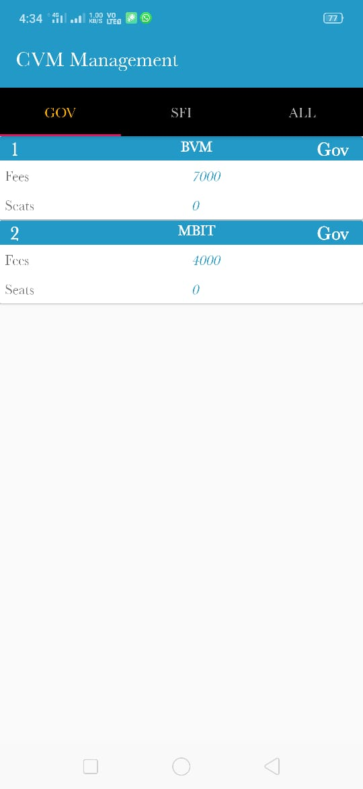
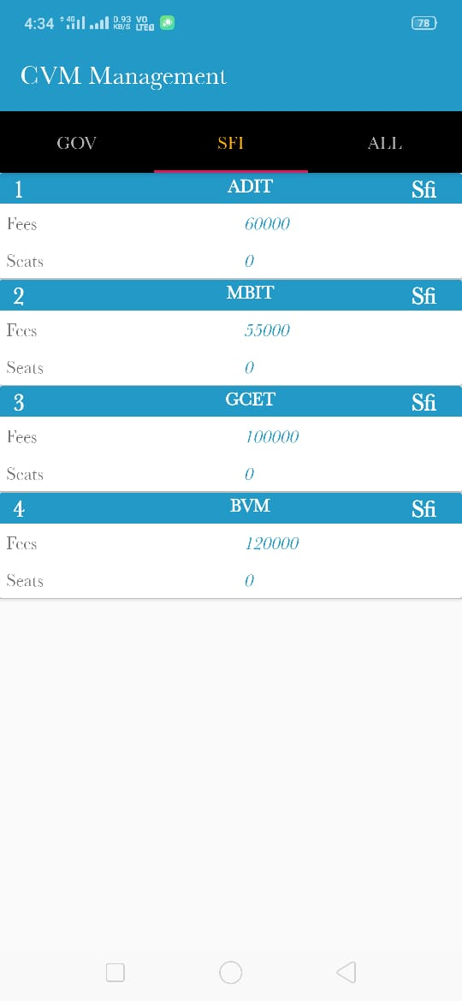
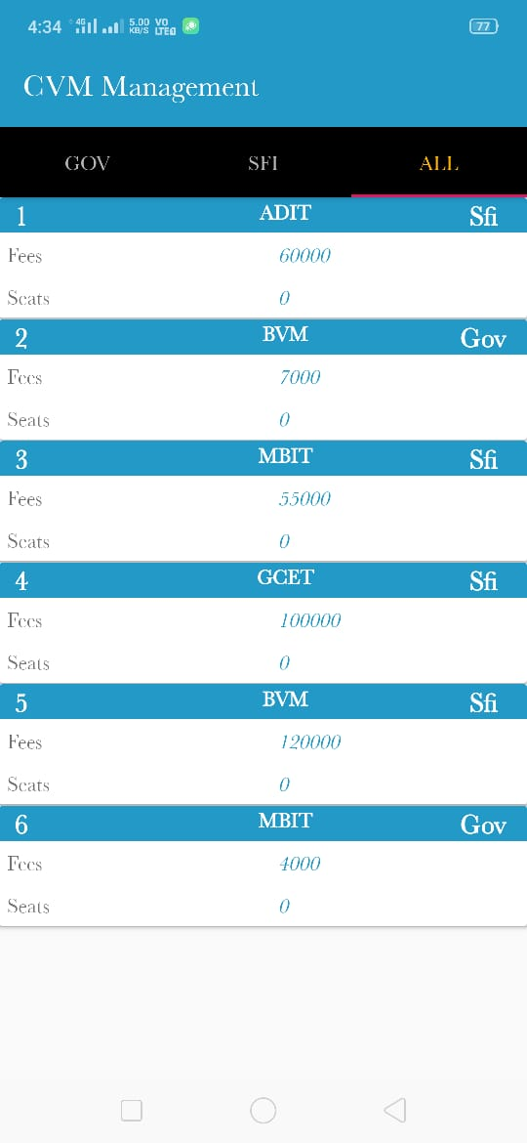
COLLEGES PAGE

Slide 17
result MODULE
In Result Module User Can Directly View Their GTU Result.

Slide 18
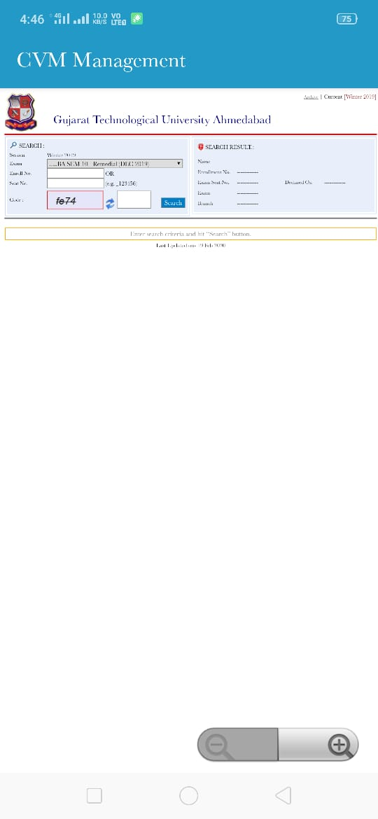
result page

Slide 19
maps MODULE
In Maps Module User Can Show The Exact Location Of All CVM Colleges.

Slide 20
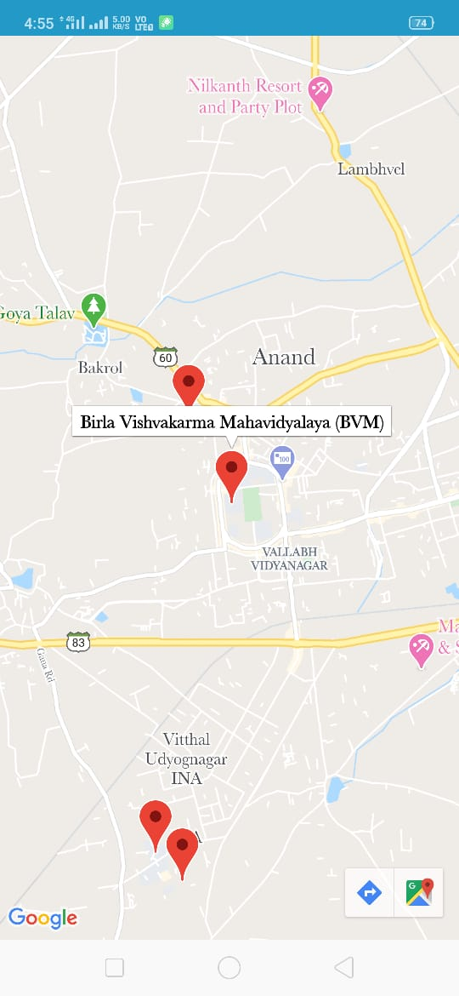
College Map page

Slide 21
Management quota admission process
In Admission Process Module First It Shows The Admission Process Steps.
It Also Includes Online Management Quota Admission Process In Which Students Can Fill The Form And Pay Online Fees For That Form.
This Module Provides Online Payment Gateway For Management Quota Form So Students Have No Need To Go For A Bank.
At Last It Shows The Merit List Of Students As Per Marks.
On The Date Of Admission User Can Show The Available Seats Of The Particular College And How Much Students Get Admission And How Much Students Decline The Admission.

Slide 22
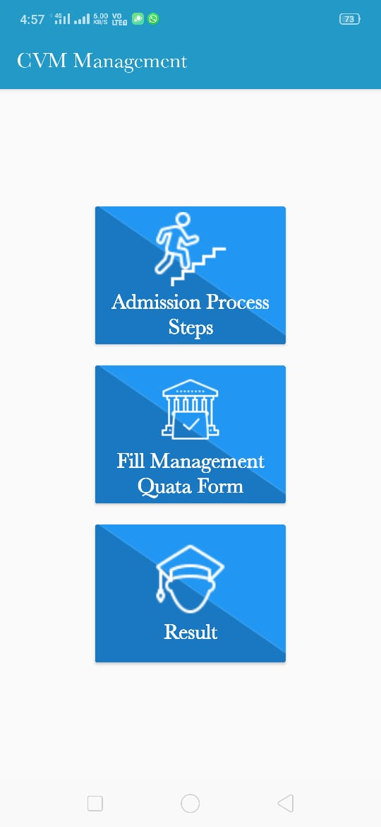
Admission process page 1 :- homepage

Slide 23
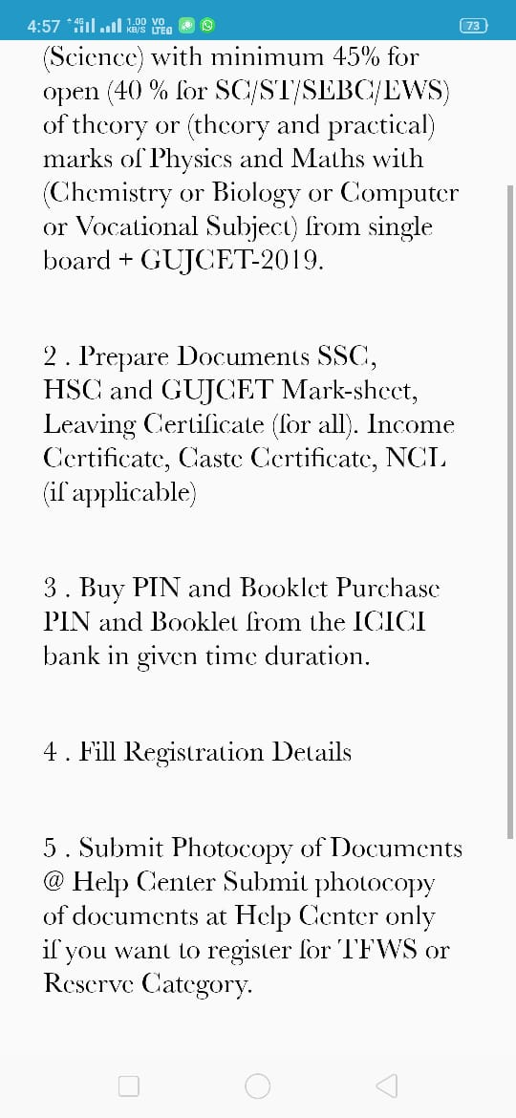
Admission process page 2 :- admission process steps

Slide 24
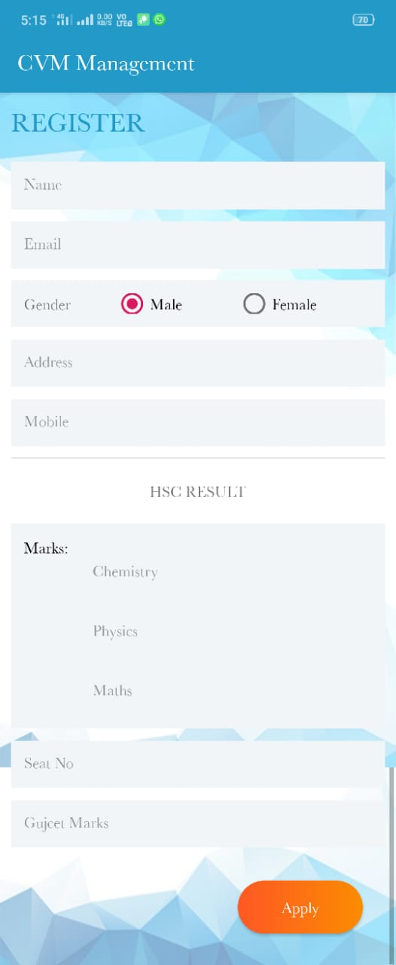
Admission process page 3 Management quota form

Slide 25
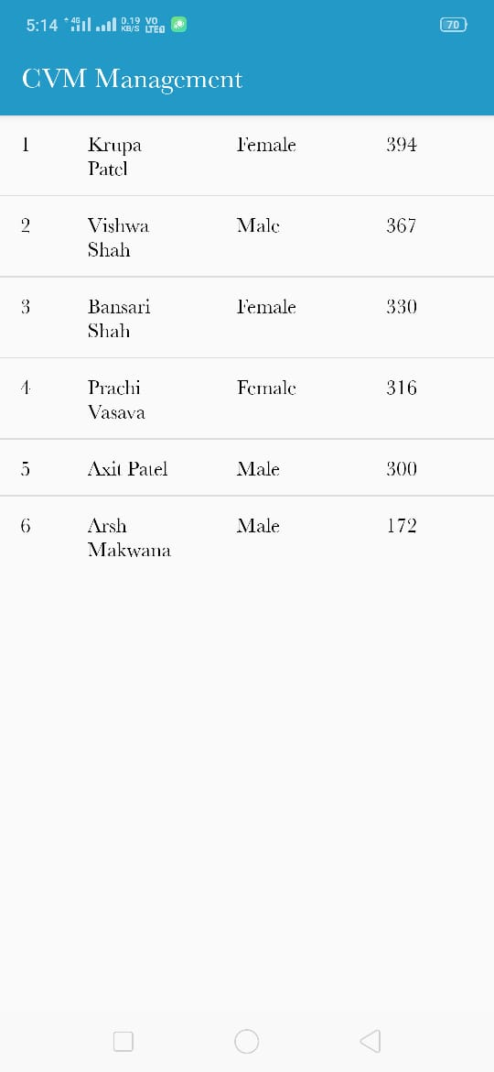
Admission process page 4 :- merit list

Slide 26
CVM Admin Key-dates
Here CVM Admin Can Insert, Update, Select And Delete Data In Key-Dates Table.

Slide 27
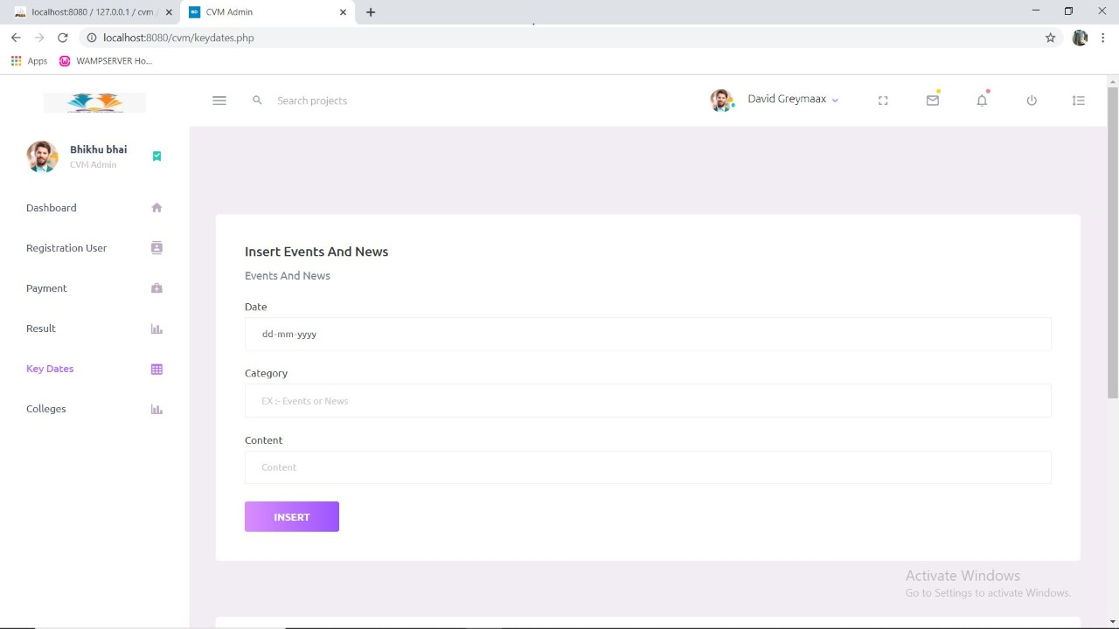
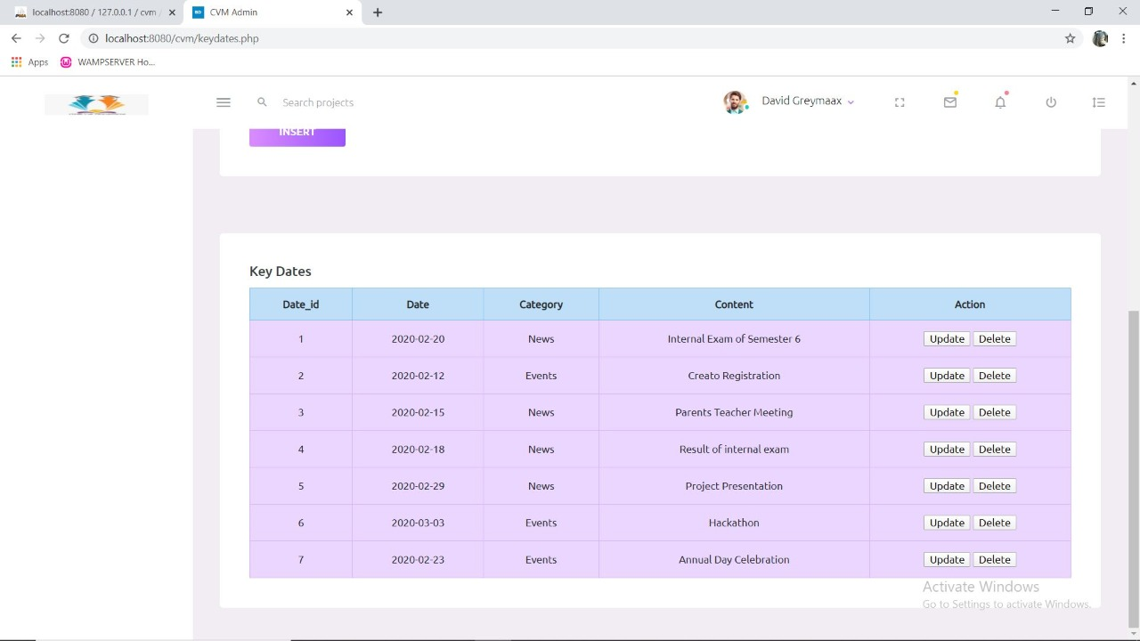
Cvm admiN KEYDATES PAGE

Slide 28
Thank you

