Slide 1


Chatbot Plugin for wordpress
Guided By: Prepared By:
Prof. Hemant Yadav Patel Krupa
CSPIT 16IT078

Slide 2
Contents:
Objective
What is plugin?
Why plugin?
How it works?
Screenshots
Future Plan

Slide 3
Objective:
It is a plugin for wordpress to add chatbot in wordpress website.
This plugin is for Charusat E-notice Board.

Slide 4
What is plugin?
A plugin is a software add-on that is installed on a program, enhancing its capabilities.
Chatbot is described as interaction between humans and machines.

Slide 5
Why plugin?
In wordpress if we choose any theme then it is not necessary that it has all functionality we want for our web development.
So to fulfill our requirements we have to add plugins.

Slide 6
How it works?
WordPress plugin installed on your site is registered in your WordPress database. You can activate and deactivate them at any time you want.
And after installing plugin user has to write shortcode of plugin.

Slide 7
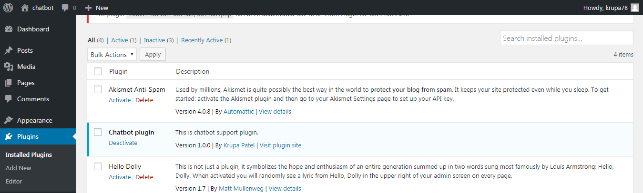

Slide 8
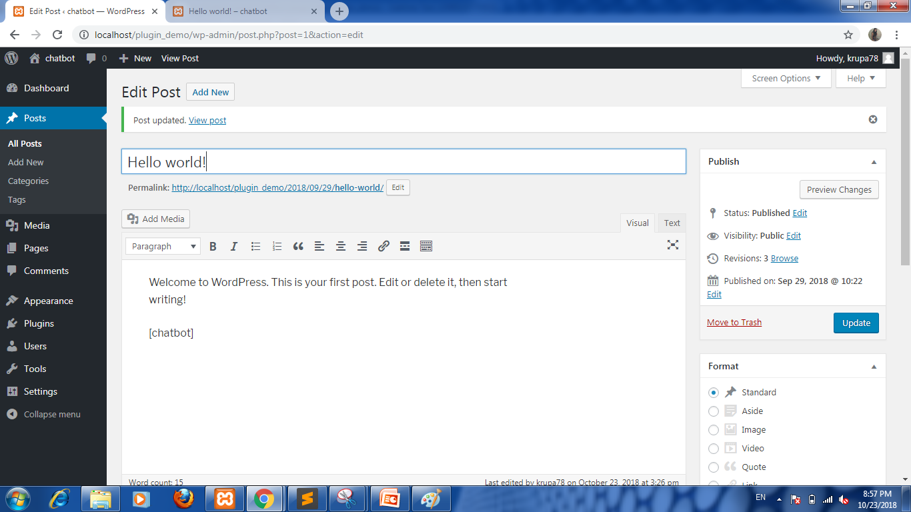

Slide 9
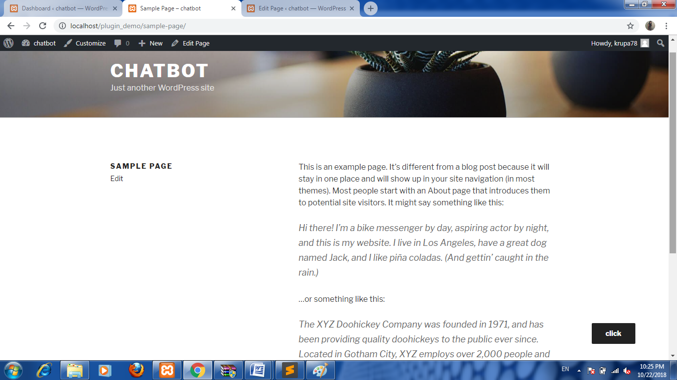
Screenshots:

Slide 10
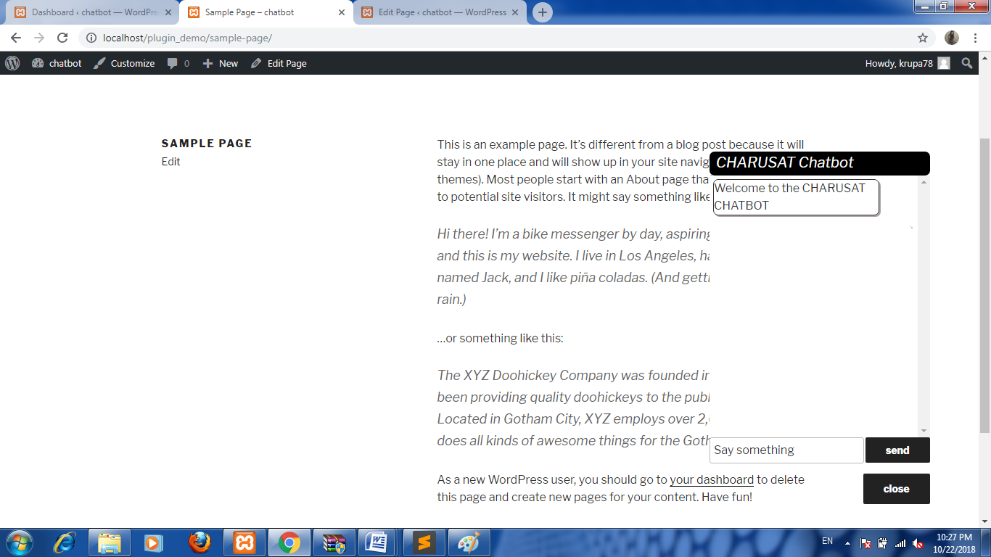
Screenshots:

Slide 11
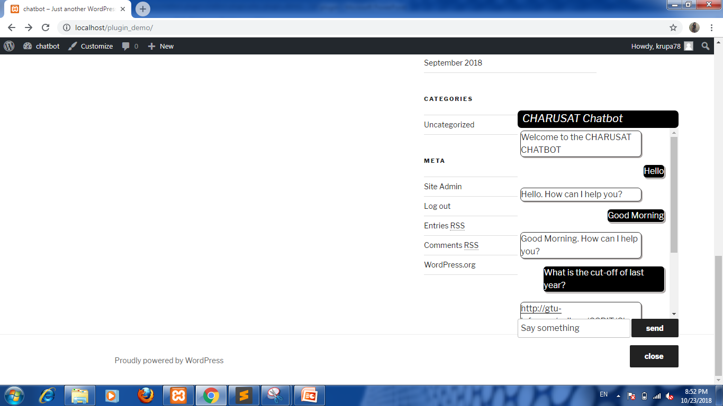
Screenshots:

Slide 12
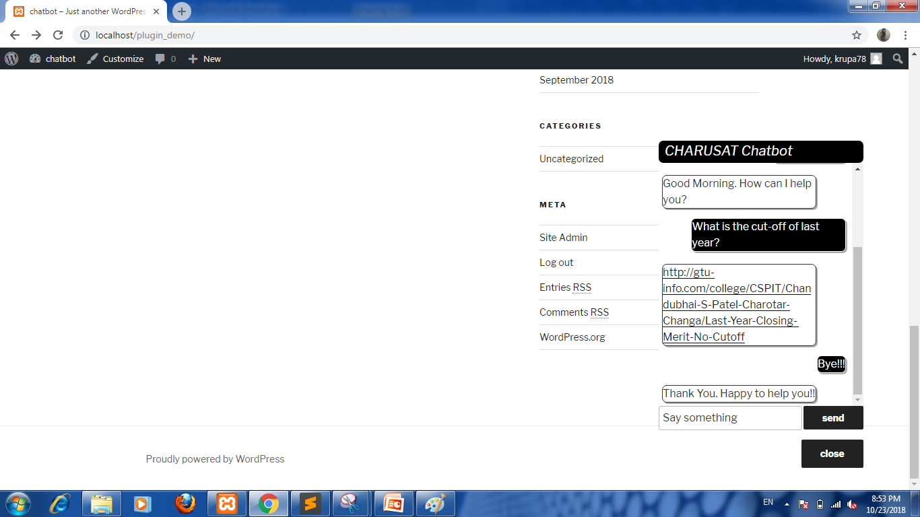
Screenshots:

Slide 13
Future Plan:
I got an error to connect with API. So the next step is to solve it and deploy it on website.

Slide 14
Thank You

