Slide 1

FLIPKART SALES ANALYSIS
USING MYSQL WORKBENCH
By KRUPA DALAL

Slide 2
PROBLEM STATEMENT
The objective of this project is to analyze large-scale e-commerce data (100K+ records) from Flipkart to uncover meaningful insights about customer behavior, product performance, and order trends.

Slide 3
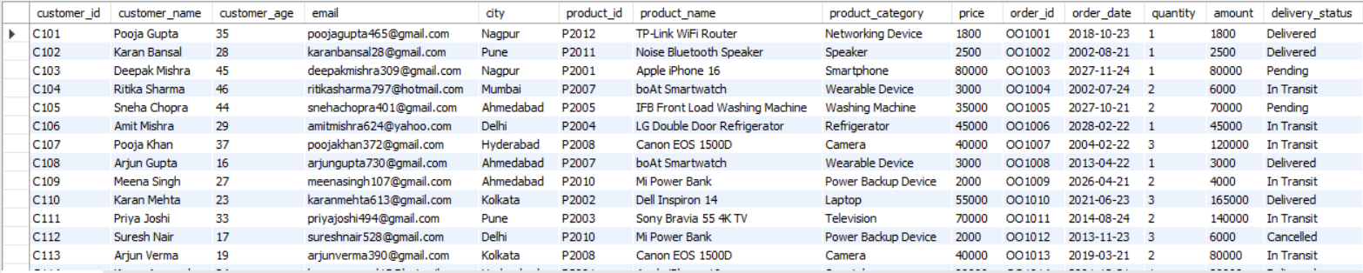
DATASET CONTAINS
100K ROWS
14 COLUMNS

Slide 4
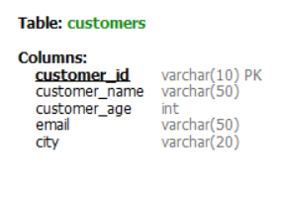
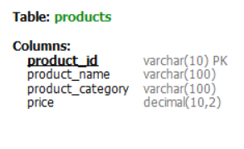
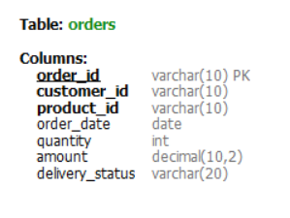
TABLES

Slide 5
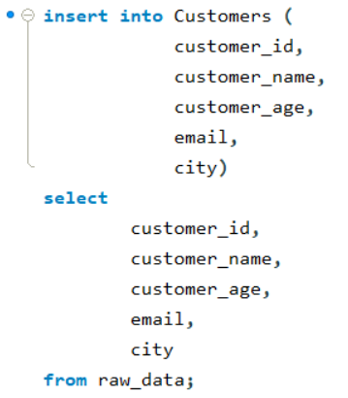
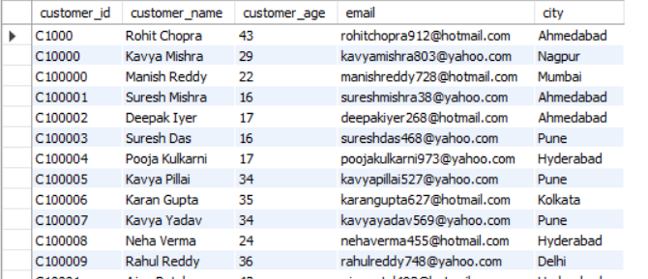
CUSTOMERS TABLE
100K Customers

Slide 6
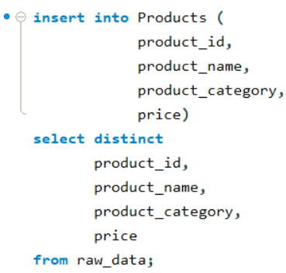
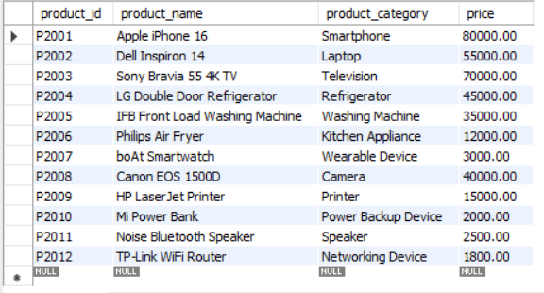
PRODUCTS TABLE
12 Products

Slide 7
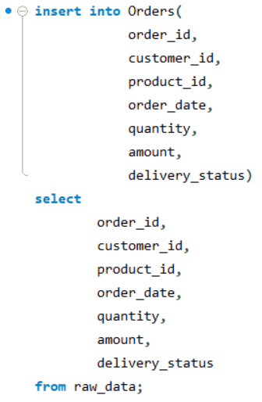
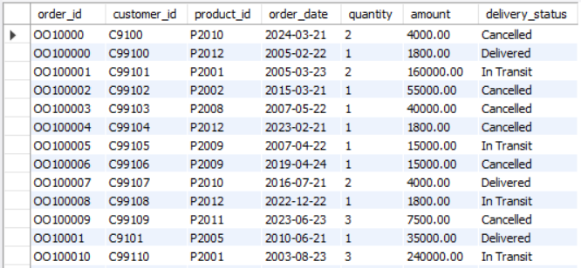
ORDERS TABLE
100k Orders

Slide 8
Customers Insights
Customer Segmentation (Age-wise)
Top Customers (Revenue-wise)
City-wise High-Value Customers
Total Orders by email domain with Revenue

Slide 9
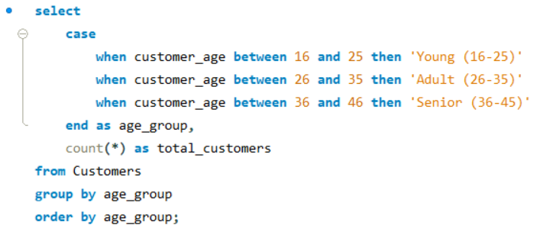

Customer Segmentation(Age-Wise)
String function (CASE WHEN)
MOST CUSTOMERS ARE FROM AGE GROUP (36-45)

Slide 10
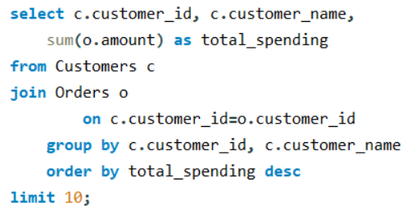
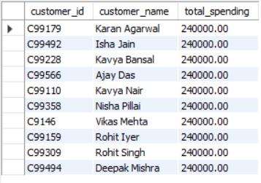
Top 10 Customers (Spending-Wise)
Using (JOINS)

Slide 11
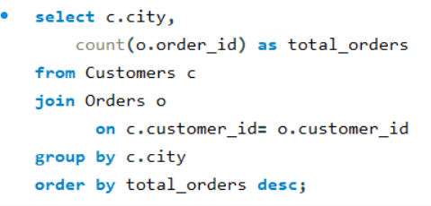
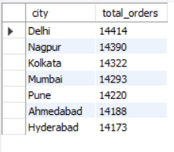
City-wise Order Count
Using (JOINS)
HIGHEST ORDERS ARE FROM DELHI

Slide 12
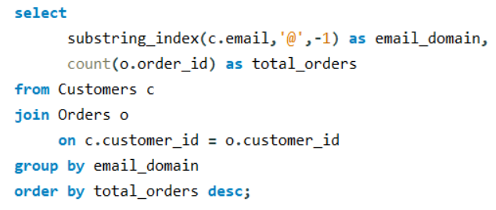
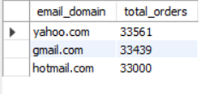
Total orders by Email domain
Using (Substring_index)
MOST ORDERS ARE FROM DOMAIN YAHOO.COM

Slide 13
Products Insights
Sales by Product Category
Top Selling Products
Most Sold Product Category
Top 6 Most Cancelled Products
Products ‘In Transit’

Slide 14
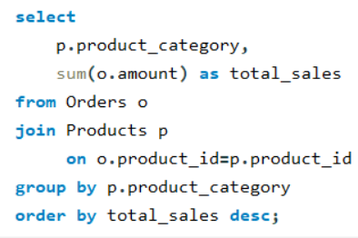
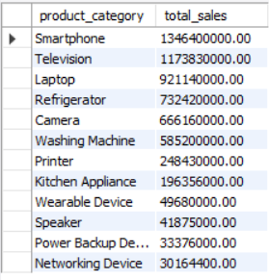
Sales by Product Category
HIGHEST SALES ARE GENERATED FROM SMARTPHONES

Slide 15
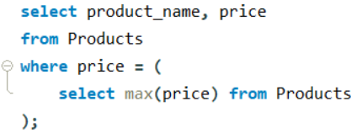

Most Expensive Product
Using Subqueries
APPLE IPHONE 16 IS MOST EXPENSIVE PRODUCT

Slide 16
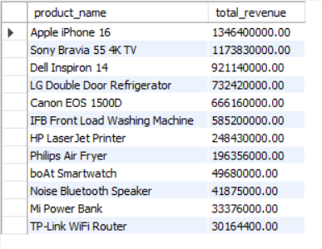
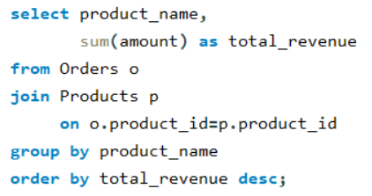
Top Selling Products
APPLE IPHONE 16 IS MOST SOLD PRODUCT

Slide 17
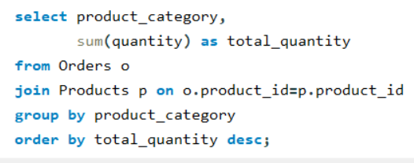
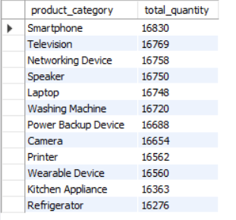
Most Sold Product Category
by order count
SMARTPHONE CATEGORY HAS HIGHEST ORDER COUNT i.e 16830

Slide 18
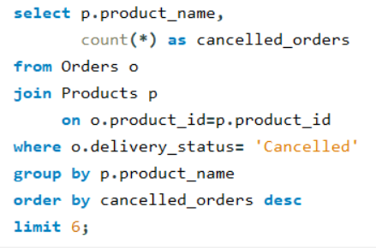
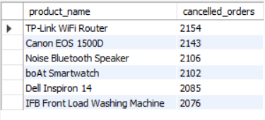
Top 6 Most Cancelled Products
MOST CANCELLED PRODUCT IS TP-Link WiFi Router

Slide 19
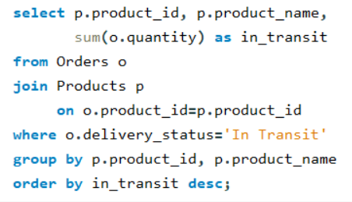
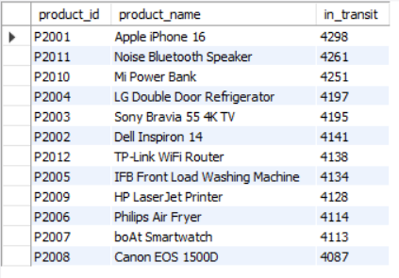
Products-wise “In Transit”
MOSTLY APPLE IPHONE 16 PRODUCTS ARE “IN TRANSIT”

Slide 20
Orders Insights
Order Status Distribution
Top 10 Total Orders by year
Total Revenue by Year

Slide 21
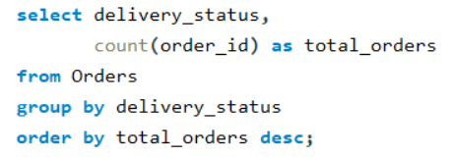
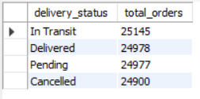
Order Status Distribution
MOST PRODUCTS ARE ‘IN TRANSIT’ = 25145

Slide 22
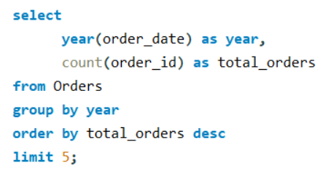
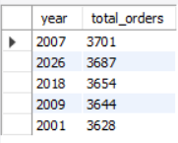
Top 6 Total Orders by Year
HIGHEST ORDERS ARE RECORDED IN YEAR 2007

Slide 23
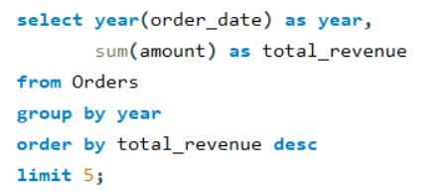
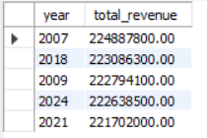
Top 5 Total Revenue by Year
HIGHEST REVENUE GENERATED IN YEAR 2007

Slide 24
Using Windows Function
Products by Revenue(using RANK)
Customers by Revenue(Using DENSE_RANK)
Products by Sales(Using ROW_NUMBER)

Slide 25
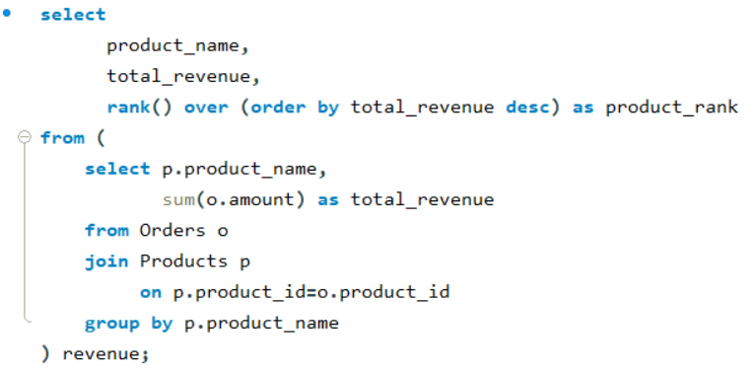
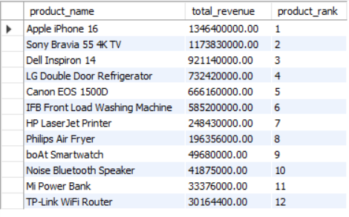
Products by Revenue
Using RANK( ) Window function

Slide 26
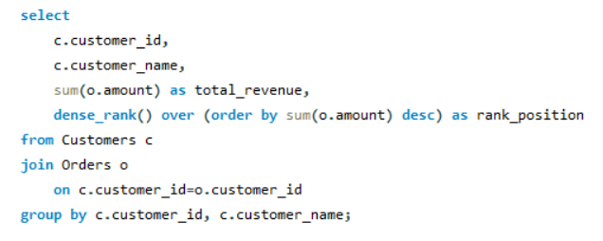
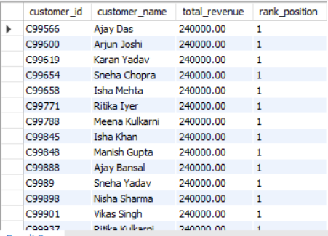
Customers by Revenue
Using DENSE_RANK( ) Window function

Slide 27
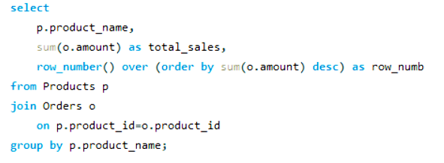
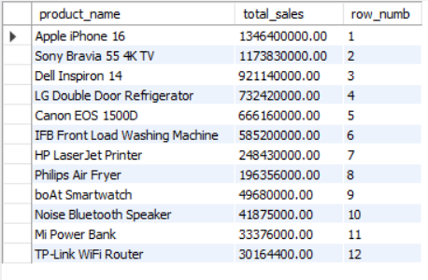
Products by Sales
Using ROW_NUMBER( ) Window function

Slide 28
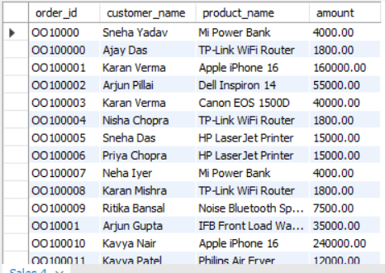
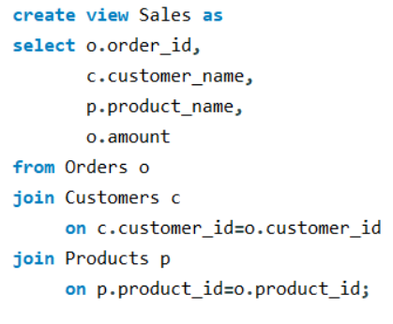
VIEWS (Virtual Table)

Slide 29
CONCLUSION
The 36–45 age group forms the largest customer segment.
Delhi contributes the highest number of orders.
Smartphones are the top-performing category in both sales and order volume.
Apple iPhone 16 emerges as the best-selling product, most expensive.
A significant number of orders are “In Transit”, indicating scope for logistics optimization
Certain products show high cancellation rates, requiring further investigation
The year 2007 recorded peak orders and revenue, highlighting strong historical performance

Slide 30
THANK YOU

