Slide 1
Predicting Diabetes risk in Individuals

Slide 2
Overview
Diabetes is among the most prevalent chronic diseases in the United States, impacting millions of Americans each year.
The total estimated cost of diagnosed diabetes in the U.S. in 2022 is $412.9 billion.
What if we could predict diabetes risk early based on lifestyle and key risk factors? By doing so, we could prevent the onset of diabetes, improve individuals' quality of life, and reduce the strain on healthcare systems.

Slide 3
Data analyzed
The Centers for Disease Control and Prevention (CDC) conducts the Behavioral Risk Factor Surveillance System (BRFSS) survey annually.
Data used for analysis is from BRFSS 2023 survey. This includes data from 48 states except Kentucky and Pennsylvania , the District of Columbia, Guam, Puerto Rico, and the US Virgin Islands.
Data and documentation sourced from 2023 BRFSS Survey Data and Documentation
Data format and column descriptions sourced from https://www.cdc.gov/brfss/annual_data/2023/llcp_varlayout_23_onecolumn.html. and https://www.cdc.gov/brfss/annual_data/2023/zip/codebook23_llcp-v2-508.zip.

Slide 4
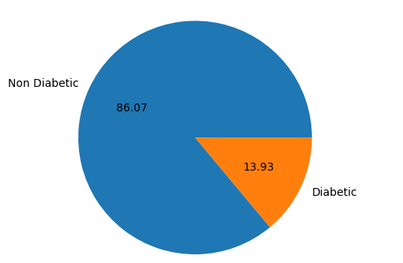
Exploratory Data Analysis.
Dataset is with 433323 survey responses and 350 survey questions i.e features
Handling Missing data.
Merge features from multiple sources, like ceephone survey, home phone survey.
Drop the features having more than 80% nulls in them
Fill missing values with mean
No catogorical data in dataset.
Outliers.
Capped at 95%
Labels/Traget Variable
Label is 1 or 0 indicates person is diabetic or not

Slide 5
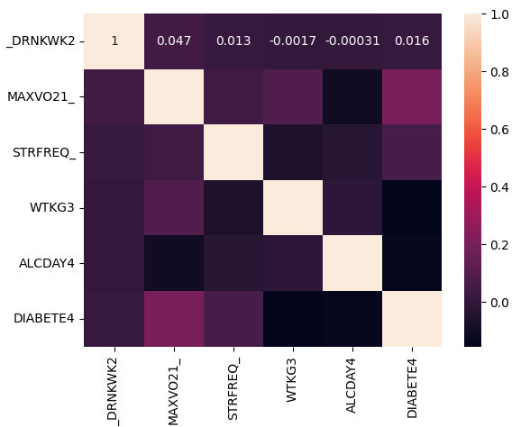
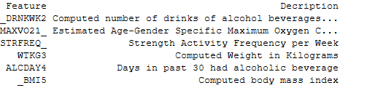
Feature Engineering
Features are 136 and target label
Standardization and normalization
Standardization will be done on the 136 features
Dimensionality reduction
PCA
UMAP
Correlation

Slide 6
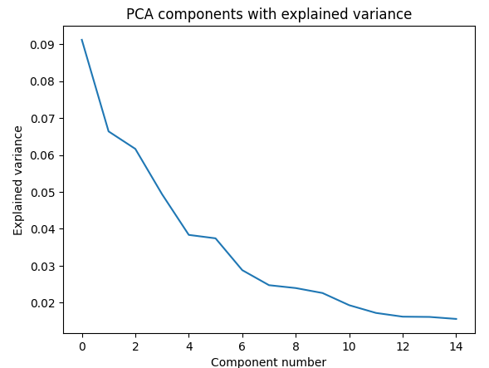
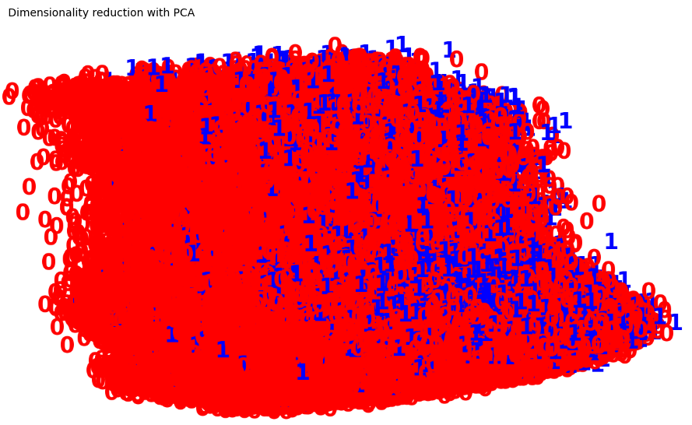
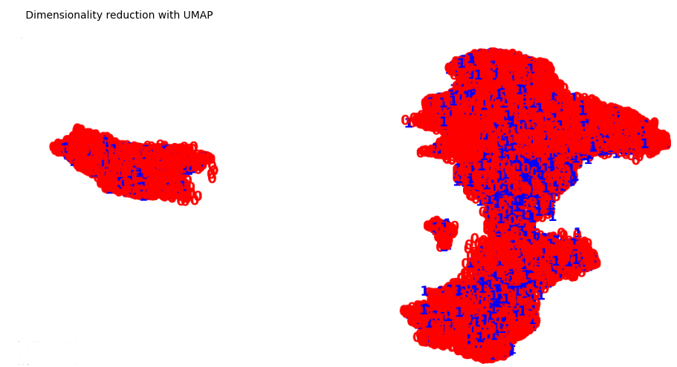
Dimensionality Reduction
PCA, variance explained is small for the components
UMAP retains cluster information little better

Slide 7
Model selection
Start with Supervised learning models.
Start with simple linear classification
Try Ensemble models Random forest and Gradient boosting
Tune Hyper parameters
Apply unsupervised learning clustering algorithms.
Start with simple k-means
Also apply Gaussian Mixture soft clustering
Tune Hyper parameters
Move to deep learning.
Apply deep learning
Tune Hyper parameters

Slide 8
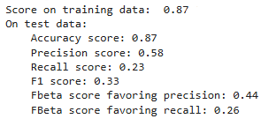
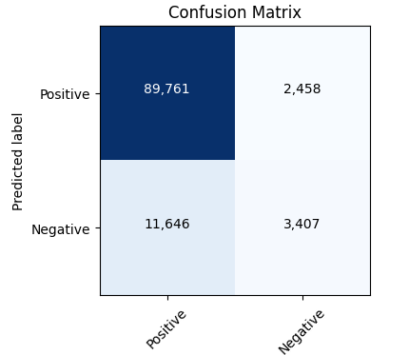
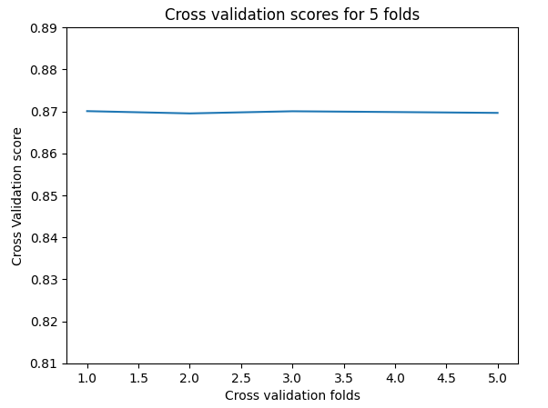
Linear Classification
Linear classification model is performing quite well with accuracy score of 0.87.
Model metrics
Cross validation scores

Slide 9
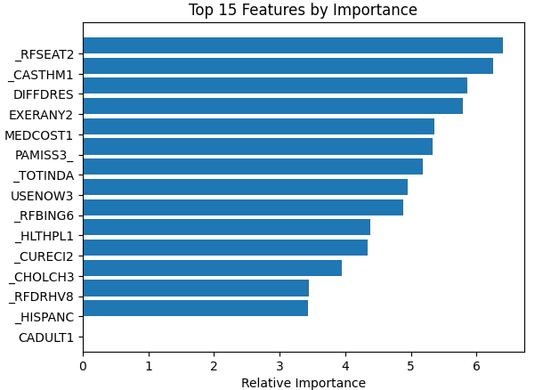
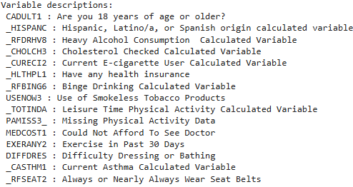
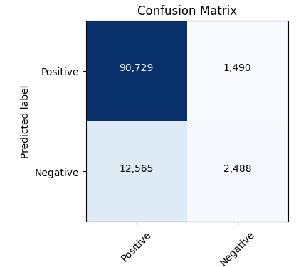
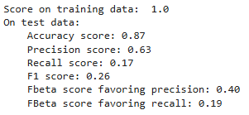
Random Forest Classification
Apply RandomizedSearchCV and tune max estimators and tree depth.
Random Forest model is performing in similar lines with linear classification with Accuracy score of 0.87.
Model metrics and Feature importance.
Cross validation with a score mean of 0.869.

Slide 10
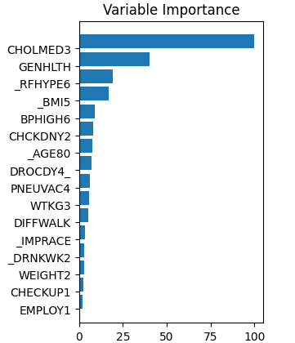
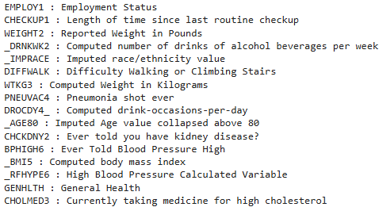
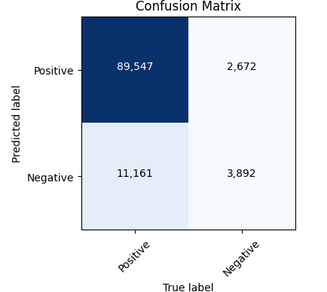
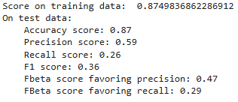
Gradient Boosting Classification
Apply GridSearchCV and tune estimators, tree depth, learning rate and loss function.
Gradient Boosting model is performing better compared liner and random forest classifications with Accuracy score of 0.87 on tet and training dataset.
Model metrics and Feature importance
Cross validation with a score mean of 0.869.

Slide 11


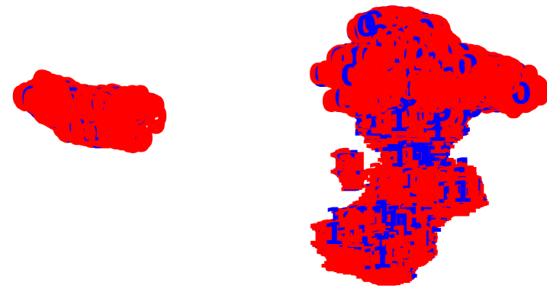
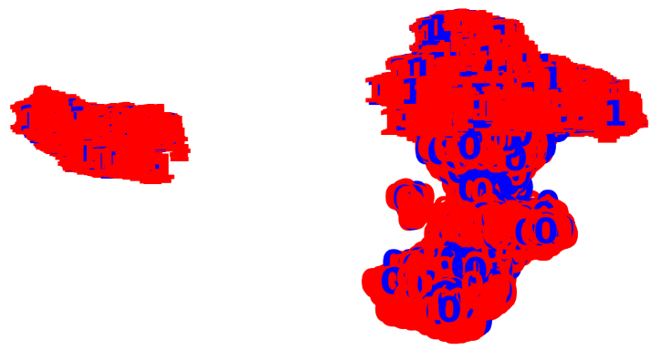
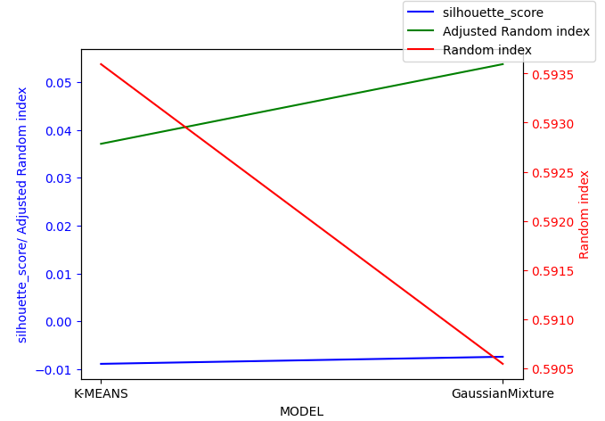
K-means and Gaussian Mixture
Model performance Metrics.
K-means.
Gaussian Mixture.

Slide 12
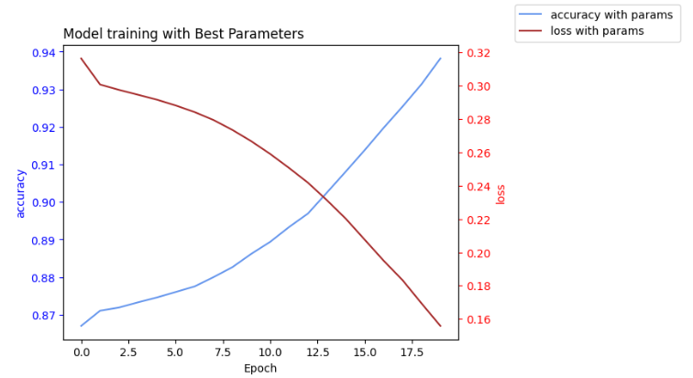
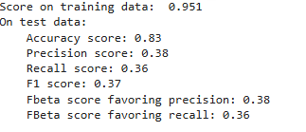
Classification with deep learning
Tune learning rate, activation function and number of layers in Artificial Neural Networks model.
Train the ANN model with best parameters

Slide 13
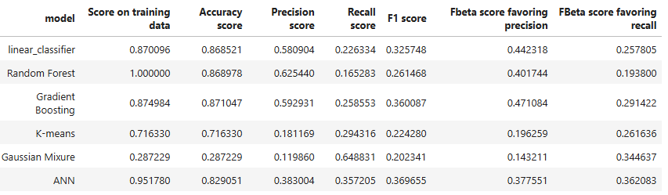
Model comparisons
Supervised learning and deep learning models demonstrate high accuracy.
Unsupervised clustering models show moderate cluster quality, with a silhouette score of -0.007 and a Rand Index (RI) of 0.59.

Slide 14
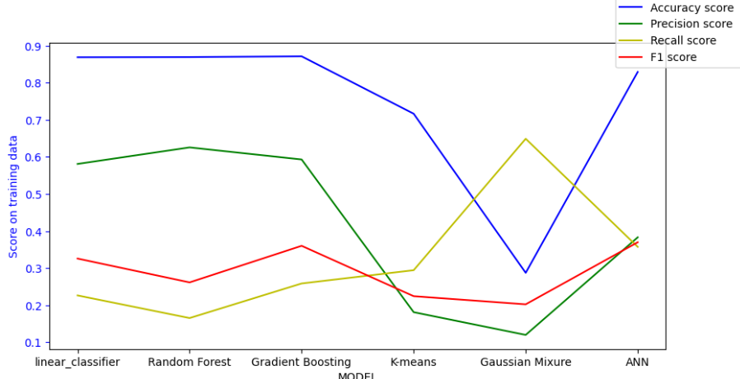
Model Selection
I selected Gradient Boosting due to its more generalized, superior performance with model explainability.
ANN performance is comparable to Gradient Boosting; further tuning could yield better results, but it would require more resources and a more complex model.

Slide 15
Conclusion and next steps
Gradient boosting can be used to identify the risk of diabetes using health data from survey questions.
Healthcare providers can integrate this model into mobile apps or websites to help patients identify their risk of diabetes.
Government agencies can use the model to identify diabetes risk in individuals and promote healthier habits to prevent it.
The feature set can be reduced by using only the features selected by the model, allowing for the deployment of a more streamlined version.
The model is trained on 203 survey data points and needs to be updated annually to reflect changing health habits.
Model reference
- https://github.com/krupakar010/DATA-401/blob/main/Capstone_IV.ipynb

Slide 16
Thank You
Questions?

